Slide 1
# 21
Kenand, Chunhui2

Slide 2
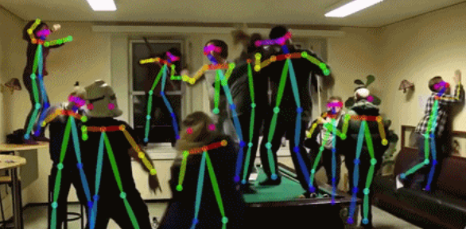
Represent 3D Trajectory of Human Actions
Motivation
Skeleton data can provide comprehensive representations of human body.
How to find a function to represent actions?
Problem Define
Given a set of action series of same label
Find a simple function to present trajectory of joints positions in this kind of action
Approaches
With a set of polynomial function basis
Apply least square approximation
Applications
Find a representative trajectory of a action
Merge trajectory to create new actions
A super fast way to perform naïve action recognition

Slide 3
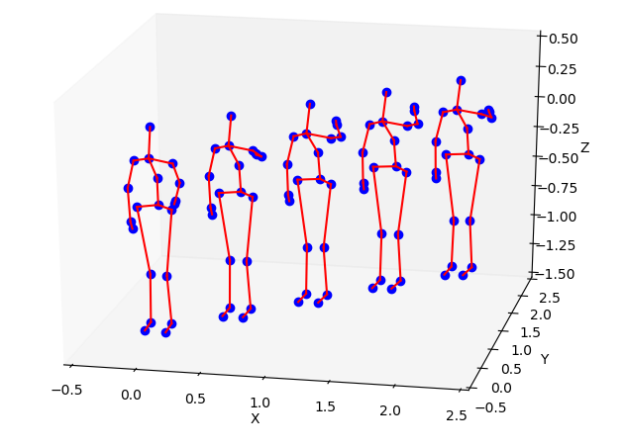
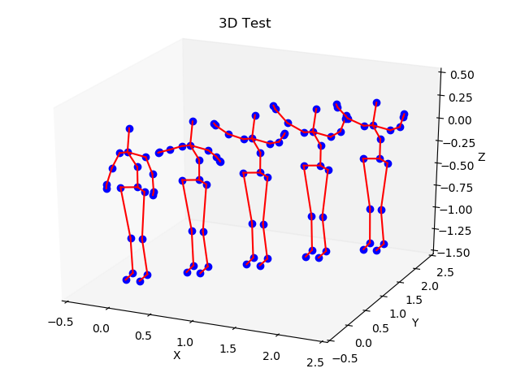
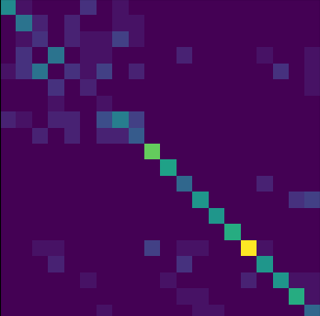
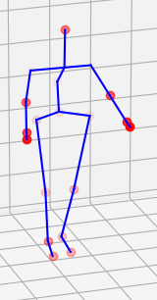
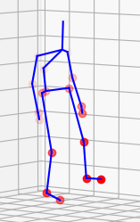
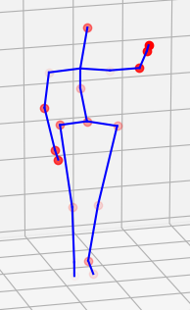

Details and Results
Generation Results
High Arm Wave Tow Hands Wave
Classification Results
MSR-action-3D (20 classes)
Action Attention
clap, kick, wave
Technical Details
Data fitting:
joint position for time t: $f\left(t\right)∈R^{20×3}$
we got n samples $f^{1}\left(t\right) f^{2}\left(t\right) …f^{n}\left(t\right)$
Given basis function $φ_{1}\left(t\right) φ_{2}\left(t\right) …φ_{k}\left(t\right)$
$c=argmin⁡({\sum_{i}^{n}{\left|f^{i} −\sum_{k}{c_{k}φ_{k}}\right|}}_{2}^{2})$
Data Preprocess
Interpolate all action to 100 frames
Length Normalization
Fix location of main body to (0,0,0)
Fit the derivation of joints
Method | Accuracy
Without normalization | 47.7%
Without derivation | 53.0%
Final Nearest Neighbor | 61.0%

