Slide 1
# 21
kenand, chunhui2

Slide 2
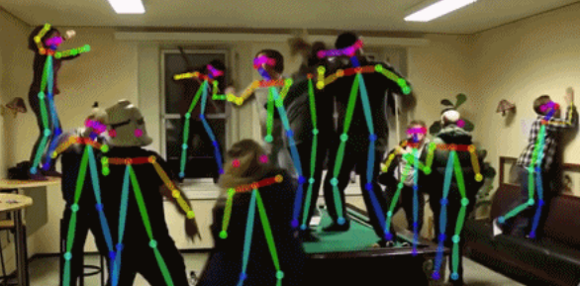
3D Trajectory Representations of Human Actions
Motivation
Skeleton data can provide comprehensive representations of human body
How to find a function to represent actions?
Problem Definition
Given a set of action series of the same label
Find a simple function to represent trajectory of joints positions for this given action
Approaches
Define a set of polynomial function basis
Apply least square approximation
Applications
Find a representative trajectory of an action
Merge trajectory to create new actions
A super fast way to perform naïve action recognition

Slide 3
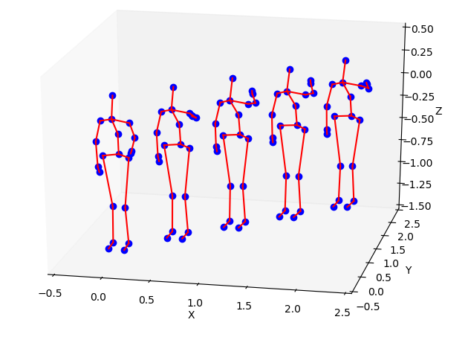
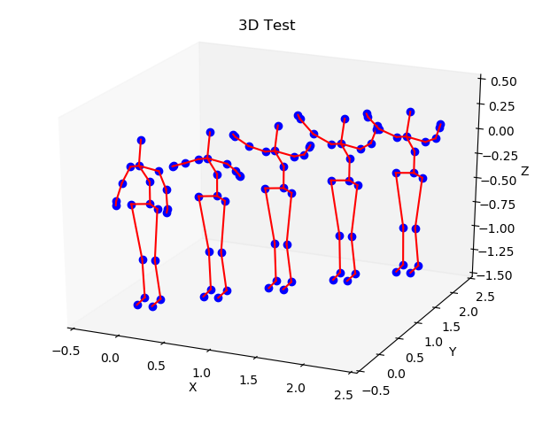
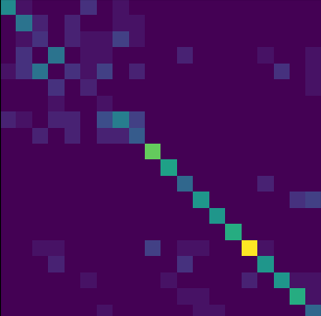
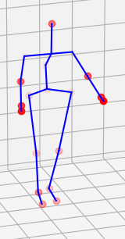
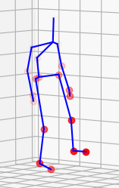
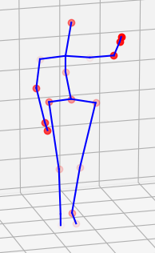

Details and Results
Generation Results
High Arm Wave Tow Hands Wave
Classification Results
MSR-action-3D (20 classes)
Action Attention
clap, kick, wave
Technical Details
Data fitting:
joint position for time t: $f\left(t\right)∈R^{20×3}$
we got n samples $f^{1}\left(t\right) f^{2}\left(t\right) …f^{n}\left(t\right)$
Given basis function $φ_{1}\left(t\right) φ_{2}\left(t\right) …φ_{k}\left(t\right)$
$c=argmin⁡({\sum_{i}^{n}{\left|f^{i} −\sum_{k}{c_{k}φ_{k}}\right|}}_{2}^{2})$
Data Preprocess
Align all actions to 100 frames by interpolation
Normalize bone length
Fix location of main body to (0,0,0)
Fit the forward difference of joint locations
Method | Accuracy
Without normalization | 47.7%
Without derivation | 53.0%
Final Nearest Neighbor | 61.0%

