Slide 1
Heritage Digital Twin Ontology
in action
Maria Theodoridou, Athina Kritsotaki, Sorin Hermon

Slide 2
Use Case:
The Derynia icon

Slide 3
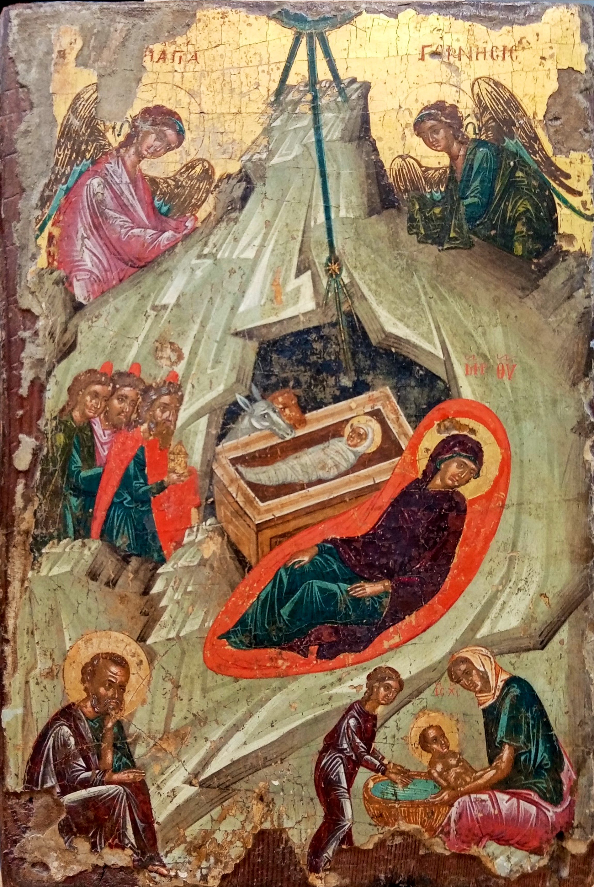
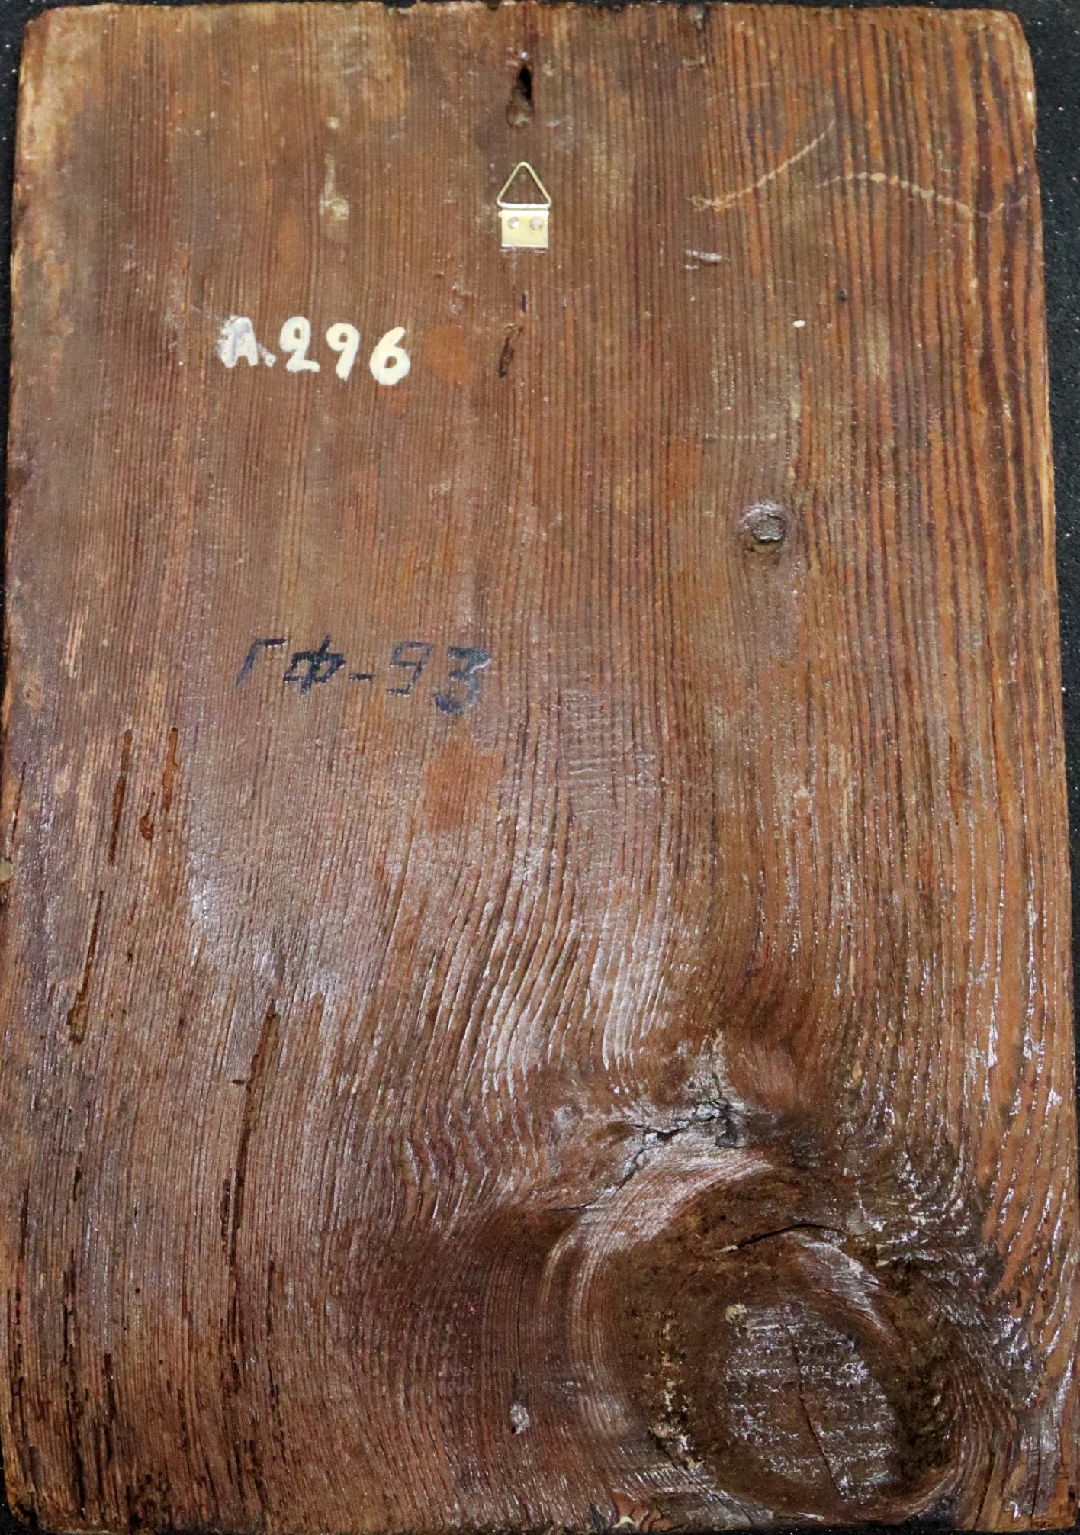
The Derynia icon
The icon originates from the church of the Birth of the Virgin, built in the 15th / 16th century in Deryneia, Cyprus.
The white frame delineates the XRF scanning area.

Slide 4

Art Characterisation
Provenance
Ownership
Bibliography
Access
Attestations
Biography
Genre
History
Visual analysis
Intangible aspects
Related artworks
Conservation
Treatment
Restoration
Prevention
Physical properties
Structure
Dimensions
Materiality
Technique
Preservation

Slide 5
Technical metadata of the in-house built MA-XRF, RIS, LIS scanner
Processing software: PyMCA
RIS:
    Python library pysptools 0.15.0 and SPECTRONON software.
    Endmembers extracted using NFINDER algorithm implemented in the pysptools library.
    Spectral Angle Mapper (SAM) was performed with SPECTRONON software.
LIS: LIS datacube processed with PyMCA software
Experimental conditions
  Data acquisition: 365-nm;
  Size area: 25 x 17 cm2;
  Step size: 500-µm step size / 80-ms of dwell time per pixel;
  Time of scan: 3h30 min;
  XRF - X-Ray generator operated at 40 kV and 500 µA
  RIS - reflectance spectroscopy range 470-820 nm (UV-Vis-NIR)
  LIS - luminescence excitation wavelength - 365 nm, 655 nm
Raw data:
  Raw datacube size: 498 pixels (h) by 340 pixels (w);
  Total channels 2600: CXRF=512 CRIF=1044 and CLIS=1044

Slide 6
Lead white
Observations
Low energy Pb-M lines (2.3 keV) relate to surface lead emission. High energy Pb-L lines (10.55 keV) relate to lead deeper within the paint layers. The PyMCA RGB correlator qualitatively assess Pb-L and Pb-M intensity lines: blue denotes a deeper presence of lead (Pb-L signals, not Pb-M), magenta the presence of Pb-L and Pb-M lines, i.e. surface lead.
Derivate Statements
Lead white was used to tint flesh and clothing folds. The cave, the star rays, Mary’s mattress edges, have several layers of lead white (blue areas), magenta - a single surface layer.

Slide 7
Heritage Valuation

Slide 8
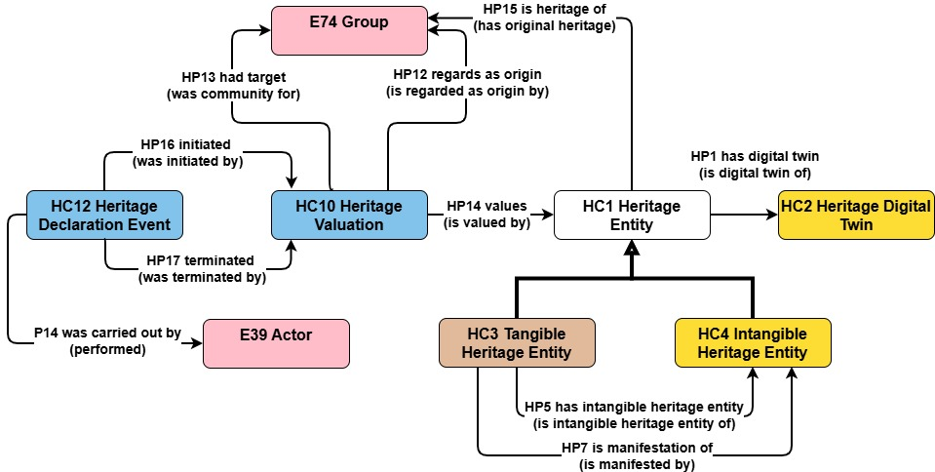
Heritage Valuation

Slide 9
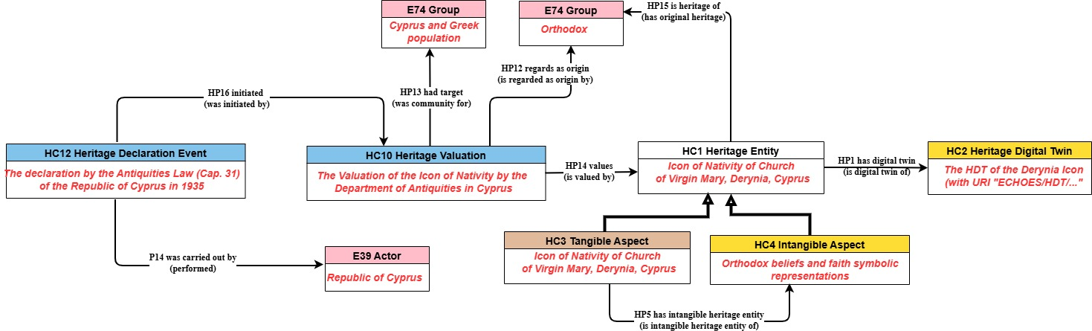
Derynia - Heritage Valuation

Slide 10
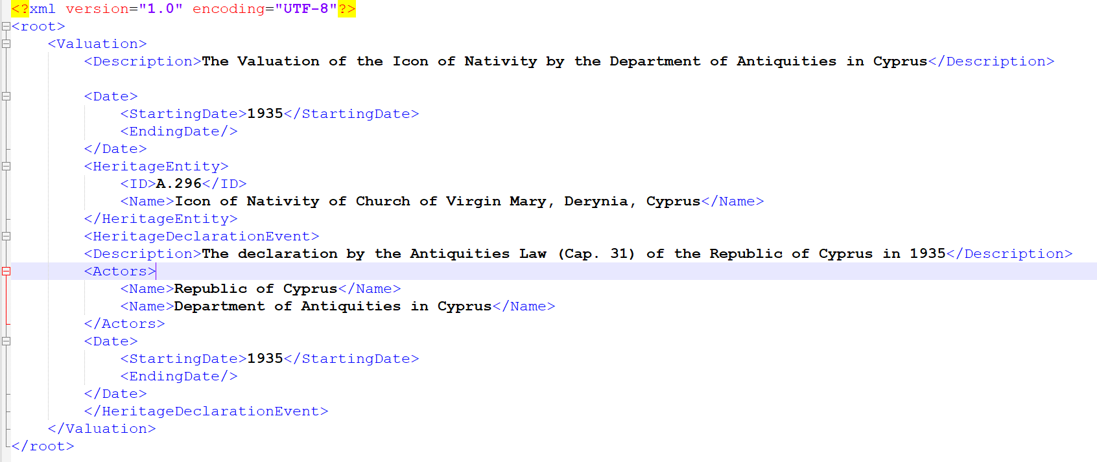
Derynia - Valuation

Slide 11
Digital Twin Maintenance

Slide 12
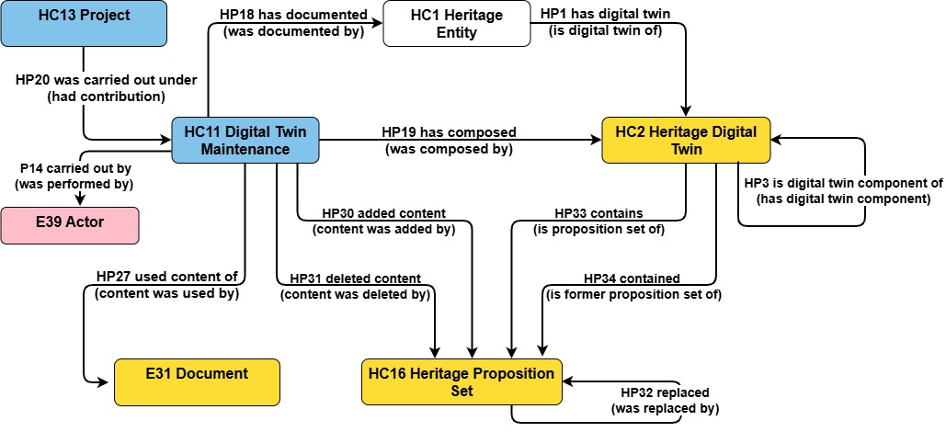
Digital Twin Maintenance

Slide 13
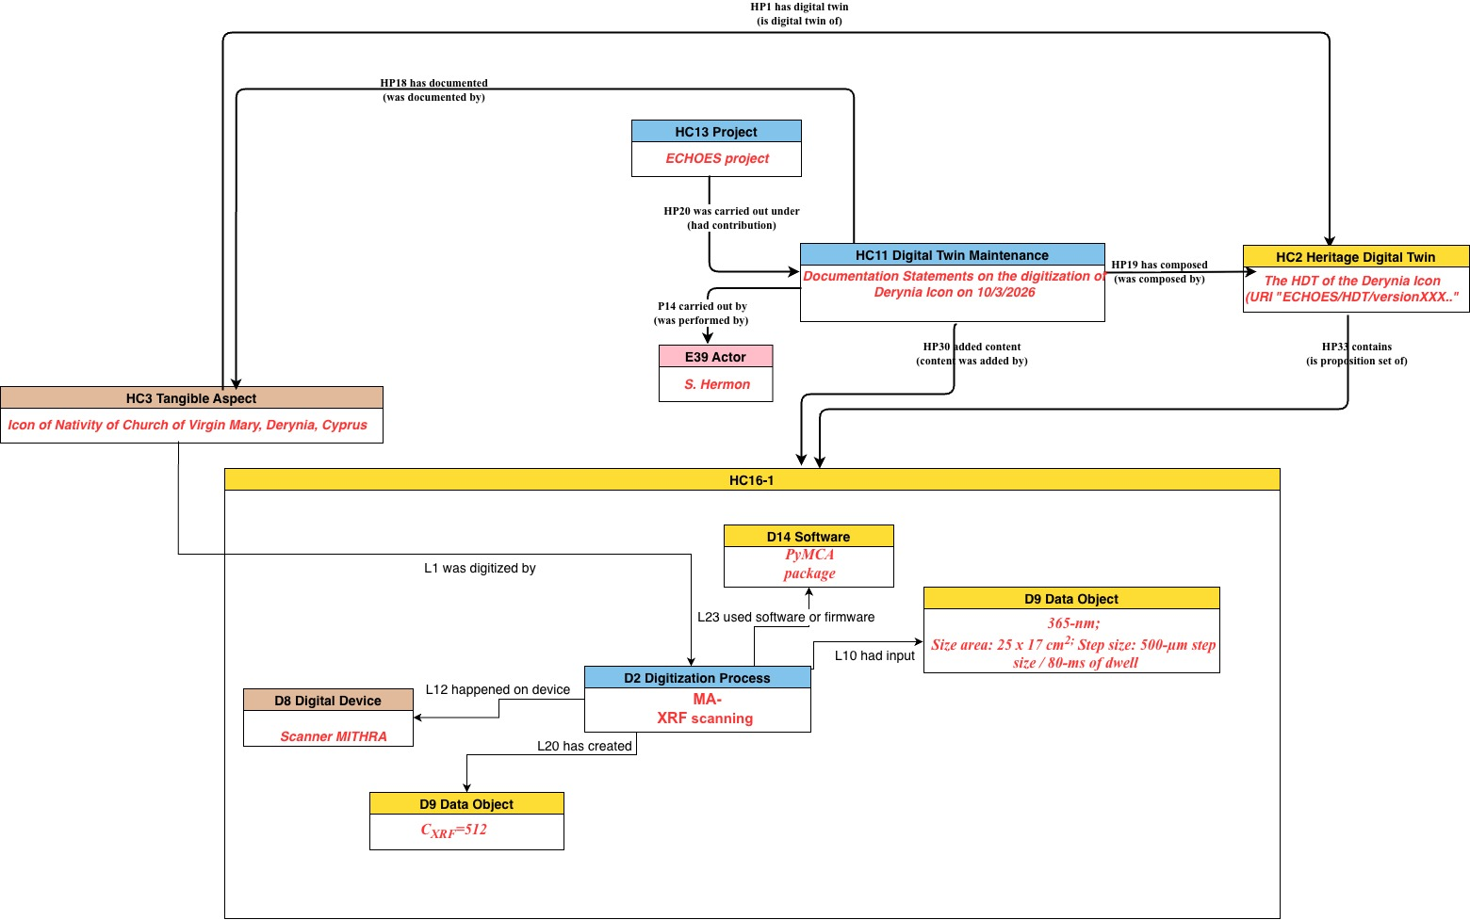
Derynia - Digital Twin Maintenance 1

Slide 14
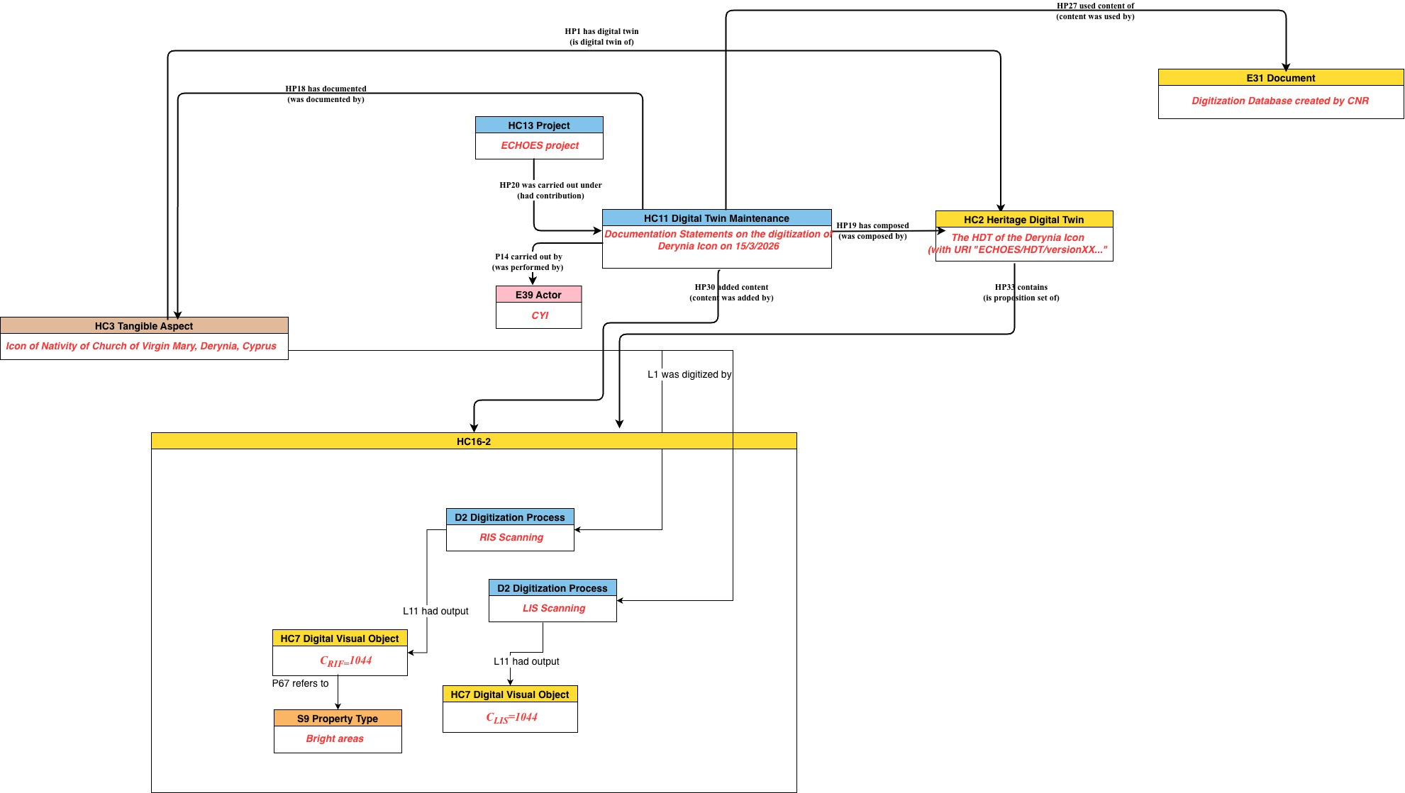
Derynia - Digital Twin Maintenance 2

Slide 15
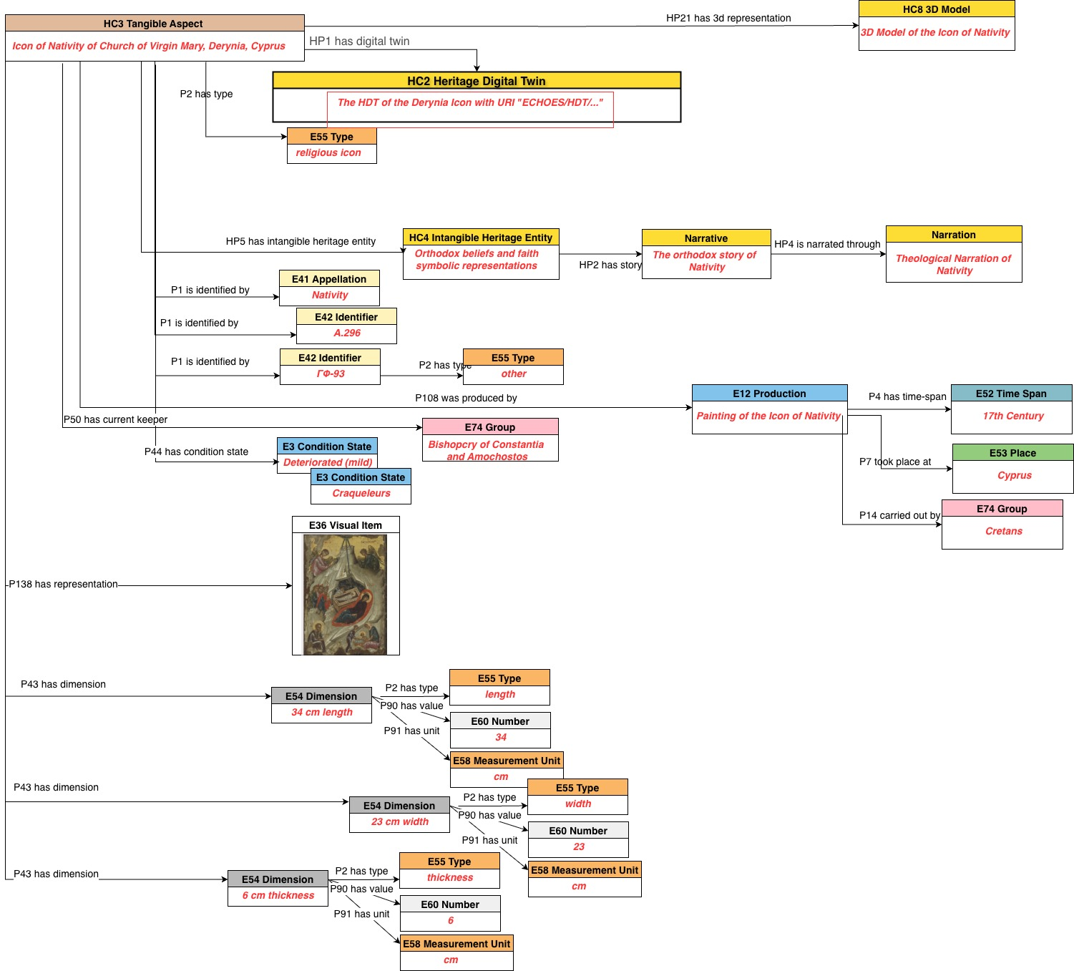
Derynia - Digital Twin Maintenance 3

Slide 16
Study

Slide 17
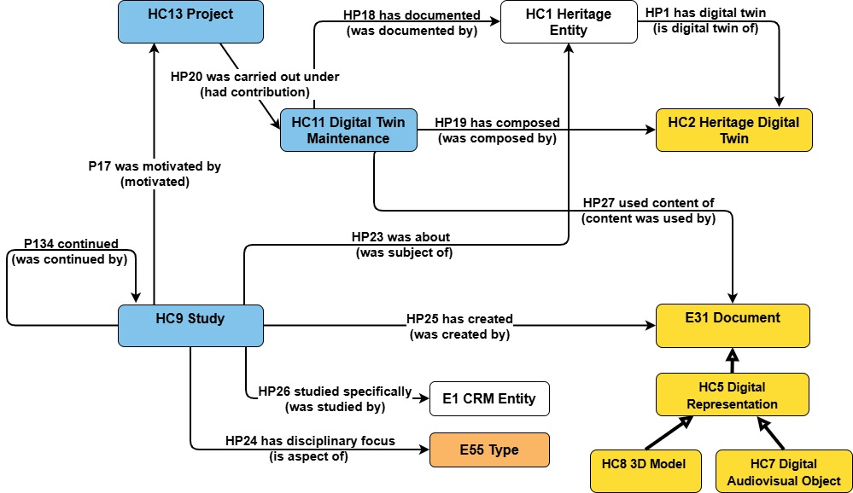
Study

Slide 18

Thank you for your attention!
Let’s stay in touch: maria@ics.forth.gr
For general inquiries: contact@echoes-eccch.eu
Questions?

