Slide 1

Data Science for Electron Microscopy

Slide 2
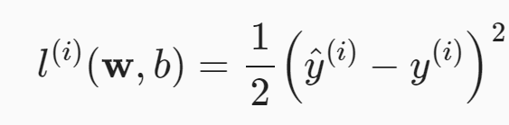
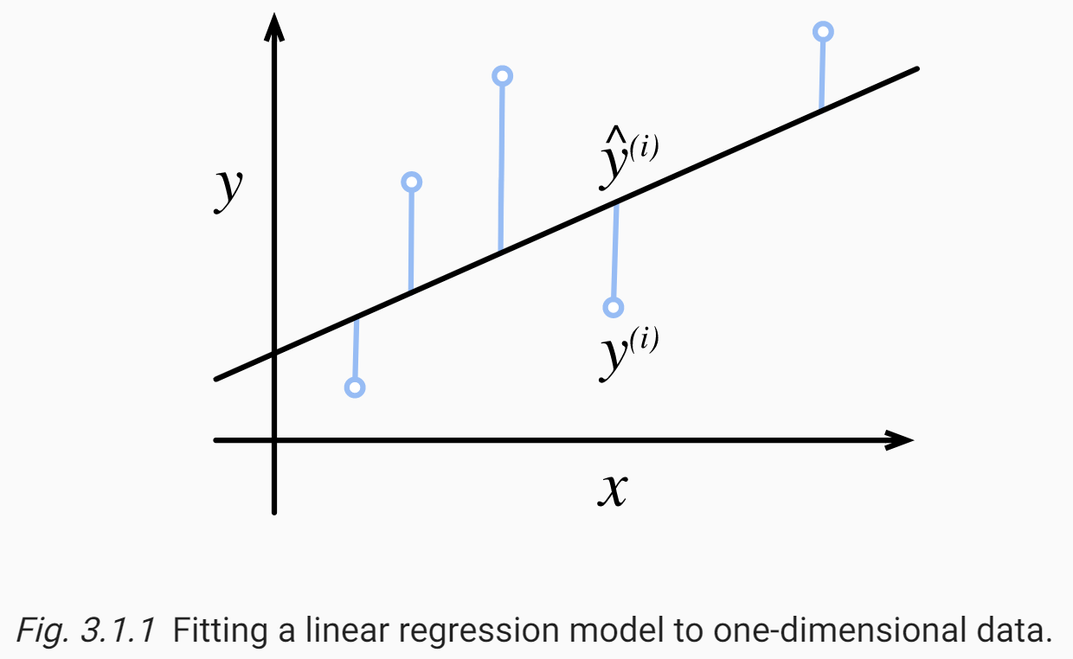
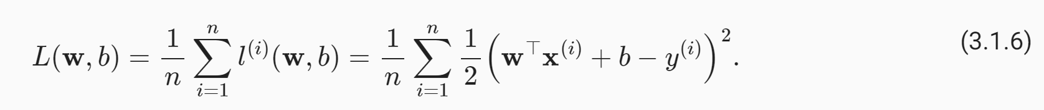
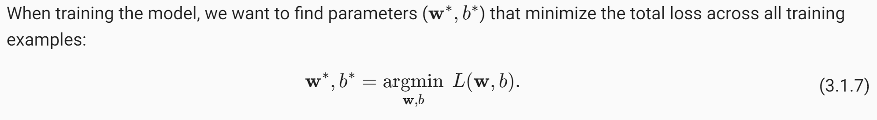
3 Regression Problems
revenue = (ad spending) w + b
Loss function:

Slide 3
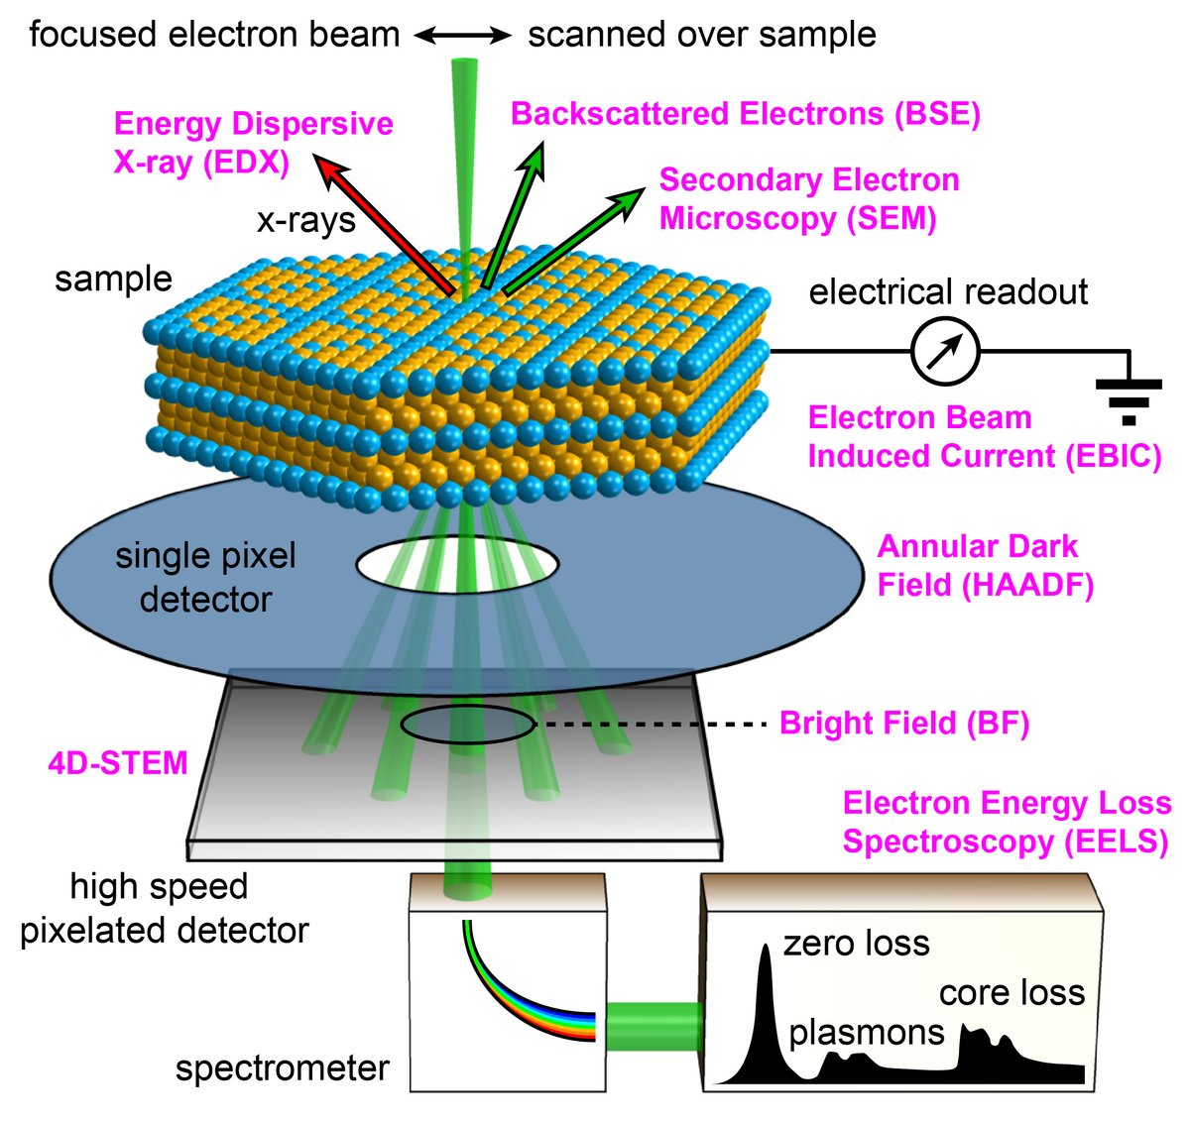
Data fusion
(STEM) can focus sub-angstrom electron beams on and between atoms to quantify structure and chemistry in real space from elastic and inelastic scattering processes.
chemical composition of specimens is revealed by spectroscopic techniques produced from inelastic interactions in the form of energy-dispersive X-rays (EDX) or electron energy loss (EELS)
High resolution chemical imaging requires high doses (e.g., >10^6 e/Å2) that often exceed the specimen limits—resulting in chemical maps that are noisy or missing entirely
Direct interpretation of atomic structure at higher-SNR is provided by elastically scattered electrons collected in a high-angle annular dark-field detector (HAADF); however, this signal under-describes the chemistry

Slide 4
Data fusion
Reaching the lowest doses at the highest SNR ultimately requires fusing both elastic and inelastic scattering modalities.
Currently, detector signals—such as HAADF and EDX/EELS—are analyzed separately for insight into structural, chemical, or electronic properties
Data fusion, popularized in satellite imaging, goes further than correlation by linking the separate signals to reconstruct new information and improve measurement accuracy
recover chemical maps by reformulating the inverse problem as a nonlinear optimization that seeks solutions that accurately match the actual chemical distribution in a material

Slide 5
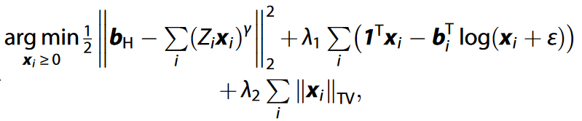
Data fusion
Fused multi-modal electron microscopy recovers chemical maps by solving an optimization problem seeking a solution that strongly correlates with
the HAADF modality containing high SNR,
the chemically sensitive spectroscopic modality (EELS and/or EDX), and
encourages sparsity in the gradient domain producing solutions with reduced spatial variation.
λ are regularization parameters, b_{H} is the measured HAADF, b_{i} and x_{i} are the measured and reconstructed chemical maps for element i, ε herein prevents log(0) issues but can also account for background, log is applied element-wise to its arguments, superscript ^{T} denotes vector transpose, and 1 denotes the vector of nx × ny ones, where nx × ny is the image size.

Slide 6
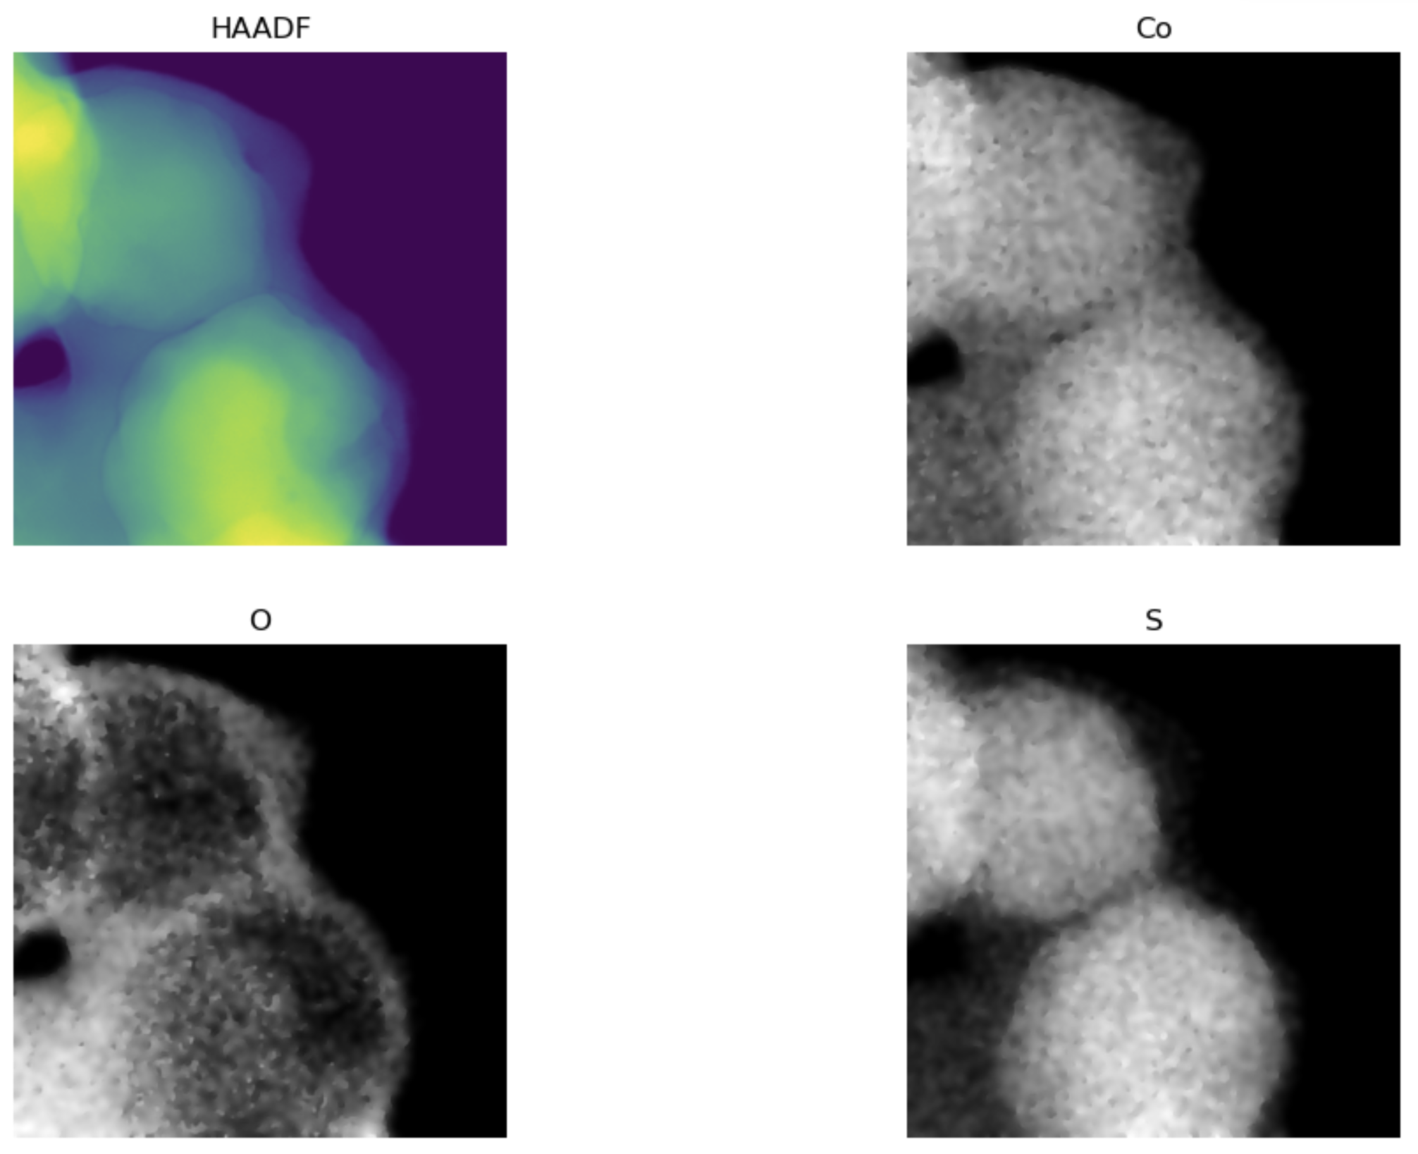
Data fusion
First term: the HAADF image is the sum of
All the elemental images, to the power of gamma

Slide 7
Data fusion
Second term: The measurement noise of the EDS channels follows a Poisson distribution → Minimize the negative Poisson Likelihood

Slide 8
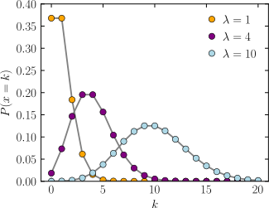
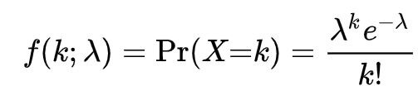

Poisson likelihood
How do we get this term?
In the case of a perfect detector, the only source of noise is “shot noise”, i.e. counting statistics
The probability distribution follows a Poisson distribution
This product can diverge numerically → use negative log likelihood
The Likelihood for all pixels on the detector is then
$$\prod_{pixels i}{Pr⁡(Xi=k)}$$
Epsilon for numerical stability, leave constant terms out

Slide 9
Data fusion
Third term: only depends on EDS maps → prior information that EDS maps should be piecewise constant functions
Essentially: at each iteration, change the current estimate to be less noisy

Slide 10
Thank you
for your attention!

