Slide 1


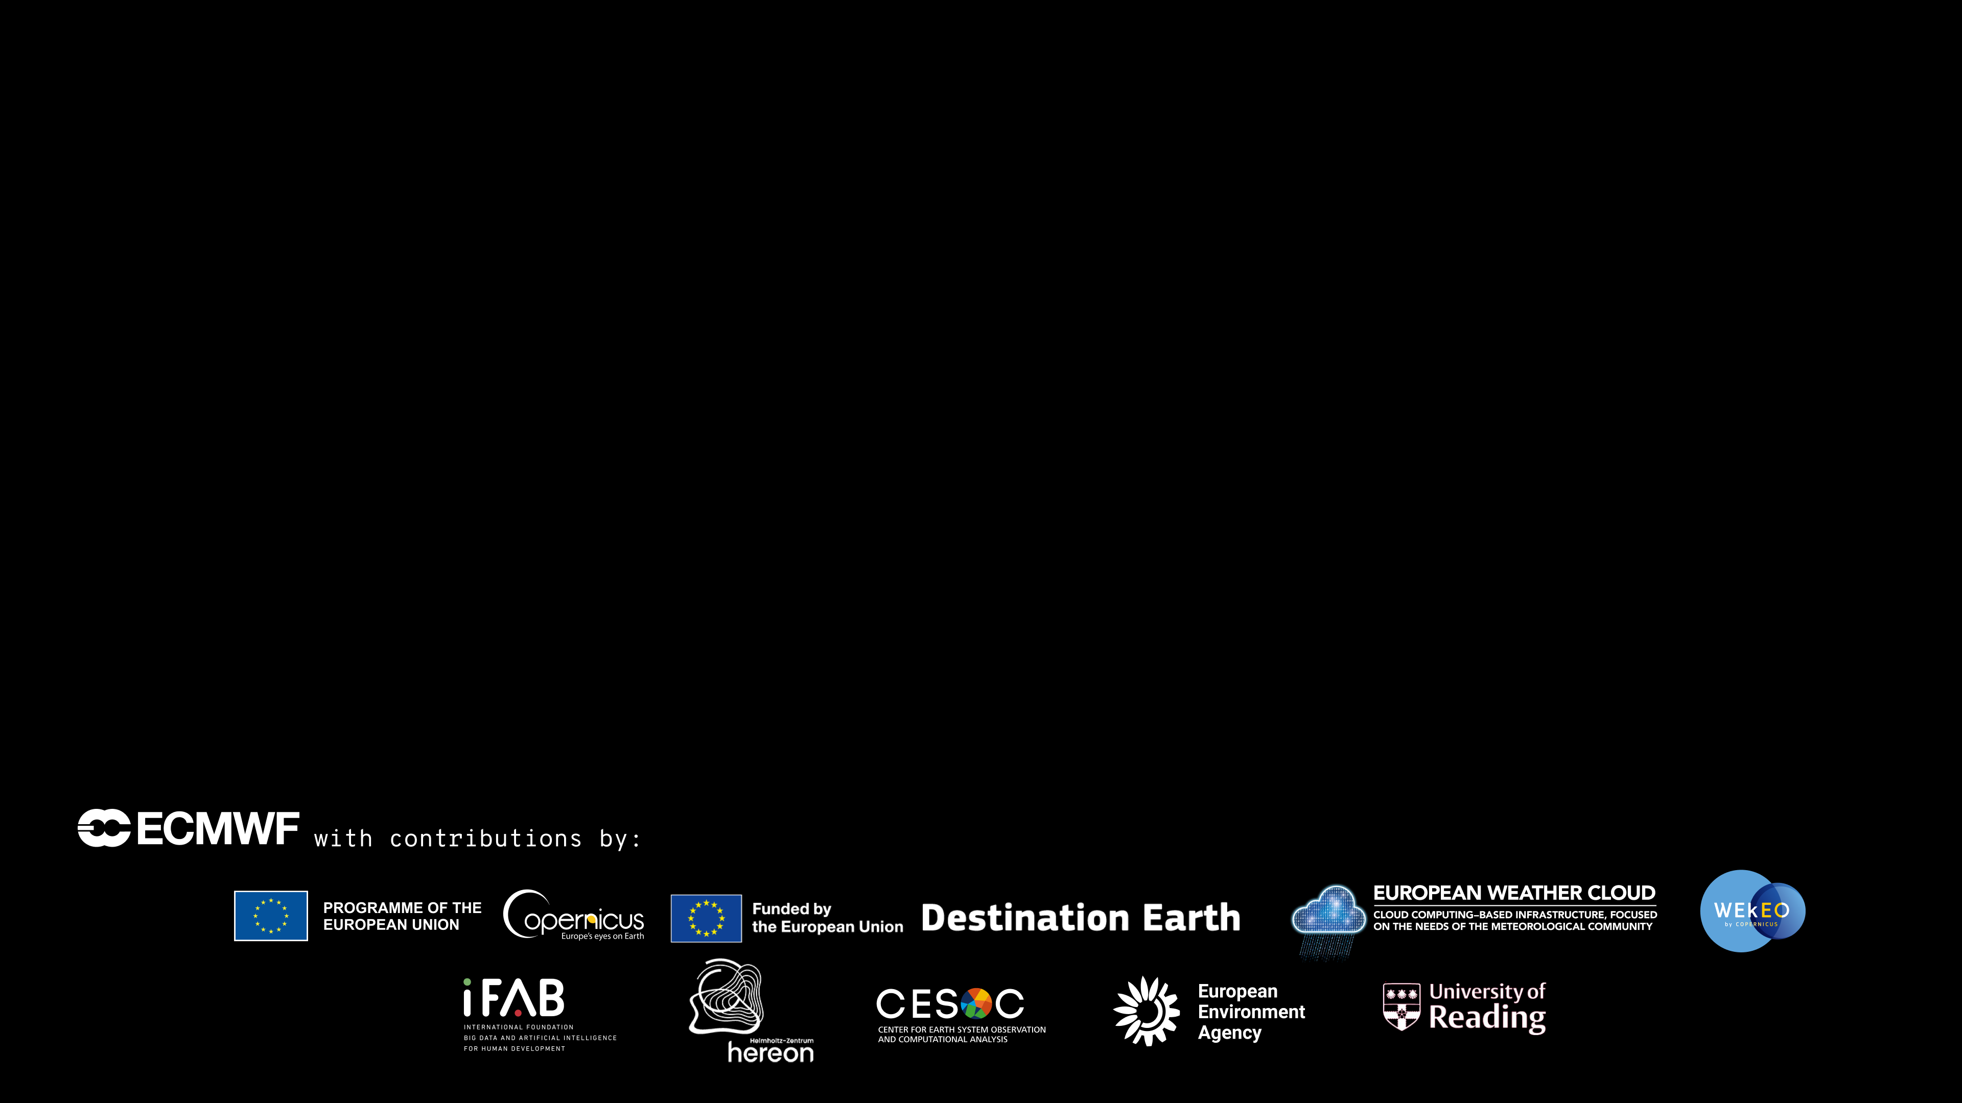
Code for Earth 2024 KGB-TruthGuiding: Knowledge graph to enhance LLM: A use case in
Presenter:
NGUYEN Quoc Viet
Other team members:
NGO Duc Thinh
VU Thi Hai Yen
Mentors:
Ana Prieto Nemesio
Florian Pinault
Baudouin Raoult
DAO Nhat Minh
PHAM Vu Hoang Anh
Notes:
Key innovation action at ECMWF to address needs in data analysis, data management, visualization or services across ECMWF (Core, Copernicus, DestinE)

Slide 2


Agenda
Problem description
Solution
Our approach
Knowledge extraction
Knowledge storage
Community detection + Local and global retriever (GraphRAG paper)
Visual-aid knowledge presentation
Demo
Future direction
Annex

Slide 3
1. Problem description
Given the large scientific literature* of ECMWF
-Organizing knowledge
- Make interactive graphs
*Example source: Technical Memoranda | ECMWF

Slide 4
1. Problem description
LLMs finds themselves in many application recently
LLMs usually suffer from hallucilation and knowledge cutoffs
A common way is to add external knowledge
=> GraphRAG: LLMs on steroids

Slide 5
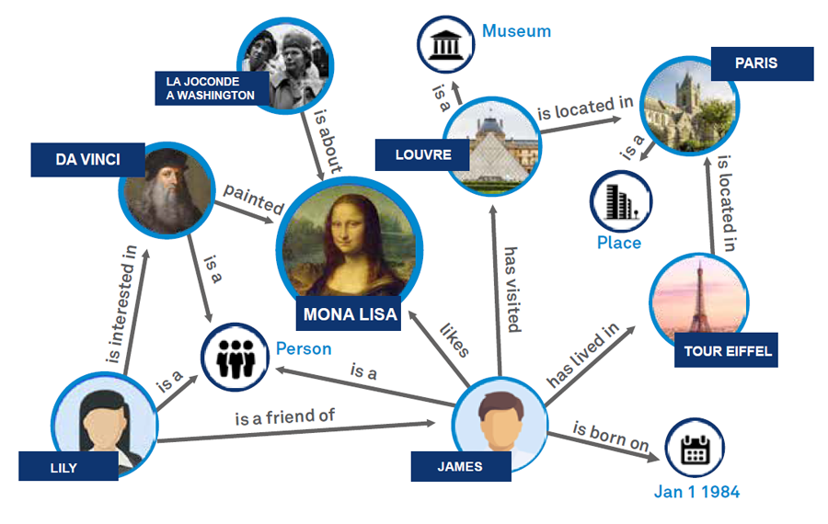
2.1 Our solution
Structured data storage: Knowledge graph
What is a knowledge graph?
Structured representation of entities and relationships.
Enables comprehensive data organization and retrieval.
Enhances contextual understanding and accuracy.
Benefit for chatbot:
Enhancing retrieval
Indexing knowledge
Visualization for comprehensibility

Slide 6
2.2. Related work
llm-graph-builder:
Developed by neo4j
Friendly user interface
Cloud database
GraphRAG:
Developed by Microsoft
Novel ideas
Heavy
No visualization

Slide 7
3. Our approach
Overview
Knowledge extraction
Knowledge storage
Data structure
Retriever
Web application

Slide 8





3.I. Overview
Kg_generator
Neo4j _uploader
neo4j
Flask
React

Slide 9
3.II. Knowledge extraction
Raw data extraction
LLM* extraction
Entities and relationships extraction – [name, label, properties]
Text chunk extraction – [content, embedding]
txt files
Self-verification + fewshot examples
LLM*: Large Language Model

Slide 10
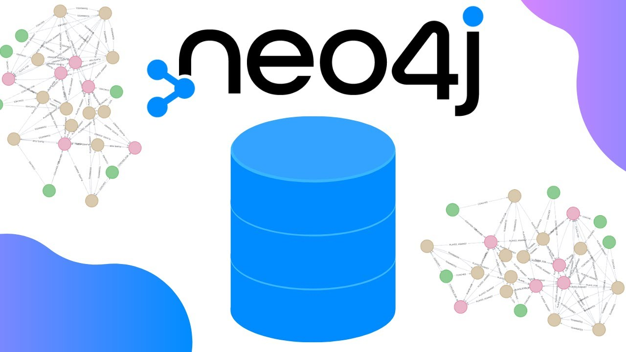
3.III. Knowledge storage
Technology: Neo4j
Graph database
Store data in nodes and edges
Large community base
=> Our option: Neo4j local database

Slide 11
3.IV. Data structure
ECWMF model
__Community__
Summary: …
Physical fluxes archived by the ECMWF model
Physical fluxes
__Chunk__
Content: …
__Entity__
Name: …
Text: …
IN_COMMUNITY
APPEARED_IN

Slide 12
3.V. Retriever mechanism – Local retriever
Relevant Chunk
Contexts
User query
Relevant entities
Relevant Communities
Chat History

Slide 13
3.V. Retriever mechanism – Global retriever
User query
Contexts
Ranking global summaries
Chat History

Slide 14
3.VI. Web application
Backend:
Flask application
Frontend:
React application

Slide 15



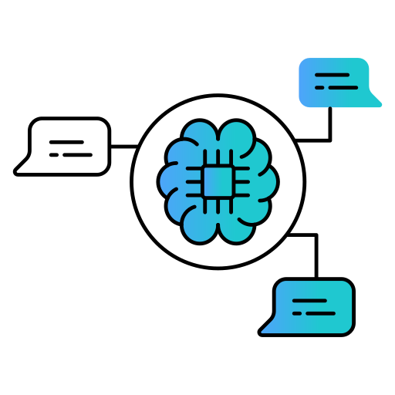


3.VI. Visual-aid knowledge presentation
Image credit to: Freepik, Prosymbols, Icongeek26, smalllikeart, musketeers, Creative_Captain, Flat Icons in Flaticon.com

Slide 16
4. Demo
Link:Viet1004/Code4Earth-2024-Challenge-24 at Attempt_to_add_container (github.com)

Slide 17
Difficulty
Prompt engineering
Unpredictability of LLMs
Open API limit call in constructing database
Visualization

Slide 18
5. Future direction
Enhance the entity extraction:
Entity Resolution
Prompt engineering
Extend local retriever
Enhance visualization

Slide 19
Annex
Collect dataset:
Create a Crawl tool for ECMWF homepage:
=> download publications and reports from ECMWF
Data source:
Technical Memoranda (38 pages - downloaded 10 pages 250 files)
Reports (23 pages - downloaded 10 pages 240 files)
Extract texts from pdf
Use the package PyMuPDF
Text extracted: saved under file ‘.txt

Slide 20
Annex
Entity and Entity Relation Extraction:
Experiment with LLMs for the prompts to guide the model extract the entity and entity relation (done):
Open LLMs (olama with Lama3):
Low quality
Take a lot of time + computation
ChatGPT (paid products):
Less time + better quality, however, it needs paid
Best performance if there is human feedbacks

