Slide 1

MilESTONE 1 IMPortING DATASET from OpenAQ and ECMWF
Content
Completion of Milestone 1
Plan for Milestone 2
Ideas for Milestone 2
PARTICIPANT: Gordon RATEs ECMWF Mentors: Johannes Flemming and Miha Razinger

Slide 2
Milestone 1
Task 1: Get Access to OpenAQ dataset
Task 2: Download some data to Local PC
Task3: Construct Presentation
Task 4: Find insights on categories of stations for Milestone 2
Task 1 Statistical Analysis
Task 2 Cluster Analysis Methods
Milestone 1
Milestone 2

Slide 3
Last meeting ACtions
Feedback to Gordon's presentation and the project plan:
Using additional information (emissions, CAMS model results, population density) is very welcome and the mentors Miha and Johannes can help with data access
Linking the result to the openAQ community developments is to be encouraged.
Being aware of the large variability in the openAQ data (data coverage period, spatial density, quality control, sensor quality) is important and "lower data quality" in certain areas should not lead automatically to dismissal if no alternative data are available for the area (e.g. Africa)
Agreed actions items:
Gordon to a send the milestones/deliverables list with an added deliverable about setting up data acquisition in the next couple of days
Gordon to acquire the full set of openAQ data as soon as possible to identify any data access problems quickly
Miha will set a cloud machine
Johannes will set up the next meeting in two weeks time
Johannes will fill in the form about project description

Slide 4
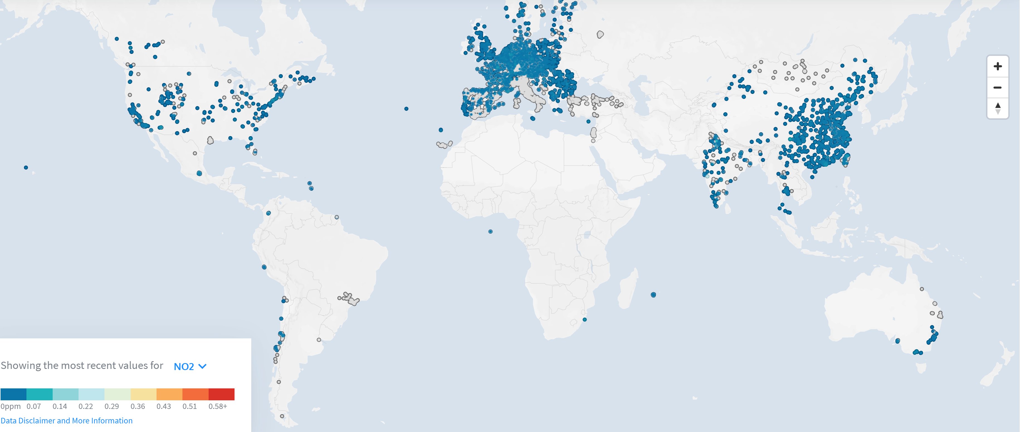
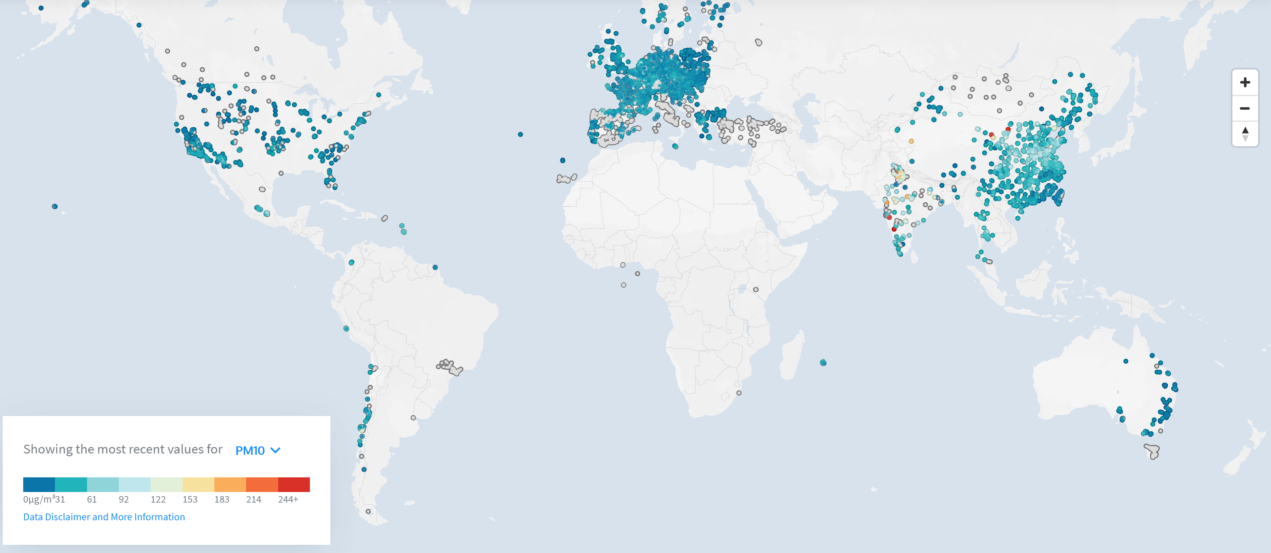
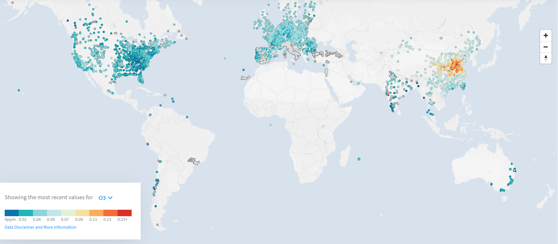
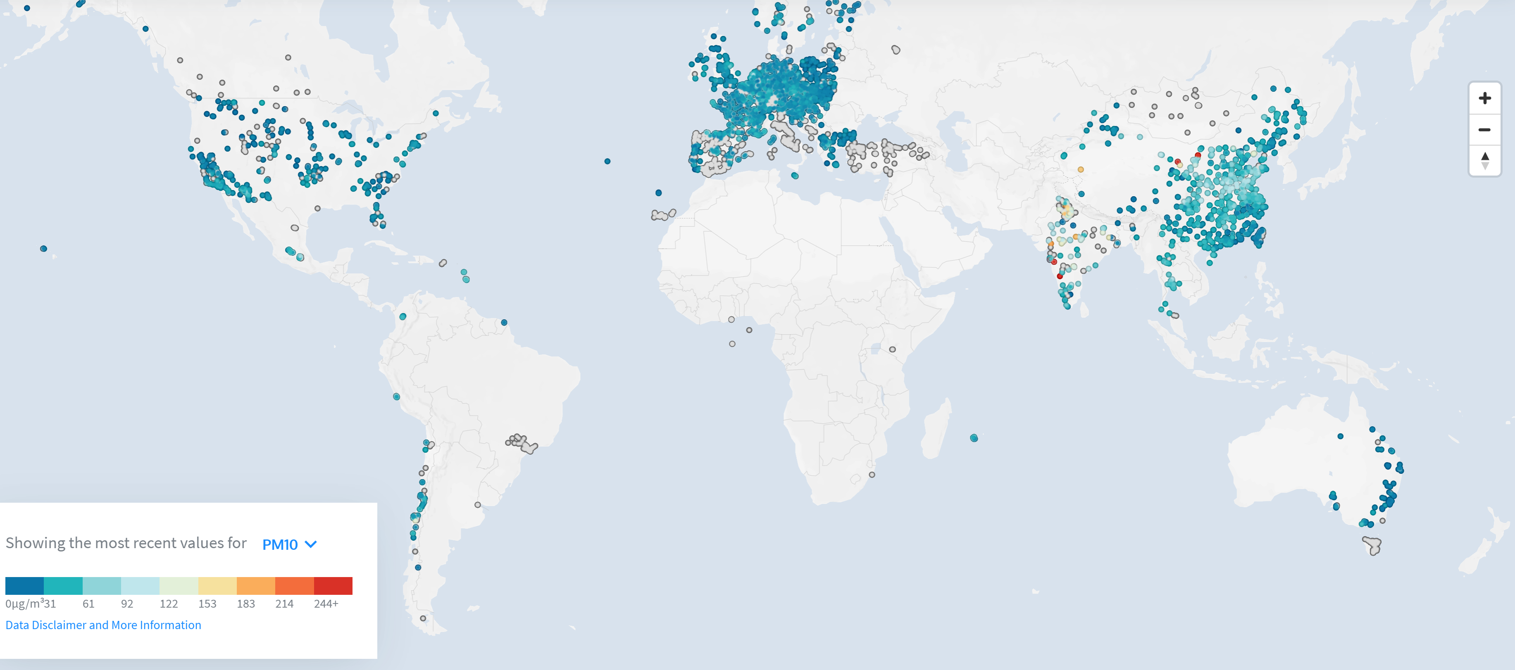
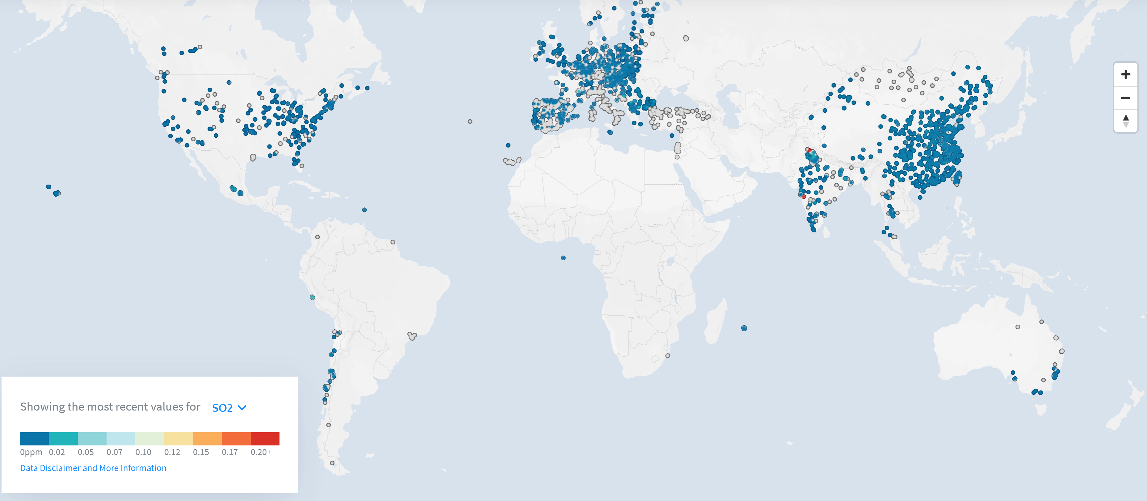
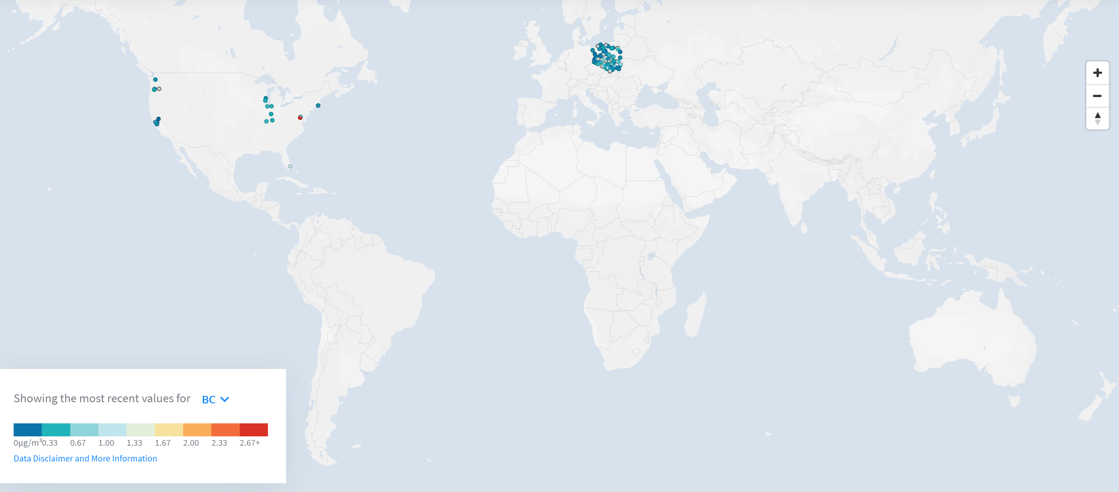
Coverage OF OpenAQ DATASET
NO2
PM10
Ozone (O3)
PM2.5
SO2
CO BC

Slide 5
POtenTIAL CATEGORIES OF RELIABLE STATIONS
Uncertainties
Sensor Errors
Missing measurements
Faulty Sensors
Not Calibrated Sensors
Old sensor
Sensor damaged
Sensor covered or hindered
Sensor not calibrated
Sensor affect by seasonal difference
Sensor affect by traffic volume or emission volume
Sensor affected by humidity
Authority errors
Authority Fabricated
Unqualified sensor manager
Error in data processing or publishing
Why More Reliable - Criteria
Other sensors to validate
Regulations on Air Quality dataset
National Networks that are audited
E.g. European and EU
e.g. Belgium (use for validation)
Why Less Reliable - Selection
India (Stations 456 Total Measurements 32,033,248)
NO2 302 Stations, PM10 267 Stations, PM2.5 309 Stations, O3 280 Stations
SO2 291 Stations, BC 0 Stations, CO 302 Stations
Turkey (Stations 172 Total Measurements 5,640,285 Latest upload 2018/10/13 )
NO2 137 Stations, PM10 158 Stations, PM2.5 0 Stations, O3 82 Stations
SO2 142 Stations, BC 0 Stations, CO 75 Stations
Eastern Europe
China (Stations )

Slide 6
TiME and FREQUENCY of OPENAQ DATASET
Amount of measurements
Amount of measurements
2017
2018
2019
Amount of measurements
2020
Amount of measurements

Slide 7
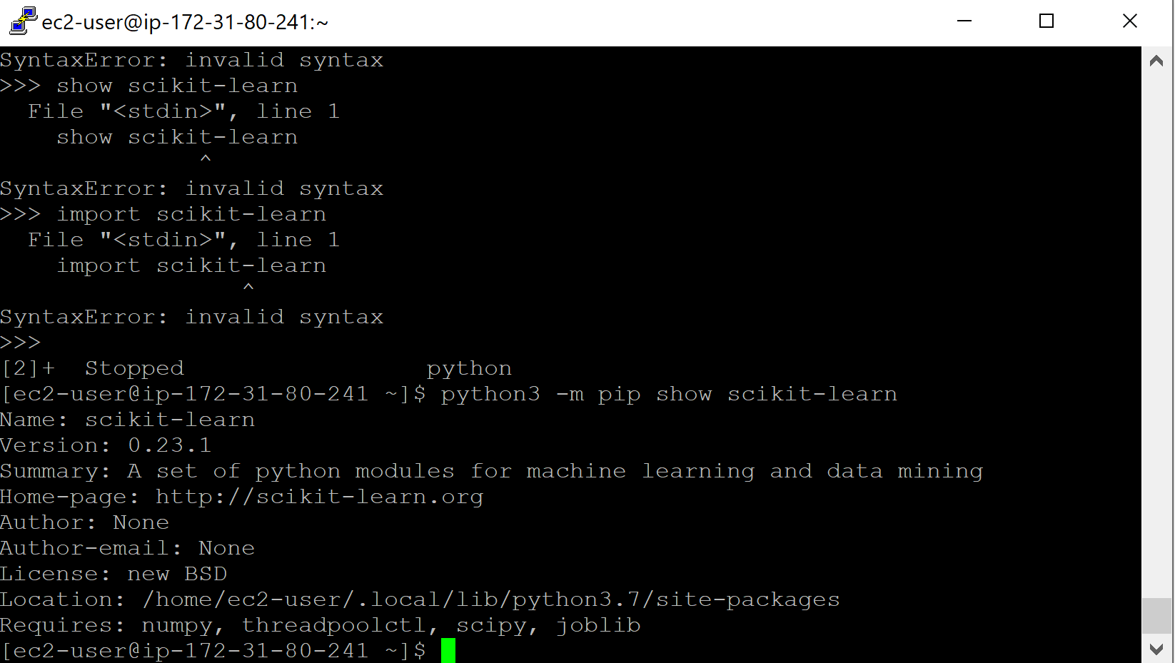
INSTALLED PACKAGES for ANALYSIS
Output
Setup AirNode_AQCA folder on EWC
Setup FTP and SSH to EWC
Copied all of OpenAQ to EWC AirNode_AQCA Folder
Access to EWC from Putty
Installed Anaconda for ML, Analysis python packages
Reviewed scope of available OpenAQ datasets
Written a Python program to access S3 and analyse dataset
Installed scikit-learn on EWC
Used pip3 install -U scikit-learn
python3 -m pip show scikit-learn
Copied openAD Data to EWC AirNode Folder
Installed Anaconda
Used AWS Athena to
Query openAQ
Setup an FTP Client using SSH to EWC instance
Use boto3 to access S3 through Putty on EC2
Reviewed Queries
Task 1: Get Access to AWS and OpenAQ dataset
Task 2: Download some data to Local PC
Queried OpenAQ for Temporal and Spatial differences
Task 3: Construct Presentation
Task 4: Find insights on categories of stations for Milestone 2

Slide 8
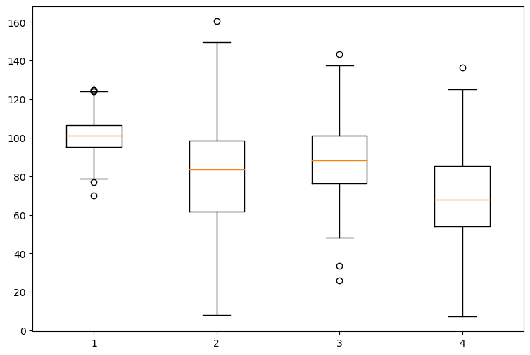
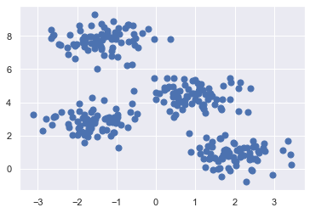
COMPLETED ELEMENTS
BoxPlots KmeaNS

Slide 9
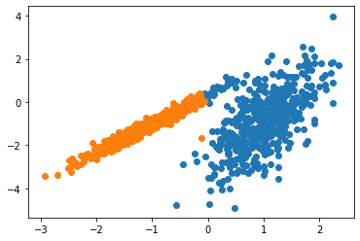
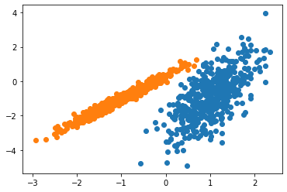
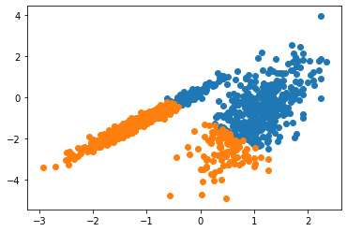
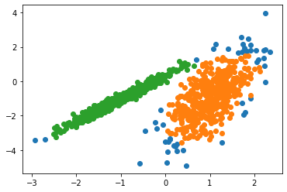
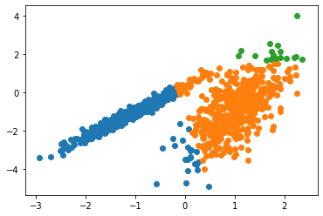
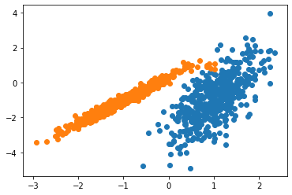
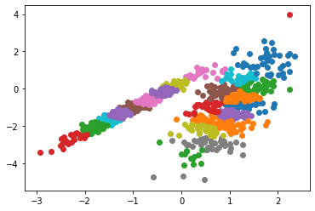
COMPLETED Cluster Analysis
Distance-based and Density Methods
Distance Metric : “An appropriate dissimilarity measure is far more important in obtaining success with clustering than choice of clustering algorithm. This aspect of the problem ... depends on domain specific knowledge and is less amenable to general research.” Hastie, Tibshirani and Friedman's Elements of Statistical Learning
Python Application available:
1 Affinity propagation clustering
2 Agglomerative clustering
3 Kmeans
4 Mini Batch Kmeans
5 Birch
6 Mean Shift
7 Gaussian mixture
8 Density-based spatial clustering of applications with noise ( DBSCAN)
Same Dataset
Spectral
Gaussian Mixture
Kmeans
DBSCAN
Birch
Affinity propagation
Mean Shift

Slide 10
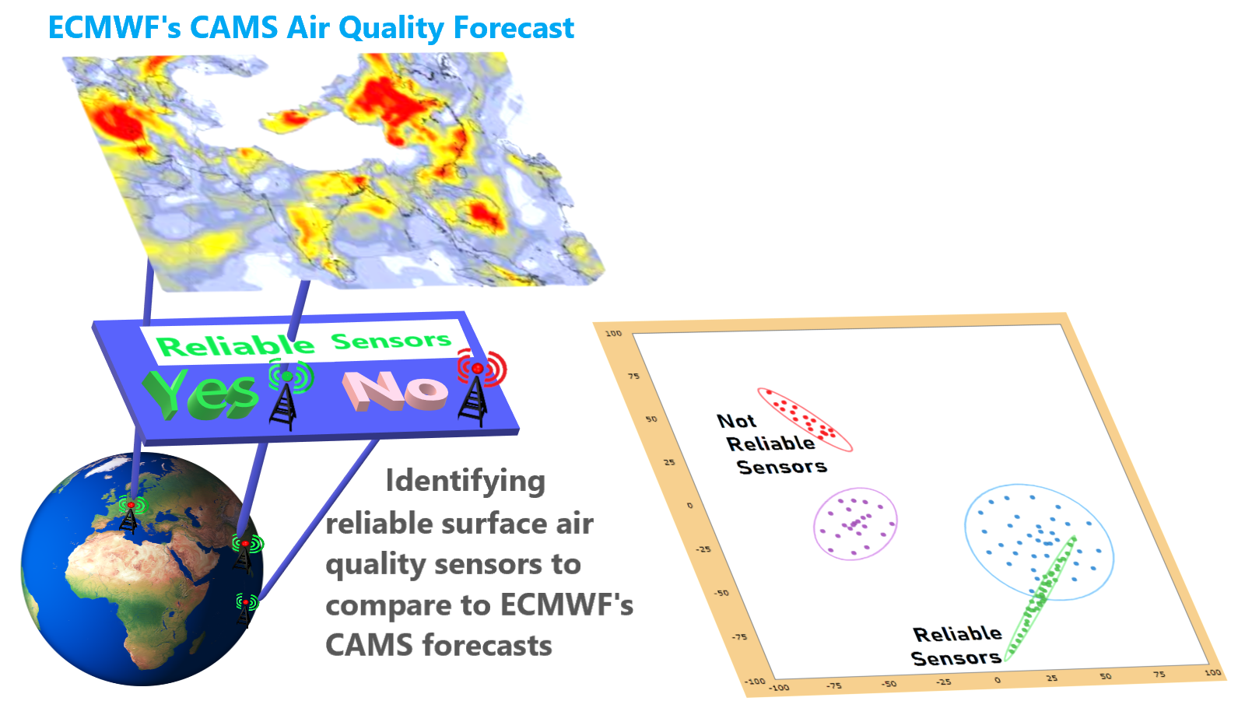
PartICIPANTS FORM
Project Description
Validating and removing errors outliers from surface air quality observations from individual sensors so that these observation can be compared to ECMWF's CAMS air quality forecasts.
By clustering analysis on these observations more reliable observations can be identified. Enhancing these observations by attaching data about factors that affect air quality these observations can have more credibility about their accuracy.
CAMS lacks credible surface air quality observations in many parts of the world, often in the most polluted area such as in India or Africa. Some observations are available for these areas from data harvesting efforts such as openAQ but there is no quality control applied to the data, and it is often not well known if the observations are made in a rural, urban or heavily polluted local environment.
This information on the environment is important because the very locally influenced measurements are mostly not representative for the horizontal scale (40 km) of the CAMS forecasts and should therefore not be used for the evaluation of the CAMS model.

Slide 11
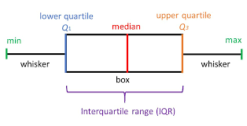
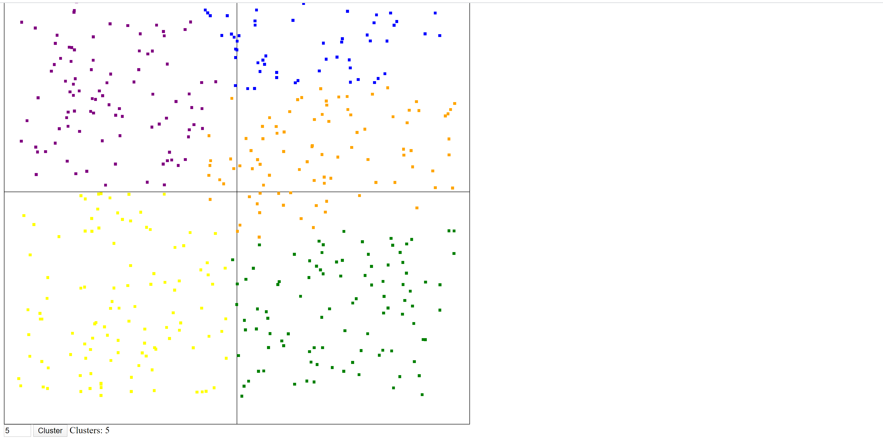
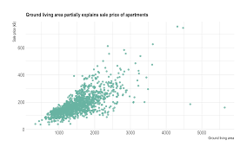
Plan to Categories Station IN MILESTONE 2
IMPORT Datasets -> Choose Variables - > Identify Clusters -> Obvious Outliers (Global Outlier )
Step 1 Step 2
Visual analytics Cluster Analysis (K-means, Expectation Maximization, Canopy,
Farthest First and Hierarchical clustering)
Box plots
Scatter plot
Output
1 Threshold of Air quality value that indicates an outlier
2 A lower threshold and number of times that exceeding this threshold indicate an outlier
Z-score
Import Air Quality dataset from OpenAQ for 3 – 6 years + more years
Python: pandas, numpy, matplotlib, sci-kit learn

Slide 12
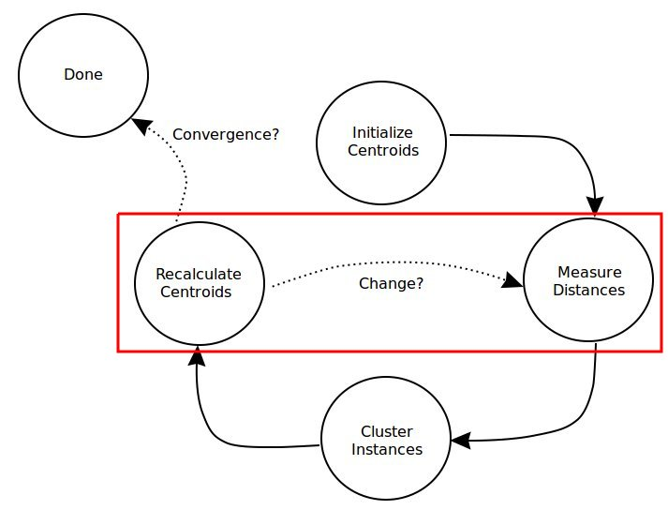
1 POtenTIAL Other DATASETS 2 Evolving of Cluster AnalYSIS
Wind Direction
Wind Speed
Humidity
Weather
Rainfall
Land Use
Cloud cover
Temperature
Source: https://www.kdnuggets.com/2017/08/comparing-distance-measurements-python-scipy.html

Slide 13
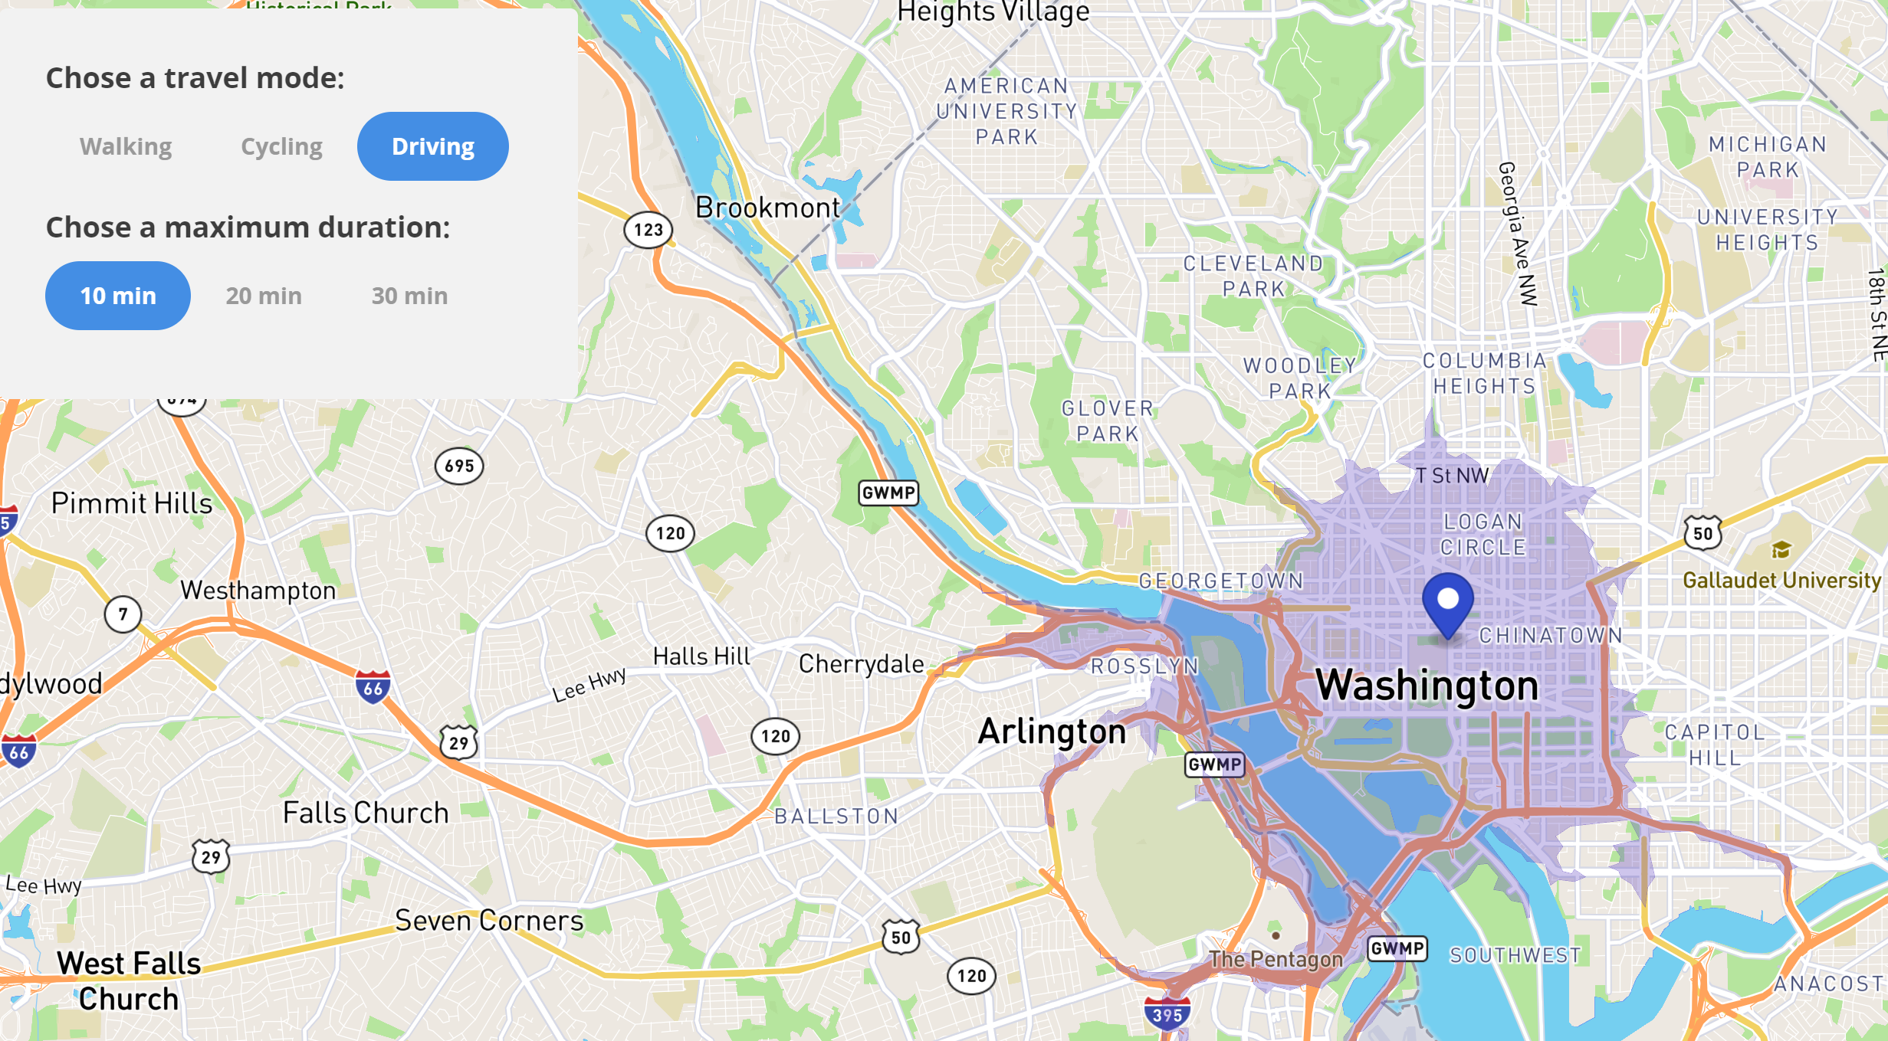
Ideas foR Analysis
Isochrone
The spatial distribution that affects Air Quality Sensors
How
1 Use Wind direction and Speed
2 Find any obvious Emissions sources in distribution
3 Find an obstruction in distribution
(Find Wind direction where begins)
(Estimate potential distribution)

Slide 14
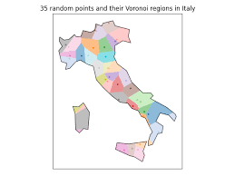
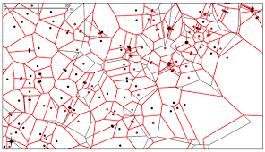
Spatial Datasets
Using Voronoi Spatial Analysis for distance from other Sensors
Advantage
Distance to other OpenAQ sensors and reliability of comparing to other sensors
Coverage of that is near to that OpenAQ sensor

Slide 15
POTENTIALLY MORE RELIABLE STATION
US EMBASSY Sensors (Potentially more reliable)
From Spatial Analysis (Stations with other stations close by are more reliable)
Stations with most measurements (More measurements means identifying frequent errors in sensors)
Cluster similarity metrics (How formed are the clusters and whether there are many outliers)
PCA Completed and available on the EWC (What are the most significant factors )

