Slide 1
Survey on the satisfaction of majoring geography to Daxia platform
Team 2：胡碧皓 武美玖 韩庆慧 刘冠群 潘香霖
Notes:
标题字体为：方正正中黑简体 可以用微软雅黑代替哦

Slide 2
目录
CONTENTS
01
02
03
The questionnaire
Data analysis
Conclusion & suggestion
问卷情况
数据分析
总结建议

Slide 3
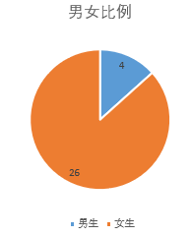
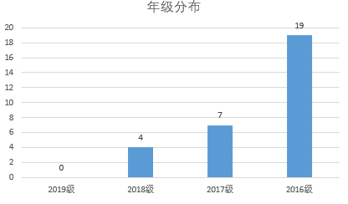
The questionnaire
(问卷情况)
32 questionnaires
Others (2)
Geography (30)

Slide 4
Data analysis
数据分析
Reliability coefficients(信度系数)
Above 0.9
0.8-0.9
0.7-0.8
below 0.7
信度甚佳
可接受的
有价值的
需要修改
Need to modify
Valuable
Acceptable
Good reliability

Slide 5
Data analysis
数据分析
Dimension | Cronbach's Alpha
Attractiveness （吸引力） | 0.93
Perspicuity（明晰） | 0.61
Efficiency （效率） | 0.82
Dependability（可靠性） | 0.83
Stimulation（促进） | 0.85
Novelty（新奇） | 0.88
Result:
the attractiveness scale has a high reliability
the perspicuity scale need to be modified
Dimension | Lambda2
Attractiveness （吸引力） | 0.92
Perspicuity（明晰） | 0.63
Efficiency （效率） | 0.82
Dependability（可靠性） | 0.81
Stimulation（促进） | 0.83
Novelty（新奇） | 0.86

Slide 6
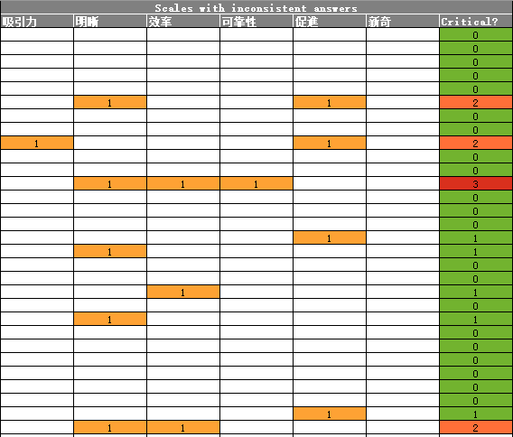
Data analysis
数据分析
Detect Suspicious Data(可疑数据）
Result:
one person did not answer seriously in three dimensions
Three people did not answer seriously in two dimensions
Most of the data are consistent
Notes:
Most of the investigators were very serious about this questionnaire.

Slide 7
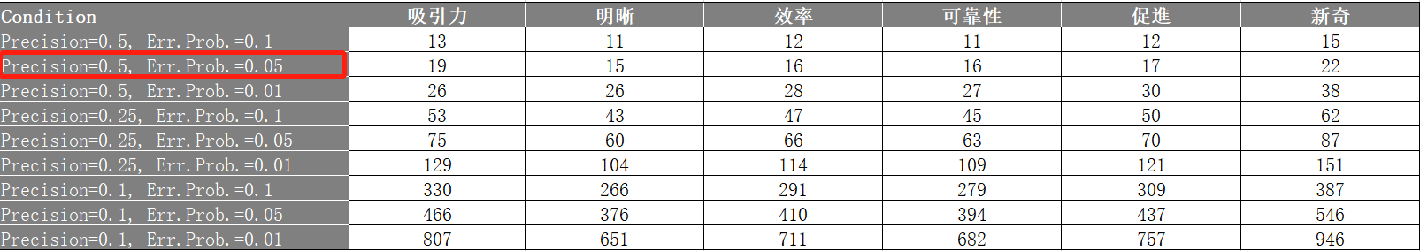
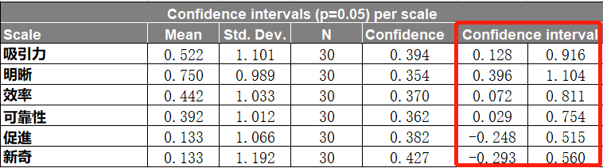
Data analysis
数据分析
Error probability:5%
Precision：0.5
When you have another sample, there's a 95% possibility that it's going to be within these ranges.

Slide 8
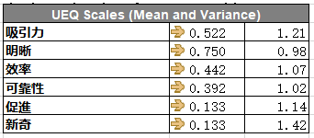
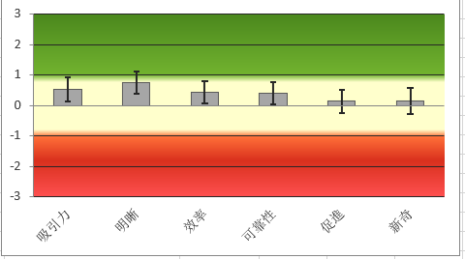
Data analysis
数据分析
Main results (主要结论）
Result:
0.8>All are >-0.8（in the medium level，Between positive and negative）
the highest is perspicuity(明晰度)，mean=0.75
the lowest are the scale of stimulation and novelty(促进和新奇)，mean=0.133

Slide 9
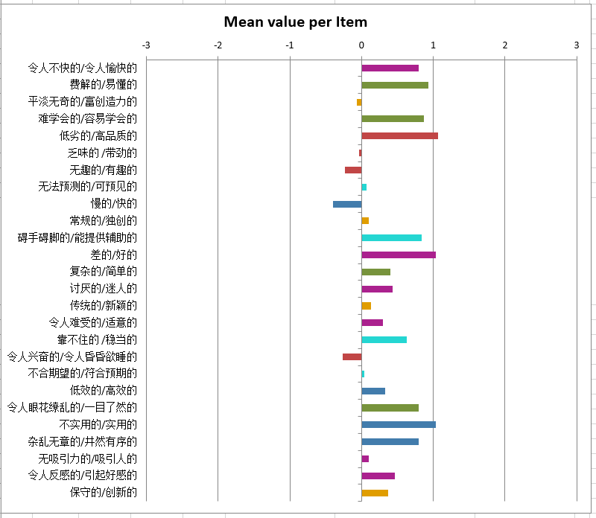
Data analysis
数据分析
Main results (主要结论）
Notes:
more detailed descriptions of each item.

Slide 10
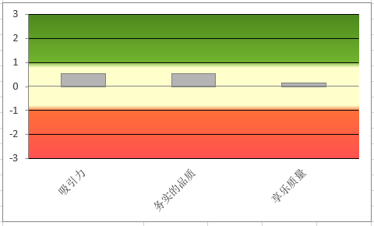

Data analysis
数据分析
Main results (主要结论）
Result:
All are <0.8（in the medium level，Between positive and negative）
the quality of hedonic is lower than pragmatic and attractiveness obviously
Daxia platform are less attractive and practical, not to mention its hedonic quality.

Slide 11
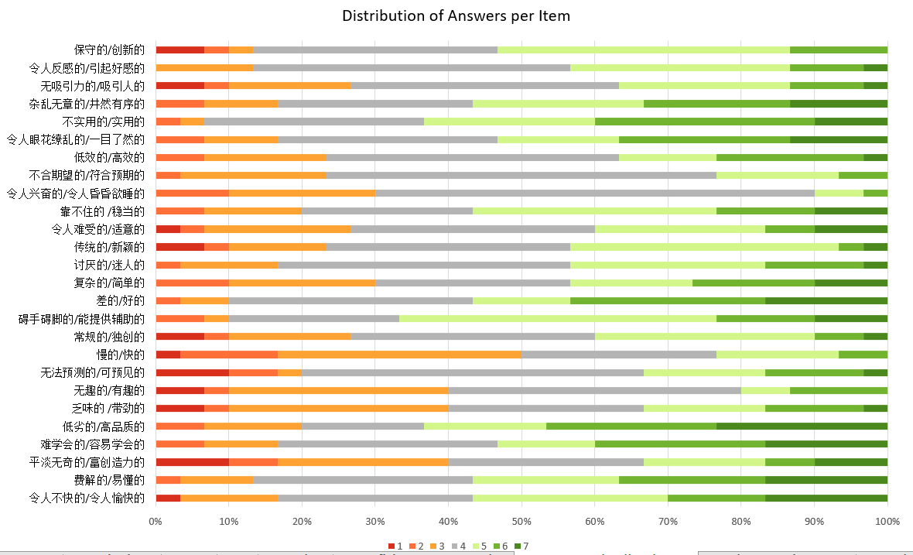
Data analysis
数据分析
Answer Distribution(答案分布）
mostly in 4 or 5 points

Slide 12
Data analysis
数据分析
Answer Distribution(答案分布）
slow & fast
not interesting & interesting
boring & exciting
The most negative evaluation:
Impractical & Practical
Obstructive & Supportive
Inferior & Valuable
The most positive evaluations

Slide 13
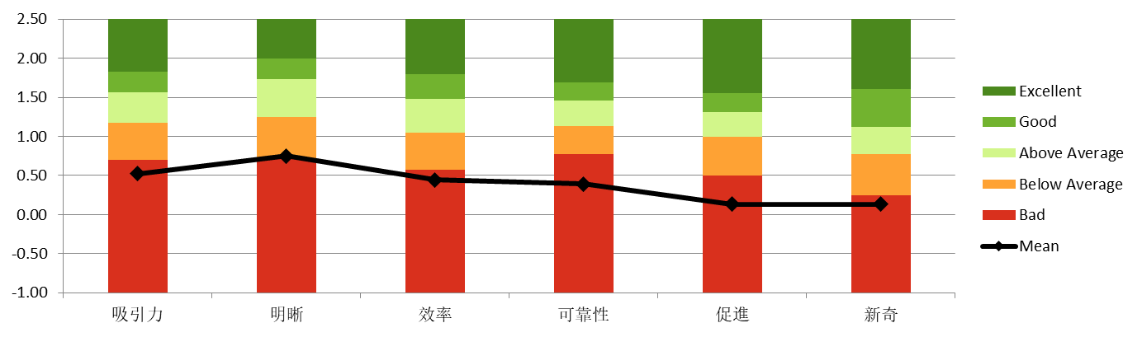
Data analysis
数据分析
Benchmark comparison(与基准比较情况）
All the six dimensions of Daxia are at the bottom
Five are in the last layer
(perspicuity is on last but one layer 明晰在倒数第二)
Result:
Daxia still has considerable space for improvement in these six dimensions.

Slide 14
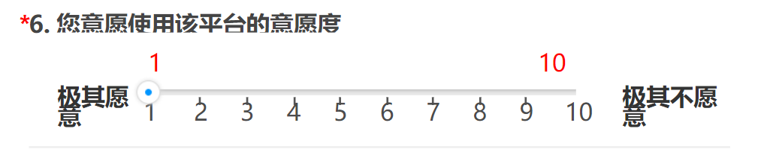
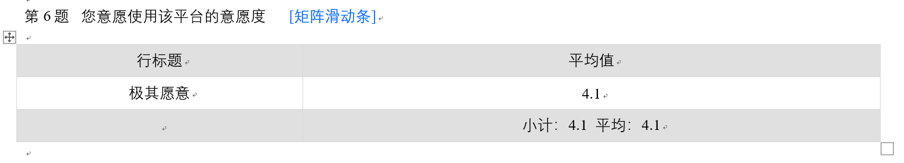
Data analysis
数据分析
Lower than 5 , students majoring geography are unwilling to use it

Slide 15
Conclusion
总结建议
Full function
Bad user experience
If more attention is paid to user experience, Daxia will be more perfect.

Slide 16
THANK YOU
Notes:
标题字体为：方正正中黑简体 可以用微软雅黑代替哦

