Slide 1

华东师范大学
East China Normal University
ETer Application
Reporting group：Third group

Slide 2
Content
1
The purpose of our project
2
The methods of measuring the learning outcome
3
3
3
The way to help students to get good learning experience
4
Different types of data we care about
5
Data sources
6
Conceptual model

Slide 3

The purpose of our project
——Target group
——Services provided
1

Slide 4
Target group
The learners who are preparing for the postgraduate entrance exams of educational technology and the students who have passed the postgraduate examination of educational technology.

Slide 5
Services provided
01
02
1
Previous examination papers
Bibliography
Resources
Community
2
Discussion community
Services
3
Exercise bank, simulation test
Test
second-hand transaction
4
Second-hand transaction
03
04

Slide 6
The methods of measuring the learning outcome
——Diagnostic evaluation
——Process evaluation
——Summative evaluation
2

Slide 7
Evaluations
Students do simulated test questions, we use the results to evaluate the learning behavior of learners
Through questionnaires and diagnostic tests, we can understand learners' learning intention, style and starting point, so as to provide suggestions for learners.
Diagnostic
Summative
Process
By analyzing the learning behavior data of learners on the platform, including practice times, time and error rate, the performance of students is evaluated, so as to provide more accurate evaluation for learners

Slide 8
The way to help students to get good learning experience
3

Slide 9
Good learning experience
Simple and clear interface
Clear function button
Interface design
Analyze students' learning behavior and provide accurate resources for students
Precise positioning
The quantity and quality of resources are guaranteed and updated in time
Platform maintenance

Slide 10
Different types of data we care about
4

Slide 11
Different types of data
Learning behavior data
Feedback data
Platform maintenance data

Slide 12
Data sources
5

Slide 13
Data sources
Actor
Verb
Object
xAPI

Slide 14
Conceptual model
6

Slide 15
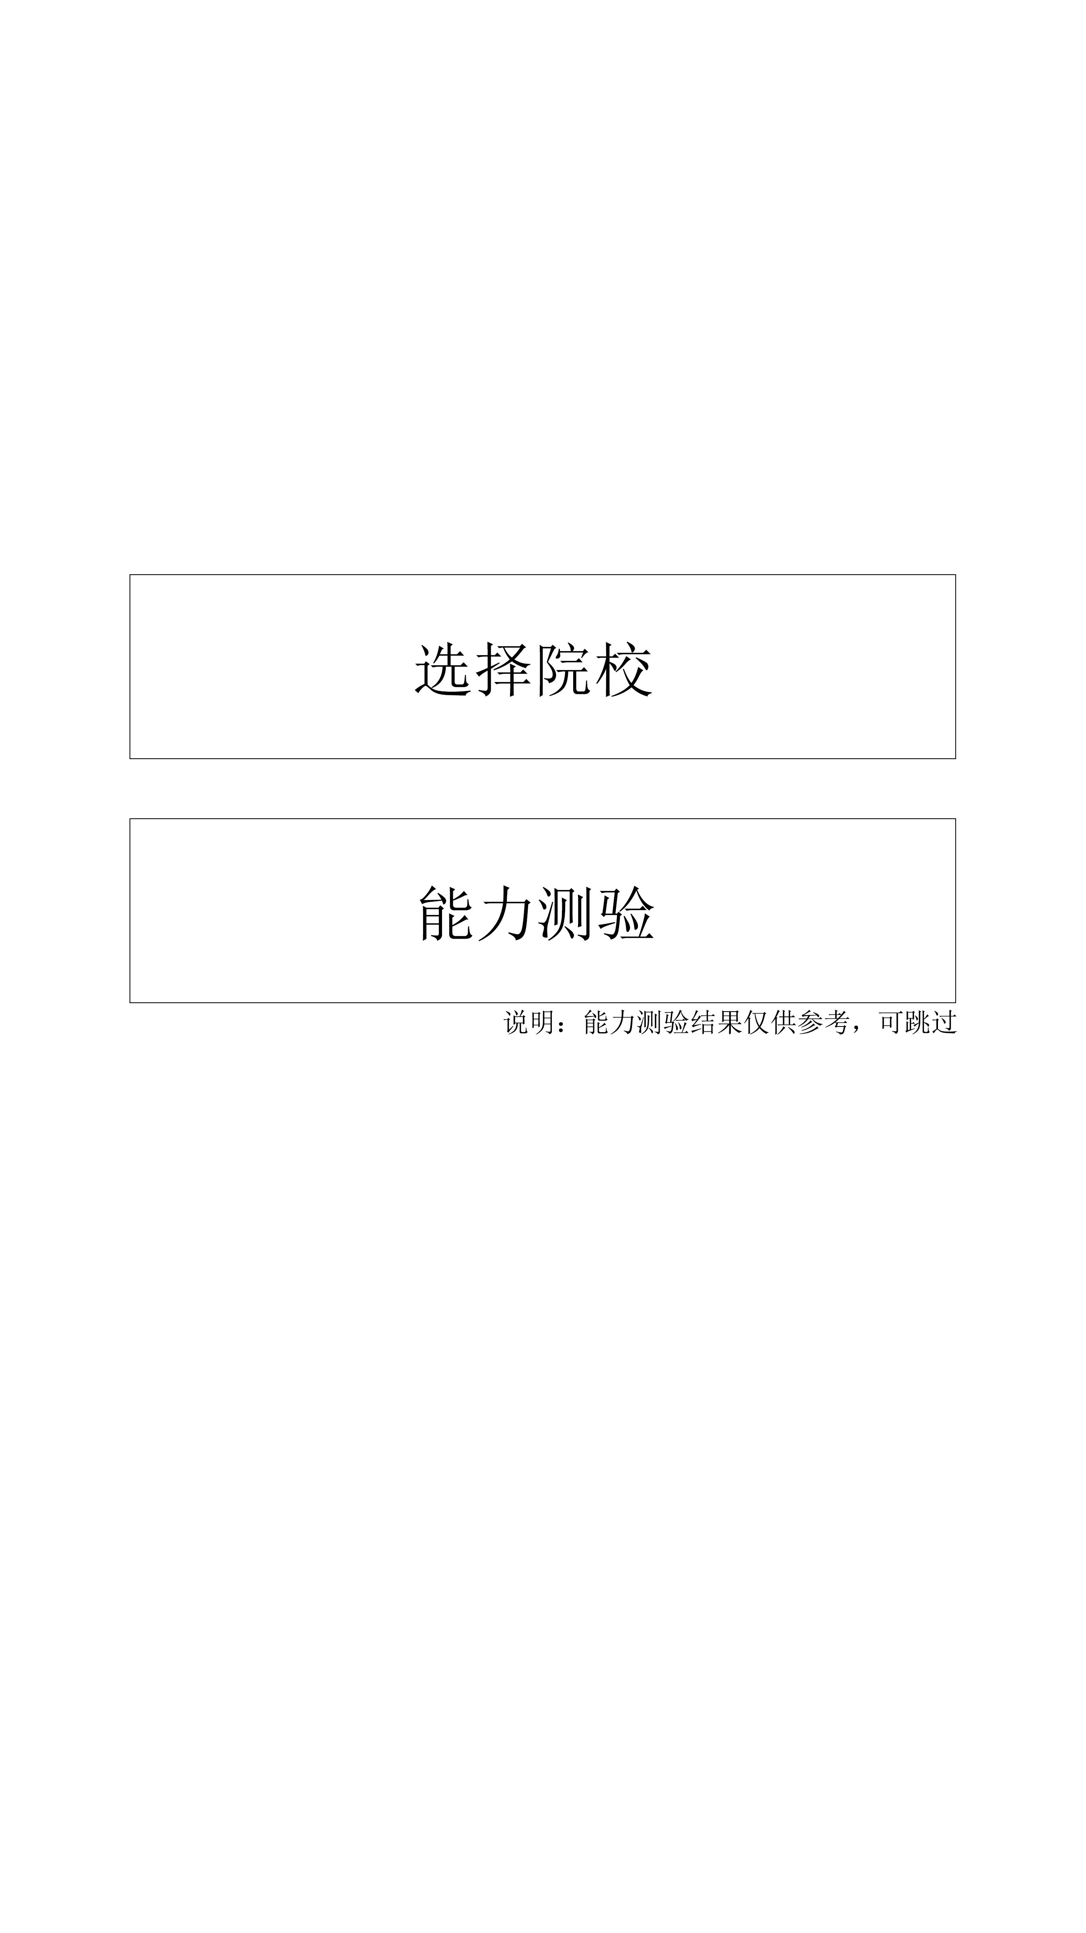
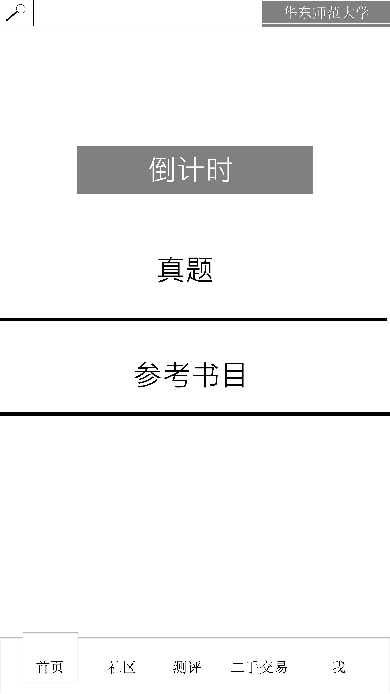
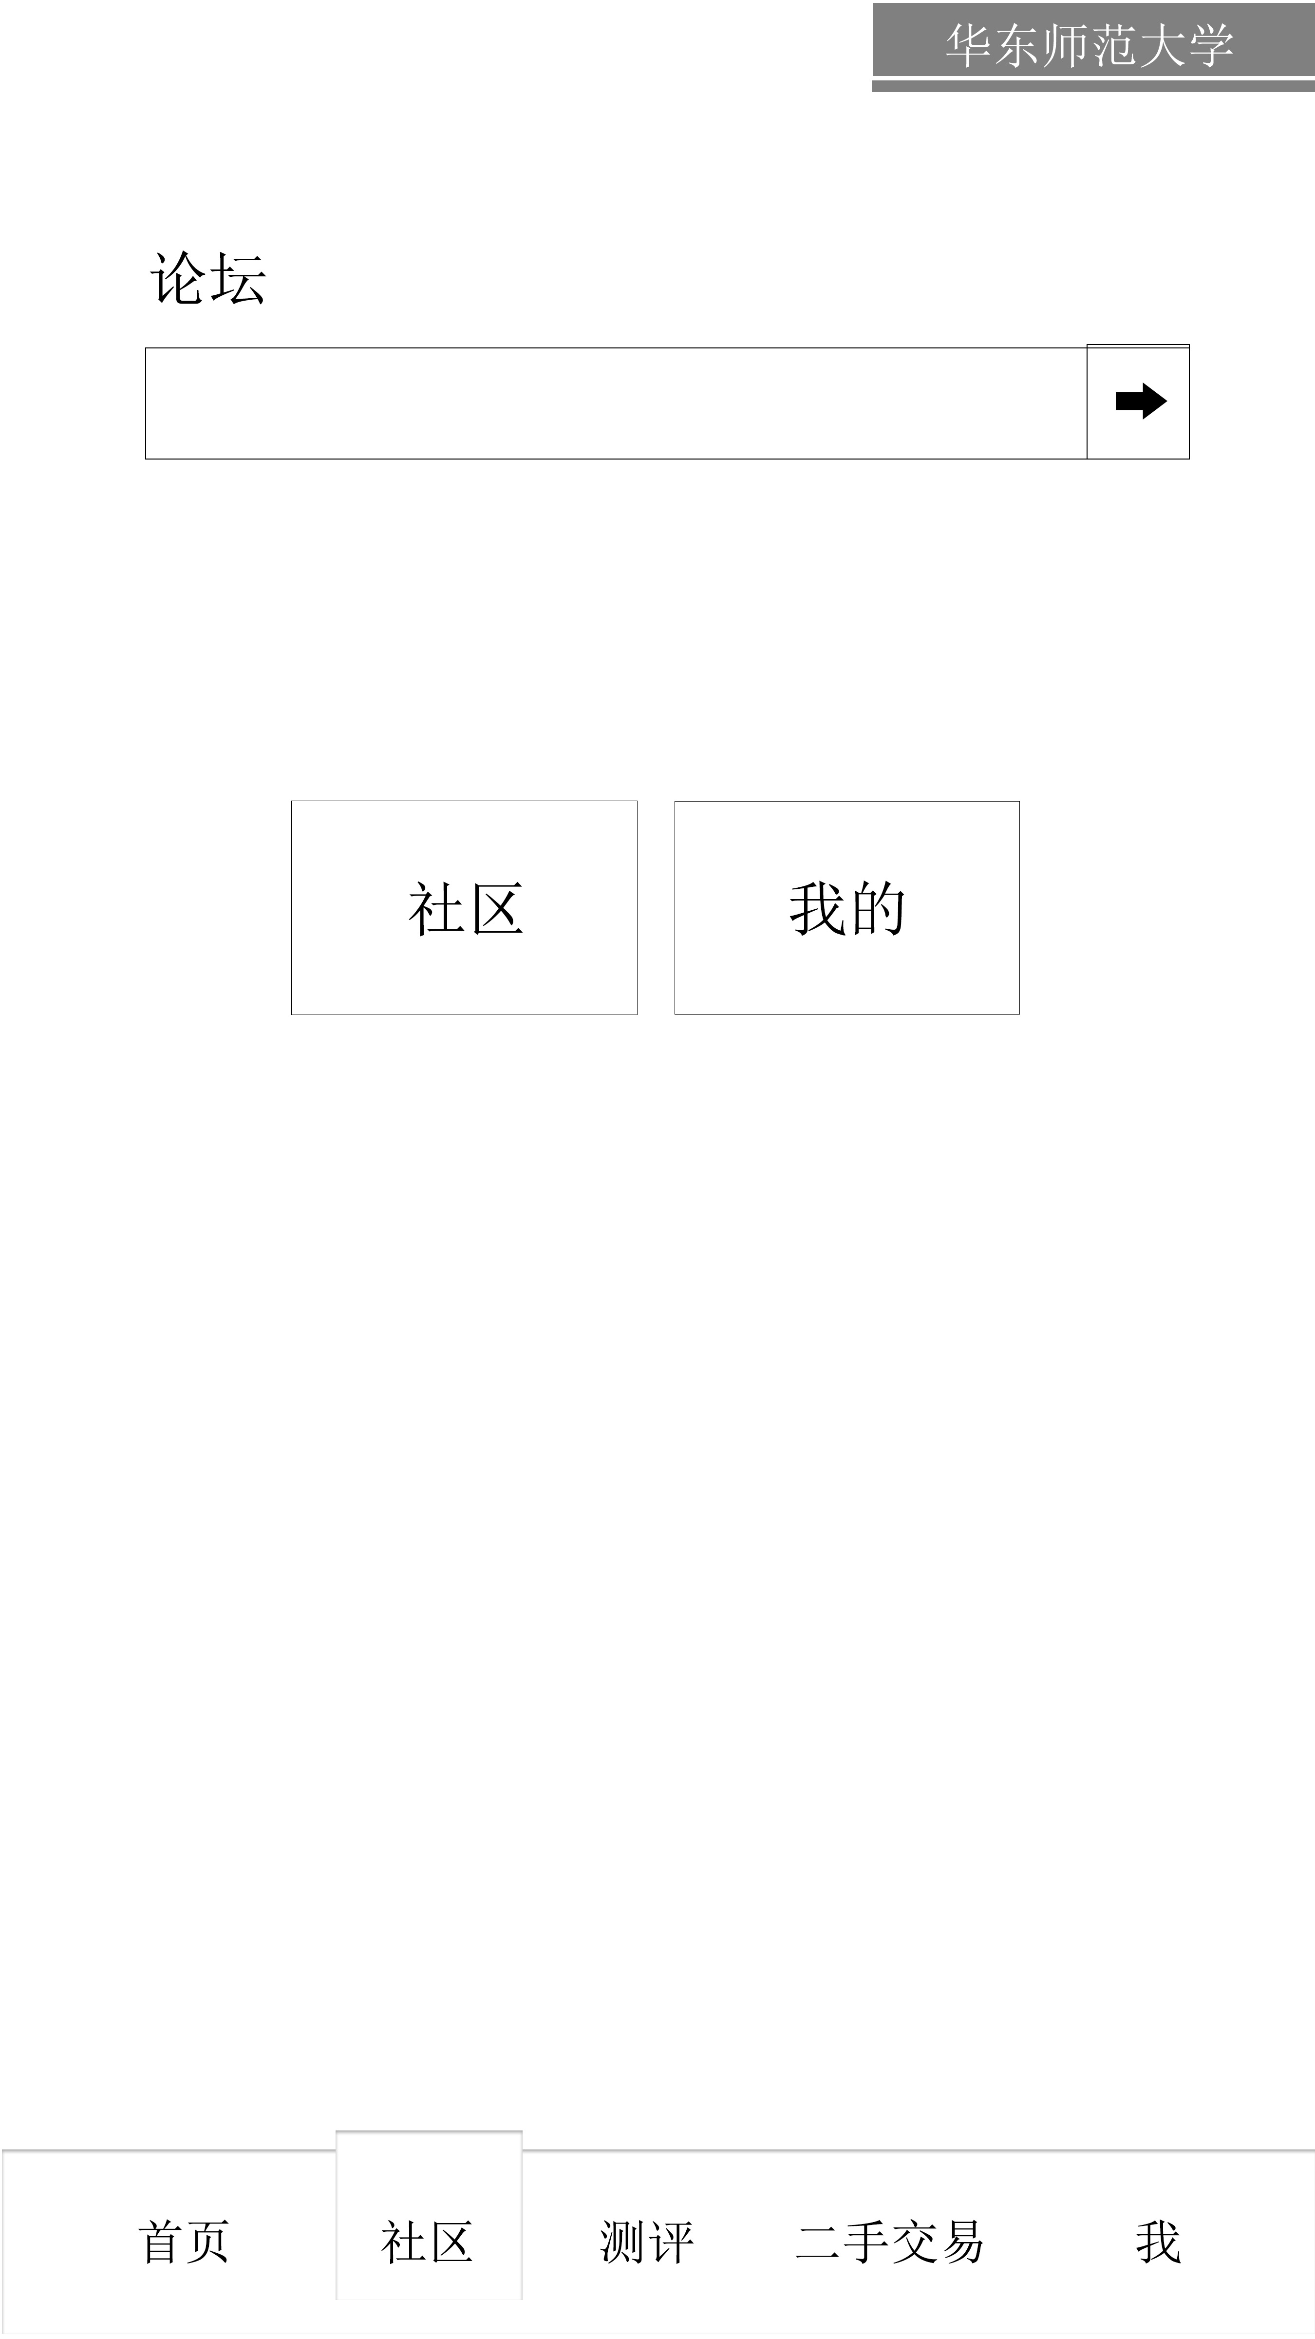
Conceptual model

Slide 16
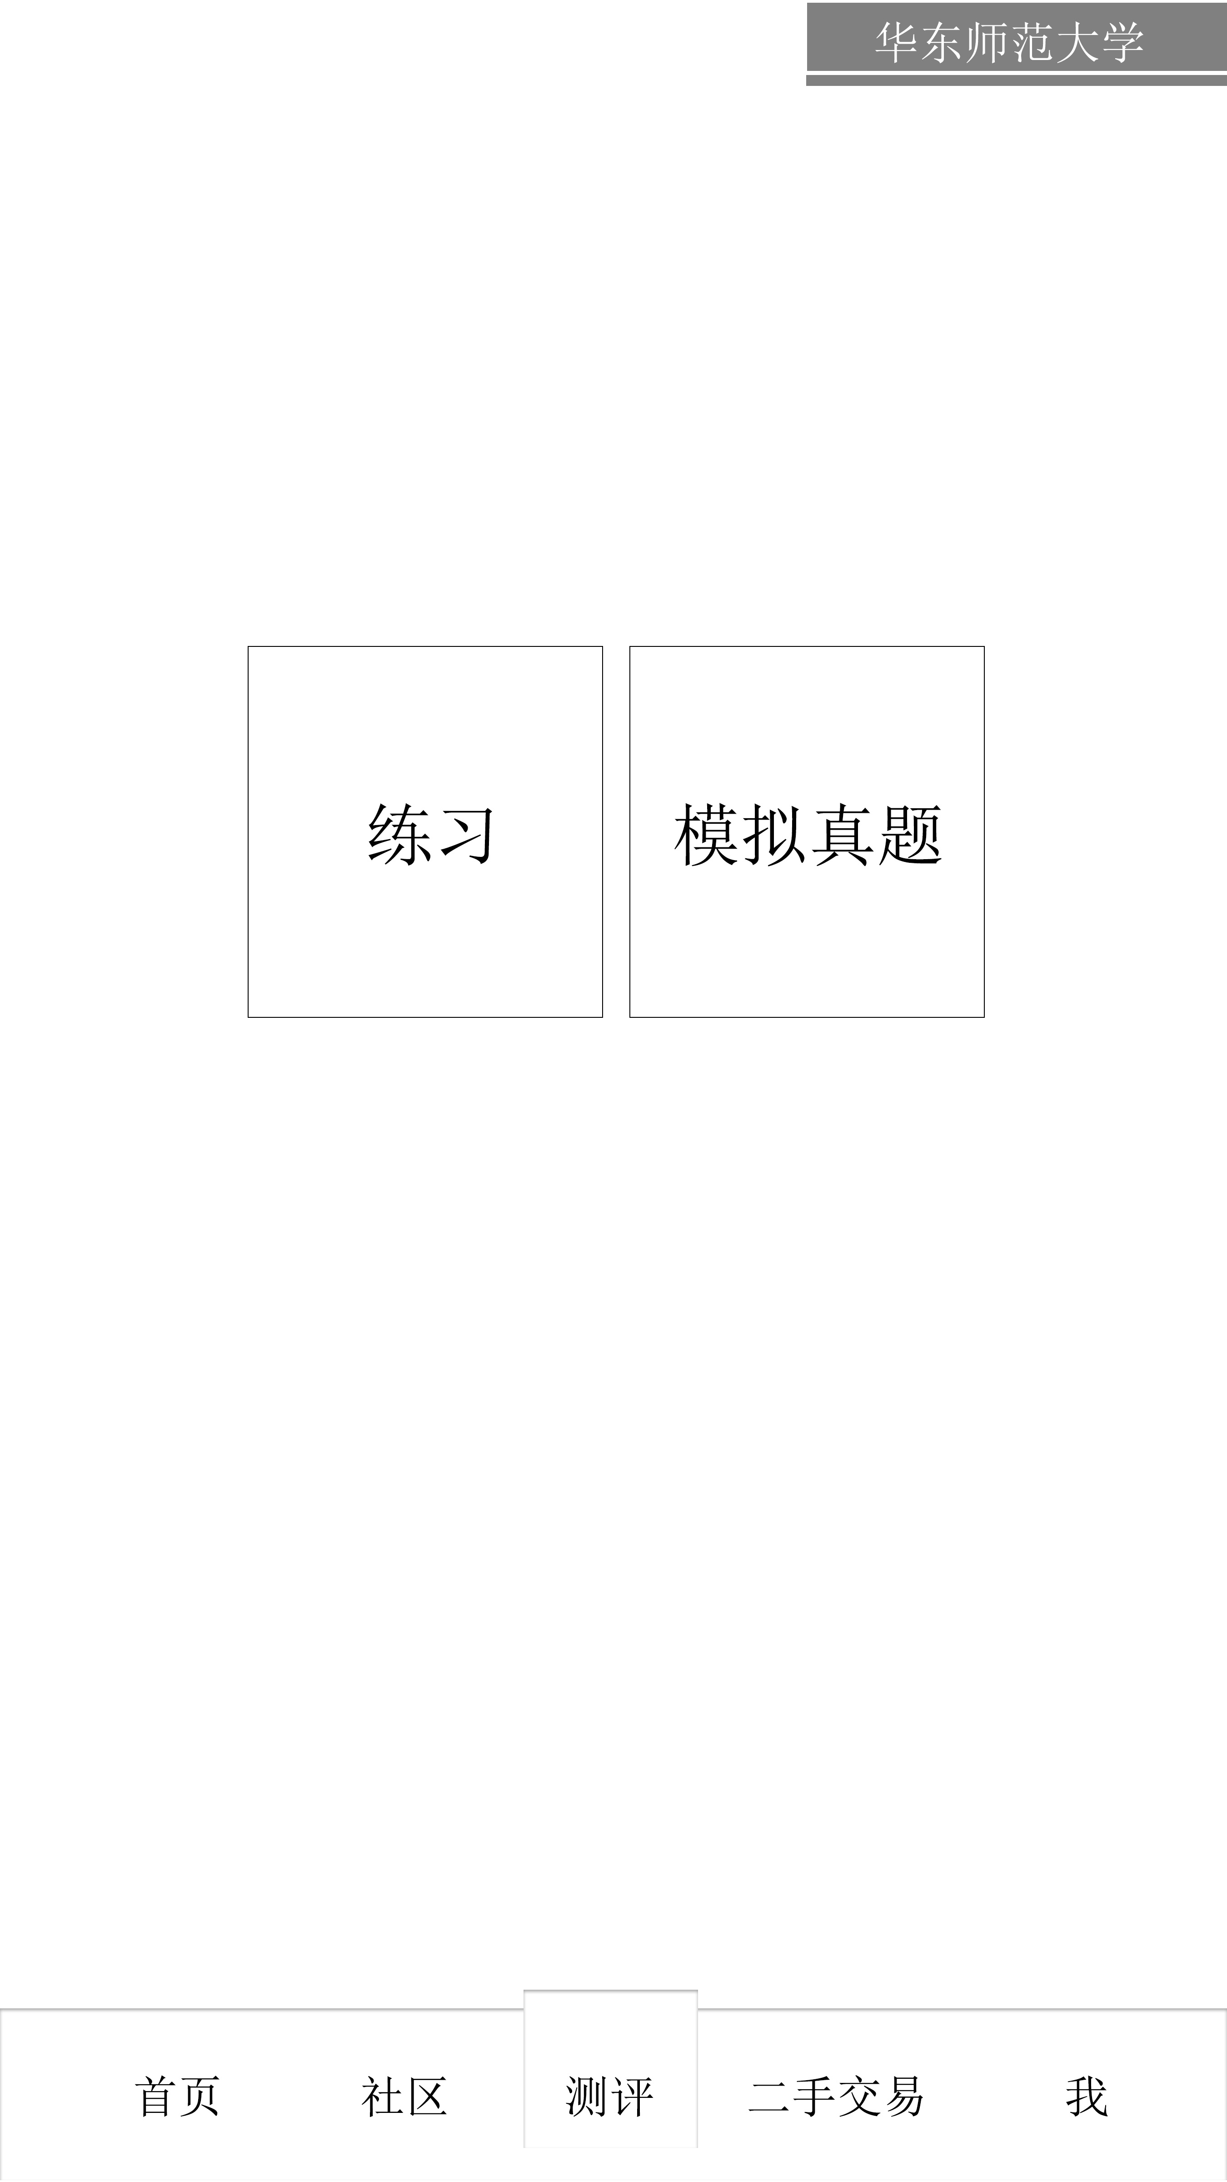
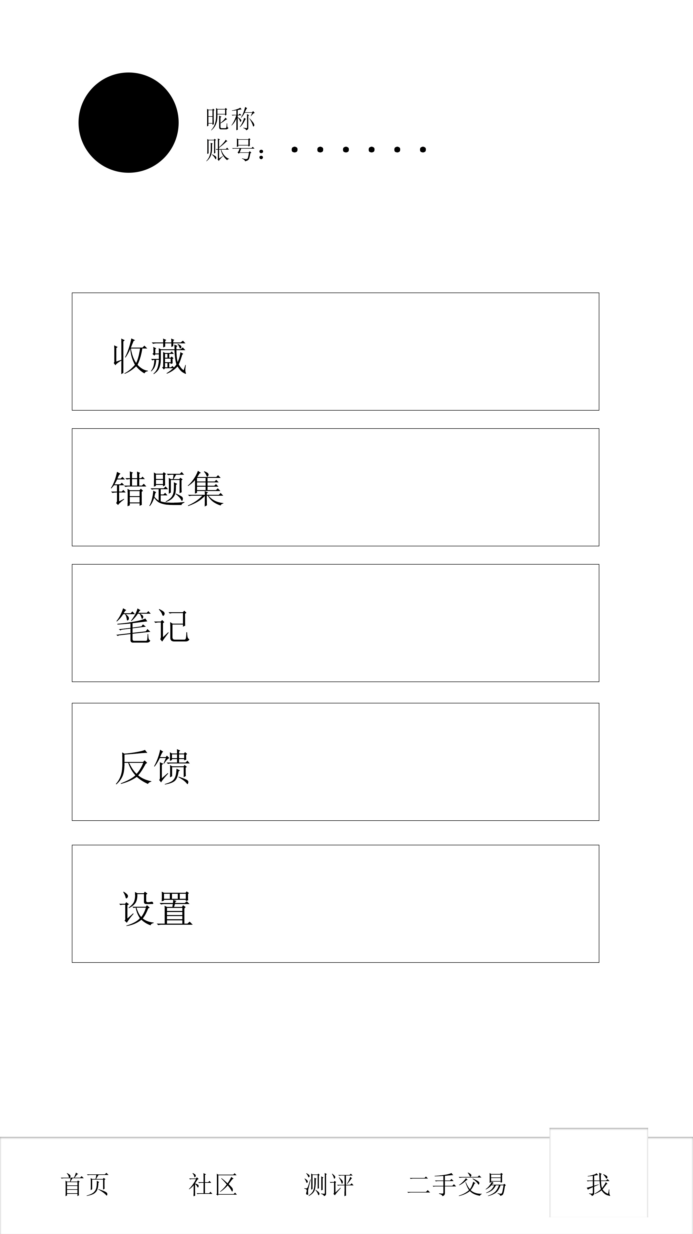
Conceptual model

Slide 17
华东师范大学
East China Normal University
Thanks!
Reporting group：Third group

