Slide 1

安全教育
平台设计探讨
e-learning platform design
第一小组

Slide 2
How to measure the learning outcome?
The difficulty of the level and the students' performance are used to measure what learners learn in this lesson. The difficulty of the game level is adapted to the change of students' ability. Students with different ability values can conduct personalized learning under different learning contents, so as to further adjust the matching relationship between the difficulty dimension of the game and the teaching effect dimension.

Slide 3
What's the purpose of my project?

Slide 4
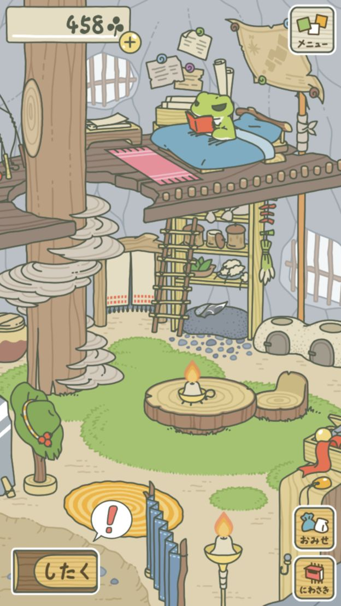
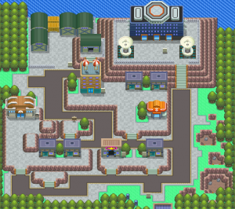
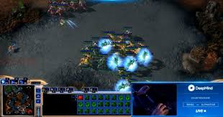
Website Interface
A combination...

Slide 5
Logic

Slide 6
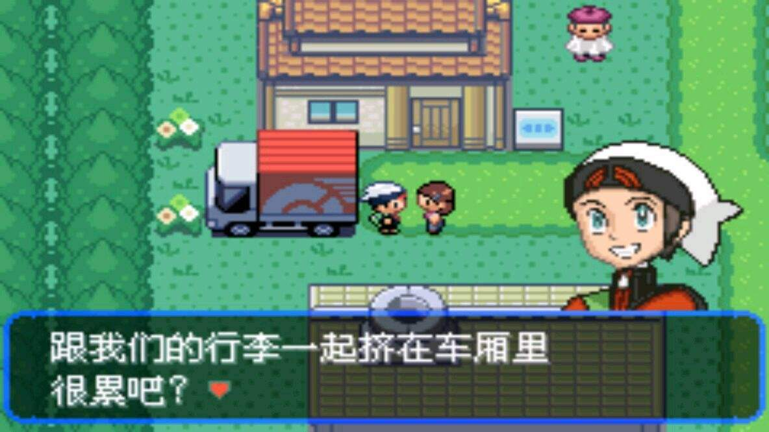
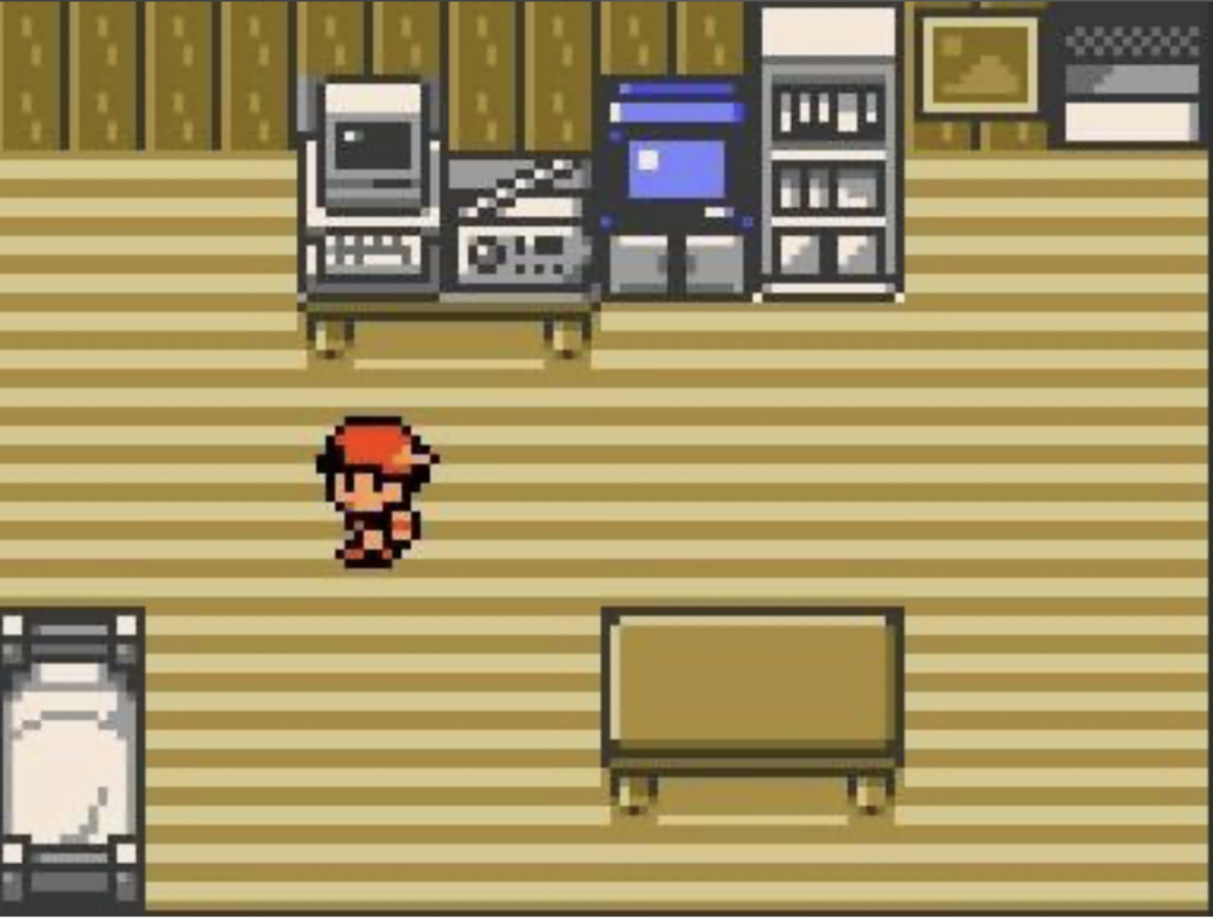
Game Interface
window
towel
fire
hydr-ant
water chan-nel
🔥🔥
🔥🔥🔥🔥🔥🔥🔥🔥🔥

Slide 7
How to help students to get good learning experience
Planting the learning process into the game process
Students' behavior based on their own cognitive representation will receive rapid feedback
Interactive, immersive learning experience

Slide 8
What type of data do we care about and where to get
Students' knowledge mastered degree ——> Gaming process data ——> through buttons、choice、click order
Self-protection skills ——> Gaming process data ——> through buttons、choice、click order
Problem-solving thoughts ——> Behavioral order data ——> button click order
Time of students' learning knowledge ——> Page residence time data ——> time between button click
Students' related safety awareness ——> Students' knowledge mastered degree and Self-protection skills before and after the game & The extent to which students invest in games and learning process ——> Gaming process data、comparison data of twice-game time data ——> through buttons、choice、click order、game results
... ...

Slide 9
Thank Q
过

