Slide 1
E-Learning Platform
--Safety Education
Group Two-The Powerpuff Girls
Reporter：Group 2
Date：2019.10.13

Slide 2
CONTENTS
1
About Our Platform
Safety Education Platform
2
The Main Learning Theory
Constructivism
3
Analysis of KIEBIE
Platform Analysis
4
Summary
The Framework

Slide 3
PART 01
About Our Platform
Safety Education Platform for Teenagers.

Slide 4
About Our Platform
We are going to make a platform about safety education for youth.
Our platform is about the adolescent security,which aims to enhance their awareness of safety and self-protection. Youth safety education includes the following:
campus safety education
traffic safety education
fire safety education
public health safety education
sex safety education
network safety education
········
From the perspective of sex education, we will design the prototype of the platform, including video learning, situational survival, communication, case analysis and other aspects of safety education for teenagers.

Slide 5
PART 02
Main Learning Theroy
Constructivism

Slide 6
The main Learning Theory
We are going to make our platform follow the Constructivism.
Constructivism
Learning Theory
Constructivism as a paradigm or worldview posits that learning is an active, constructive process. The learner is an information constructor. People actively construct or create their own subjective representations of objective reality. New information is linked to to prior knowledge, thus mental representations are subjective.

Slide 7
PART 03
Analysis of KIEBIE
Platform Analysis

Slide 8
“K”-- Knowledge
what we can learn from the platform?
Health and hygiene
Network security
sex, drugs, allergies, infectious diseases, influenza, hepatitis safety, etc.
Radiation, network security, network crime, online shopping, online love and so on.
Mental health
Natural disasters
teacher-student relationship, classmate relationship, adolescence.
Air pollution,earthquake, drought,tsunami, flood, landslide, volcano,.
Accidental injuries
Social security
Explosion, trampling, electric shock, knife use,sports, asphyxiation, etc.
School violence, sexual assault, lost, fraud,traffic, terrorism, etc.

Slide 9
“K”--Skill
The skill we can learn from the platform.
Deal with dangerous
SKILL
Through the establishment of scenarios, learners can learn how to act and deal with potential dangers in some situations.
Protect themselves
Through the establishment of scenarios, students can master the skills to protect themselves.

Slide 10
“K”--Attitude
The attitude we can learn from the platform.
Learners can put adolescent emotional problems in perspective
Improve the life safety awareness of learners
Improve network ethics, network security awareness.
Learners pay more attention to health.
Learners more abide by laws and regulations, Improve learners' social skills, etc.
Learners are more in awe of and grateful for the nature, the awareness of environmental protection has been improved, pay more attention to early warning signals, etc.

Slide 11
“I”--Interact object
From Who To Learn?
Human-human interaction
students-students
students-teachers
Human-machine interaction
interactive videos，pictures and so on.

Slide 12


“E”--Environment
Where To Learn?
Because our group wants to do a safety education website for primary and middle school students, so for the applicable object of the website -- primary and middle school students, the main environment is the online environment..
On the other hand, after learning online, students will mainly apply it in real life and interact with the environment, which includes human interaction and human-computer interaction.

Slide 13
“B”--Behavior
Effect of Learning the platform.
In the study of safety education platform, students' learning behavior is mainly reflected in the following aspects:
Interaction between students and the platform
Transformation and adaptation of knowledge
Through learning on the platform, on the one hand, students can enhance their safety awareness and on the other hand, improve their self-protection ability.
Students learn relevant safety knowledge through the platform and will transform it into some means to protect themselves according to their actual situation.

Slide 14
“I”--Interact
Between the learner and the learning video.
1
Between the teacher and learners
2
The learning scenario asks learner to choose .
3
The learners' communication in the platform.

Slide 15
“E”--Experience
The process、feeling.....
The Experience in Our Platform
The platform aim to help children construct the knowledge by the virtual reality. Let them react to the situation to build a right framework about safety.
Firstly
Secondly
You can choose a column you want the children to learn and a Flash will appear after clicking the button.And the outcome will be different depend on what the children have chosen. If they chose a wrong one, the platform will display the bad consequence-the girl got into troubles and tell them how to deal with this problems, but if they chose the right one, they will facilitate the girl to achieve her goals.
You need to sign up an account(the parents and teachers can help the children do this thing),and there will be a lot of columns that about different types of the safety after logging in.

Slide 16
PART 04
SUMMAYR
The Framework

Slide 17
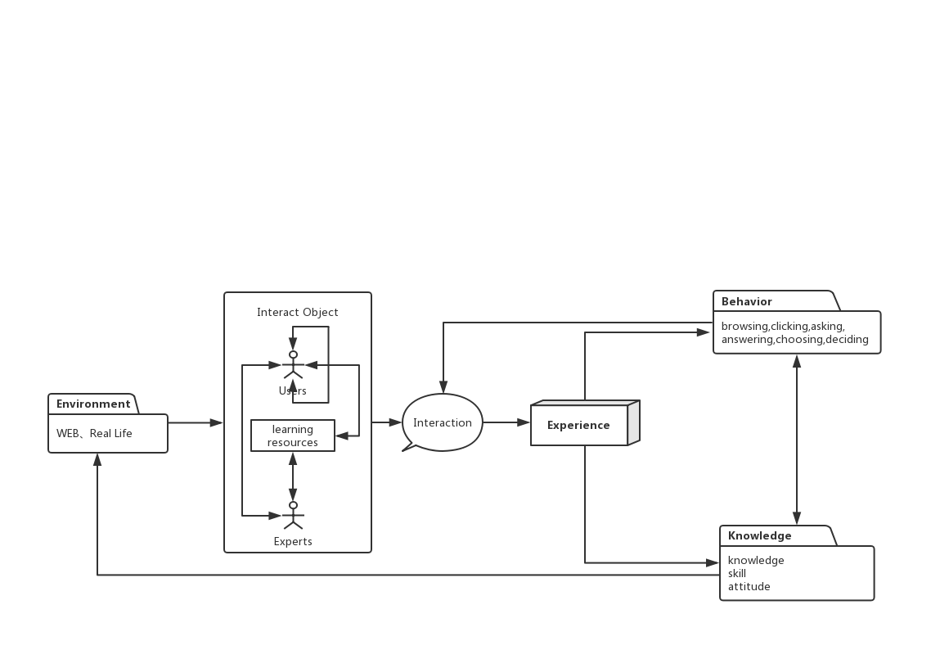
The Framework of our platform
Follow the principle”KIEBIE”.

Slide 18
THANK
YOU

