Slide 1
LAN Technologies
LAN TECHNOLOGIES

Slide 2
Technology Options
LAN Technologies
Ethernet
Fast Ethernet
Gigabit Ethernet
10 Gig Ethernet
WLAN

Slide 3
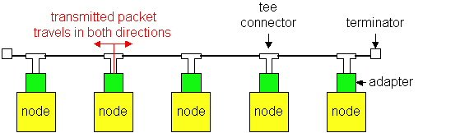
Media Access
LAN Technologies
Ethernet and Wi-Fi are both “multi-access” technologies
  Broadcast medium, shared by many hosts
  Simultaneous transmissions will result in collisions
Media Access Control (MAC) protocol required
  Rules on how to share medium
The Data Link Layer is divided into two Part MAC Media Access Control) Sublayer and LLC (Logic Link Control) Sublayer

Slide 4
802.3 Ethernet
LAN Technologies
Carrier-sense multiple access with collision detection (CSMA/CD).
  CS = carrier sense
  MA = multiple access
  CD = collision detection
Base Ethernet standard is 10 Mbps.
  100Mbps, 1Gbps, 10Gbps standards came later

Slide 5
Ethernet CSMA/CD
LAN Technologies
CSMA/CD (carrier sense multiple access with collision detection) media access protocol is used.
    Data is transmitted in the form of packets.
    Sense channel prior to actual packet transmission.
    Transmit packet only if channel is sensed idle; else, defer the transmission until channel becomes idle.
    After packet transmission is started, the node monitors its own transmission to see if the packet has experienced a collision.
    If the packet is observed to be undergoing a collision, the transmission is aborted and the packet is retransmitted after a random interval of time using Binary Exponential Backoff algorithm.

Slide 6
Ethernet Address
LAN Technologies
End nodes are identified by their Ethernet Addresses (MAC Address or Hardware Address) which is a unique 6 Byte address.
MAC Address is represented in Hexa Decimal format e.g 00:05:5D:FE:10:0A
The first 3 bytes identify a vendor (also called prefix) and the last 3 bytes are unique for every host or device

Slide 7

Ethernet Frame Structure
LAN Technologies
Preamble:
  7 bytes with pattern 10101010 followed by one byte with pattern 10101011
  Used to synchronize receiver, sender clock rates
Addresses: 6 bytes, frame is received by all adapters on a LAN and dropped if address does not match
Length: 2 bytes, length of Data field
CRC: 4 bytes generated using CR-32, checked at receiver, if error is detected, the frame is simply dropped
Data Payload: Maximum 1500 bytes, minimum 46 bytes
  If data is less than 46 bytes, pad with zeros to 46 bytes
Length

Slide 8
Ethernet
LAN Technologies
10 Base 5 (Thicknet) (Bus Topology)
10 Base 2 (Thinnet) (Bus Topology)
10 Base T (UTP) (Star/Tree Topology)
10 Base FL (Fiber) (Star/Tree Topology)

Slide 9
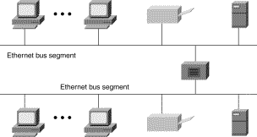
Ethernet BUS Topology
LAN Technologies
Repeater

Slide 10
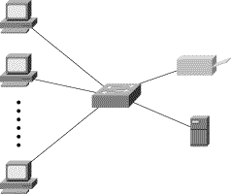
Ethernet STAR Topology
LAN Technologies
Hub

Slide 11
Ethernet
LAN Technologies
Physical Media :-
  10 Base5 - Thick Co-axial Cable with Bus Topology
  10 Base2 - Thin Co-axial Cable with Bus Topology
  10 BaseT - UTP Cat 3/5 with Tree Topology
  10 BaseFL - Multimode/Singlemode Fiber with Tree
  Topology
Maximum Segment Length
  10 Base5 - 500 m with at most 4 repeaters (Use Bridge to extend
  the network)
  10 Base2 - 185 m with at most 4 repeaters (Use Bridge to extend
  the network)
  10 BaseT - 100 m with at most 4 hubs (Use Switch to extend the
  network)

Slide 12
Fast Ethernet
LAN Technologies
100 Mbps bandwidth
Uses same CSMA/CD media access protocol and packet format as in Ethernet.
100BaseTX (UTP) and 100BaseFX (Fiber) standards
Physical media :-
    100 BaseTX - UTP Cat 5e
    100 BaseFX - Multimode / Singlemode Fiber
Full Duplex/Half Duplex operations.

Slide 13
Fast Ethernet
LAN Technologies
Provision for Auto-Negotiation of media speed:
10 Mbps or 100Mbps (popularly available for copper media only).
Maximum Segment Length
    100 Base TX - 100 m
    100 Base FX - 2 Km (Multimode Fiber)
    100 Base FX - 20 km (Singlemode Fiber)

Slide 14
Gigabit Ethernet
LAN Technologies
1 Gbps bandwidth.
Uses same CSMA/CD media access protocol as in Ethernet and is backward compatible (10/100/100 modules are available).
1000BaseT (UTP), 1000BaseSX (Multimode Fiber) and 1000BaseLX (Multimode/Singlemode Fiber) standards.
Maximum Segment Length
    1000 Base T - 100m (Cat 5e/6)
    1000 Base SX - 275 m (Multimode Fiber)
    1000 Base LX - 512 m (Multimode Fiber)
    1000 Base LX - 20 Km (Singlemode Fiber)
    1000 Base LH - 80 Km (Singlemode Fiber)

Slide 15
10 Gig Ethernet
LAN Technologies
10 Gbps bandwidth.
Uses same CSMA/CD media access protocol as in Ethernet.
Propositioned for Metro-Ethernet
Maximum Segment Length
    1000 Base-T - Not available
    10GBase-LR - 10 Km (Singlemode Fiber)
    10GBase-ER - 40 Km (Singlemode Fiber)

