Slide 1
Token Ring and
FDDI
Networks: Token Ring and FDDI

Slide 2
Networks: Token Ring and FDDI

Slide 3
IEEE 802.5 and Token Ring
Proposed in 1969 and initially referred to as a Newhall ring.
Token ring :: a number of stations connected by transmission links in a ring topology. Information flows in one direction along the ring from source to destination and back to source.
Medium access control is provided by a small frame, the token, that circulates around the ring when all stations are idle. Only the station possessing the token is allowed to transmit at any given time.
Networks: Token Ring and FDDI

Slide 4
Token Ring Operation
When a station wishes to transmit, it must wait for token to pass by and seize the token.
  One approach: change one bit in token which transforms it into a “start-of-frame sequence” and appends frame for transmission.
  Second approach: station claims token by removing it from the ring.
Frame circles the ring and is removed by the transmitting station.
Each station interrogates passing frame, if destined for station, it copies the frame into local buffer. {Normally, there is a one bit delay as the frame passes through a station.}
Networks: Token Ring and FDDI

Slide 5
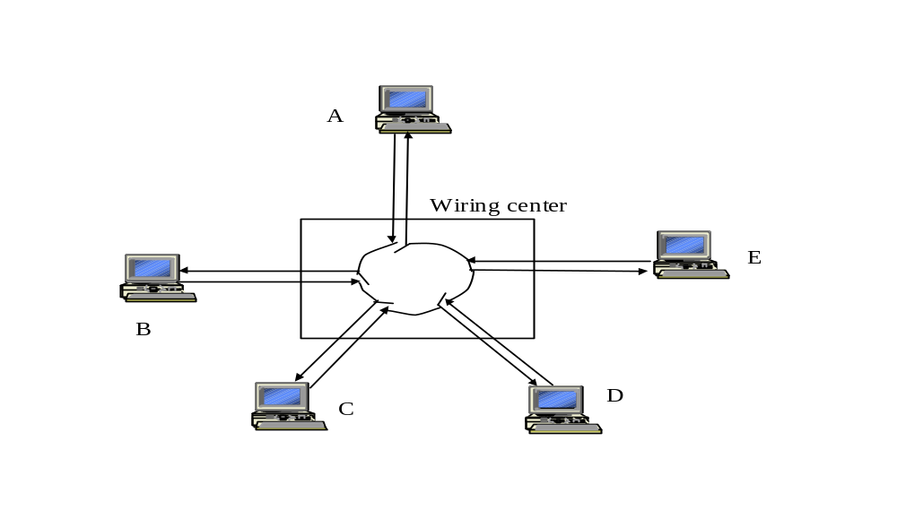
Token Ring Network
with star topology
Copyright ©2000 The McGraw Hill Companies
Leon-Garcia & Widjaja: Communication Networks
Figure 6.58
Networks: Token Ring and FDDI

Slide 6
Re-inserting token on the ring
Choices:
After station has completed transmission of the frame.
After leading edge of transmitted frame has returned to the sending station
The essential issue is whether more than one frame is allowed on the ring at the same time.
Networks: Token Ring and FDDI

Slide 7
(a) Low Latency Ring
A
A
A
A
t=0, A begins frame
t=90, return
of first bit
t=400, transmit
last bit
t=490, reinsert
token
(b) High Latency Ring
A
A
A
A
t=0, A begins frame
t=400, last bit of frame enters ring
t=840, return of first bit
t=1240, reinsert
token
Networks: Token Ring and FDDI
Copyright ©2000 The McGraw Hill Companies
Leon-Garcia & Widjaja: Communication Networks
Figure 6.59

Slide 8
(a) Low Latency Ring
A
A
A
A
t=0, A begins frame
t=90, return
of first bit
t=210, return of header
t=400, last bit enters ring, reinsert token
(b) High Latency Ring
A
A
A
A
t=0, A begins frame
t=400, transmit
last bit
t=840, arrival
first frame bit
t=960, reinsert
token
Networks: Token Ring and FDDI
Copyright ©2000 The McGraw Hill Companies
Leon-Garcia & Widjaja: Communication Networks
Figure 6.60

Slide 9
IEEE 802.5 Token Ring
4 and 16 Mbps using twisted-pair cabling with differential Manchester line encoding.
Maximum number of stations is 250.
Waits for last byte of frame to arrive before reinserting token on ring {new token after received}.
8 priority levels provided via two 3-bit fields (priority and reservation) in data and token frames.
Permits 16-bit and 48-bit addresses (same as 802.3).
Networks: Token Ring and FDDI

Slide 10
Networks: Token Ring and FDDI

Slide 11
Token Ring
Under light load – delay is added due to waiting for the token.
Under heavy load – ring is “round-robin”
The ring must be long enough to hold the complete token.
Advantages – fair access
Disadvantages – ring is single point of failure, added issues due to token maintenance.
Networks: Token Ring and FDDI

Slide 12
Token Maintenance Issues
What can go wrong?
Loss of token (no token circulating)
Duplication of token (forgeries or mistakes)
The need to designate one station as the active ring monitor.
Persistently circulating frame
Deal with active monitor going down.
Networks: Token Ring and FDDI

Slide 13
IEEE 802.5 Token and data frame structure
Token Frame Format
SD
AC
ED
Data Frame Format
1
1
1
2 or 6
2 or 6
4
1
1
SD
AC
Destination
Address
Source
Address
Information
FS
FC
FCS
ED
Starting
delimiter
J K 0 J K 0
0
0
J, K non-data symbols (line code)
Access
control
PPP Priority; T Token bit
M Monitor bit; RRR Reservation
P P P
T
M
R R R
Frame
control
FF frame type
ZZZZZZ control bit
F F
Z Z Z Z Z Z
Ending
delimiter
J K 1 J K 1
I intermediate-frame bit
E error-detection bit
I
E
A address-recognized bit
xx undefined
C frame-copied bit
Frame
status
A
C
x x
A
C
x x
Networks: Token Ring and FDDI
Copyright ©2000 The McGraw Hill Companies
Leon-Garcia & Widjaja: Communication Networks
Figure 6.61

Slide 14
Fiber Distributed Data Interface (FDDI)
FDDI uses a ring topology of multimode or single mode optical fiber transmission links operating at 100 Mbps to span up to 200 kms and permits up to 500 stations.
Employs dual counter-rotating rings.
16 and 48-bit addresses are allowed.
In FDDI, token is absorbed by station and released as soon as it completes the frame transmission {release after transmission}.
Networks: Token Ring and FDDI

Slide 15
FDDI Token Ring
A
E
B
C
D
Networks: Token Ring and FDDI
Copyright ©2000 The McGraw Hill Companies
Leon-Garcia & Widjaja: Communication Networks
Figure 6.62

Slide 16
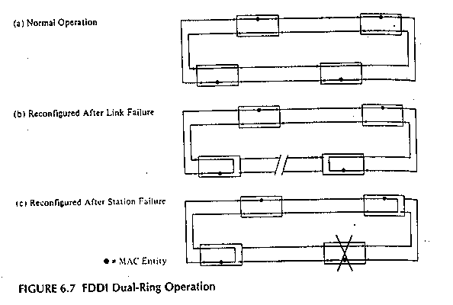
FDDI Repair
Networks: Token Ring and FDDI

Slide 17
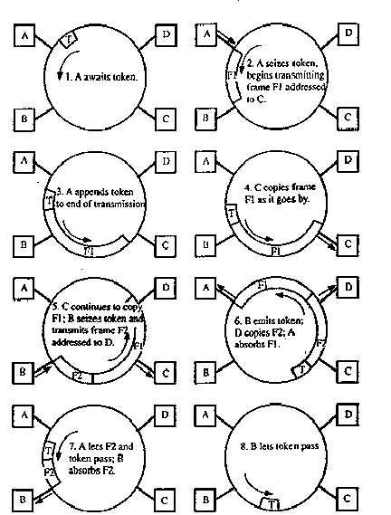
FDDI Ring
Operation
Networks: Token Ring and FDDI

Slide 18
FDDI
To accommodate a mixture of stream and bursty traffic, FDDI is designed to handle two types of traffic:
  Synchronous frames that typically have tighter delay requirements (e.g., voice and video)
  Asynchronous frames have greater delay tolerances (e.g., data traffic)
FDDI uses TTRT (Target Token Rotation Time) to ensure that token rotation time is less than some value.
Networks: Token Ring and FDDI

Slide 19
FDDI Data Encoding
Cannot use differential Manchester because 100 Mbps FDDI would require 200 Mbaud!
Instead each ring interface has its own local clock.
  Outgoing data is transmitted using this clock.
  Incoming data is received using a clock that is frequency and phase locked to the transitions in the incoming bit stream.
Networks: Token Ring and FDDI

Slide 20
FDDI Data Encoding
Data is encoded using a 4B/5B encoder.
  For each four bits of data transmitted, a corresponding 5-bit codeword is generated by the encoder.
  There is a maximum of two consecutive zero bits in each symbol.
The symbols are then shifted out through a NRZI encoder which produces a signal transition whenever a 1 bit is being transmitted and no transition when a 0 bit is transmitted ➔ guarantees a signal transition at least every two bits.
Local clock is 125MHz. This yields 100 Mbps (80% due to 4B/5B).
Networks: Token Ring and FDDI

Slide 21
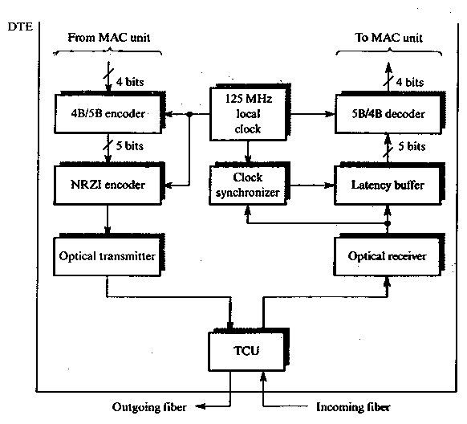
FDDI
Networks: Token Ring and FDDI

Slide 22
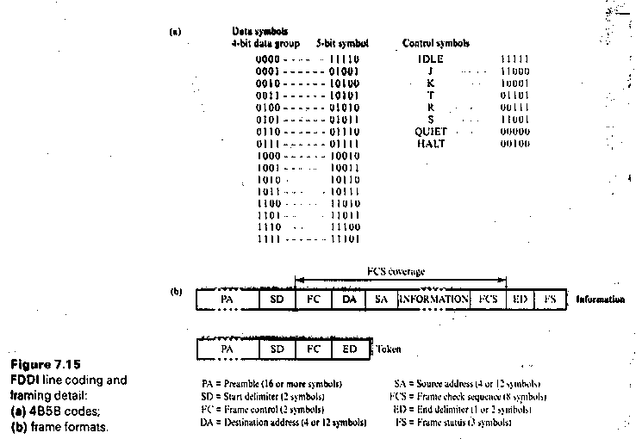
Networks: Token Ring and FDDI

Slide 23
FDDI frame structure
Token Frame Format
PRE
SD
FC
ED
Data Frame Format
8
1
1
2 or 6
2 or 6
4
1
1
PRE
SD
FC
Destination
Address
Source
Address
Information
FCS
ED
FS
Preamble
Frame
Control
CLFFZZZZ C = Synch/Asynch
L = Address length (16 or 48 bits)
FF = LLC/MAC control/reserved frame type
Leon-Garcia & Widjaja: Communication Networks
Figure 6.63
Networks: Token Ring and FDDI

Slide 24
More FDDI Details
Transmission on optical fiber requires ASK
The simplest case: coding is done via the absence or presence of a carrier signal {Intensity Modulation}
Specific 5-bit codeword patterns chosen to guarantee no more than three zeroes in a row to provide for adequate synchronization.
1300 nm wavelength specified
Dual rings (primary and secondary) –transmit in opposite directions
Normally, second ring is idle and used for redundancy for automatic repair (self-healing).
Networks: Token Ring and FDDI

Slide 25
Differences between 802.5 and FDDI
Token Ring
Shielded twisted pair
4, 16 Mbps
No reliability specified
Differential Manchester
Centralized clock
Priority and Reservation bits
New token after receive
FDDI
Optical Fiber
100 Mbps
Reliability specified (dual ring)
4B/5B encoding
Distributed clocking
Timed Token Rotation Time
New token after transmit
Networks: Token Ring and FDDI

