Slide 1



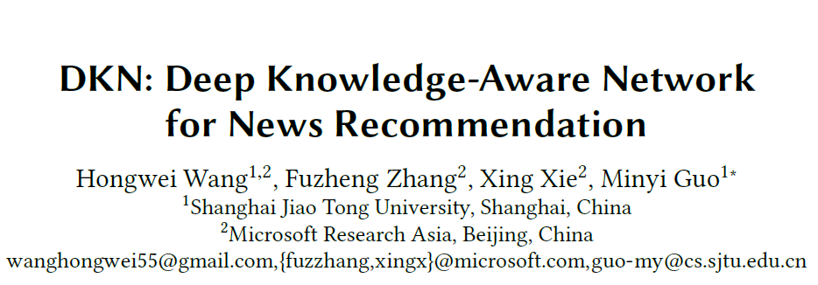
霍沛

Slide 2

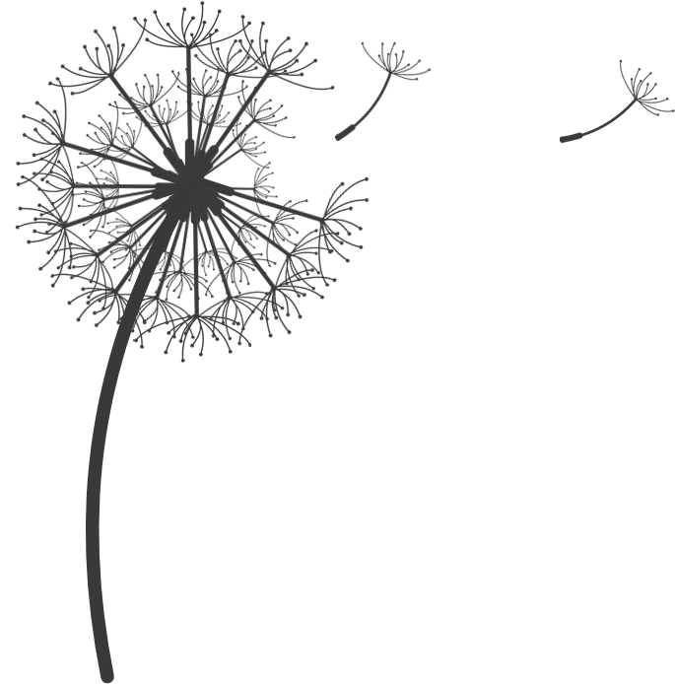
Content
Intention and background
Basic knowledge introduction
Model architecture
Experiments and results
Conclusion

Slide 3
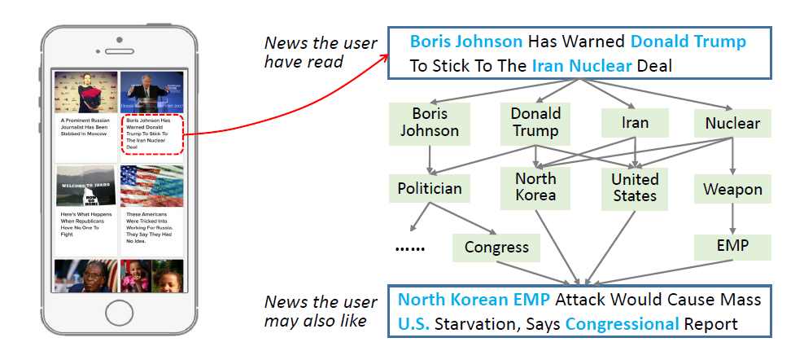
Intention and background
Goal：Explosion of news and make personalized recommendation
Major challenges:
Highly time-sensitive
Topic-sensitive and Multi-interested user
Highly condensed and comprised of a large amount of knowledge entities and common sense.

Slide 4

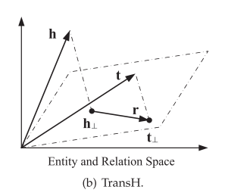

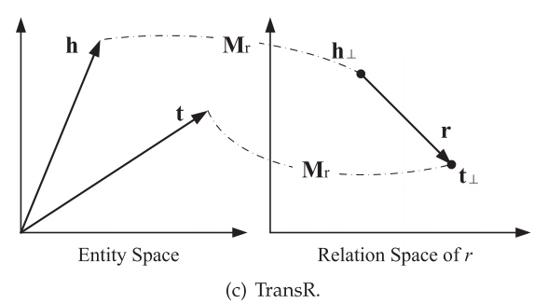


Basic knowledge introduction
Knowledge Graph Embedding
表示图中的实体和关系
定义一个打分函数(scoring function)
学习实体和关系的向量表示
• TransE
score：
• TransH
hyperplanes
• TransR
Entity space
Each relation

Slide 5
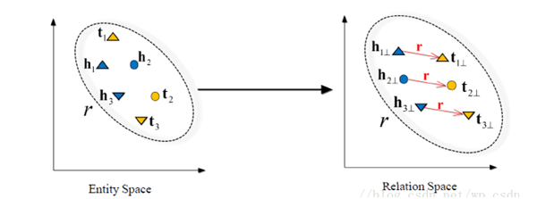





• TransD
损失函数：

Slide 6

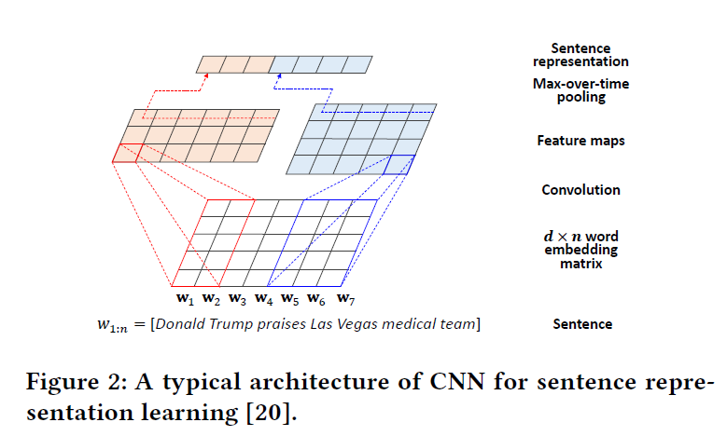




CNN for Sentence Representation Learning
a sentence of length n
convolution operation with filter
max-over-time pooling operation

Slide 7

Problem Formulation
user i
click history:
aim to predict whether user i will click a candidate news tj that he has not seen before

Slide 8
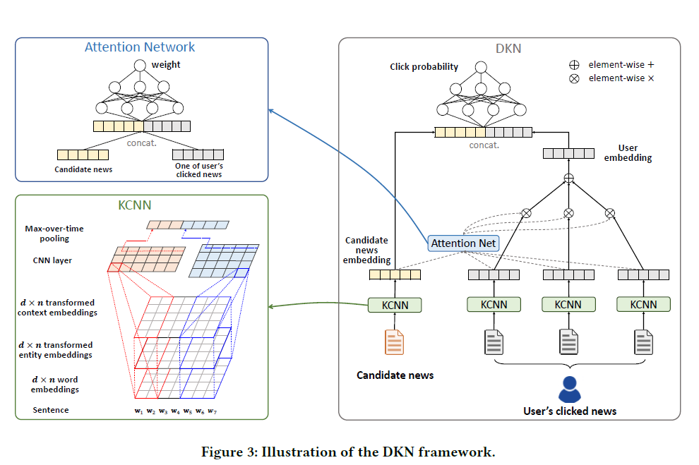
DKN Framework

Slide 9
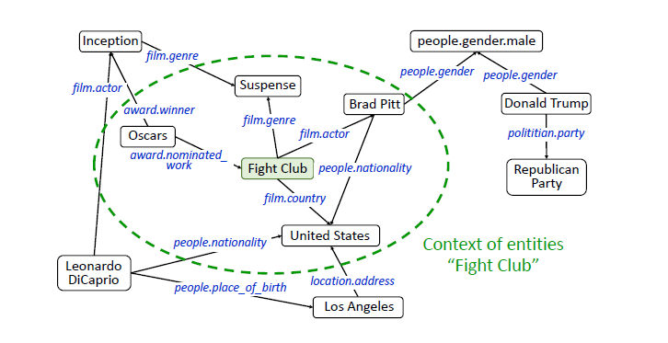

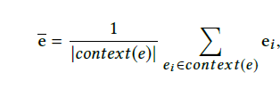
Knowledge Distillation
By the technique of entity linking to identify entities
Construct a sub-graph
Knowledge graph embedding
additional contextual information for each entity

Slide 10
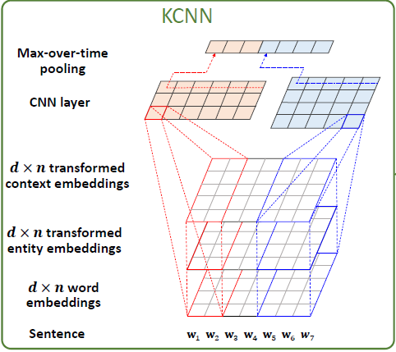








Knowledge-aware CNN
a news title t of length n
knowledge distillation
Simply method
multi-channel method
fed into CNN
g is the transformation function
multi-channel input W :

Slide 11
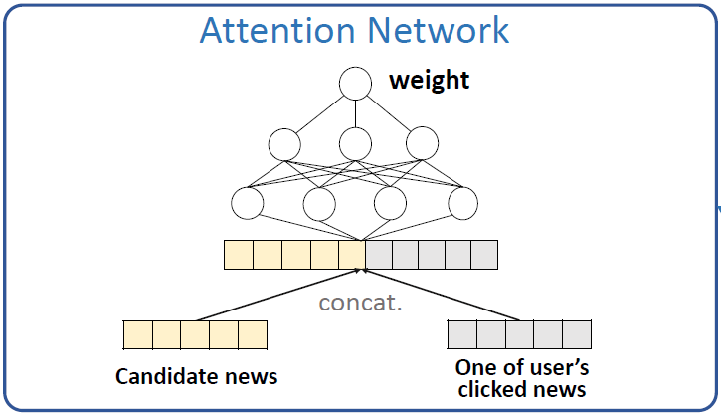




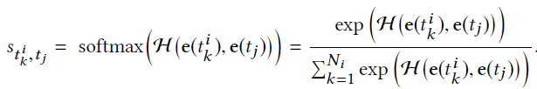

Attention-based User Interest Extraction
user i with clicked history
KCNN
Simply method
Attention network
the candidate news t j
apply a DNN

Slide 12
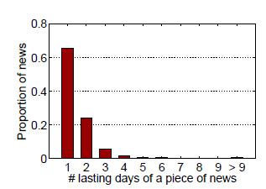
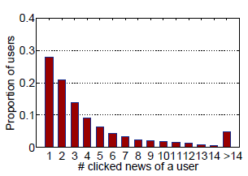
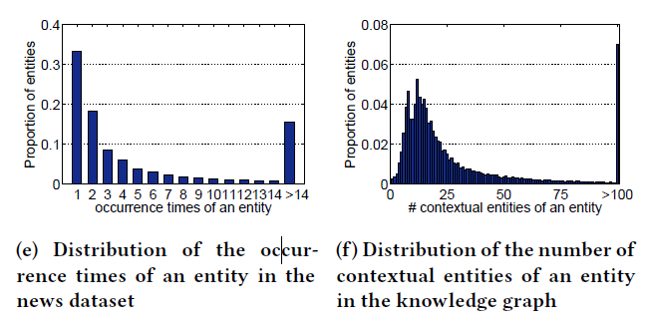
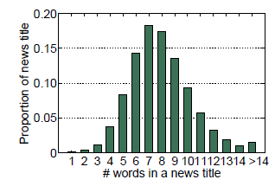
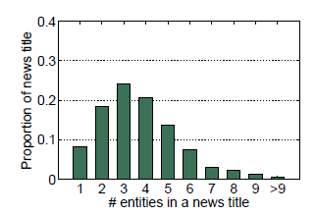
Experiments and results
Dataset:
Bing News Microsoft Satori knowledge graph

Slide 13
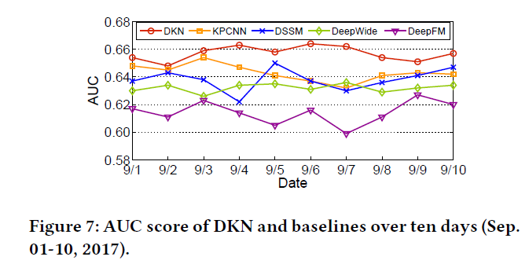
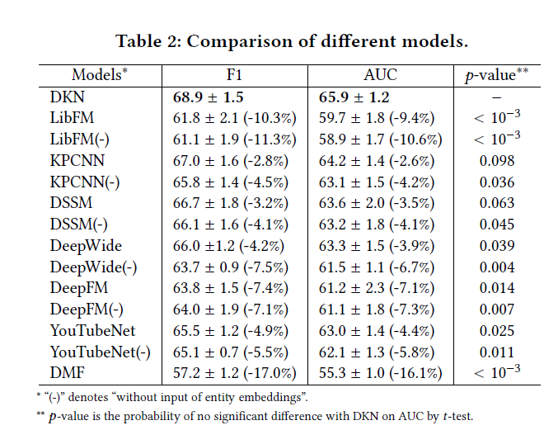
Result:

Slide 14
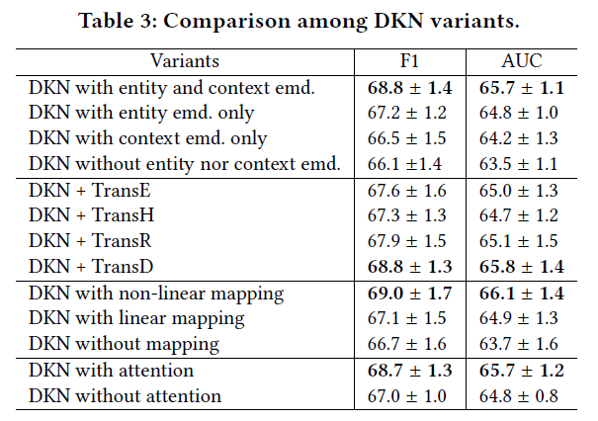

Slide 15
CONCLUSIONS
对于新闻推荐中存在的问题和特点：新闻具有时效性和较多的实体，有针对性地提出了 DKN 模型，解决了三个挑战：
DKN 是一个基于内容过滤的深度推荐系统模型；
为了利用知识图谱中的信息，通过 KCNN 来融合文本的语义层面、实体层面上的异构表示；
使用了注意力机制对用户的兴趣进行动态提取。

Slide 17
THANKS

