Slide 1
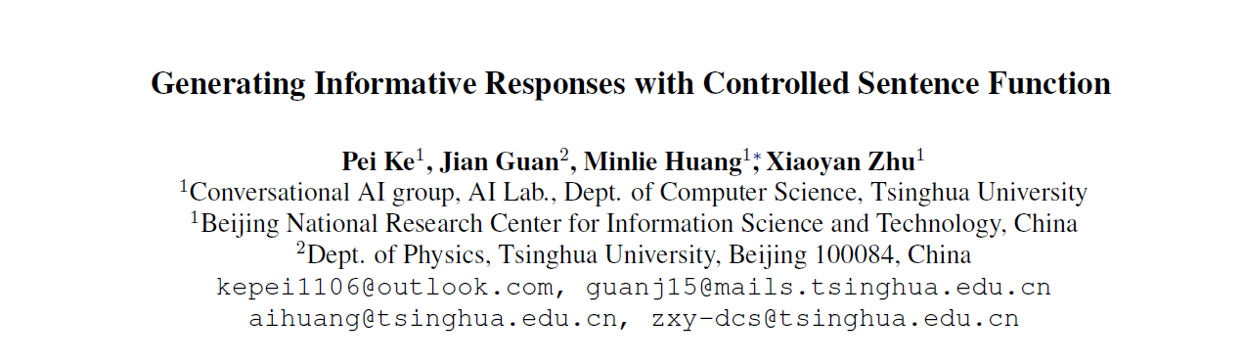

Slide 2
CONTENT
Intention
Model
Experiment

Slide 3
Intention
闲聊对话生成领域，研究如何控制生成回复的全局功能特征，并解决功能控制和内容丰富性的兼容问题。句子功能（Sentence Function）是一种重要的语言学特征，按句子功能可将语言划分为疑问句、陈述句、祈使句等多个类别，该特征在对话中能够体现说话者的目的。模型生成的回复不仅在结构上符合设定的功能类别，而且在内容上具备丰富的信息量。

Slide 4
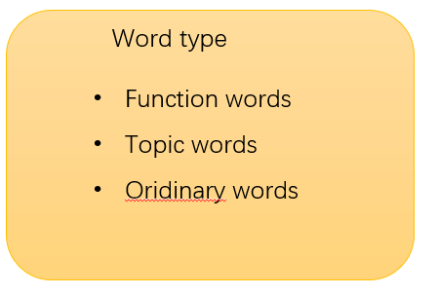
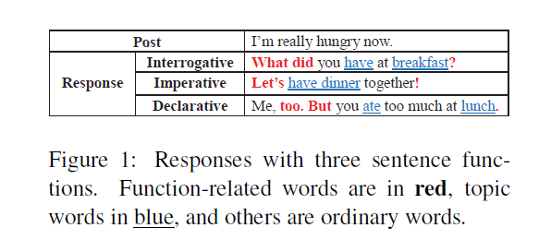
Example:
Goal:
Deal with the global control of sentence function and the compatibility of controlling sentence function and generating informative content.

Slide 5






Model
Input:
A post and sentence function category
Output:
A response
*not only coherent with the specified function category l but also informative in content
Goal is to estimate the conditional probability
indicates
the sampling process of z

Slide 6
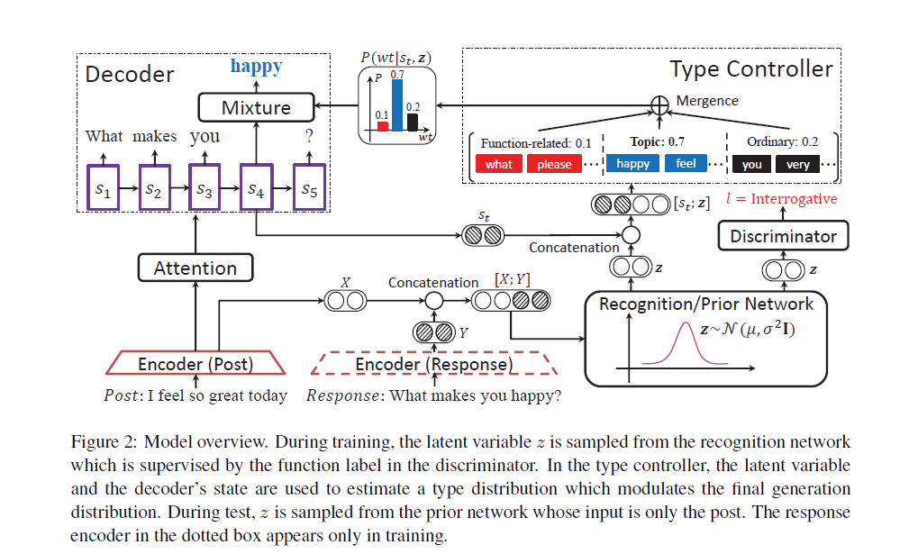
Tips:
encoder-decoder framework
CVAE framework sample a latent variable z from two normal distributions

Slide 7





Encoder-Decoder Framework
Encoder:
Decoder:

Slide 8
CVAE(conditional variational auto-encoder)
条件有向图模型，输入是

Slide 9








Recognition/Prior Network
Training :
Sample z from
recognition network
to approximate the true posterior distribution
假定z服从多变量高斯分布，协方差矩阵是对角矩阵
Testing :
prior network
To bridge the gap between the recognition and the prior networks,

Slide 10


Slide 11

Discriminator
z as input instead of the generated response Y to avoid the vanishing gradient of z,
With supervision signals

Slide 12
Type Controller
type controller estimates a distribution over the word types at each decoding position

Slide 13
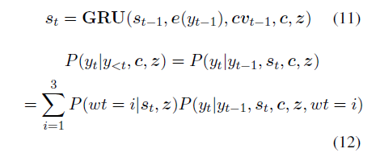

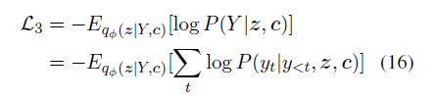
Decoder
gradually increase from 0 to 1.

Slide 14


Topic Word Prediction
relevance score of a topic word to a given post

Slide 15
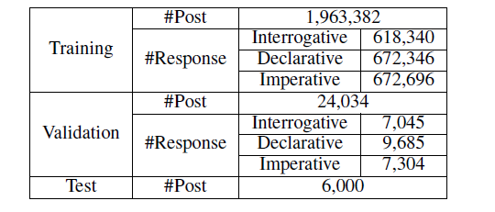
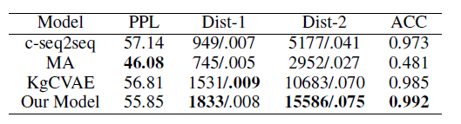
Dataset：
Chinese dialogue dataset from Weibo
10 million post responses pairs
function label for each pair
sampled about 2,000 pairs
the self-attentive classifier
Accuracy 0.78
annotated the data manually
Evaluation：
annotate the large dataset
Automatic Evaluation
Acc：预先指定好的句子功能和模型生成的句子功能

Slide 16
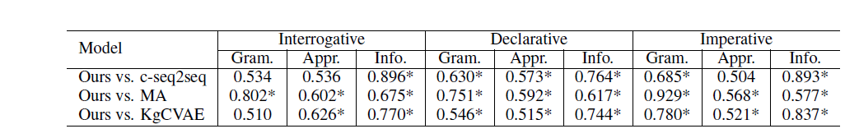
Manual Evaluation
200 posts were randomly sampled from the test set
give a preference (win, lose, or tie) with three baselines
crowdsourcing service for annotation, and each pair-wise comparison was judged by 5 curators
three metrics：
Grammaticality
Appropriateness
Informativeness
Total annotation amounts to 200*3*3*3=5,400

Slide 17
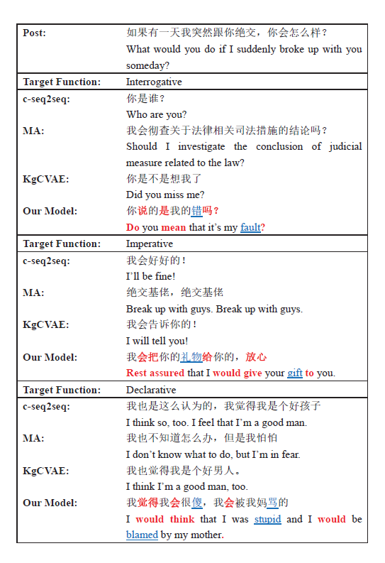
Case Study

