Slide 1
Signed Network Embedding in Social Media
Suhang Wang， Jiliang Tang， Charu Aggarwalz， Yi Chang， Huan Liu
SDM
汇报人：周晓旭
汇报时间：2020年2月26

Slide 2
1
介绍
目录/content
2
SiNE框架
3
实验
4
结论
CONTENT

Slide 3
Part 01
介绍

Slide 4
1、介绍
Network embedding 学习顶点的低维向量表示。
按照模型： matrix factorization, random walk, deep neural networks
and their variations.
按照网络：无符号网络，有符号网络

Slide 5
1、介绍
符号网络 , 指边具有正或负属性的网络, 其中正边和负边分别表示积极和消极的关系。
例如,符号网络中的正边（+）可以表示朋友、信任、喜欢、支持等积极关系。
负边（-）通常用于表示敌人、不信任、讨厌、反对等消极关系。

Slide 6
1、介绍
问题：unsigned network embedding设计的算法能否用在signed network上？
根据有符号网络利用的社会理论homophily 和 social influence：“two linked nodes are likely to be similar and so as their vector representations“，但是符号网络中存在负边，所以不能简单直接用。

Slide 7
Part 02
SiNE框架

Slide 8
2、SiNE框架
结构平衡理论
It is recently extended as: a structure in signed social network should ensure that users should be able to have their“friends"
closer than their “foes“.
i.e., users should sit closer to their “friends" (or users with positive links) than their“foes" (or users with negative links).

Slide 9
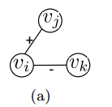
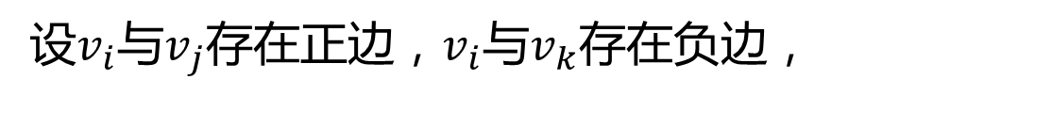


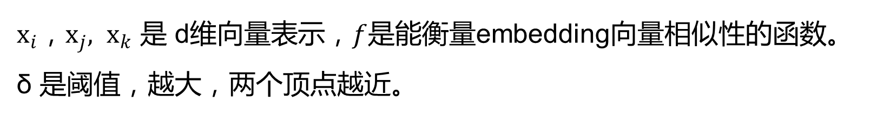
2、SiNE框架
A users should sit closer to their “friends” than their“foes”.

Slide 10
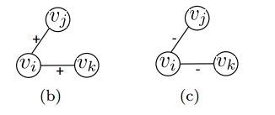
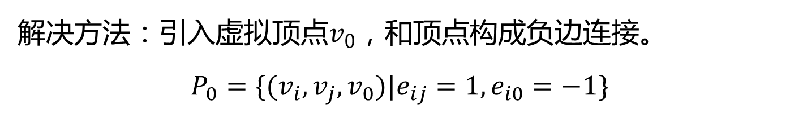
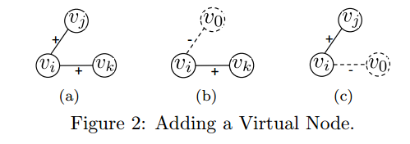

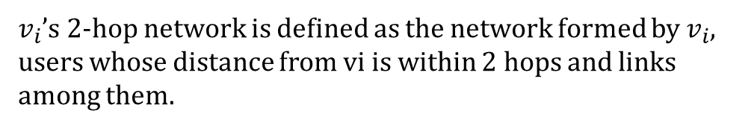
2、SiNE框架
有些顶点的2-hop network，都是正边或者负边。三元集合P 中不包括这些顶点，无法学习它们的向量表示。

Slide 11
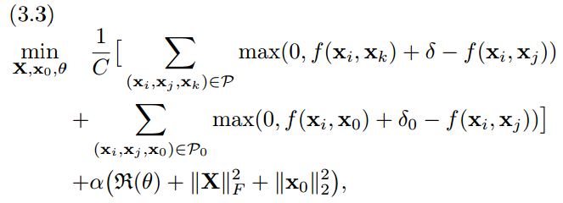
2、SiNE框架
目标函数

Slide 12

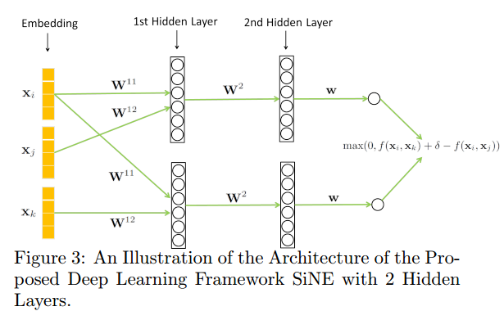

2、SiNE框架
2-layers architecture of SiNE

Slide 13


2、SiNE框架
N-layers architecture of SiNE
第1层
第n层，1 < n < N
第N层

Slide 14
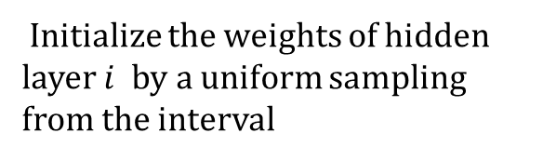

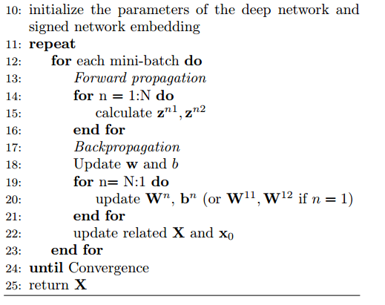
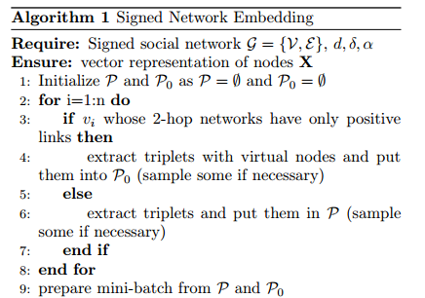
2、SiNE框架
算法

Slide 15
Part 03
实验

Slide 16
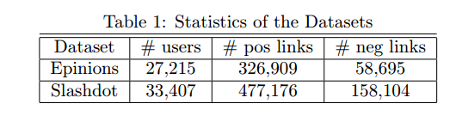
数据集
Epinions
消费者评论网站。 users can create both trust (positive) and distrust (negative) links to other users. Slashdot
信息技术网站。 users can create friend (positive) and foe (negative) links to other users.

Slide 17
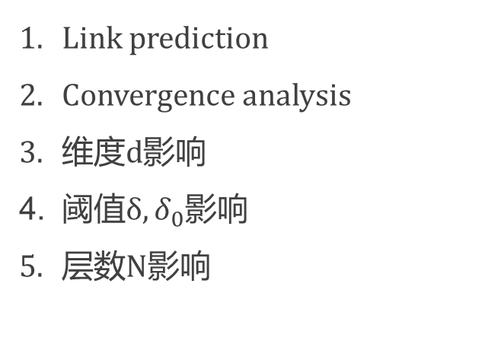
实验
training set ：80% links ---- learn the signed network embedding. test set ：remaining 20%
train a logistic regression classifier on training dataset.
predict link on the test set with the logistic regression classifier.

Slide 18
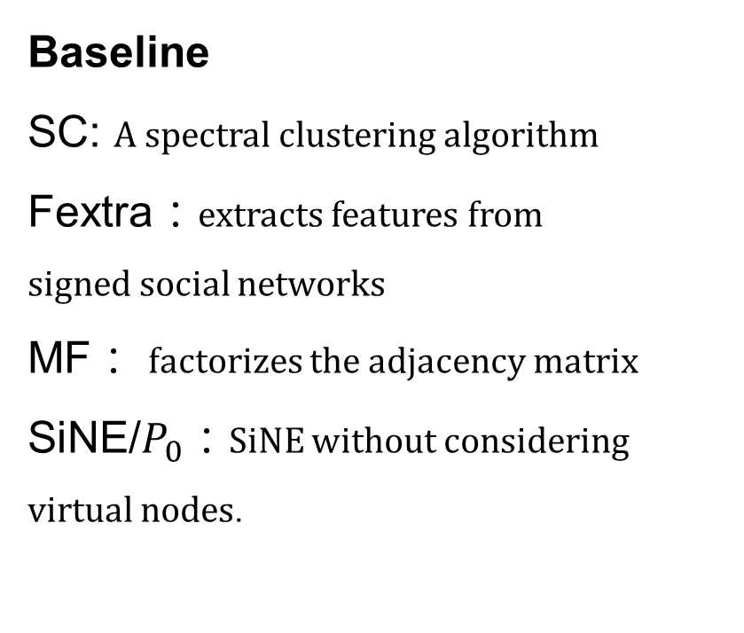
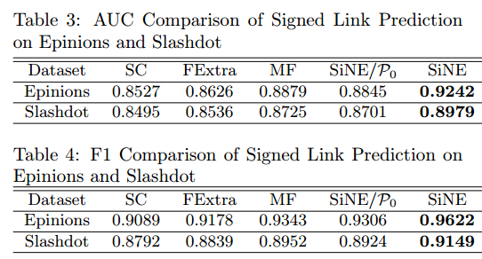
Link prediction

Slide 19
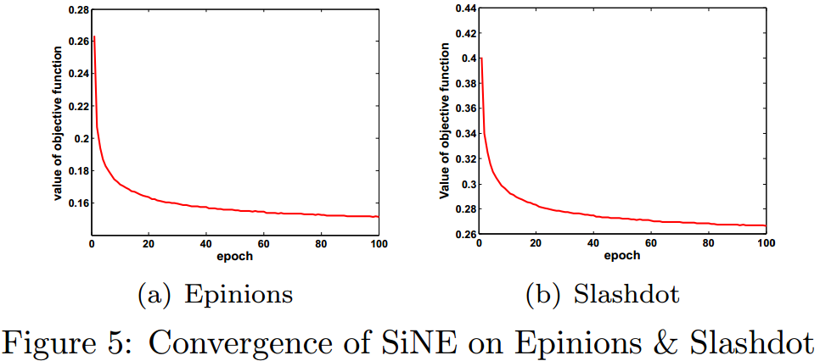
Convergence
前10 轮训练里，目标函数下降快。大约100轮后，模型收敛.

Slide 20
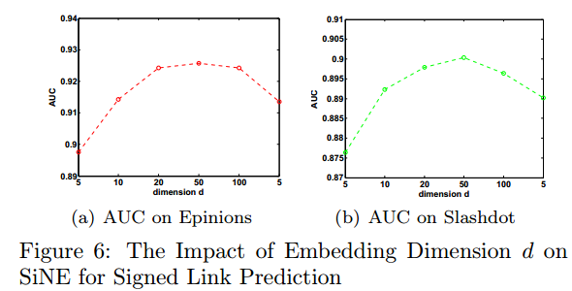
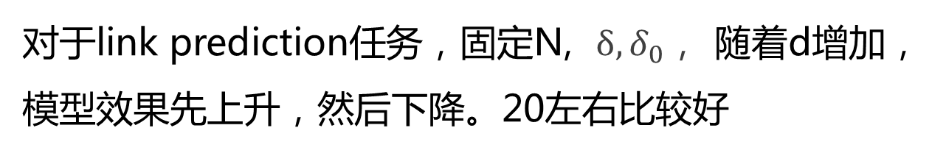
维度d影响

Slide 21
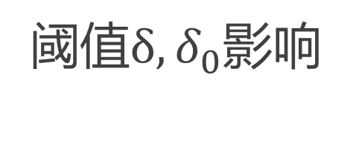
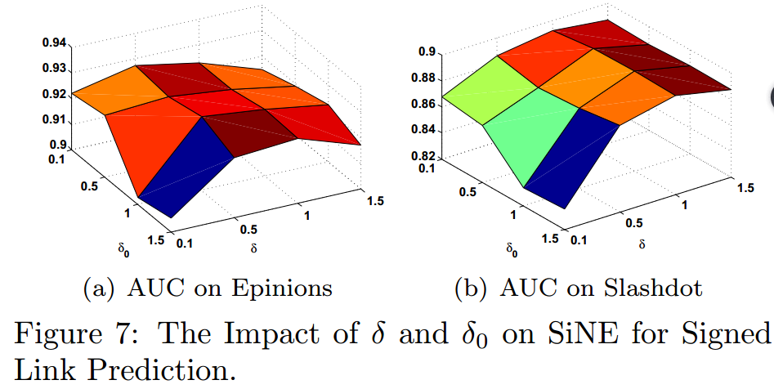
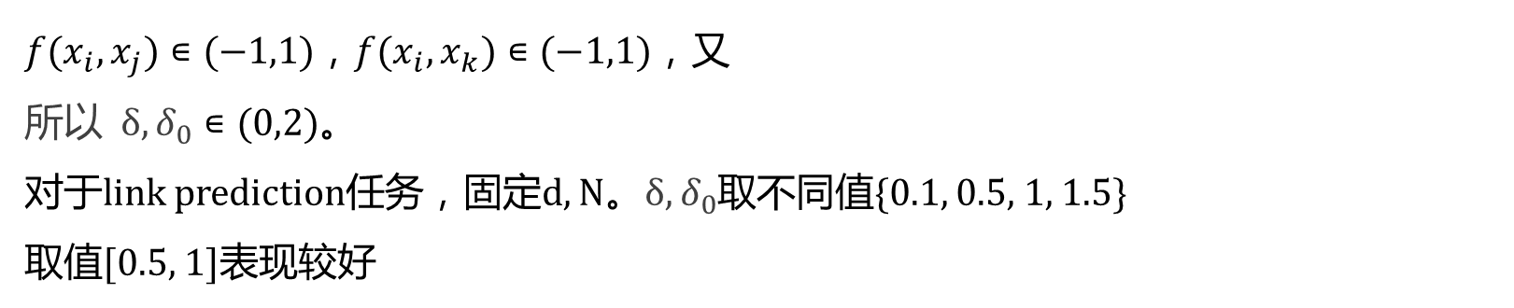


Slide 22
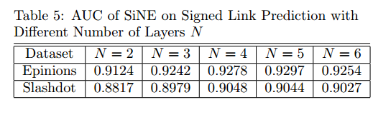
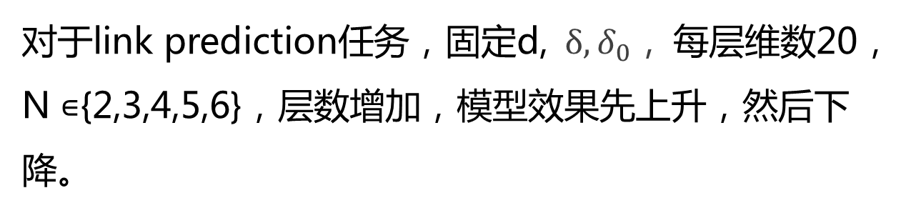
层数N影响

Slide 23
Part 04
结论

Slide 24
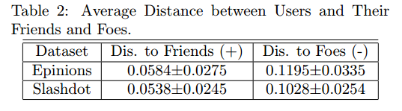
Case study
After embedding, nodes are indeed closer to their friends (positive link) than their foes (negative link), which suggests that the embedding from SiNE can perverse the principle suggested by the extended structural balance theory.

Slide 25
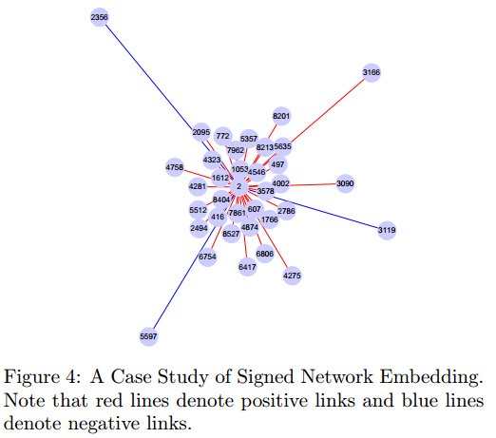
Case study
the length of the line represents the embedding distance of two nodes.
Node 2 is likely to be closer to his/her friends than his/her foes.

Slide 26
结论
Design an objective function for signed social network embedding guided by social theories;
Propose a deep learning framework SiNE for signed network embedding;
Conduct experiments on two signed social networks to demonstrate the effectiveness of SiNE.

Slide 27
THANK YOU
感谢观看

