Slide 1
Recovering Concept Prerequisite Relations from University Course Dependencies
Chen Liang
Jian bo Ye
Zhao hui Wu
Bart Pursel
C. Lee Giles

Slide 2
研究意义
给学生学习提供参考

Slide 3
研究目的
从课程的先后顺序中挖掘出概念之间的先后顺序关系

Slide 4
研究历史
数据集上的变化
从维基百科，到课程表，到教科书，到讲稿，到语料库，到教科书，到MOOC数据（讲过）
挖掘方法
提取特征，当分类问题做
建立模型当优化问题做

Slide 5
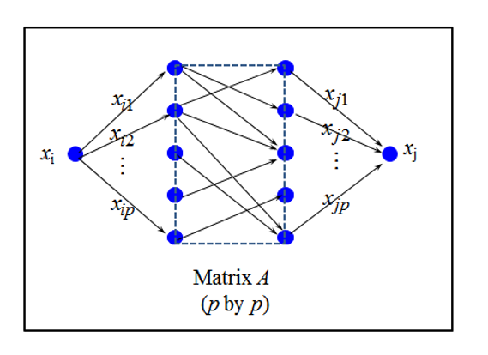

基本想法
将每个课程表示成概念向量，计算一个课程到另一个课程中的加权路径

Slide 6
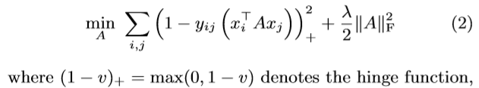
基本想法
将每个课程表示成概念向量，计算一个课程到另一个课程中的加权路径

Slide 7
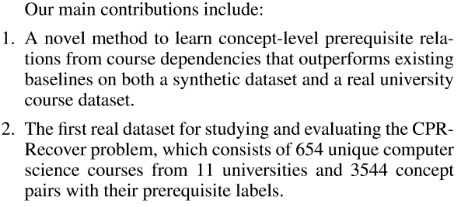

Slide 8
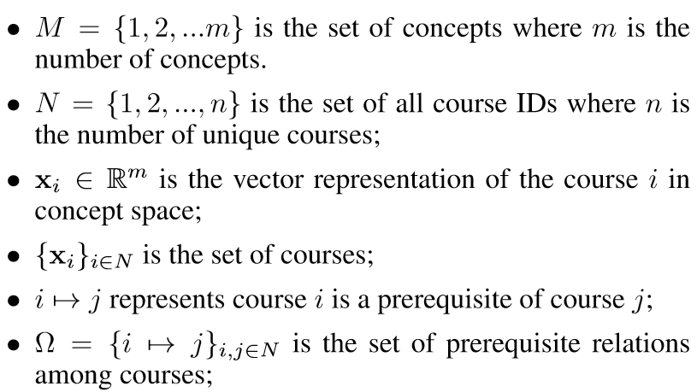
符号说明

Slide 9
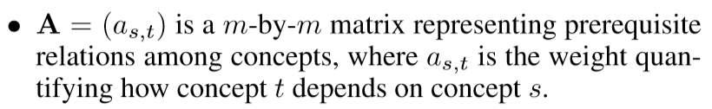
符号说明

Slide 10
两个假设
causality assumption
The former assumes that the prerequisite relation between two courses is caused by sufﬁcient evidence provided by prerequisite relations among concepts which the two courses consist of
sparsity assumption
The latter assumption is that the prerequisite relations in a concept graph are sparse: the number of prerequisite relations is much smaller than the total number of concept pairs.

Slide 11
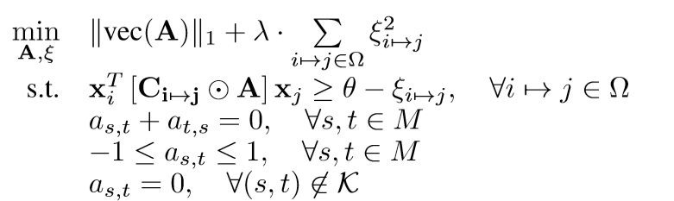






模型

Slide 12

模型
we assume there is no prerequisite relation between two concepts which are not linked.
If concepts occur in both course i and j, we assume they are not the cause of the course dependency

Slide 13

我觉得他还有一个没说的假设
决定两门课程先后顺序的阈值是相近的

Slide 14
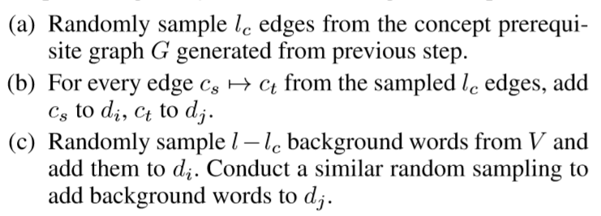
We follow the Erd˝os-R´enyi model to generate the underlying concept prerequisite graph， Then
人造数据

Slide 15
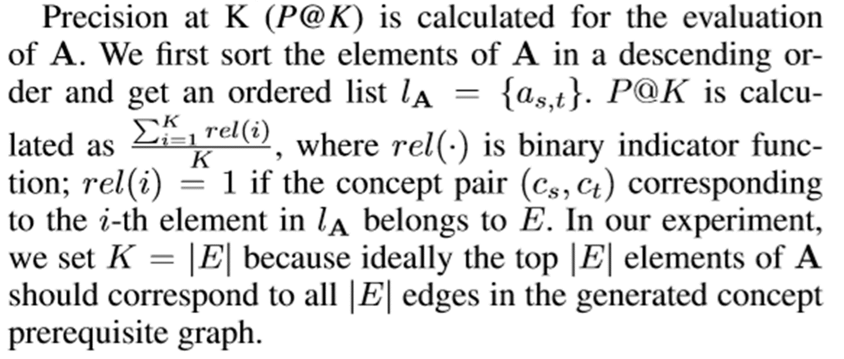
人造数据衡量标准

Slide 16
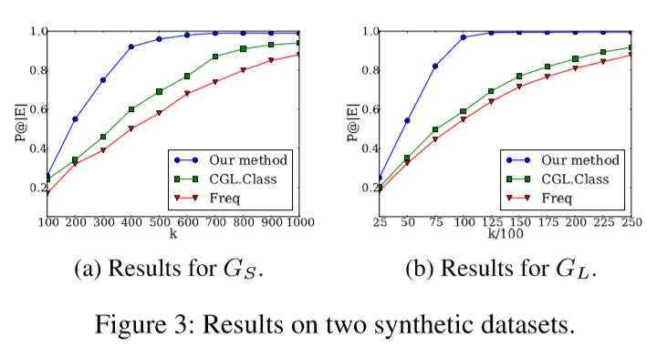
人造数据结果

Slide 17
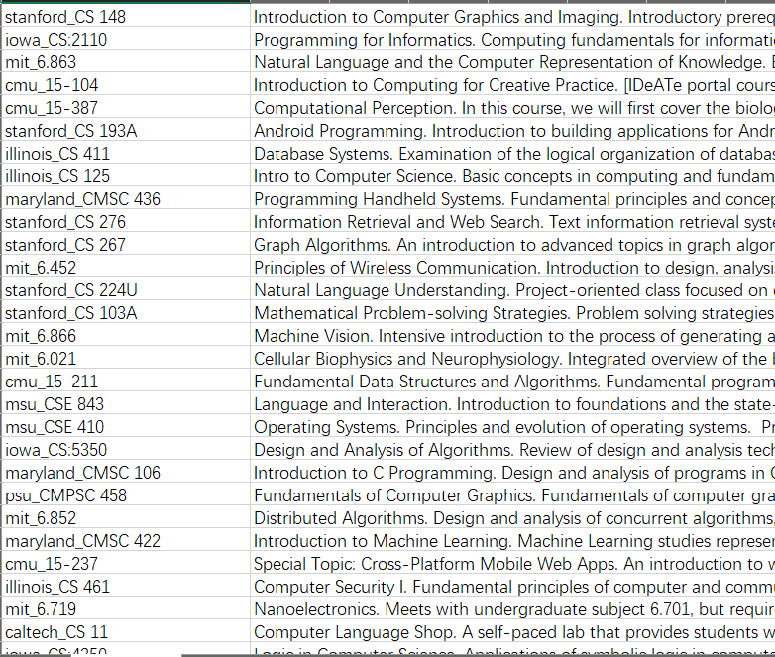
数据集 课程描述

Slide 18
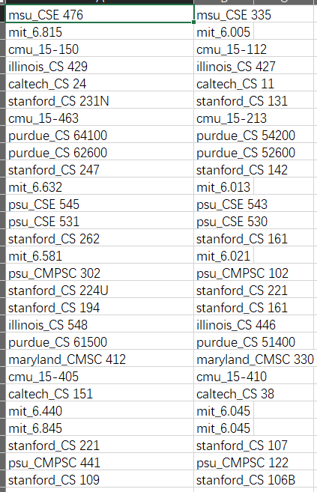
数据集课程先后关系

Slide 19
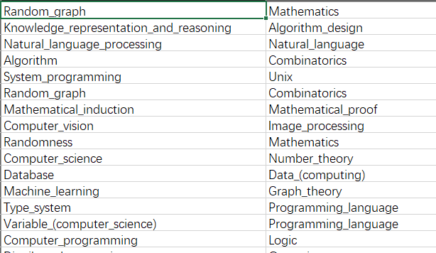
数据集 知识点先后顺序

Slide 20
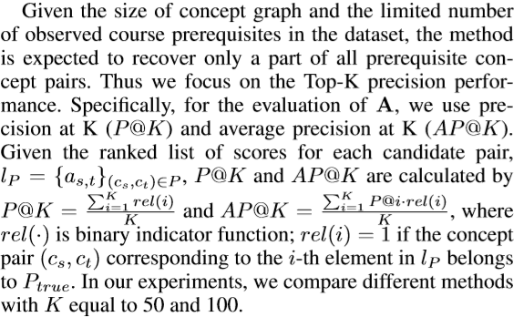
实际数据衡量标准

Slide 21
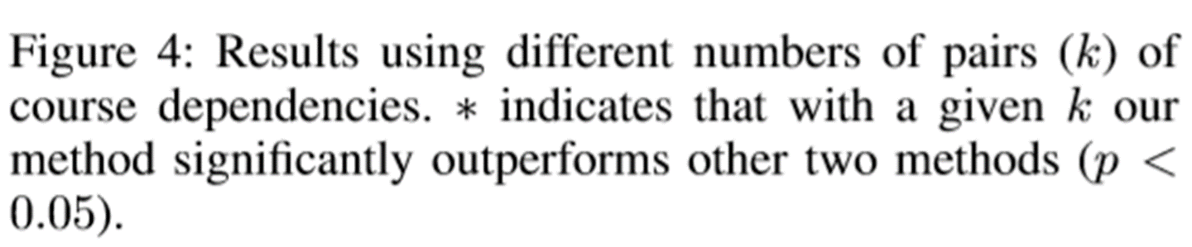
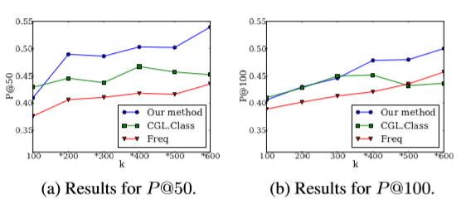
最终结果

Slide 22
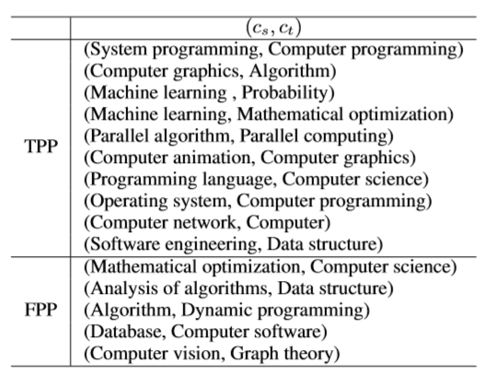
挖掘出的关系对

Slide 23
CASE STUDY
The performance of concept extraction is not that good. For example, the Wikipedia Miner extracts Mathematical optimization from the course description “...basic program analysis and optimization...” rather than ﬁnd the correct concept Program optimization. Program optimization requires Computer science, but Mathematical optimization does not.

Slide 24
CASE STUDY
(ii) A Wikipedia concept can have different levels of interpretation, which will affect the choice for data labeling. For example, both Database and DBMS correspond to the same Wikipedia concept Database. Computer software is a prerequisite for DBMS but not for the general Database.

Slide 25
CASE STUDY
(iii) For our dataset, concept pairs such as (Algorithm, Dynamic programming) and (Analysis of algorithms, Data structure) co-occur many times in course prerequisites. Such pairs are more likely to be recovered by data-driven methods including ours and the compared baselines.

Slide 26
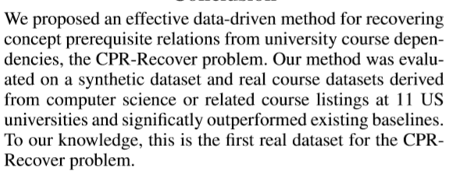
结论

