Slide 1
Prerequisite Relation Learning for
Concepts in MOOCs
Liangmin Pan, Chengjiang Li, Juanzi Li* and Jie Tang
Tsinghua University, Beijing
汇报人： 付英男
汇报时间: 2019.3.1

Slide 2
目录
Contents
1
3
5
Introduction
Method
Conclusions
2
4
Problem Formulation
Experiments

Slide 3
01 Introduction

Slide 4
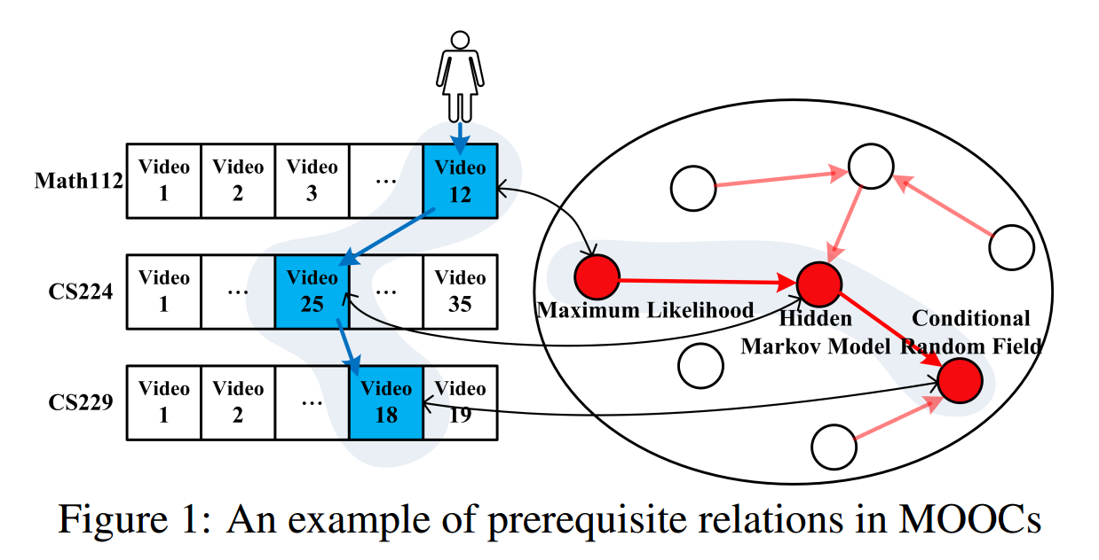
1、Introduction
1. “Mastery learning” [Bloom, 1981]
2. prerequisite relations between knowledge concepts (teachers, teaching assistants)
3. In the era of MOOCs:
· hundreds of thousands of students
· thousands of courses
automatically dig out the prerequisite relationships among knowledge concepts from the large course space

Slide 5
1、Introduction
Difficulties:
1. Many course concepts are not included in Wikipedia. (previous attempts are based on Wiki)
2. MOOCs scenario is much more complicated.
3. User interactions
How to fully leverage the different information to obtain a better performance for inferring prerequisite relations in MOOCs?

Slide 6
1、Introduction
Contributions:
1. The first attempt to detect prerequisite relations among concepts in MOOCs.
2. proposal of a set of noval features.
· semantic feature (feature 1)
· contextual feature (feature2, feature3, feature4)
· structural features (feature5, feature6, feature7)
3. design of three datasets based on real courses of Coursera

Slide 7
02 Problem Formulation

Slide 8
2、Problem Formulation
S(Sentence)
......
V(Teaching Video)
......
C(Course)
D(MOOC corpus)

Slide 9
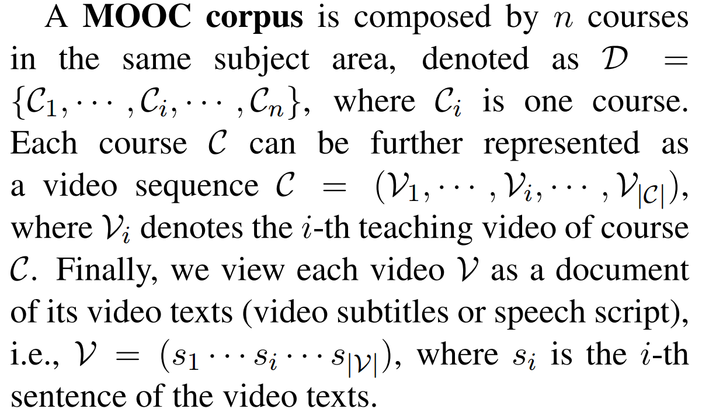
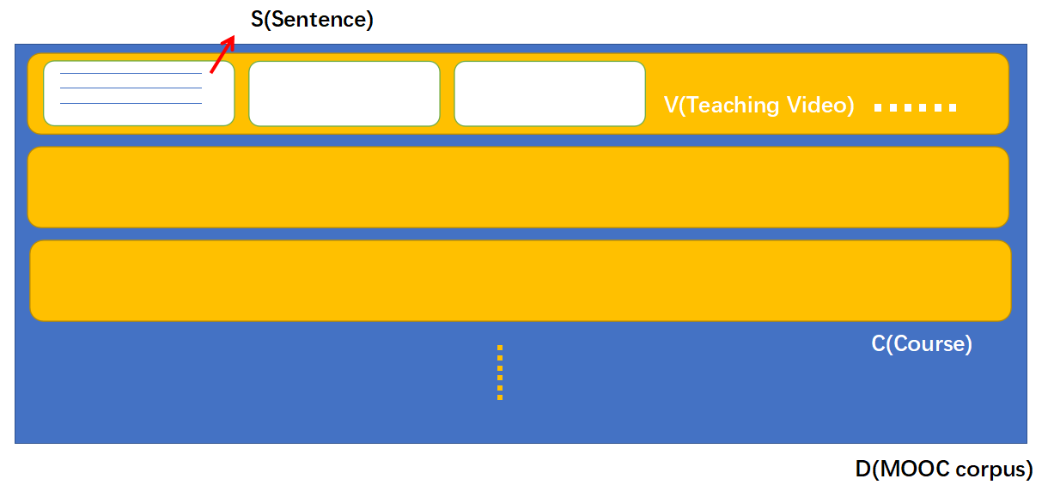
2、Problem Formulation

Slide 10
2、Problem Formulation
C₁
C₂
C₃
C₄
K₁
K₂
K₃
K₄
K

Slide 11
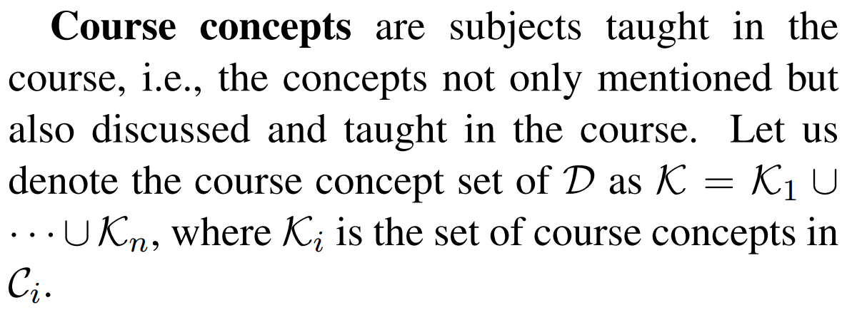
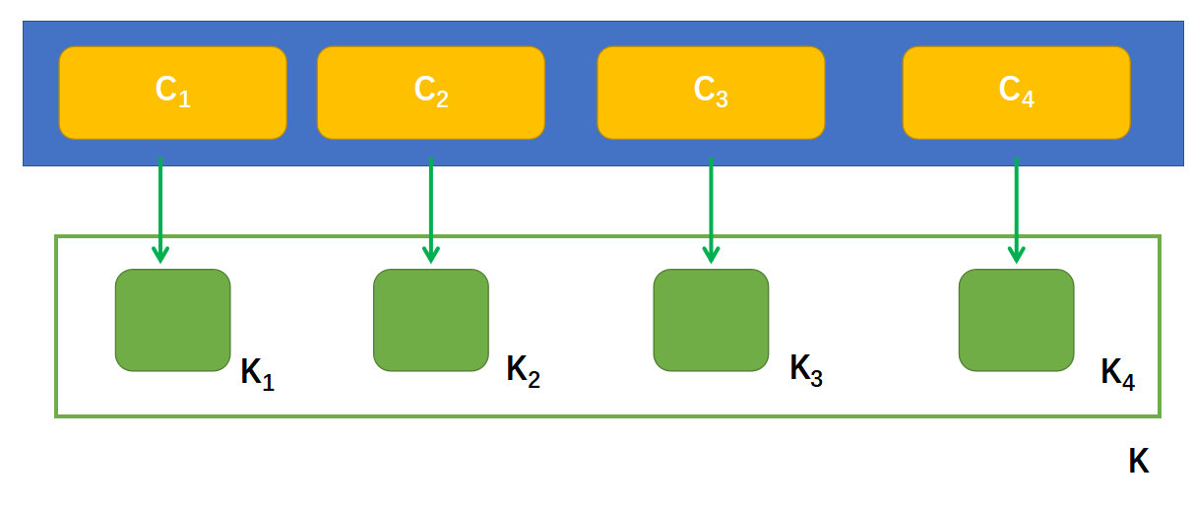
2、Problem Formulation

Slide 12
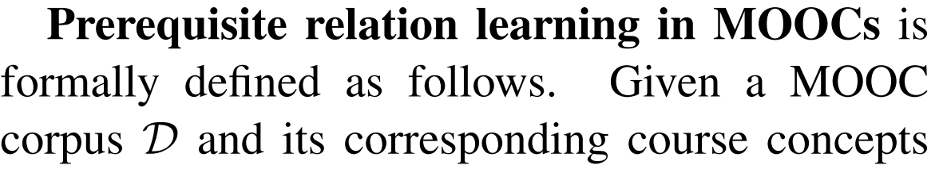
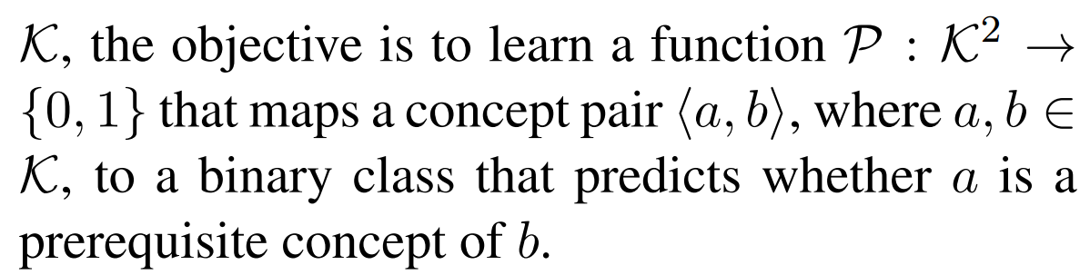
2、Problem Formulation

Slide 13
2、Problem Formulation
concept a
binary classifier
0
?
cencept b
1
a is a prerequisite concepts of b
semantic feature
concept representation
feature
contextual feature
structrual features

Slide 14
03 Method

Slide 15
3.1 Concept Representation & Semantic Relatedness
Concept Representation
we utilize a Wikipedia corpus to learn semantic representations for concepts in K.
Wikipedia corpus W: W = <w₁,w₂,......,w_{m}>
w1, w2, w3, w4, w5, w6, w7, w8, w9, w10
concept1 : w1, w7, w10
concept2 : w2, w3, w4
= v(w1) + v(w7) + v(w10)
= v(w2) + v(w3) + v(w4)

Slide 16
3.1 Concept Representation & Semantic Relatedness
Concept Representation
we utilize a Wikipedia corpus to learn semantic representations for concepts in K.
Wikipedia corpus W: W = <w₁,w₂,......,w_{m}>
w1, w2, w3, w4, w5, w6, w7, w8, w9, w10
Entity Annotation
x1, x2 x3, x4, x5, x6, x7, x8
concept1 : w1, w7, w10
concept2 : w2, w3, w4
= v(x1) + v(x5) + v(x8)
Representation
Learning
= v(x2)

Slide 17
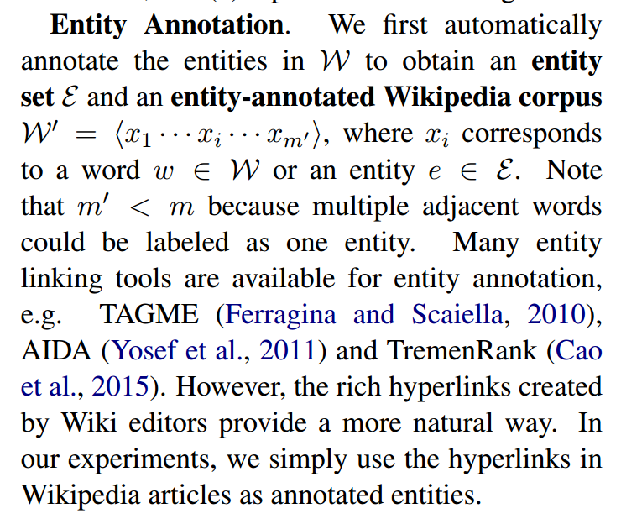
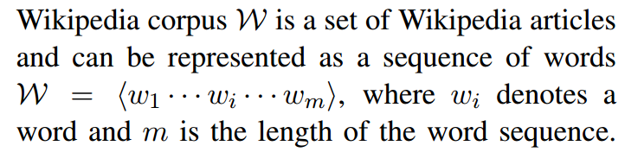
3.1 Concept Representation & Semantic Relatedness
Concept Representation

Slide 18
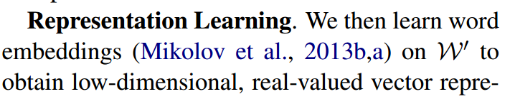
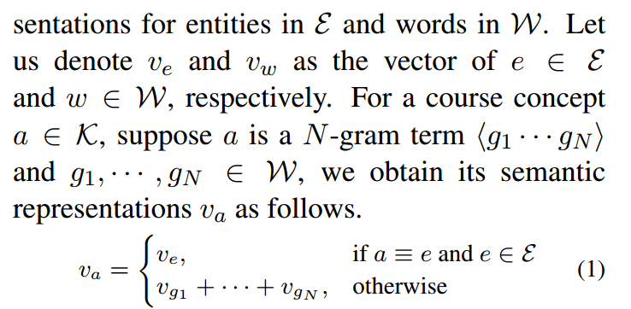
3.1 Concept Representation & Semantic Relatedness
a has no corresponding vector only if any of its constituent word is absence in the whole Wikipedia corpus
Concept Representation
over 98% of the course concepts have vector representations

Slide 19
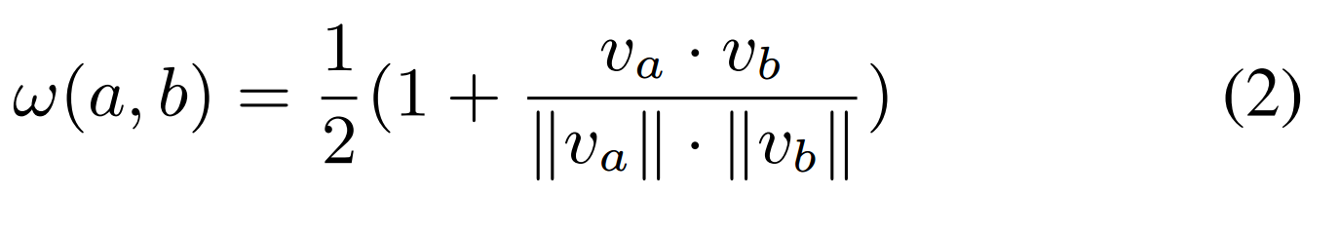
3.1 Concept Representation & Semantic Relatedness
Feature1. Semantic Relatedness(sr)

Slide 20
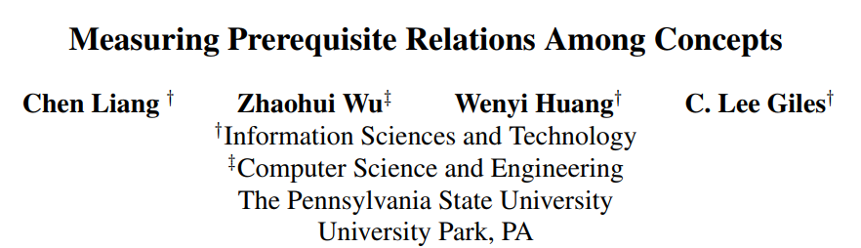
3.2 Contextual Features
Assumption:
In videos where concept A is taught, if the teacher also mentions concept B for a lot but not vice versa, then B is more likely to be a prerequisite of A thant A of B.
RefD
2015, EMNLP

Slide 21

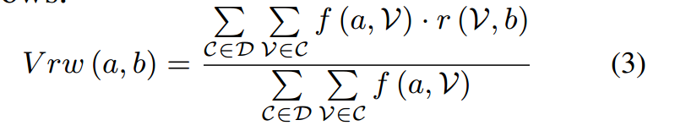

3.2 Contextual Features
Video reference distance(Vrd)
the term frequency of concept a in videoV
reflects how important is concept a to this video

Slide 22


3.2 Contextual Features
Video reference distance(Vrd)
between 0 and 1

Slide 23
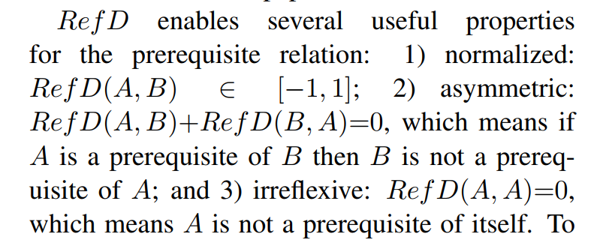
3.2 Contextual Features
Video reference distance(Vrd)

Slide 24
3.2 Contextual Features
Video reference distance(Vrd)
disadvantage: for an arbitrary concept pair, they may have no co-occurrence in all course videos.
=0
sparse feature!
Generalized video reference weight(GVrw)
consider the cases in which A-related concepts refer to B

Slide 25
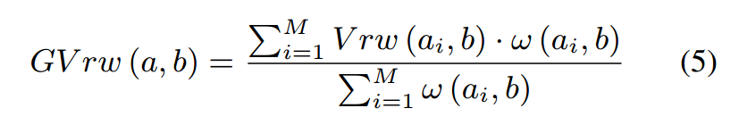
3.2 Contextual Features
Feature2. Generalized video reference distance(GVrd)

Slide 26
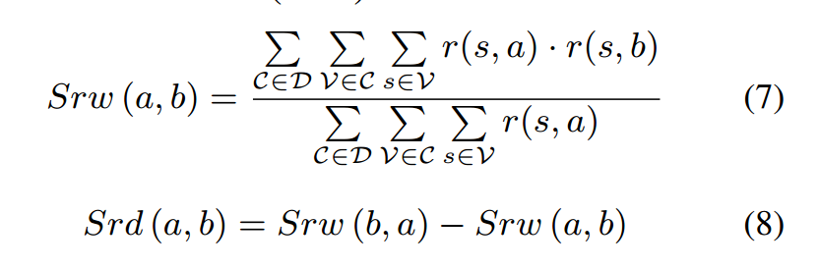

3.2 Contextual Features
Feature3. Generalized sentence reference distance(GSrd)

Slide 27
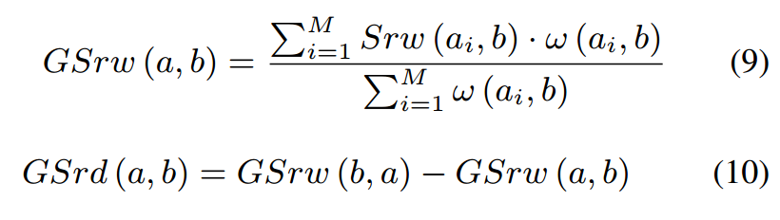
3.2 Contextual Features
Feature3. Generalized sentence reference distance(GSrd)

Slide 28
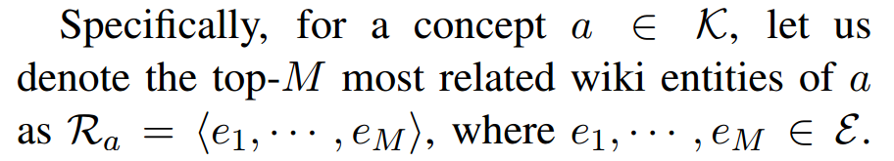
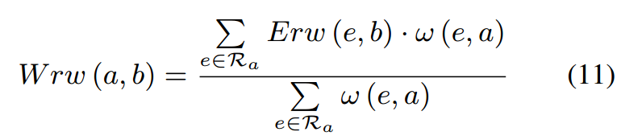
3.2 Contextual Features
Feature4. Wikipedia refence distance(Wrd)

Slide 29
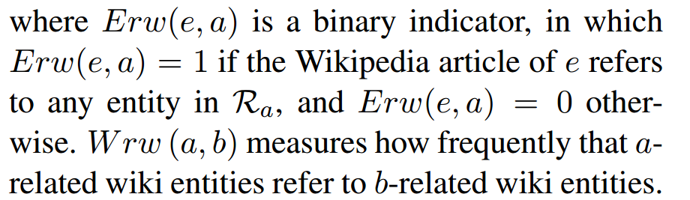
3.2 Contextual Features
Feature4. Wikipedia refence distance(Wrd)

Slide 30

3.2 Contextual Features
Feature4. Wikipedia refence distance(Wrd)

Slide 31


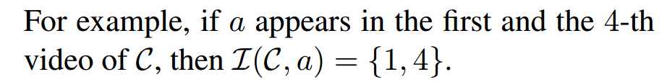
3.3 Structural Features
C(a) are the courses in which a is a course concept.
are the video indexes that contain concept a in course C

Slide 32
3.3 Structural Features
Feature5. Average position distance(Apd)
Assumption:
for a specific concept, its prerequisite concepts tend to be introduced before this concept and its subsequent concepts tend to be introduced after this concept.

Slide 33
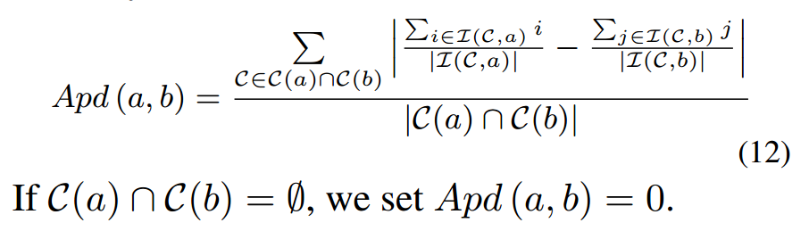
3.3 Structural Features
Feature5. Average position distance(Apd)

Slide 34

3.3 Structural Features
Feature6. Distributional Asymmetry Distance(Apd)
Assumption:
the chance that a prerequisite concept is frequently mentioned in its subsequent videos is larger than that a subsequent concept is talked about in its prerequisite videos.
a -> b, V_{a} -> V_{b}

Slide 35
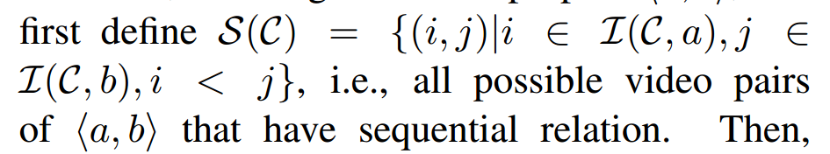
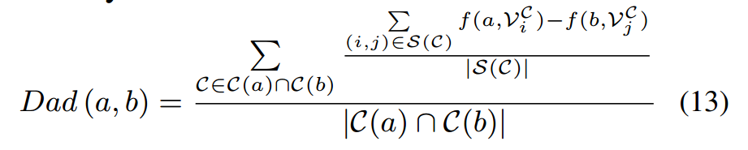
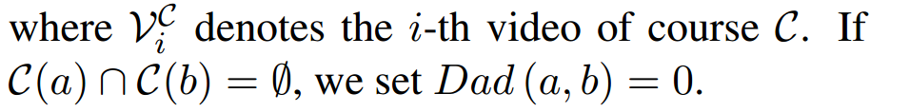
3.3 Structural Features
Feature6. Distributional Asymmetry Distance(Apd)
?

Slide 36
3.3 Structural Features
Feature7. Complexity Level Distance(Apd)
Assumption:
For a concept in MOOCs, if it covers more videos in a course or it survives longer time in a course, then it is morelikely to be a basic concept rather than an advanced one.

Slide 37
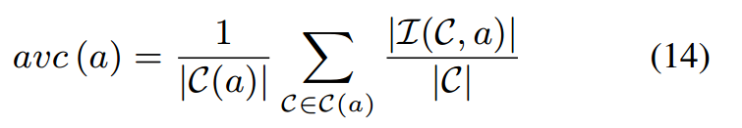
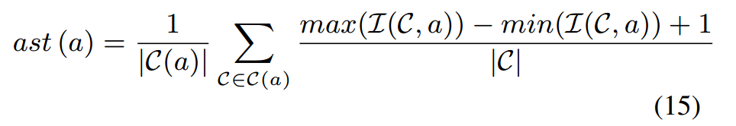
3.3 Structural Features
Feature7. Complexity Level Distance(Cld)
average video coverag(avc)
average survival time(ast)

Slide 38
04 Experiments

Slide 39
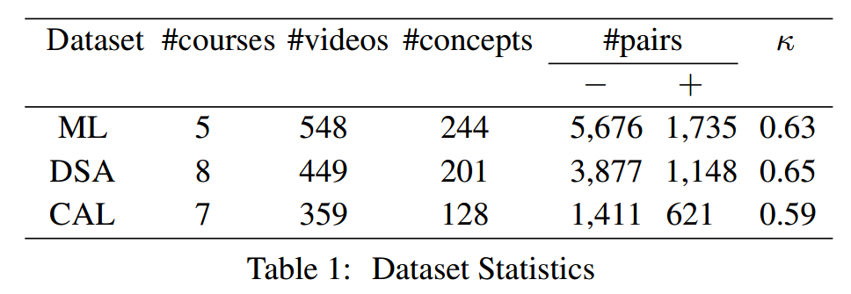
Machine Learning
4.1 Data Set
DATA SET
Data Structure and
Algorithms
Calculus

Slide 40
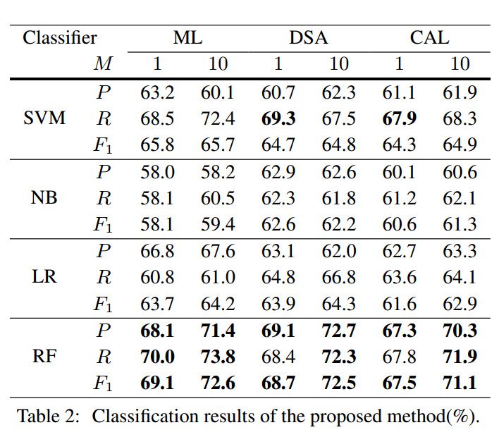
4.2 Evaluation Results
· 5-fold cross validation
· oversampling the positive instances

Slide 41
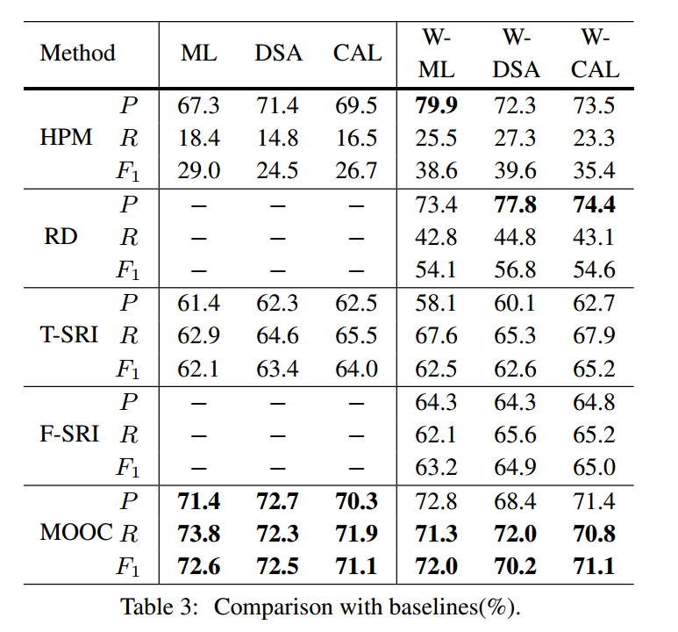
4.2 Comparison with Baselines
49% of course concepts in ML have their corresponding Wikipedia articles

Slide 42
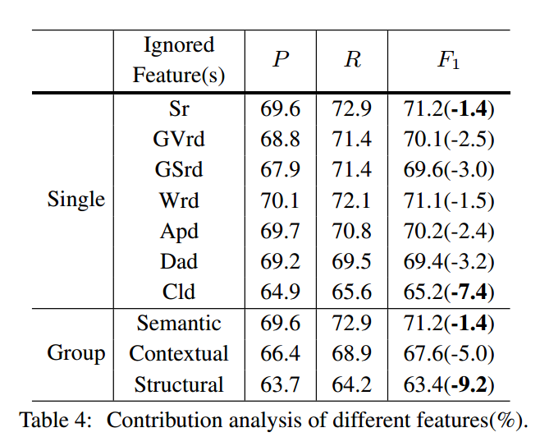
4.2 Feature Contribution Analysis

Slide 43
05 Conclusions

Slide 44
感谢您的观看!

