Slide 1
Question Difficulty Prediction for READING Problems in Standard Tests
Zhenya Huang, Qi Liu, Enhong Chen, Hongke Zhao,
Mingyong Gao, Si Wei, Yu Su, Guoping Hu
AAAI 2017
Presenter: Zhu Renyu
Notes:
这是一篇将深度学习方法应用于教育领域去解决与教育相关问题的论文。

Slide 2
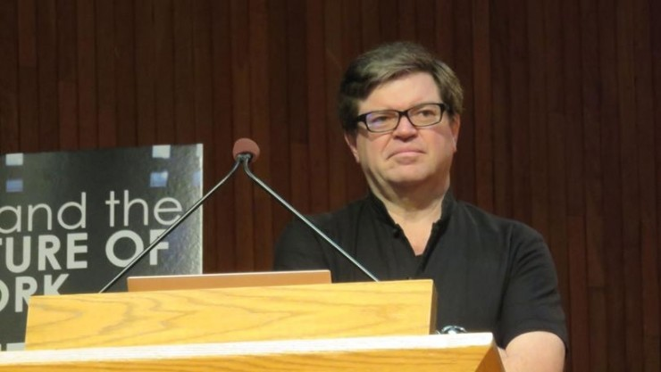
Deep Learning = AIchemy?
2017 NIPS LeCun against Ali Rahimi(Test of Time Awards)
Notes:
请大家带着一个一样思考问题去看全文？深度学习究竟是不是炼金术？

Slide 3
Background
Standard test, such as TOFEL or SAT, needs consistent difficulties to guarantee the fairness.
Traditional methods often resort to expertise, such as manual labeling or artificial tests organization.
Available auxiliary information, such as test logs of examinees and text materials of questions, are recorded.
Notes:
我们先来看一下本文研究问题的大背景。

Slide 4
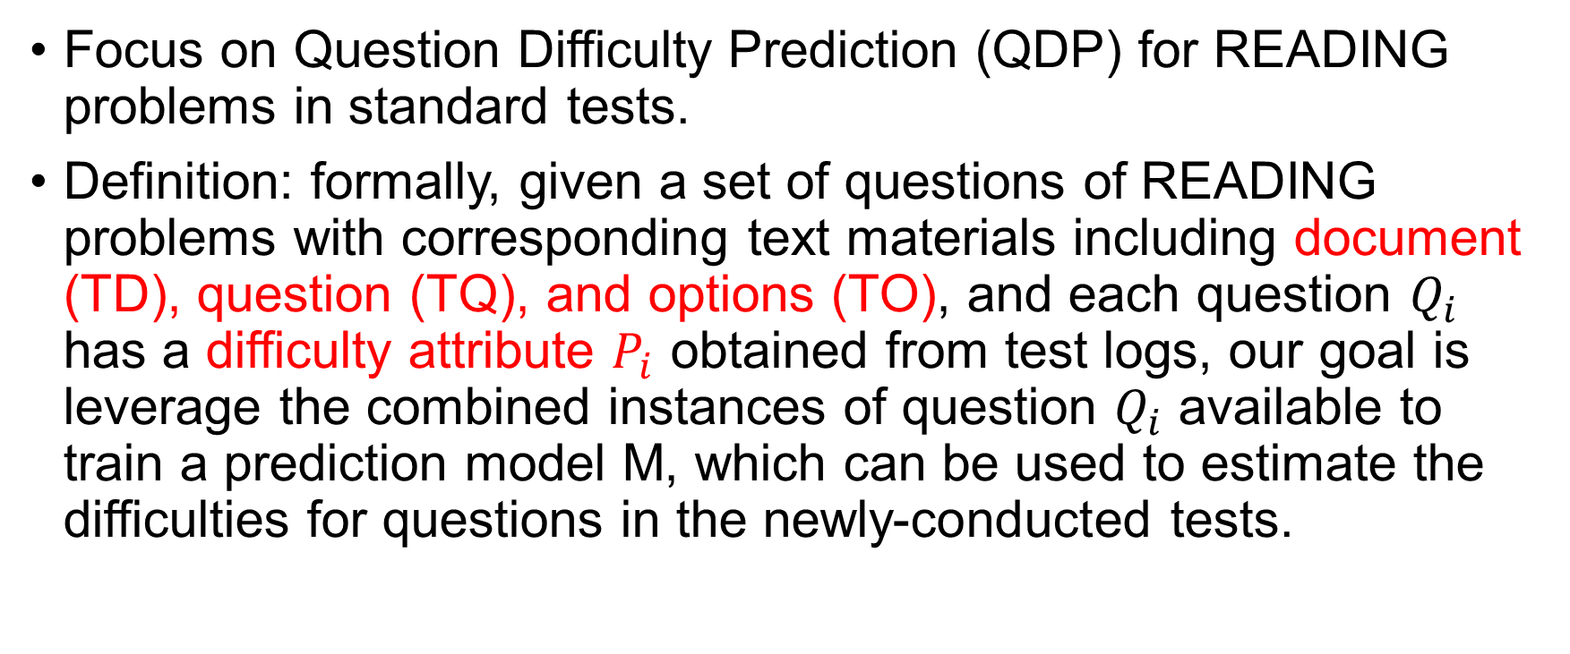
Problem
Focus on Question Difficulty Prediction (QDP) for READING problems in standard tests.
Definition: formally, given a set of questions of READING problems with corresponding text materials including document (TD), question (TQ), and options (TO), and each question $Q_{i}$ has a difficulty attribute $P_{i}$ obtained from test logs, our goal is leverage the combined instances of question $Q_{i}$ available to train a prediction model M, which can be used to estimate the difficulties for questions in the newly-conducted tests.
Notes:
再来看看在之前介绍背景下，本文所研究的科学问题。

Slide 5
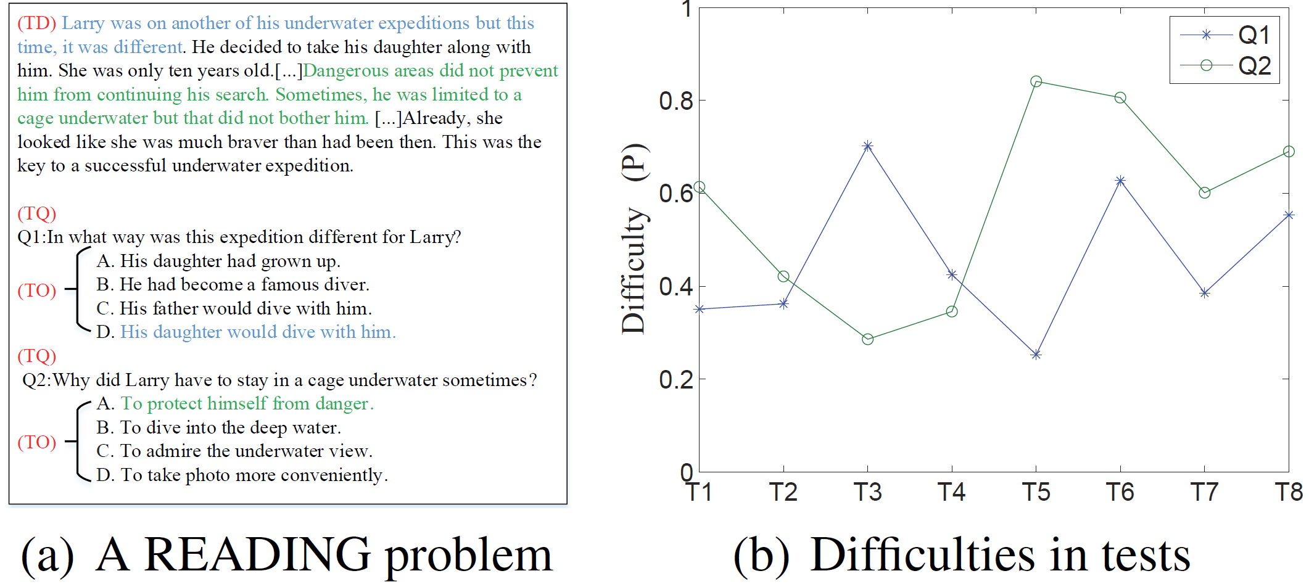
Three Challenges
How to establish a unified way to understand and represent multiple parts of text materials?
How to distinguish the importance of text materials to a specific question?
How to wipe out difficulty biases in different tests?
Notes:
但是，在研究这个数学问题时，会遇到一些挑战，一些与领域背景知识相关的挑战。

Slide 6
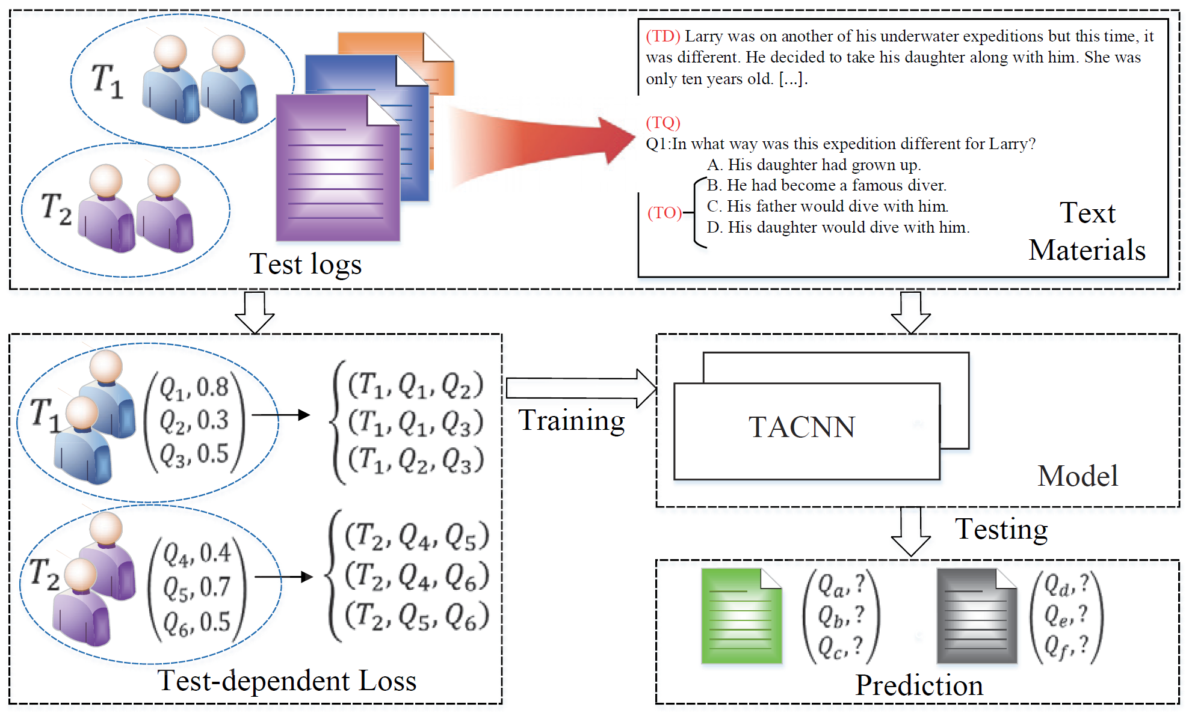
Solution
The flowchart overview of the paper
Notes:
针对于上述问题和领域背景下的挑战，本文提出如图所示的解决方案。

Slide 7
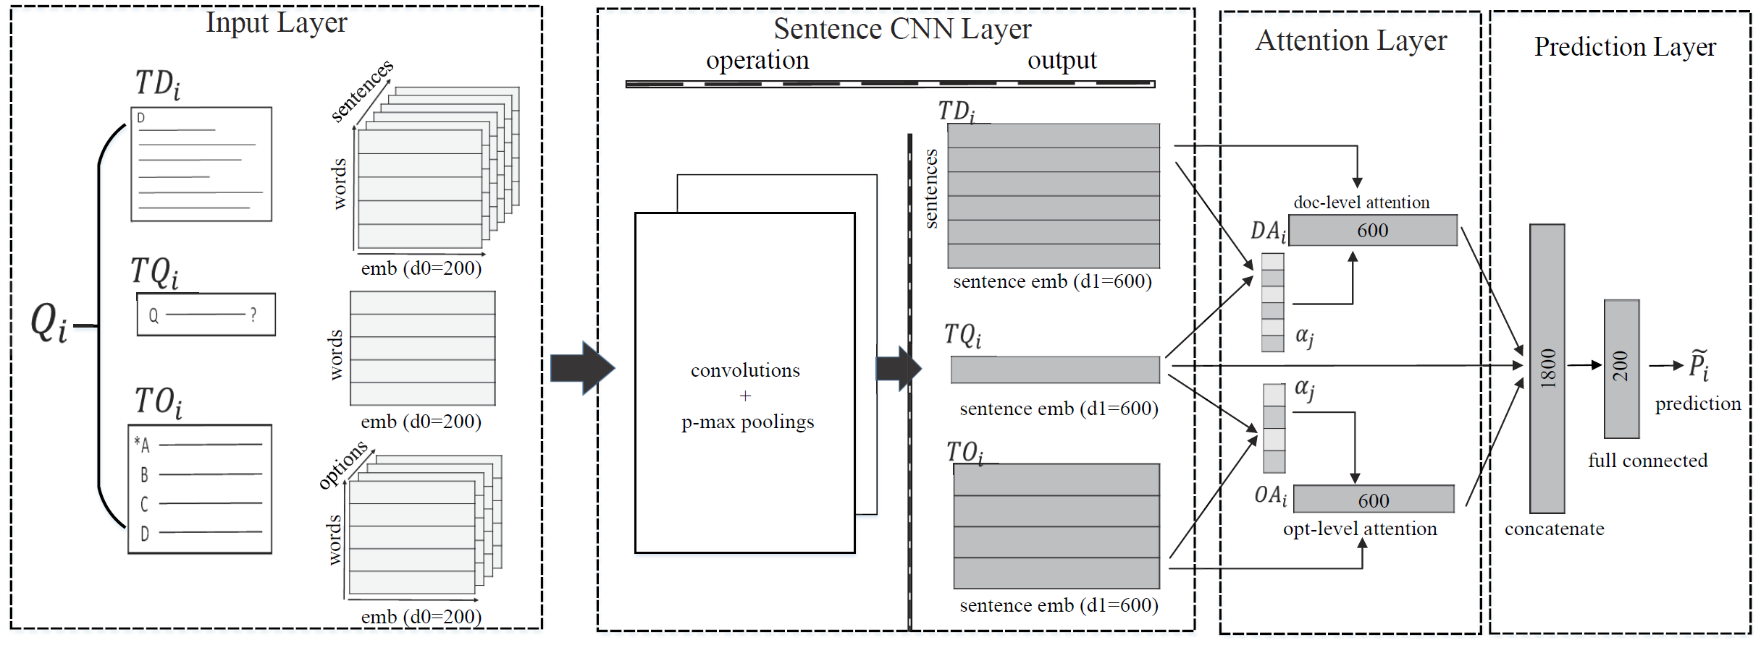
TACNN
TACNN framework. The numbers in the TACNN are the
dimensions of corresponding feature vectors.
Notes:
这是网络的总架构。
共分为四层：输入层、句子CNN层、注意力层、预测层。

Slide 8
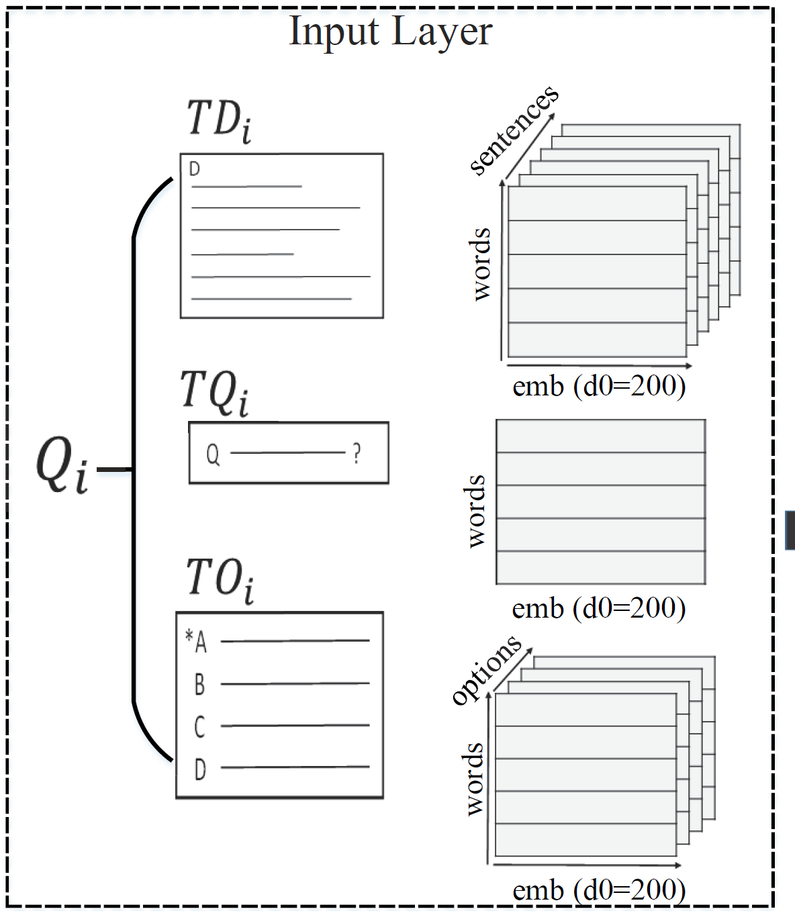
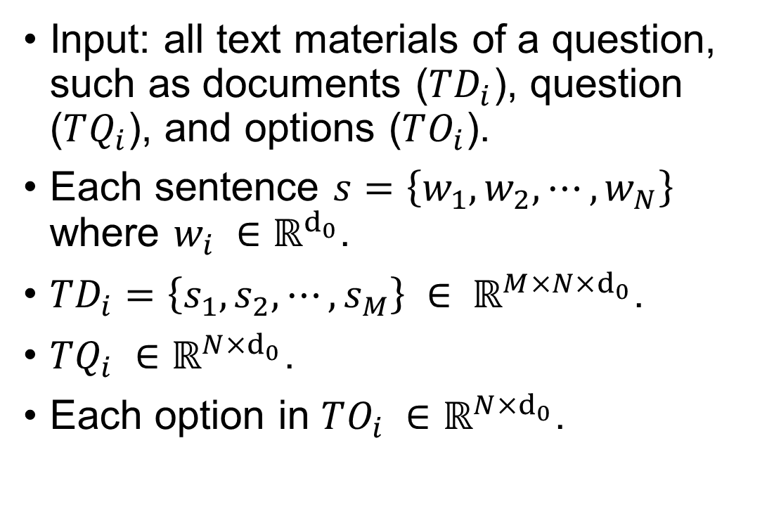
Input Layer
Input: all text materials of a question, such as documents ($TD_{i}$), question ($TQ_{i}$), and options ($TO_{i}$).
Each sentence $s=\left\{w_{1},w_{2},⋯,w_{N}\right\}$ where $w_{i} ∈ℝ^{d_{0}}$.
$TD_{i}=\left\{s_{1},s_{2},⋯,s_{M}\right\} ∈ ℝ^{M×N×d_{0}}$.
$TQ_{i} ∈ℝ^{N×d_{0}}$.
Each option in $TO_{i} ∈ℝ^{N×d_{0}}$.
Notes:
每个单词用一个200维的词向量表示。现在看到的每一页是一个句子多个单词。每个文档可能有多个句子。

Slide 9
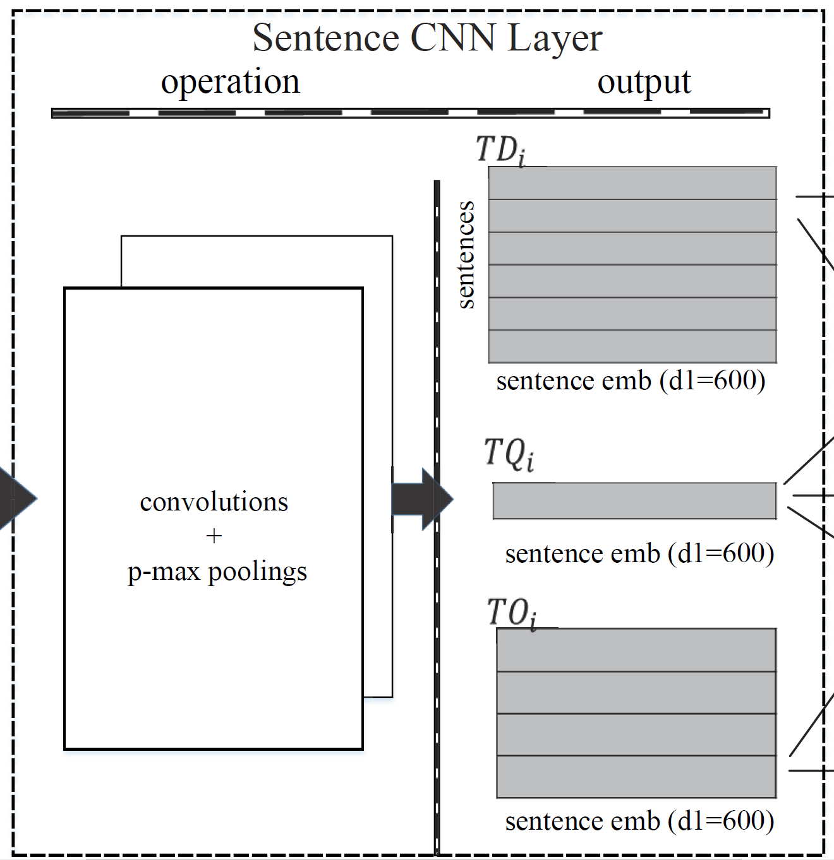
Sentence CNN Layer (1)
Target: learning each sentence representation (fixed length vectorial) from word level.
Why use CNN-based architecture?
Capturing dominated information of each sentence from local to global views.
Exploiting the interactions between words at larger scale and learn the deep comparable semantic representations for sentences.
Reducing the model complexity.
Notes:
将每个句子学习成固定长度的向量。解决了第一个挑战。

Slide 10
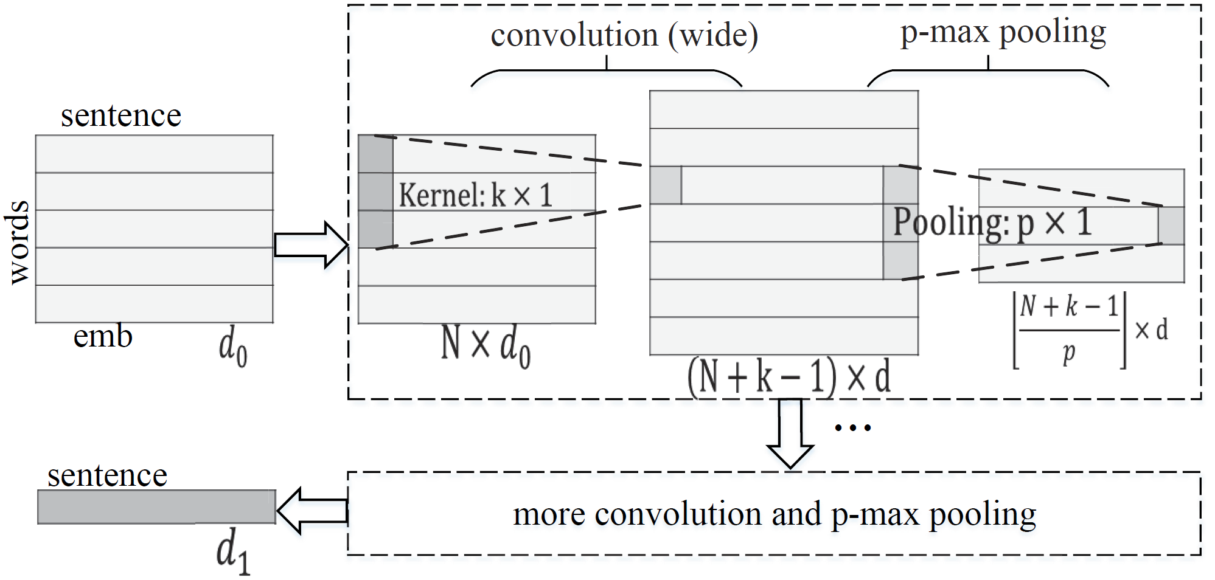
Sentence CNN Layer (2)
A variant of the traditional one (Collobert et al. 2011) that alternates several layers of convolution and p-max pooling.
Sentence CNN
Notes:
来看一下句子CNN网络的具体架构。

Slide 11
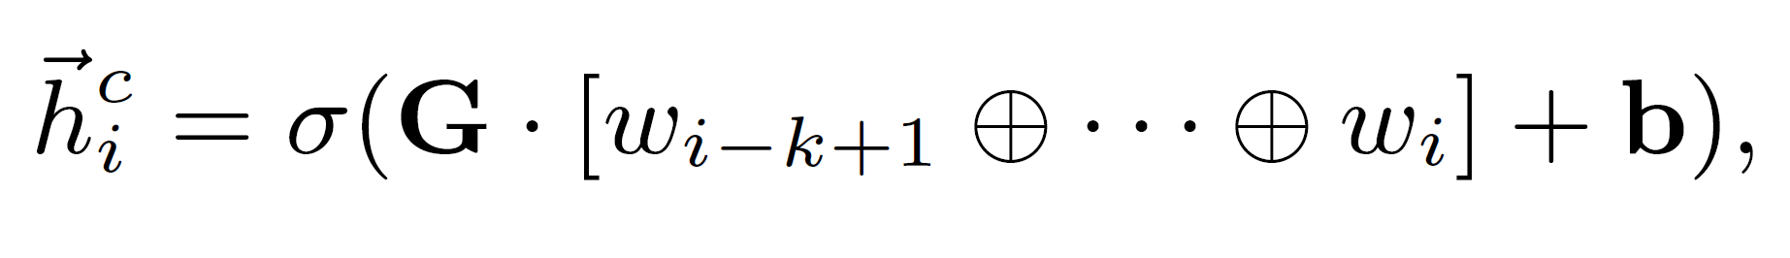
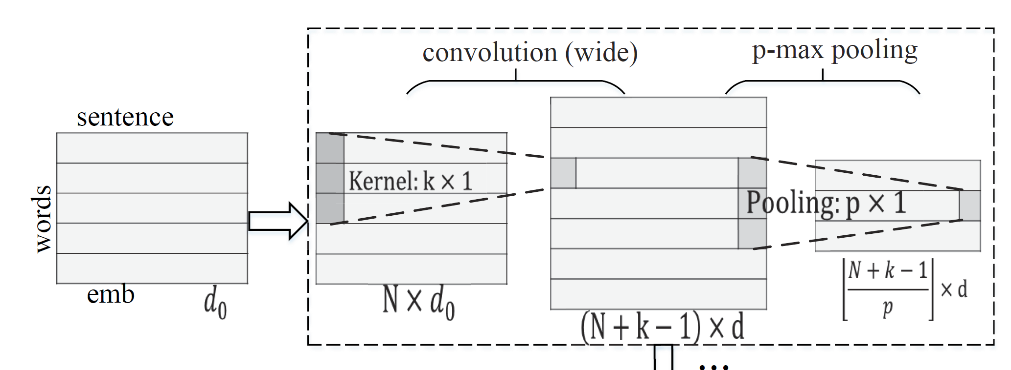

Sentence CNN Layer (3)
Given a sentence matrix $s=\left\{w_{1},w_{2},⋯,w_{N}\right\}∈ℝ^{N×d_{0}}$, the wide convolution operates on a sliding window of every $k$ words with a kernel $k ×1$ and obtain a new hidden sentence $h^{c}=\left\{{\vec{h}}_{1}^{c}, ⋯,{\vec{h}}_{N+k−1}^{c}\right\}$, where:

Slide 12
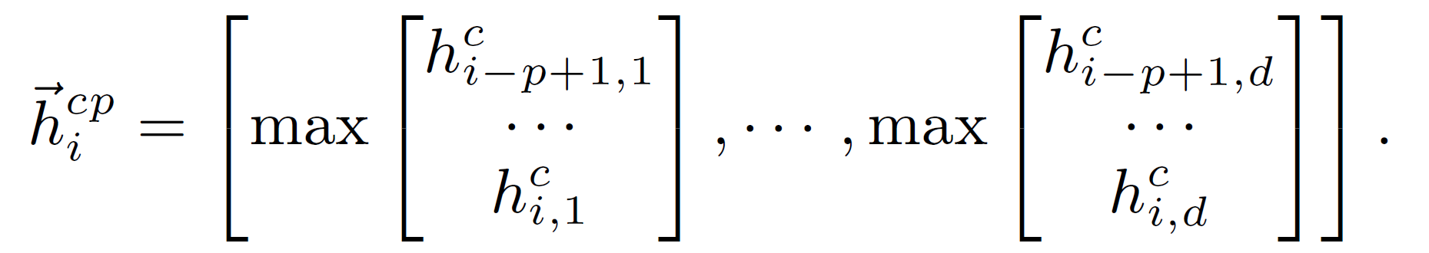

Sentence CNN Layer (4)
Exploit p-max pooling operation to merge the features from convolution sequence $h^{c}$ into to a new global hidden sequence, $h^{cp}=\left\{{\vec{h}}_{1}^{cp}, ⋯,{\vec{h}}_{(N+k−1)/p}^{cp}\right\}$ , where
Notes:
P-max池化。

Slide 13
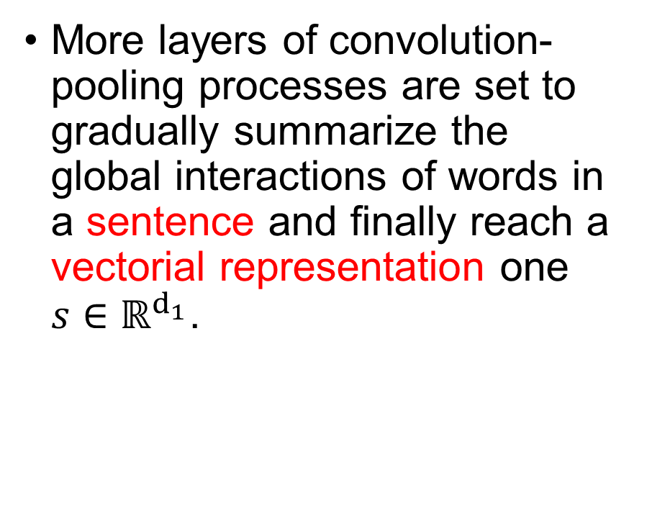
Sentence CNN Layer (5)
More layers of convolution-pooling processes are set to gradually summarize the global interactions of words in a sentence and finally reach a vectorial representation one $s∈ℝ^{d_{1}}$.
Notes:
最后，我们得到一个句子的向量表示。这个系统得到的是600维的数据。

Slide 14
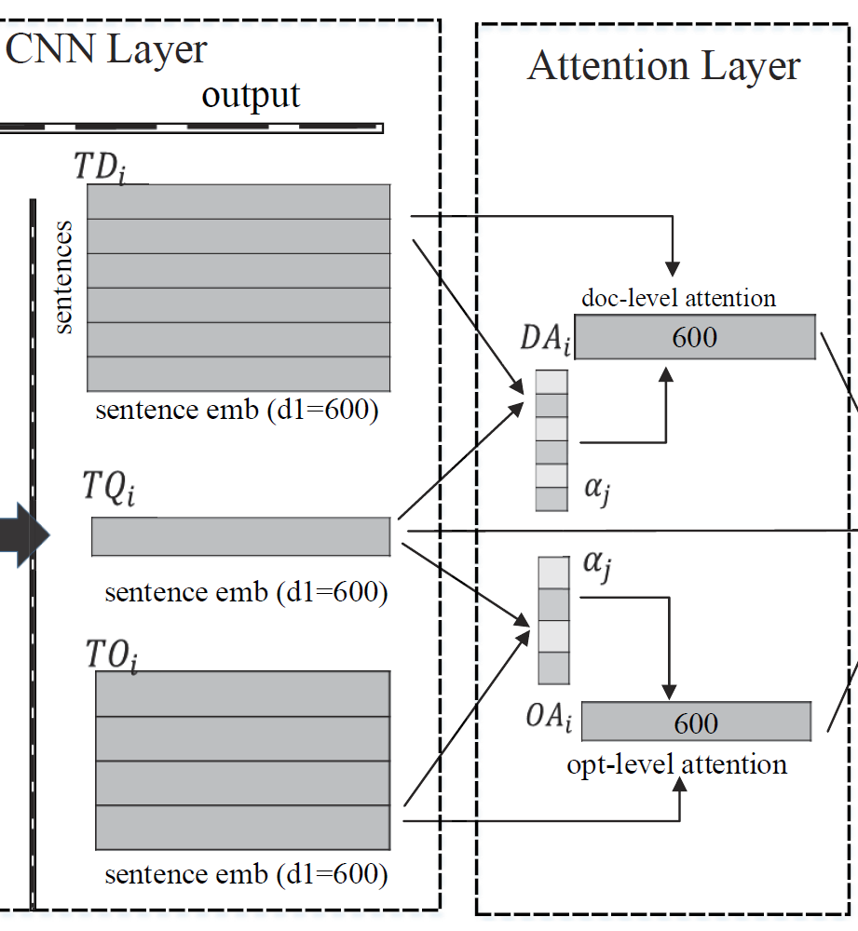
Attention Layer (1)
Aiming at detecting difficulty attention representations for each question.
The same texts should have different representations based on the given questions.
Notes:
然后是第三层，注意力层。解决是第二个挑战。

Slide 15
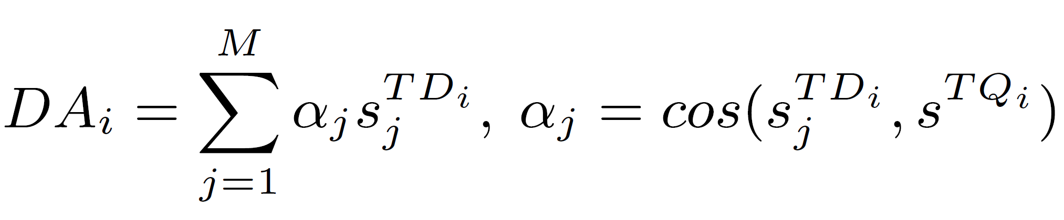
Attention Layer (2)
The attention representations are modeled as vectors by a weighted sum aggregated result of the sentence representations from both document-level and option-level perspectives.
Notes:
计算两个向量间的余弦相似度，然后再对应相加、

Slide 16
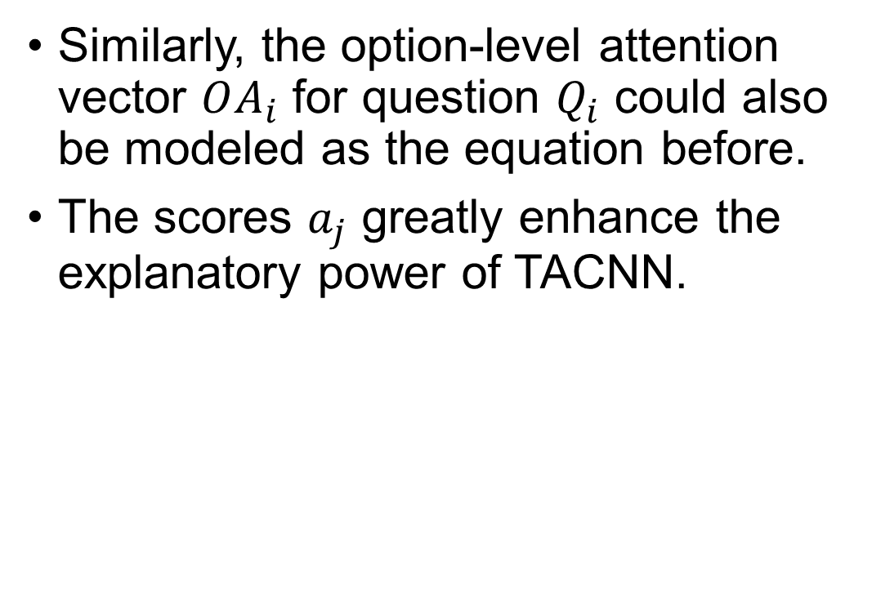
Attention Layer (3)
Similarly, the option-level attention vector $OA_{i}$ for question $Q_{i}$ could also be modeled as the equation before.
The scores $a_{j}$ greatly enhance the explanatory power of TACNN.
Notes:
同样的，选择文档也是计算余弦相似度在对应相加。

Slide 17
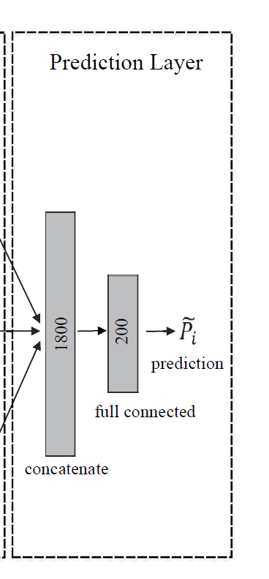
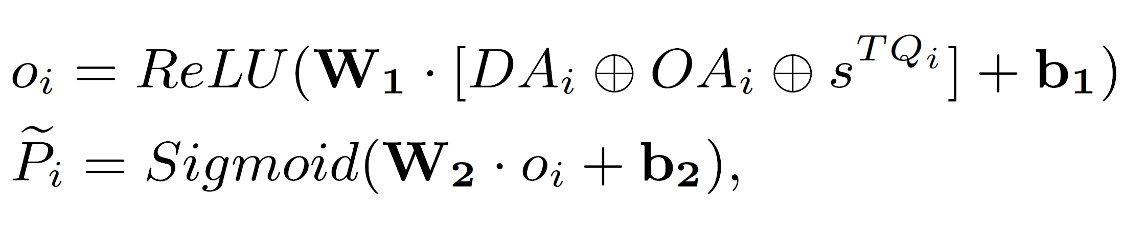

Prediction Layer
Aggregate them by concatenation operation, then utilize a classical full-connected network to learn the overall difficulty representation $o_{i}$ and finally predict the difficulty ${\tilde{P}}_{i}$ by logistic function:
Notes:
最后一层是预测层。先对之前的句子向量进行整合相加后，使用RELU激活函数后，再用Sigmoid去预测输出。

Slide 18
TACNN
TACNN framework. The numbers in the TACNN are the
dimensions of corresponding feature vectors.
Notes:
这是网络的总架构。
共分为四层：输入层、句子CNN层、注意力层、预测层。

Slide 19
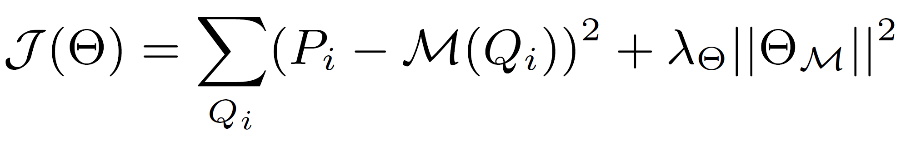
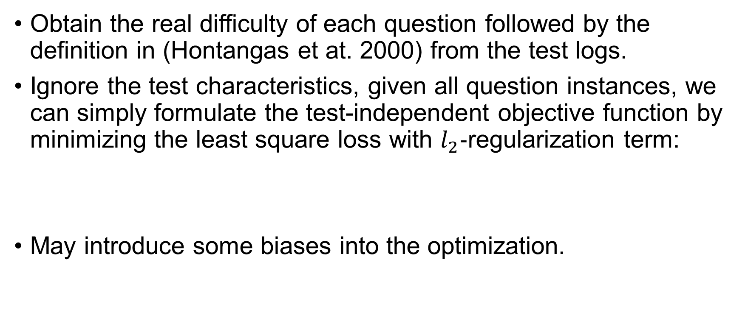
Test-independent Loss Function
Obtain the real difficulty of each question followed by the definition in (Hontangas et at. 2000) from the test logs.
Ignore the test characteristics, given all question instances, we can simply formulate the test-independent objective function by minimizing the least square loss with $l_{2}−$regularization term:
May introduce some biases into the optimization.
Notes:
与测试无关的损失函数。

Slide 20
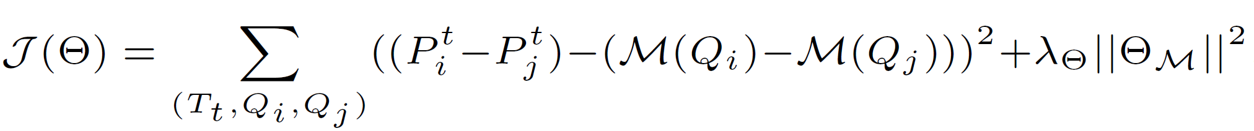
Test-dependent Loss Function
Realize that difficulties of questions in same tests are comparable.
Model and optimize the difficulty comparison for a pair of questions in same tests by a pairwise strategy:
Notes:
与测试相关的损失函数。

Slide 21
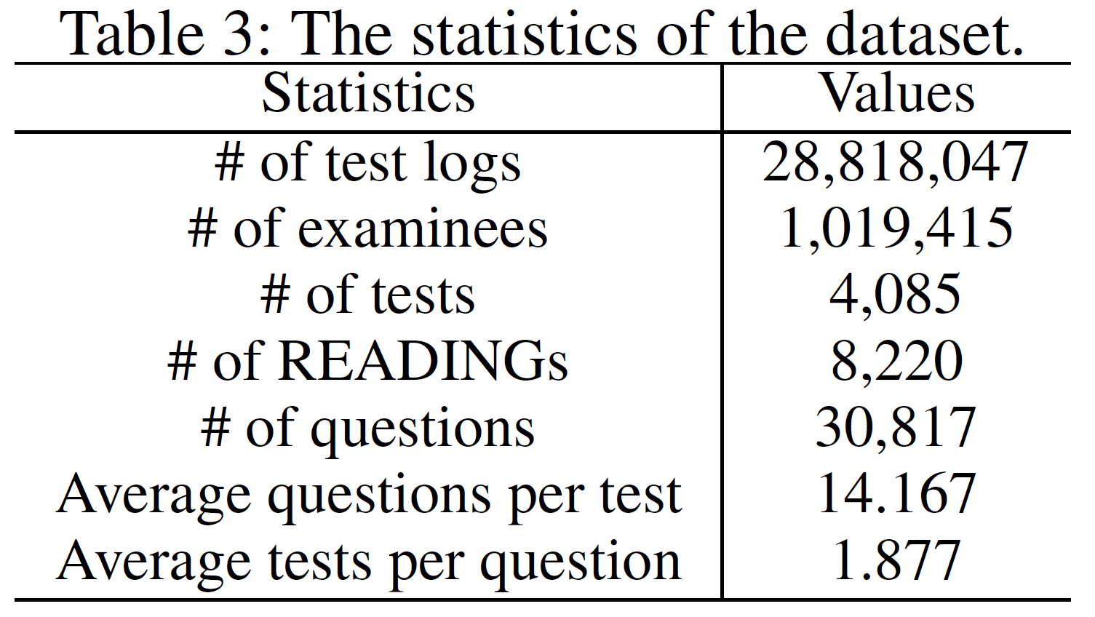
Dataset
Supplied by IFLYTEK (科大讯飞).
Collected from real-world standard tests for READING problems.
3 million test logs of thousands of Chinese senior high schools from the year 2014 to 2016.

Slide 22
Experimental Design
Word embedding: on a large-scale gigaword corpus using public word2vec tool (Mikolov and Dean 2013) with the dimension 200.
TACNN setting: maximum length of sentence (words) as 25 (40) (Zero padded when necessary); four layers of convolution (Three wide and one narrow convolution, and feature map as 200, 400, 600, 600) and max-pooling (pooling window as 3, 3, 2, 1); kernel size as 3.
Training setting: Xaiver initialization; mini-batch size 32; dropout probability 0.2.
Theano, Tesla K20m GPU.

Slide 23
Baseline Approaches
CNN: with attention-ignored strategy and test-independent loss.
ACNN: with attention strategy and test-independent loss.
TCNN: with attention-ignored strategy and test-dependent loss.
HABCNN: a machine comprehension model from (Yin, Ebert, and Schutze 2016) with a kind of CNN and sentence attention.

Slide 24
Evaluation Metrics
Root Mean Squared Error (RMSE) (Salakhutdinov and Mnih 2011) for QDP precision comparison.
Degree of Agreement (DOA) (Liu et al. 2012) for ranking perspective to measure the percentage of correctly ranked difficulties of question pairs.
Person Correlation Coefficient (PCC) (Benesty et al. 2009) to measure the correlation performance.
T-test Passing Ratio (PR) to evaluate confidence performance.

Slide 25
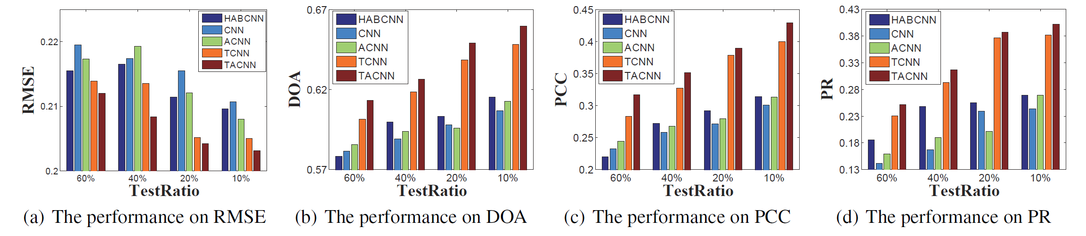
Overall QDP Results
Overall performance on the task of QDP

Slide 26
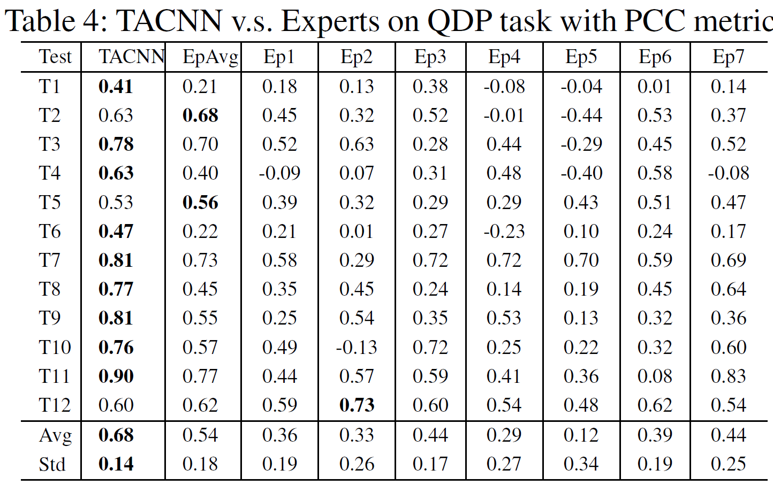
Experts Comparison

Slide 27
Contributions
A novel Test-aware Attention-based Convolutional Neural Network (TACNN) framework to automatic predict question difficulty for READING problems.
An unified CNN-based architecture to exploit the sematic representations for all text materials.
Utilizing an attention strategy to qualify the difficulty contribution of each sentence to one question.
Proposing a test-dependent pairwise strategy to wipe out the difficulty biases in different test.
Extensive experiments on a large-scale real-world dataset.

Slide 28
Pros and Cons
Pros
Question difficulty prediction.
Good combination of different deep learning methods.
Cons
The code is not open.
The network architecture is not specific.
The optimization is easy.
The experimental design is bad.

Slide 29

Deep Learning = AIchemy?
Notes:
请大家带着一个一样思考问题去看全文？深度学习究竟是不是炼金术？
从本文的结构来看，它的确是一个炼金术。

