Slide 1


Reverse k-Ranks Query
Zhao Zhang, Cheqing Jin, and Qiangqiang Kang
cqjin@sei.ecnu.edu.cn
Institute for Data Science and Engineering
East China Normal University
VLDB 2014 @Hangzhou

Slide 2
Outline
Background
Related work
Our solutions: NA, TPA, BPA and MPA
Experiments
Conclusion

Slide 3




Background
Scenario: Many applications have a product set and a customer set.
  Each product: d-dimensional vector (p¹, p², ..., p^{d})
  Each customer: d-dimensional preference weight (w¹, w², ..., w^{d}).
  For each i, w^{i}>=0, and ∑w^{i}=1.
  ∑(p^{i}×w^{i}) measures the preference of a customer to a product.
Motivation: Recommend a product to potential customers.
Bob
Price
o3
Alice
o4
o1
Tom
o2
The distance to beach

Slide 4




Traditional top-k query
Consider a hotel-booking application.
Each hotel has two attributes, including price and the distance to beach.
A monotonic preference function f(.) that outputs the score of a hotel.
Top-k query: retrieving k hotels with the smallest scores.
monotonic preference function
f(o) = o.distance+ o.price
Price
top-2 hotels
The distance to beach

Slide 5
Customized preference
Each customer has different preference.
  Alice: care more about price.
    f(o) = 0.1*o.distance+ 0.9*o.price
  Bob: care more about the distance to beach
    f(o) = 0.9*o.distance + 0.1*o.price
  Tom: in the middle
    f(o) = 0.5*o.distance + 0.5*o.price
Bob and Tom like o1 very much. But Alice prefers o2 to o1.
Tom
Price
Bob
Alice
o3
o5
o4
o1
o6
o2
o7
The distance to beach

Slide 6
Reverse k-Ranks: A novel query
Given a query object q, a reverse k-Ranks query returns k customers with highest ranks.
Let query object q=o2
  For Alice, q's rank is: 0
  For Bob, q's rank is: 2
  For Tom, q's rank is: 1
Hence,
  If k = 1, result = {Alice}
  If k = 2, result = {Alice, Tom}
Tom
Price
Bob
Alice
o3
o5
o4
o1
o6
o2
o7
The distance to beach

Slide 7
Outline
Background
Related work
Our solutions: NA, TPA, BPA and MPA
Experiments
Conclusion

Slide 8
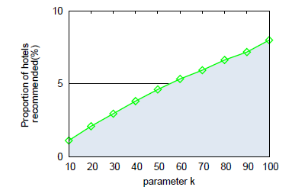
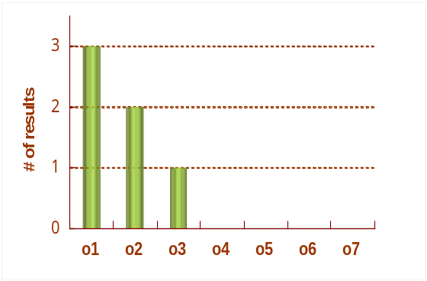

Related work
Traditional top-k query [Abundant work]
  It has been widely studied for several decades.
  Limit: it often uses a single preference function.
Reverse top-k query [ICDE 2010]
  Return all customers who treat the query object q as one of his(her) top-k objects.
  Limit: it does not consider the niche products well.
5000 customers
5000 products
Bob
Price
o3
o5
o4
o1
Tom
Alice
o6
o7
o2
The distance to beach
k=2

Slide 9
Related work
Traditional top-k query [Abundant work]
  It has been widely studied for several decades.
  Limit: it often uses a single preference function.
Reverse top-k query [ICDE 2010]
  Return all customers who treat the query object q as one of his(her) top-k objects.
  Limit: it does not consider the niche products well.
Ranked Reverse kNN [TKDE 2008]
  Return t points close to q according to the rank.
  Limit: different model, it is mainly for Euclidean space.
Reverse k-Scores [Also in this paper]
  A variant of Reverse k-Ranks, according to the value of score.
  Limit: Cannot suit for the biased data set.

Slide 10
Outline
Background
Related work
Our solutions: NA, TPA, BPA and MPA
Experiments
Conclusion

Slide 11
Solution 1: Naive approach (NA)
Main idea: Scan each customer one by one, compute the score of all products to get the rank of q. Finally, return k customers with highest ranks of q.
Example: Let q=o2, k=2
  Check Alice:
  Check Bob:
  Check Tom:
  Finally, result = {Alice, Tom}
Tom
Price
Bob
Alice
o3
o5
o4
o1
q's rank = 0;
o6
q's rank = 2;
o2
o7
q's rank = 1.
The distance to beach

Slide 12
Solution 2: Tree-Based Pruning Approach (TPA)
Main idea: build an R-tree to index all products in advance to avoid pairwise computations.
Fact 1: If an MBR is above the hyperplane (or line), the score of any product within the MBR is greater than the score at the hyperplane (or line).
Fact 2: If an MBR is below the hyperplane (or line), the score of any product within the MBR is smaller than the score at the hyperplane (or line).
Any product in R3 has a socre higher than blue line;
Price
o3
o5
R1
o4
o1
R3
o7
o6
o2
R2
R4
The distance to beach
Any product in R2 has a score smaller than the green and blue lines.

Slide 13
TPA Example
Algorithm desciption: visit each customer one by one, using an R-tree to avoid pairwise computation.
Example: Let q=o2, k=2
  Check Alice, both R1 and R3 can be pruned. rank_{Alice}(q)=0
  Check Bob, only R3 can be pruned. rank_{Bob}(q)=2
  Check Tom, both R1 and R3 can be pruned. rank_{Tom}(q)=1.
  Return {Alice, Tom}
Bob
Price
o3
o5
Tom
R1
o4
o1
R3
o7
o6
o2
R2
R4
The distance to beach
Alice

Slide 14
Solution 3: Batching Pruning Approach (BPA)
Main idea: The rank of an object may be similar for some customers with similar preference.
Build a multi-dimensional histogram to partition the customers.
Compute the upper and lower bounds of the rank using the above or below relationships.
For the customers in B5, the rank of o2 is in [2, 6].
B4
B5
Price
For the customers in B3 and B4, the rank of o2 is in [0, 6].
o8
o3
R1
o5
o4
B3
o9
B2
o1
R3
o7
o6
o2
B1
R2
R4
The distance to beach
For the customers in B1 and B2, the rank of o2 is either 0 or 1.

Slide 15
BPA Example (cont.)
Algorithm desciption:
  Build an R-tree to index products.
  Build an Histogram to partition customers.
  Scan each bucket in the histogram to get the lower and upper bounds of the rank.
  Decide which customers need further evaluation.
Example: let k=2
  If |B1| + |B2| >=2, then B5 can be pruned.
  Otherwise, all buckets must be checked.
B5
B4
B3
B2
B1
0
1
2
3
4
5
6
rank

Slide 16
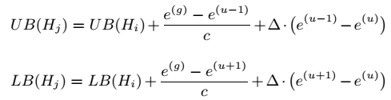
Solution 4: Marked Pruning Approach (MPA)
Main idea: In BPA, the execution for each bucket is independent. For example, computing B5 does not rely on the computations on B1-B4.
Fortunately, the bounds of the neighbor bucket can be computed efficiently.
Hence, we use a 2-D array B (with a size of |R| × |H|) to record all relationships, where R is the R-tree and H is a set containing all valid weight buckets, so that the rank bounds of a weight bucket are set efficiently.
g: affected dim.
u: split dim.

Slide 17
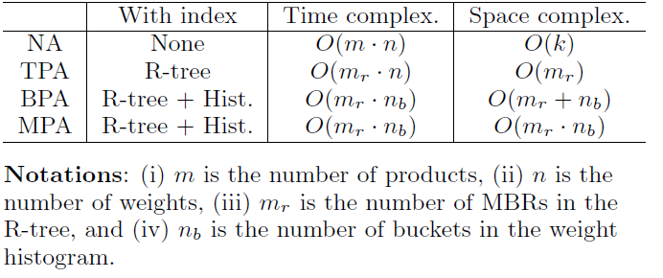
Comparison

Slide 18
Outline
Background
Related work
Our solutions: NA, TPA, BPA and MPA
Experiments
Conclusion

Slide 19
Experiments
Product database
  Synthetic databases
    UN: uniform; CO: correlated; AC: anti-correlated
  Real databases
    Bank: a bank market dataset, 45k tuples, 3-5 attributes
    Taobao: a Taobao dataset, 51k tuples, 3-5 attributes
    Dianping: a dianping dataset, 9.8k tuples, 4 attributes
Customer database
  Synthetic databases
    UNI: Uniform distribution; CLU: Clustered distribution
  Real databases
    Dianping: 20k users' preference extracted from their history rating records.

Slide 20
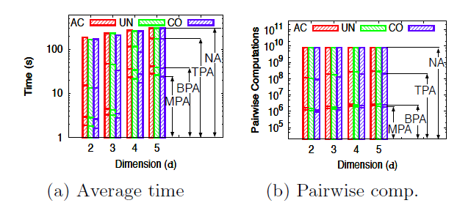
Time-efficiency
The performance of four methods (NA, TPA, BPA and MPA) when varying the number of dimensions. We use UNI weight set and three product sets, including UN, CO and AC. We set |D| = 20K, |W| = 400K and k = 10. Each query point is randomly selected in the domain.
Observation: MPA > BPA >> TPA >> NA

Slide 21
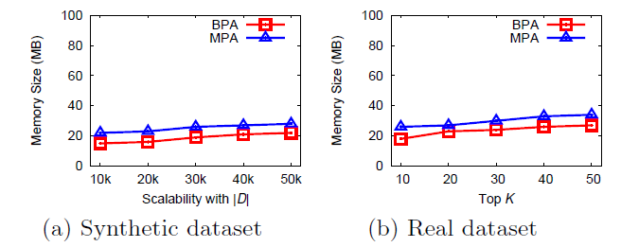
Space-efficiency
We set |W | = 100k and use CLU weight dataset. Figure (a) uses UN product dataset (d =3). Figure (b) uses Taobao data set.
Observation: BPA is more space-efficient than MPA, since MPA needs an additional 2-D array. But the gap is small.

Slide 22
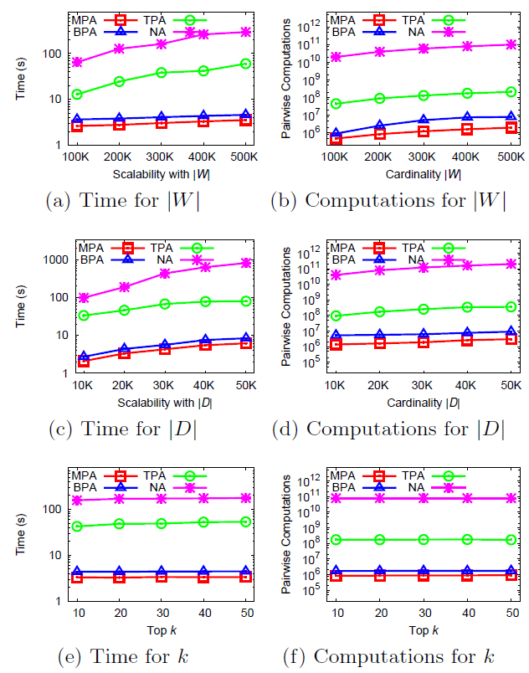
Scalability
The right figure reports the scalability of NA, TPA, BPA and MPA under different |D|, |W| and k. The metrics are time cost and pairwise computations. By default, |D| = 20K, k = 10, |W| = 400K and c = 10.
Observation: Under all situations, MPA still behaves the best.

Slide 23
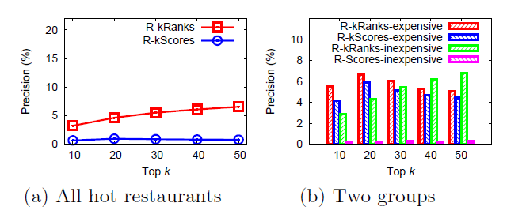
Effectiveness
Product set: 9,800 restaurants from Dianping.com, each has four attributes, including average cost per person (ac), taste (ta), environment (en) and service (se).
Weight set: 20,054 users who have reviews for the restaurants.
Precision: the proportion of users who indeed visit the query restaurant in the next year.
R-kScores tends to return expensive restaurants to all customers, no matter they like inexpensive restaurants or not.
R-kRanks
outperforms R-kScores

Slide 24
Conclusion
Define a new ranking-based query type, called reverse kRanks (shorten as R-kRanks).
Propose four solutions to deal with R-kranks, including NA, TPA, BPA and MPA.
Conduct experiments upon synthetic and real data sets to evaluate the performance.
Future work
  Devise approximate solutions.
  Devise distributed solutions.

Slide 25
Thank you!

Slide 26
Reverse top-k query
A reverse top-k query returns all customers who treat the query object q as one of his(her) top-k objects.
Assume k=2.
If q = o4, o5 or o6 then
  result = {};
If q = o3 then
  result = {Bob};
If q = o1 then
  result = {Alic, Bob, Tom};
If q = o2 then
  result = {Alice, Tom}
Bob
Price
o3
o5
o4
o1
Alice
Tom
o6
o2
The distance to beach

Slide 27
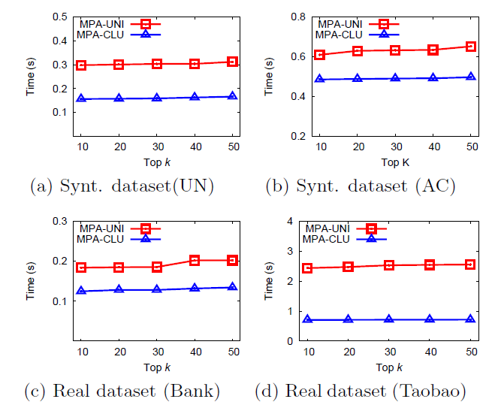
The effect of weight data set
Assuming |W| = 10K and c = 4, this figure illustrates the behaviors of MPA when using different weight datasets (UNI, CLU) when k increases.
MPA behaves better on the uniform weight set (UNI) than the clustered weight set (CLU) under all settings.

Slide 28
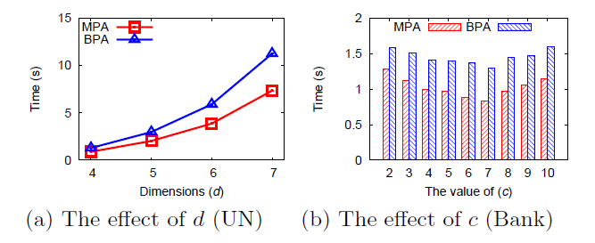
The effect of dimensionality and cell width
Assuming |D| = 20K, |W| = 100K, k = 10, d = 3, and c = 4. We use CLU weight dataset in this series of experiments.
Observation 1: when d increases, the time cost rises.
Observation 2: a small c will result in a coarse split. But if c is set too large, the overhead is high.

