Slide 1

Chapter 6
Consumer Choices
Notes:
Welcome to Chapter 6 on Consumer Choices. In this chapter, we'll explore how consumers make decisions about what to buy given their limited budgets. We'll examine the economic concepts of utility, budget constraints, and how changes in income and prices affect our purchasing decisions. We'll also look at behavioral economics, which challenges some traditional assumptions about rational decision-making. By the end of this presentation, you'll understand the fundamental principles that drive consumer behavior in markets.

Slide 2
The Central Problem
The Consumer's Dilemma
Unlimited wants, limited budget
Consumers seek to maximize total utility (satisfaction)
Constrained by income and prices
Every choice involves trade-offs
Analogy: Like packing for a trip with a weight limit—you want to bring everything, but must choose what gives you the most value within your constraint.
Notes:
Every consumer faces a fundamental economic problem: we have unlimited wants but limited resources. Whether you're a college student with $50 to spend this week or a family managing a monthly budget, you must make choices. Economists believe that people try to get the most satisfaction—what we call utility—from their available money. This is like packing a suitcase with a 50-pound weight limit for a two-week vacation. You want to bring your entire wardrobe, but you must prioritize and choose items that will give you the most value during your trip. Every item you pack means something else must stay home. Similarly, every dollar you spend on one thing means you can't spend it on something else. Understanding these trade-offs is the foundation of consumer choice theory.

Slide 3
Key concepts
Understanding Utility
Utility = Satisfaction from consumption
Total Utility (TU) = Overall satisfaction from all units consumed
Marginal Utility (MU) = Additional satisfaction from one more unit
MU = Change in TU ÷ Change in Quantity
Law of Diminishing Marginal Utility: Each additional unit provides less additional satisfaction
Notes:
Let's define our key terms. Utility is simply the satisfaction or pleasure you get from consuming goods and services. Economists measure this in hypothetical units called "utils"—these aren't real measurements like inches or pounds, but they help us think systematically about satisfaction. Total utility is your overall satisfaction from consuming a certain quantity of something. Marginal utility is the extra satisfaction you get from consuming one more unit. The formula is straightforward: marginal utility equals the change in total utility divided by the change in quantity. The most important principle here is the law of diminishing marginal utility. This law states that as you consume more and more of something, each additional unit gives you less extra satisfaction than the previous one. Think about your favorite food—the first bite is amazing, but by the tenth serving, you're not enjoying it nearly as much. This principle applies universally to consumer goods.

Slide 4
Diminishing Marginal Utility Example
Real-World Example: Coffee Consumption
First coffee of the day = lifesaver (30 utils) Fifth coffee = jittery and unnecessary (5 utils)
Cup | Total Utility | Marginal Utility
1st | 30 | 30
2nd | 50 | 20
3rd | 65 | 15
4th | 73 | 8
5th | 78 | 5

Slide 5
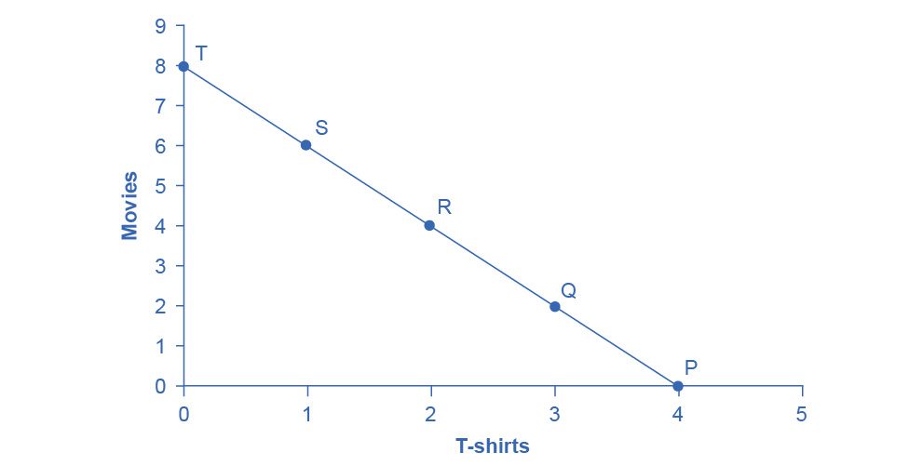
The Budget Constraint
Your Economic Reality Check
Shows all affordable combinations of two goods
Slope = opportunity cost (what you give up)
Any point on the line uses entire budget
Points inside = under budget; outside = unaffordable
Analogy: Like a fence around your consumption possibilities—you can choose any point on or inside the fence, but can't jump over it
José has total income of $56.
Movies cost $7 and T-shirts cost $14.
The points on the budget constraint line show the combinations of movies and T-shirts that are affordable.
Which combination does Jose actually choose?
José wishes to choose the combination that will provide him with the greatest utility, which is the term economists use to describe a person’s level of satisfaction or happiness with their choices.
How does that work?
Notes:
The budget constraint is a visual representation of your economic reality. It shows all the possible combinations of two goods you can afford with your limited income and given prices. Picture it as a fence around your consumption possibilities—you can choose any combination on or inside the fence, but you can't magically jump over it to afford things beyond your budget. The slope of the budget constraint line represents opportunity cost: it shows how many units of one good you must give up to get more of the other. For example, if movies cost $7 and T-shirts cost $14, the opportunity cost of one T-shirt is two movies. Every point on the line represents spending your entire budget. Points inside the line mean you're not spending all your money—you have budget left over. Points outside the line are unaffordable combinations you can't reach with your current income. The budget constraint is a powerful tool because it forces us to confront trade-offs. You can't have everything, so what combination will give you the most satisfaction?

Slide 6
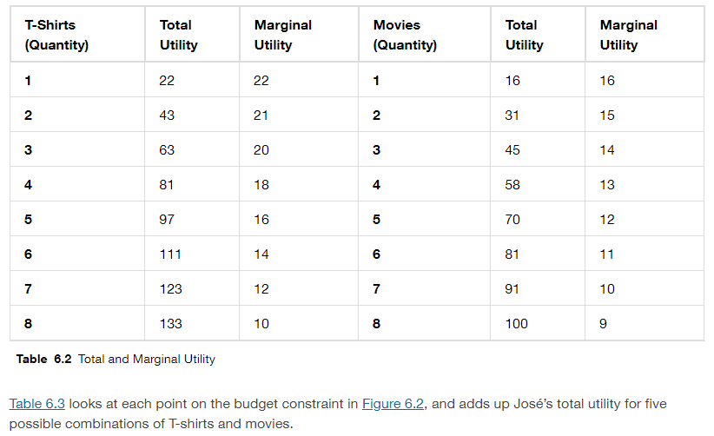
Jose’s Total and Marginal Utility
Notes:
Transcript:
Let’s begin with an assumption, which we will discuss in more detail later, that José can measure his own utility with something called utils.
Total utility is the satisfaction derived from consumer choices.
The table shows both Jose’s total utility for T-Shirts and Movies. Generally, his total utility or satisfaction will increase the more of them he has. In the table, you can see total utility indeed increasing as the quantity increases.
The marginal utility is the additional utility provided by one additional unit of consumption.
Notice that marginal utility diminishes as additional units are consumed, which means that each subsequent unit of a good consumed provides less additional utility. For example, the first T-shirt José picks is his favorite and it gives him an addition of 22 utils. The fourth T-shirt is just something to wear when all his other clothes are in the wash and yields only 18 additional utils. This is an example of the law of diminishing marginal utility, which holds that the additional utility decreases with each unit added.

Slide 7
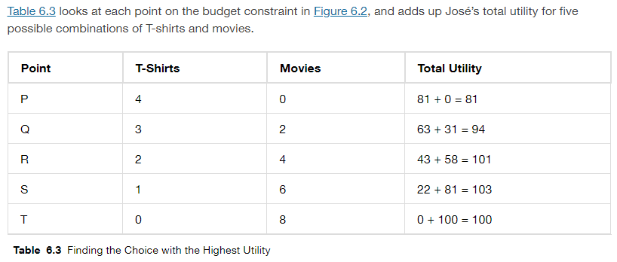
Jose’s Choice Problem
Case Study: José's Decision
Budget: $56 T-shirts: $14 each | Movies: $7 each
Options on budget line:
4 T-shirts, 0 movies (Point P) → TU = 81
2 T-shirts, 4 movies (Point R) → TU = 101
1 T-shirt, 6 movies (Point S) → TU = 103 ✓
0 T-shirts, 8 movies (Point T) → TU = 100
José chooses Point S: maximum utility
Notes:
Let's work through a concrete example with José, who has $56 to spend on T-shirts and movies. T-shirts cost $14 each, and movies cost $7 each. José could spend all his money on 4 T-shirts and see no movies—this is point P on his budget constraint, giving him a total utility of 81 utils. Or he could buy 2 T-shirts and see 4 movies—point R with a total utility of 101 utils. He could choose 1 T-shirt and 6 movies—point S with a total utility of 103 utils. Or he could skip T-shirts entirely and see 8 movies—point T with a total utility of 100 utils. After calculating the total utility at each affordable combination, José discovers that point S—buying 1 T-shirt and attending 6 movies—gives him the highest total utility of 103 utils. This is his utility-maximizing choice. Notice that José doesn't choose the extreme of all T-shirts or all movies. He finds a balanced combination that maximizes his overall satisfaction given his budget constraint.

Slide 8
The Decision rule
Utility Maximization Rule
Marginal Utility per Dollar: MU per $ = MU ÷ Price
Optimization Rule: MU₁/P₁ = MU₂/P₂
At optimal choice, last dollar spent on each good provides equal marginal utility
Analogy: Like balancing a scale—keep shifting purchases until both sides give equal "bang for your buck"
Notes:
Economists have discovered a powerful decision rule for maximizing utility. The key concept is marginal utility per dollar—how much extra satisfaction you get per dollar spent on a good. You calculate this by dividing the marginal utility by the price. The optimization rule states that you maximize utility when the marginal utility per dollar is equal across all goods you purchase. Mathematically, MU₁ divided by P₁ should equal MU₂ divided by P₂. Why does this make sense? Imagine marginal utility per dollar is higher for movies than T-shirts. This means movies are giving you more "bang for your buck." You should buy more movies and fewer T-shirts, which will raise the marginal utility of T-shirts (because you have fewer) and lower the marginal utility of movies (because you have more) until they balance. Think of it like balancing a scale. You keep shifting purchases from one good to another until both sides are perfectly balanced—meaning the last dollar spent on each good gives you equal additional satisfaction. At this point, you can't improve your situation by reallocating your budget, so you've maximized utility.

Slide 9
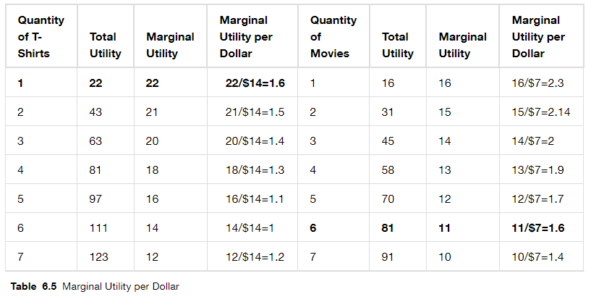
Jose’s optimal Choice
2.3 > 1.6 so add another movie.
2.14 > 1.6 so add another movie.
2 > 1.6 so add another movie.
1.9 > 1.6 so add another movie.
1.7 > 1.6 so add another movie.
1.6 = 1.6 Stop! Total Utility will be maxed at 1 T-Shirt, 6 Movies.
Notes:
Let's see how José uses the marginal utility per dollar rule to find his optimal choice. José starts by comparing options. The first T-shirt has a marginal utility of 22 and costs $14, giving a marginal utility per dollar of 1.6. The first movie has a marginal utility of 16 and costs $7, yielding 2.3 utils per dollar. Since movies provide more satisfaction per dollar, José buys movies first. He continues buying movies because they keep offering higher marginal utility per dollar. The second movie gives 2.14 utils per dollar, the third gives 2.0, and so on. José keeps buying movies until he reaches the sixth movie, which provides marginal utility per dollar of 1.6—exactly equal to what the first T-shirt offers. At this point, José has found the balance. The sixth movie and the first T-shirt both provide 1.6 utils per dollar. If he bought a seventh movie, it would only give 1.4 utils per dollar—less than the T-shirt. So José's optimal choice is 1 T-shirt and 6 movies, exactly what we found by comparing total utilities. This rule gives us a systematic way to find utility-maximizing choices.

Slide 10
changes in income
How Income Changes Affect Choices
Income Increase → Budget constraint shifts outward
Normal goods: Buy more when income rises (Most goods: food, clothing, entertainment)
Inferior goods: Buy less when income rises (Ramen noodles, used cars, bus tickets)
Analogy: Getting a raise means upgrading from fast food to sit-down restaurants
Notes:
Now let's examine what happens when your income changes. When your income increases, your budget constraint shifts outward—parallel to the original line. This means you can afford more of both goods. For most products, called normal goods, people buy more when their income rises. These include things like restaurant meals, new clothing, entertainment, and travel. When you get a raise, you typically consume more of these goods. However, some goods are classified as inferior goods—not because they're low quality, but because people buy less of them as income rises. Classic examples include ramen noodles, fast food, used cars, and public transportation. When a college student graduates and lands a good job, they typically stop living on ramen noodles and start buying fresher food. They might stop taking the bus and buy a car. They're not buying less ramen because they suddenly hate it—they're buying less because they can now afford better alternatives. Think about your own life—when you got your first real paycheck, what did you stop buying? Those were probably inferior goods for you.

Slide 11
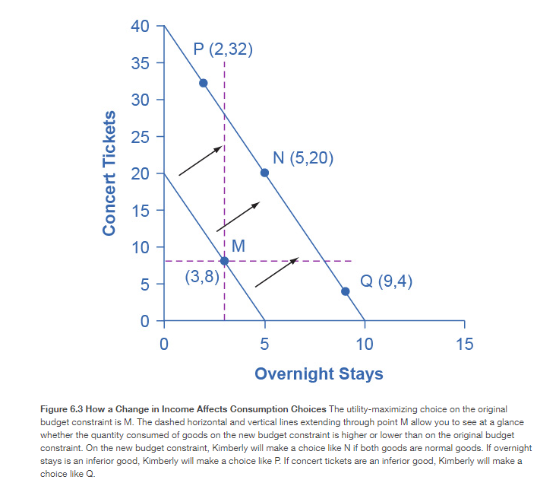
Example: Concert Tickets vs. Overnight Getaway, if Income Increases
An increase in income will move the budget constraint outward. Points P, N, and Q are on the new budget constraint.
On the new budget constraint, a choice like N will be made if both goods are normal goods.
If overnight stays is an inferior good, a choice like P will be made.
If concert tickets are an inferior good, a choice like Q will be made.

Slide 12
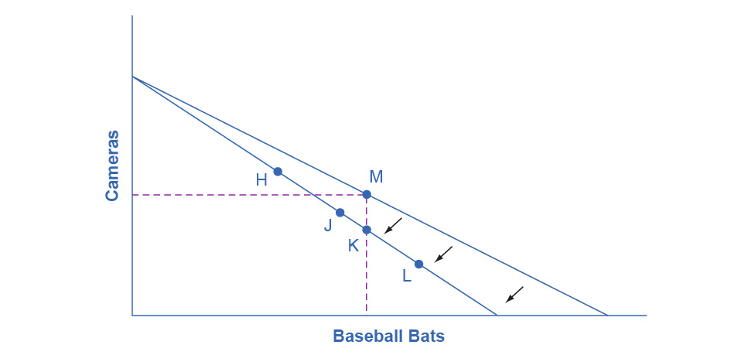
Changes in Price
How Price Changes Affect Choices
Price Increase → Budget constraint rotates inward (Pivots on the axis of the unchanged good)
Two effects occur simultaneously:
Substitution Effect: Buy less of the expensive good, more of relatively cheaper alternatives
Income Effect: Higher prices reduce purchasing power, so buy less (for normal goods)
Notes:
Price changes work differently than income changes. When the price of one good increases, the budget constraint rotates inward, as if on a hinge. Imagine the price of baseball bats rises but camera prices stay the same. The budget line pivots on the camera axis—you can still afford the same number of cameras if you buy no bats, but you can now afford fewer bats. Two important effects happen simultaneously when prices change. First, the substitution effect kicks in: when one good becomes relatively more expensive, you have an incentive to substitute away from it toward relatively cheaper alternatives. If beef prices rise but chicken stays the same, you'll likely buy more chicken and less beef. Second, the income effect occurs: even though your actual income hasn't changed, higher prices reduce your purchasing power—you effectively feel poorer. For normal goods, this means you buy less of the now-more-expensive product. These effects reinforce each other. If gas prices double, you'll drive less both because driving is now relatively more expensive compared to alternatives like walking or biking (substitution effect) and because you feel poorer overall (income effect).

Slide 13
Foundations of Demand Curves
From Utility to Demand
Price changes → Budget constraint rotates → Quantity demanded changes
As price rises: Consumers seeking maximum utility choose less of that good
This generates the demand curve: Price ↑ → Quantity demanded ↓ (ceteris paribus)
The logic of utility maximization creates the law of demand
Notes:
Here's where everything comes together. The concepts of utility maximization and budget constraints provide the logical foundation for demand curves—one of the most fundamental tools in economics. When the price of a good changes, the budget constraint rotates. As we've discussed, consumers seeking to maximize utility will adjust their consumption. Generally, as price increases, consumers choose less of that good—both because of substitution effects and income effects. If we track these changes, plotting different prices against the quantities demanded at each price, we generate a demand curve. The demand curve slopes downward, reflecting the law of demand: as price increases, quantity demanded decreases, ceteris paribus—all else being equal. This is not just an empirical observation; it's grounded in the logical behavior of utility-maximizing consumers facing budget constraints. When you see a demand curve in economics, remember it represents millions of individual consumers, each solving their own utility maximization problem, responding rationally to price changes within their budget constraints.

Slide 14
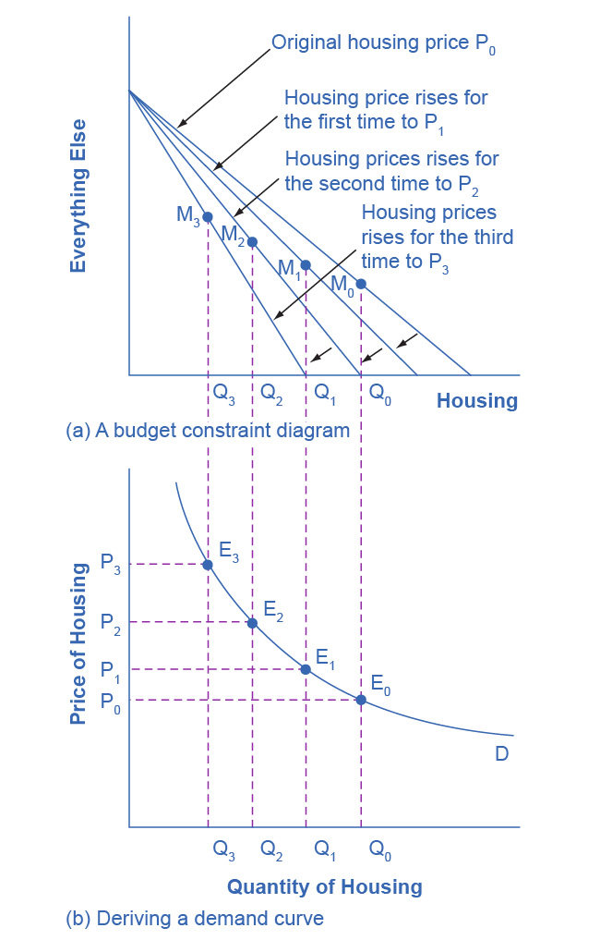
Foundations of a Demand Curve: An Example
In (a) as the price increases from P₀ to P₁ to P₂ to P₃, the budget constraint on the upper part of the diagram rotates inward.
The utility-maximizing choice changes from M₀ to M₁ to M₂ to M₃.
As a result, the quantity demanded of housing shifts from Q₀ to Q₁ to Q₂ to Q₃, ceteris paribus.
The demand curve (b) graphs each combination of the price of housing and the quantity of housing demanded, ceteris paribus.
The quantities of housing are the same at the points on both (a) and (b).
Thus, the original price of housing (P₀) and the original quantity of housing (Q₀) appear on the demand curve as point E₀.
The higher price of housing (P₁) and the corresponding lower quantity demanded of housing (Q₁) appear on the demand curve as point E₁.

Slide 15
Behavioral Economics
When "Irrational" Makes Sense
Traditional economics assumes:
Perfect rationality
Complete self-control
Dollars are fungible (interchangeable)
Behavioral economics recognizes:
Emotions and mental states affect decisions
Predictable "irrational" patterns exist
Context matters
Notes:
Traditional economic theory assumes people are perfectly rational—that we make consistent, informed decisions always in our best interest. But behavioral economics challenges this view. Behavioral economists, drawing on psychology, argue that human decision-making is more complex. They don't claim people are irrational; rather, they show that emotions, mental states, and context systematically affect our choices in predictable ways. Traditional economists might say that if you lose $10 and then find $10, you should feel neutral—after all, negative 10 plus 10 equals zero. But behavioral research shows most people still feel upset. We focus more on losses than equivalent gains. Traditional theory assumes complete self-control, but people buy cigarettes by the pack instead of the carton to limit consumption, even though cartons are cheaper per cigarette. We deliberately overpay taxes to force ourselves to save. Traditional economics assumes dollars are fungible—completely interchangeable—but people often practice mental accounting, treating money differently based on its source. You might be careful with hard-earned money but frivolously spend $50 you found on the street, even though they're economically equivalent.

Slide 16
Loss Aversion
Losses Hurt More Than Gains Help
Research finding (Kahneman & Tversky): A $1 loss causes 2.25 times more pain than a $1 gain causes pleasure
Real-world implications:
Investors overreact to market losses
People avoid risks even with positive expected value
Status quo bias ("better safe than sorry")
Analogy: Losing a $20 bill feels worse than the joy of finding $20
Notes:
One of the most important discoveries in behavioral economics is loss aversion, documented by Nobel laureate Daniel Kahneman and his colleague Amos Tversky. Their research found that losses hurt us about 2.25 times more than equivalent gains help us. Think about your own experience: losing a $20 bill creates a significant negative emotional response—maybe you're upset for hours. But finding $20 on the street, while nice, probably doesn't make you 2.25 times as happy. This asymmetry has major implications. In investing, loss aversion causes people to overreact to market downturns, selling in a panic and missing subsequent recoveries. People often avoid risks even when the expected value is positive because the potential loss looms larger than the potential gain. We exhibit status quo bias, preferring to stick with what we have rather than risk a change, even when change might benefit us. This helps explain why people stay in unsatisfying jobs, why companies resist innovation, and why customers stick with inferior products out of familiarity. Understanding loss aversion helps explain many behaviors that seem irrational from a traditional economic perspective but make perfect sense once we understand how the human mind actually processes gains and losses.

Slide 17
Mental accounting
Not All Dollars Are Equal
Traditional view: All dollars have equal value (fungible)
Behavioral reality: We categorize money differently
Examples:
"Found money" vs. "earned money"
Carrying credit card debt while maintaining savings
Not mixing "vacation fund" with "emergency fund"
Notes:
Mental accounting is another fascinating behavioral economics concept that challenges traditional theory. Economists typically assume dollars are fungible—that $50 has the same value regardless of where it came from or what you plan to use it for. But behavioral research shows we mentally categorize money into different "accounts," and we treat these accounts differently. Imagine you're walking down the street and find $50, versus working an eight-hour shift to earn $50. Economically, these are identical—both add $50 to your wealth. But psychologically, many people treat them very differently. The found money might be considered "mad money" you spend frivolously on something fun, while the earned money goes toward necessities or savings. Here's a puzzling example that illustrates mental accounting: someone might carry $1,000 in credit card debt at 15% annual interest while simultaneously maintaining $2,000 in a savings account earning 2% interest. They're paying $150 annually in credit card interest while earning only $40 in savings interest—a net loss of $110 per year. A rational economist would say pay off the credit card! But people often resist because they treat savings as sacred and separate from debt. They don't view these dollars as fungible. While this might seem irrational, it reflects the psychological reality of how people manage money.

Slide 18
Key Takeaways
Chapter 6 Summary
Consumers maximize utility given budget constraints
Marginal utility diminishes with each additional unit
Optimal choice: MU₁/P₁ = MU₂/P₂
Income changes shift budget constraint
Price changes rotate budget constraint
Behavioral economics explains "irrational" patterns
Understanding consumer choice is the foundation of demand analysis
Notes:
Let's summarize the key concepts from this chapter. First, consumers face a fundamental challenge: maximizing utility—satisfaction—given their budget constraints. We want unlimited things, but we have limited money. Second, the law of diminishing marginal utility is universal: each additional unit of consumption provides less extra satisfaction than the previous unit. Third, we found the optimization rule for utility maximization: the marginal utility per dollar should be equal across all goods purchased. When you've allocated your budget so that every good gives you the same bang for your buck on the margin, you've maximized utility. Fourth, income changes shift the budget constraint outward or inward, generally causing people to buy more normal goods and less inferior goods. Fifth, price changes cause the budget constraint to rotate, affecting consumption through both substitution effects and income effects. Finally, behavioral economics enriches our understanding by incorporating psychology, explaining behaviors that traditional economics might dismiss as irrational but which actually follow predictable patterns based on how the human mind works. These concepts provide the foundation for understanding demand in markets and consumer behavior throughout the economy.

