Slide 1

Chapter 3 Demand and Supply How Markets Determine Prices
Notes:
Welcome to our comprehensive exploration of demand, supply, and market equilibrium. This presentation consolidates the fundamental concepts that explain how prices emerge in market economies. We'll examine the mechanics of demand and supply, analyze what causes market changes, and explore the consequences of government intervention through price controls. These concepts explain the price changes you experience daily—from grocery stores to gas pumps, from rental markets to labor markets. Understanding this model provides powerful insights into economic coordination and resource allocation.

Slide 2
THE PRICE MECHANISM
A PRICE IS A SIGNAL WRAPPED IN AN INCENTIVE
Information + Motivation
Signals scarcity: Pandemic lumber prices tripled → "We don't have enough wood"
Motivates response:
Consumers: Postpone projects, seek alternatives
Producers: Ramp up production
Entrepreneurs: Develop innovations
Enables fine-tuned adjustments at the margin
Dairies divert 2% more milk to yogurt when prices rise
Resources flow to highest-valued uses
Prevents both wasteful excess and painful shortages
Notes:
Prices aren't just arbitrary numbers—they're packed with information AND motivation. Consider pandemic lumber prices: when they tripled, that spike wasn't just painful for homebuilders; it conveyed crucial information about scarcity. But prices do more than inform—they create powerful incentives to fix problems.
The same high lumber price that signaled scarcity also motivated consumers to hold off on renovations or find alternatives, producers to increase production, and entrepreneurs to develop wood substitutes or more efficient harvesting methods. This dual nature makes prices uniquely powerful for coordinating economic activity.
What's often overlooked is how prices enable incremental, fine-tuned adjustments rather than drastic all-or-nothing decisions. Dairies don't make binary choices about sending all milk to cheese or all to ice cream. Instead, they constantly adjust at the margin—perhaps diverting just 2% more milk to yogurt when its price rises slightly. Each gallon flows to its highest-valued use. This constant calibration happens millions of times daily across the economy, preventing both wasteful excess and painful shortages—all without central coordination.

Slide 3
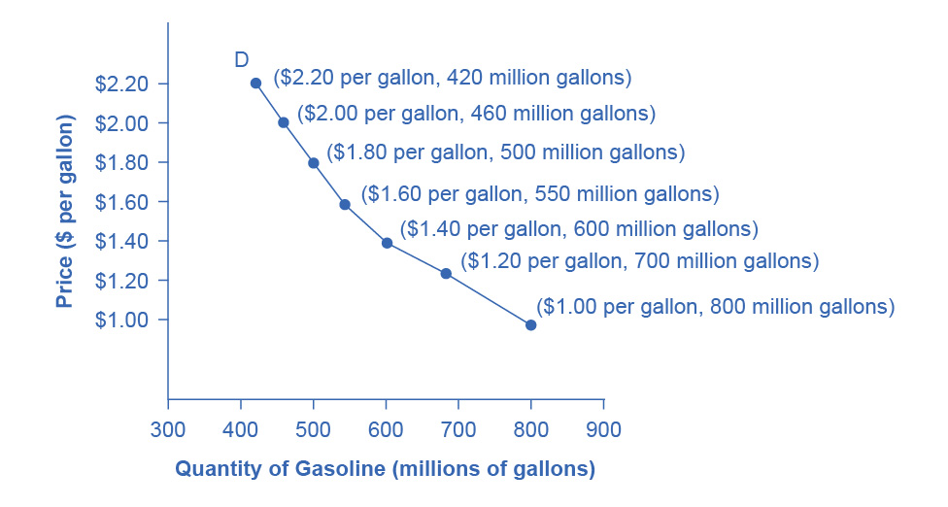
DEMAND FUNDAMENTALS
DEMAND
Definition: Consumer willingness AND ability to buy at each price
Law of Demand (Inverse Relationship)
↑ Price → ↓ Quantity Demanded
↓ Price → ↑ Quantity Demanded
Key Distinction
Demand = Entire curve (whole relationship)
Quantity Demanded = One point on curve (specific price)
Demand curves slope downward from left to right
Notes:
Demand represents consumers' willingness AND ability to purchase at each price. Both elements matter—if you have no need or want, you won't buy. If you can't pay, you have no effective demand. For example, someone without a driver's license has no effective demand for a car.
The Law of Demand describes an inverse relationship between price and quantity demanded. When gasoline prices increase, people combine errands, carpool, take mass transit, or vacation closer to home. When prices fall, the opposite occurs.
Here's a critical distinction that prevents confusion later: "Demand" refers to the entire relationship between prices and quantities—the whole curve. "Quantity demanded" refers to one specific point on that curve at a particular price. When we plot demand schedules on graphs with price on the vertical axis and quantity on the horizontal axis, we see downward-sloping demand curves. Nearly all demand curves share this fundamental characteristic, though they may be steeper, flatter, straight, or curved depending on the specific product.

Slide 4
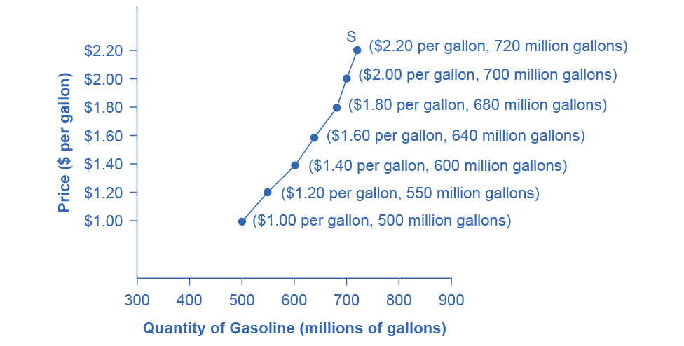
Supply Fundamentals
SUPPLY
Definition: Producer willingness to produce/sell at each price
Law of Supply (Direct Relationship)
↑ Price → ↑ Quantity Supplied
↓ Price → ↓ Quantity Supplied
Key Distinction
Supply = Entire curve (whole relationship)
Quantity Supplied = One point on curve (specific price)
Supply curves slope upward from left to right
Notes:
Supply represents producers' willingness to produce and bring to market at each price. The Law of Supply describes a direct relationship: as price rises, quantity supplied rises; as price falls, quantity supplied falls.
When gasoline prices rise, profit-seeking firms expand exploration for oil reserves, drill for more oil, invest in pipelines and tankers, build new refineries, purchase additional distribution infrastructure, and open more gas stations or keep them open longer hours. When prices fall, these activities contract. The higher price makes these activities profitable; the lower price makes them unprofitable.
Just as with demand, we must distinguish between "supply"—the entire curve showing the relationship across all prices—and "quantity supplied"—one specific point on the curve. Supply curves typically slope upward from left to right, illustrating the law of supply. The shape varies by product, but this fundamental upward slope remains consistent. Understanding this distinction between moving along a curve versus shifting the entire curve becomes crucial when analyzing market changes.

Slide 5
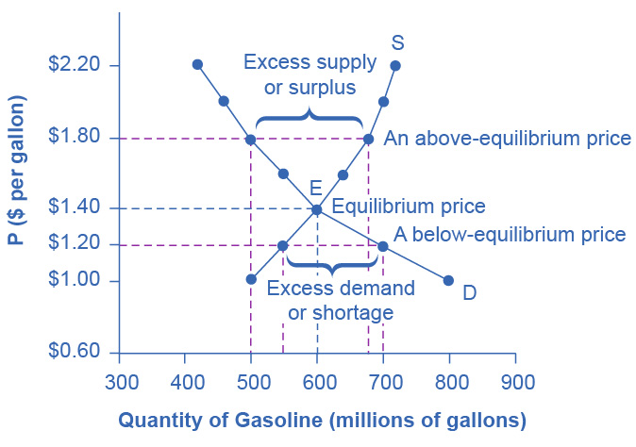
Market Equilibrium
EQUILIBRIUM: WHERE DEMAND AND SUPPLY MEET
Equilibrium = Quantity Demanded = Quantity Supplied
Graphically: intersection of D and S curves
Only price where buyers' and sellers' plans agree
No pressure to change
Market Forces Correct Imbalances
Surplus (Price > Equilibrium)
QS > QD → Product accumulates → Sellers cut prices
Shortage (Price < Equilibrium)
QD > QS → Product scarce → Sellers raise prices
Notes:
Equilibrium occurs where the supply and demand curves intersect—the point where quantity demanded equals quantity supplied. The equilibrium price is the only price where consumers' and buyers' plans agree on the quantity to exchange. At any other price, economic pressures push the market toward equilibrium.
Consider surplus situations where price exceeds equilibrium. At $1.80 per gallon when equilibrium is $1.40, quantity supplied rises to 680 million gallons while quantity demanded falls to 500 million. Gasoline accumulates at stations, in tankers, and refineries. Firms not receiving enough cash to cover expenses will cut prices because selling at a lower price beats not selling at all. These reductions stimulate higher quantity demanded, pushing price toward equilibrium.
Now consider shortage situations where price falls below equilibrium. At $1.20 when equilibrium is $1.40, quantity demanded increases to 700 million gallons while quantity supplied drops to 550 million. Eager buyers mob gas stations only to find them running short. Recognizing profit opportunities, oil companies and stations raise prices toward equilibrium. These self-correcting mechanisms work without any central coordinator—they're built into the structure of demand and supply.

Slide 6
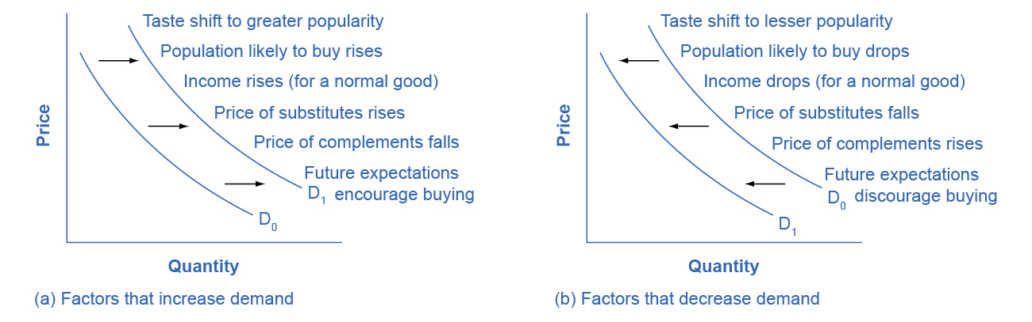
What Shifts Demand?
DEMAND SHIFTERS (Non-price factors)
Income
Normal goods: ↑ Income → ↑ Demand
Inferior goods: ↑ Income → ↓ Demand
Tastes/Preferences
Example: US chicken consumption 47 → 97 lbs/person
Population Composition
Aging society → ↑ nursing home demand
Prices of Related Goods
Substitutes: Tablets ↓ → Laptop demand ↓
Complements: Golf clubs ↑ → Golf balls ↓
Expectations of Future Prices
Expect coffee ↑ → Buy now
Remember:
Price changes = movement ALONG curve Shifters = movement OF entire curve
Notes:
The ceteris paribus assumption—"all else equal"—means demand curves show the relationship between price and quantity demanded assuming no other relevant factors change. But when these other factors DO change, the entire demand curve shifts.
First, income effects vary by product type. For normal goods like cars or restaurant meals, rising income shifts demand right—people demand more at every price. For inferior goods like generic brands or used cars, rising income shifts demand left as people trade up to higher quality.
Second, changing tastes dramatically affect demand. From 1980 to 2021, American chicken consumption rose from 47 to 97 pounds per person annually while beef fell from 76 to 59 pounds—largely due to health concerns and taste changes.
Third, population composition matters. The US elderly population rose from 9.8% in 1970 to 12.6% in 2000, with projections of 20% by 2030, increasing demand for nursing homes and hearing aids.
Fourth, prices of related goods matter. Substitutes can replace each other—falling tablet prices decreased laptop demand. Complements are used together—rising golf club prices decrease golf ball demand.
Fifth, future price expectations affect current demand. If people expect hurricanes, they rush to buy batteries and water now. Each of these factors shifts the entire demand curve rightward for increases, leftward for decreases. This differs fundamentally from price changes, which cause movements ALONG existing curves.

Slide 7
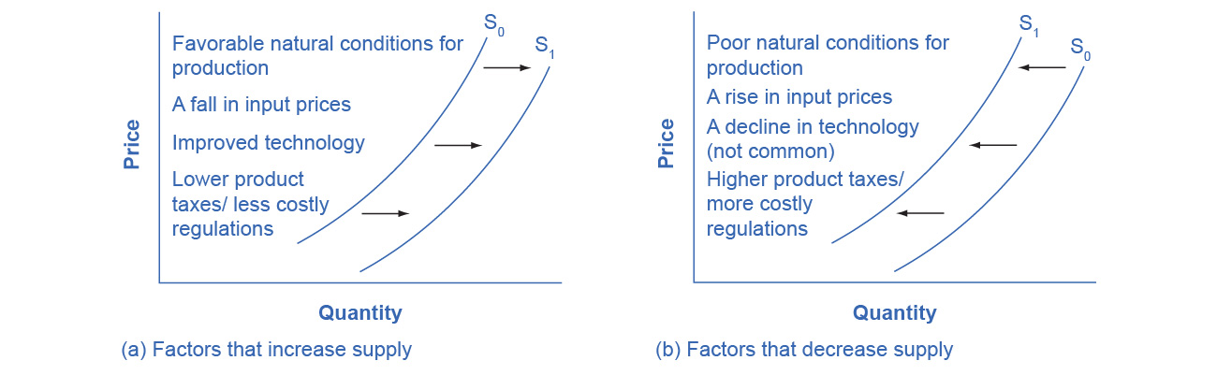
What Shifts Supply?
SUPPLY SHIFTERS (Non-price factors)
Production Costs (Input Prices)
Steel ↑ → Car supply ↓
Energy, labor, materials
Natural Conditions
Drought → Agricultural supply ↓
Excellent weather → Supply ↑
Technology
Green Revolution seeds → Doubled yields
Innovation ↑ → Supply ↑
Government Policies
Taxes/regulations → Supply ↓
Subsidies → Supply ↑
Remember: Only NON-PRICE factors shift supply curve
Notes:
Supply curves also assume ceteris paribus—no relevant factors change except price. When other factors affecting production change, the entire supply curve shifts.
First, production costs critically affect supply. When steel prices rise, producing cars becomes more expensive. At any given selling price, manufacturers now earn lower profits, so they supply less—the supply curve shifts left. Conversely, falling steel prices shift supply right. Input costs include energy, labor, and materials like lumber, steel, and rare earth metals.
Second, natural conditions affect agricultural supply dramatically. The 2014 drought in Northeastern China, producing most of the country's wheat, corn, and soybeans, represented the most severe drought in 50 years, decreasing supply. Conversely, excellent commercial salmon fishing conditions in 2015 California—heavy rains aiding breeding, cooler temperatures stimulating plankton growth, calm seas during fishing season—increased supply.
Third, technology improvements shift supply right. The Green Revolution of the 1960s focused on breeding improved seeds for basic crops. By the early 1990s, more than two-thirds of wheat and rice in low-income countries used these seeds, doubling yields per acre.
Fourth, government policies affect supply through taxes, regulations, and subsidies. The US government collects about $8 billion annually from alcohol taxes, which businesses treat as production costs, shifting supply left. Regulations requiring cleaner environments or safer workplaces increase compliance costs, also shifting supply left. Subsidies work oppositely, reducing effective production costs and shifting supply right.

Slide 8
The four step process
ANALYZING MARKET CHANGES
Step 1: Draw initial model (before change)
Identify equilibrium price and quantity
Step 2: Determine: Demand or Supply affected?
Consumer factors → Demand
Producer factors → Supply
Step 3: Determine direction: Right or Left?
Increase → Right shift
Decrease → Left shift
Step 4: Compare new vs. old equilibrium
Identify new price and quantity
Explain the change
Apply ceteris paribus: analyze one change at a time
Notes:
When economic events affect markets, use this systematic four-step process to avoid confusion.
Step 1: Draw the demand and supply model before the change. This requires understanding the law of demand (negative slope), the law of supply (positive slope), demand shifters, and supply shifters. From this model, identify the initial equilibrium price and quantity.
Step 2: Decide whether the event affects demand or supply. Does the event relate to something in the list of demand factors—income, tastes, population, prices of related goods, expectations? Or does it relate to supply factors—production costs, natural conditions, technology, government policies?
Step 3: Determine whether the effect causes the curve to shift right or left. Does the event increase or decrease the amount consumers want to buy, or producers want to sell? Increases shift right; decreases shift left.
Step 4: Identify the new equilibrium where the new curve intersects the unchanged curve. Compare the new equilibrium price and quantity to the original.
Example: Good weather for salmon fishing is a natural condition affecting supply, so it shifts supply right. The new equilibrium shows lower prices ($3.25 to $2.50) but higher quantity (250,000 to 550,000 salmon). Notice that quantity demanded increased even though the demand curve didn't move—we moved along the existing demand curve in response to the lower price.

Slide 9
Effects of demand and supply changes
PREDICTED OUTCOMES
Demand Increases (→)
Equilibrium P ↑ and Q ↑
Demand Decreases (←)
Equilibrium P ↓ and Q ↓
Supply Increases (→)
Equilibrium P ↓ and Q ↑
Supply Decreases (←)
Equilibrium P ↑ and Q ↓
Pattern:
Demand shift: P and Q move together
Supply shift: P and Q move oppositely
Notes:
Let's summarize the effects of demand and supply changes to build intuition for market analysis.
When demand increases—shifting right—both equilibrium price and quantity rise. More consumers wanting the product at every price drives up both the price and the amount sold. When demand decreases—shifting left—both price and quantity fall.
When supply increases—shifting right—equilibrium price falls while quantity rises. More product available at every price puts downward pressure on price while increasing the amount sold. When supply decreases—shifting left—price rises while quantity falls.
Notice the important pattern: when demand shifts, price and quantity move in the SAME direction—both up or both down. When supply shifts, they move in OPPOSITE directions—price up means quantity down, or price down means quantity up.
When you experience relative price increases and decreases, move beyond simplistic explanations like "greedy businesses" for increases or sudden "altruism" for decreases. The supply and demand model often explains most, if not all, of the price change. Understand which parts of the market—demand, supply, or both—are changing in which directions to explain and predict price changes for eggs, baby formula, gasoline, wages, and rent.
When BOTH curves shift simultaneously, the analysis becomes more complex. We can determine one effect definitively but the other becomes ambiguous without knowing the relative magnitudes.

Slide 10
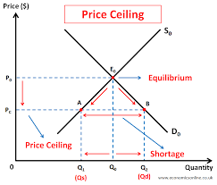
Price Ceilings
PRICE CEILING: LEGAL MAXIMUM PRICE
Purpose: Keep "necessities" affordable
Classic Example: Rent Control
Set below market equilibrium
Creates shortage (QD > QS)
Unintended Consequences:
FEWER apartments rented than at market price
Landlords convert to condos/co-ops
Reduced maintenance, quality deteriorates
Waiting lists, discrimination in allocation
"There's no free lunch—everything has opportunity costs"
Notes:
Price ceilings are legal maximum prices enacted to keep necessities "affordable." Rent control provides the classic example, common in cities like New York, Washington DC, and San Francisco.
Consider this scenario: Rising incomes or changing tastes increase demand for rental housing, shifting demand right. Without intervention, equilibrium would move from $500 rent with 15,000 units to $600 rent with 17,000 units. But suppose government imposes rent control at the original $500 level.
At that controlled price, quantity supplied remains 15,000 units while quantity demanded rises to 19,000 units—creating a shortage of 4,000 units. Here's the irony: the price ceiling intended to help renters actually results in FEWER apartments being rented (15,000) than would exist at the market rent of $600 (17,000 units).
The consequences extend beyond simple arithmetic. Some renters lose housing as landlords convert apartments to co-ops and condos—removing them from rental markets entirely. Even remaining rental units deteriorate as landlords spend less on maintenance, heating, cooling, hot water, and lighting. Those lucky enough to secure rent-controlled apartments benefit, but sellers suffer losses, and many potential renters face shortages.
The first rule of economics applies: you don't get something for nothing—everything has opportunity costs. If renters obtain "cheaper" housing than the market requires, they typically end up with lower quality housing and reduced availability.

Slide 11
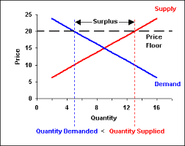
Price floors
PRICE FLOOR: LEGAL MINIMUM PRICE
Purpose: Support producer income
Classic Example: Agricultural Price Supports
Set above market equilibrium
Creates surplus (QS > QD)
Government Response:
Purchases excess supply
High-income countries: ~$1 billion/day supporting farmers
Consequences:
Farmers benefit from higher prices
Taxpayers fund government purchases
Consumers pay higher food prices
Resources inefficiently allocated
Notes:
Price floors are legal minimum prices that prevent prices from falling below a certain level. Agricultural price supports provide the primary example, though minimum wage laws also represent price floors in labor markets.
The most common mechanism: government enters the market and buys the excess product, adding to demand to keep prices higher than they otherwise would be. According to 2019 data, the European Union spends about 65.5 billion dollars annually—roughly 36% of its entire budget—on agricultural price supports.
Consider wheat markets: Without intervention, equilibrium would establish a price and quantity where supply equals demand. But policies to keep prices high for farmers set a price floor above equilibrium. The result: quantity supplied exceeds quantity demanded, creating a surplus.
Economists estimate high-income areas including the United States, Europe, and Japan spend roughly $1 billion PER DAY supporting farmers. While farmers benefit from higher prices guaranteed by government purchases, taxpayers fund these purchases, and consumers pay higher food prices than would exist at market equilibrium.
The economic inefficiency is clear: scarce resources are used to produce too much of various agricultural products. Alternative policy tools—like direct income support decoupled from production, crop insurance subsidies, or environmental conservation payments—could achieve the goal of supporting farm income while avoiding at least some of these costs and the surplus production problem. However, political support for traditional subsidies remains strong due to views about preserving rural lifestyles or agribusiness lobbying power.

Slide 12
Key Insights
FUNDAMENTAL PRINCIPLES
✓ Prices coordinate millions of decisions without central direction
✓ Market forces self-correct surpluses and shortages
✓ Distinguish movements along curves vs. shifts of curves
✓ Analyze systematically using the four-step process
✓ Price controls create unintended consequences
✓ Economic thinking goes beyond surface explanations
"Markets and voluntary cooperation enable extraordinary coordination—from pencils to airliners"
Notes:
Let's conclude with fundamental insights from the demand and supply model.
First, prices coordinate economic activity without central direction. Through signals and incentives, millions of decisions get coordinated daily. Markets test different business ideas, management styles, and production methods through the profit and loss mechanism. Profits reward providing value to customers and signal resources are being used wisely. Losses penalize failing to provide value and signal resources are being wasted.
Second, market forces self-correct imbalances. Surpluses create pressure for prices to fall; shortages create pressure for prices to rise. These adjustments occur through voluntary exchange, not government mandate.
Third, always distinguish between movements along existing curves—caused by price changes—and shifts of entire curves—caused by non-price factors. This distinction prevents analytical errors.
Fourth, use the four-step process systematically. Draw the initial model, identify whether demand or supply is affected, determine the direction of the shift, and compare equilibria. This framework prevents confusion and builds economic intuition.
Fifth, price controls—ceilings and floors—create unintended consequences that often undermine their stated goals. Shortages, quality deterioration, surpluses, and inefficiency frequently result. Alternative policies often achieve goals with fewer costs and tradeoffs.
Finally, economic thinking requires going beyond simplistic surface explanations. When prices change, ask: What's changing on the demand side? The supply side? Or both? Master this model, and you'll understand economic forces shaping your daily life. Thank you.

