Slide 1

Chapter 4
Labor & Financial Markets
Notes:
Welcome to Chapter 4, where we apply supply and demand analysis beyond the goods market. Today we'll explore how labor markets determine your salary and how financial markets determine interest rates. These principles affect whether you get that job interview, how much student loan interest you'll pay, and even your future retirement.

Slide 2
MARKETS BEYOND GOODS & Services
Key Insight: Supply and demand work in all markets—not just for products.
Three Market Types:
Goods & Services Markets: Businesses supply, households demand
Labor Markets: Workers supply, employers demand
Financial Markets: Savers supply, borrowers demand
Real-World Connection: As college students, you're already in both markets—43% of full-time students work (labor market) and 43% borrow for education (financial market).
Notes:
Think of markets like dating apps—different platforms for different exchanges. Just as Tinder connects people romantically, labor markets connect workers with employers, and financial markets connect those with extra money to those who need it. The same fundamental laws apply: scarcity, competition, and price signals. When you applied for your part-time job, you entered a labor market. When you took out student loans, you entered a financial market as a borrower.

Slide 3
Labor Market Fundamentals
The "Jobs Tinder" Analogy:
Supply side: Job seekers (you're "swiping right" on employers)
Demand side: Employers (they're "swiping right" on qualified workers)
Match (equilibrium): When wage clears the market
Laws in Action:
↑ Wage → employers hire fewer workers, more people want jobs
↓ Wage → employers hire more workers, fewer people want jobs
Notes:
Labor markets are like a sophisticated matching system. The "price" is your wage or salary. Think of nurses in Minneapolis: at $85,000/year equilibrium, exactly 41,000 nurses want to work AND exactly 41,000 positions are available—a perfect match. If hospitals offered $90,000, suddenly 45,000 people want nursing jobs but only 40,000 positions exist—creating a surplus. Conversely, at $70,000, only 27,000 want to be nurses but 52,000 positions need filling—a shortage that pushes wages up.

Slide 4
What Shifts Labor Demand?
Remember: Demand for labor is "derived demand" (depends on demand for the product)
Factor | Example | Effect on Demand
Product demand | Taylor Swift concert boom | ↑ demand for venue staff
Worker productivity | Well-trained coders | ↑ demand for skilled workers
Technology (substitute) | AI chatbots | ↓ demand for customer service reps
Technology (complement) | Data analytics tools | ↑ demand for data scientists
Number of firms | New Amazon warehouse | ↑ demand for warehouse workers
Government rules | Nursing license requirements | ↑ demand for licensed nurses
Notes:
Here's the crucial insight: employers don't hire workers for fun—they hire because consumers want products. This is "derived demand." If Tesla sells more cars, they need more assembly workers. The demand curve shifts right. But here's where it gets interesting: technology can be a double-edged sword. Word processing software replaced typists (substitute—demand shifted left), but it created demand for IT support (complement—demand shifted right). This explains wage inequality we'll discuss later.

Slide 5
What Shifts Labor Supply?
The "Talent Pool" Changes:
Modern Twist - The "TikTok Effect":
Finance influencer posts "easy money in freelance design" → Gen Z floods Fiverr → supply surges right → wages fall unless demand also rises
Factor | Viral Example | Effect on Supply
More workers | Immigration reform passes | ↑ supply shifts right
Fewer workers | #GreatResignation / "QuitTok" trend | ↓ supply shifts left
Education barriers | Requiring PhD vs. high school | ↓ supply (fewer qualified)
Government policy | Nursing school subsidies | ↑ supply shifts right
Notes:
Supply shifts when the number of available workers changes. Think about the pandemic's impact: millions left service jobs for remote work or early retirement—supply shifted left, creating those "help wanted" signs everywhere. Employers had to raise wages to attract workers back. Alternatively, when TikTok makes a career look glamorous, supply floods in. Government can manipulate supply too: subsidize nursing schools, and you get more nurses. Require expensive licenses, and supply shrinks.

Slide 6
Technology and Wage Inequality
The Skills Premium Story (1980-2019):
1980: College grad earned 30% more than high school grad
2019: College grad earned 59% more than high school grad
Why? Technology's Dual Impact:
Analogy: Technology is like a corporate ladder with a broken middle—it elevates those at the top while removing rungs for those climbing up
Worker Type | Technology Acts As | Demand Shift | Wage Change
Low-skill | Substitute (replaces file clerks) | ← Left | ↓ Wages fall
High-skill | Complement (enhances managers) | Right → | ↑ Wages rise
Notes:
This is one of the most important economic trends of our lifetime. Technology doesn't affect all workers equally. If you're a file clerk, computers replaced you—demand shifted left, wages fell. But if you're a manager, computers made you more productive—you can oversee more people, analyze more data—demand shifted right, wages rose. This is why your parents constantly tell you to get skills that complement technology, not compete with it. The gap isn't narrowing—it's widening.

Slide 7
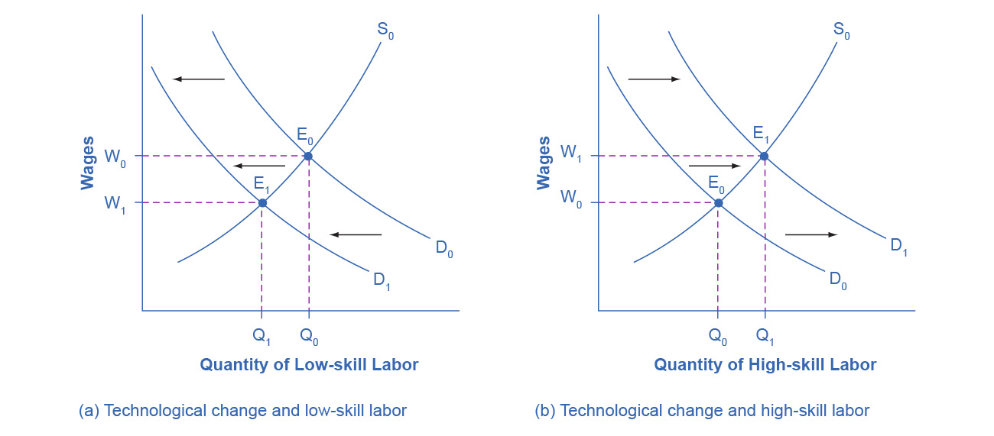
Applying Demand and Supply
(a) The demand for low-skill labor shifts to the left when technology can do the job previously done by these workers.
(b) New technologies can also increase the demand for high-skill labor in fields such as information technology and network administration.

Slide 8
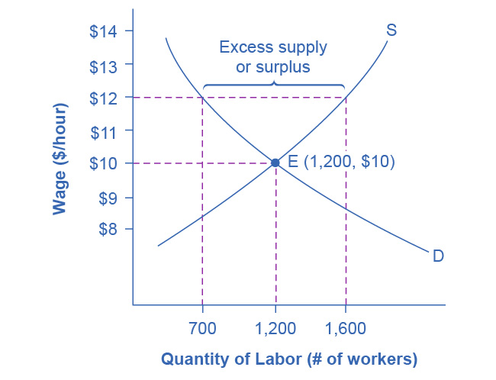
MINIMUM WAGE AS PRICE FLOOR
Living Wage Example: City requires $12/hour (equilibrium is $10/hour)
Outcome:
Quantity demanded: 700 workers (employers cut hiring)
Quantity supplied: 1,600 workers (more want jobs)
Result: 900 worker surplus = unemployment
Winners & Losers:
✅ Winners: 700 workers who keep jobs at higher pay
❌ Losers: 900 workers who wanted jobs but can't find them
The Restaurant Math:
Before: 10 workers × 40 hrs × $12/hr = $4,800/week
After: 10 workers × 40 hrs × $20/hr = $8,000/week
Challenge: Cover $3,200 extra weekly cost
Notes:
Let's be clear-eyed about minimum wage economics. It's a price floor—a legal minimum price. When set above equilibrium, it creates unemployment. But who loses their job? Those with least experience, skills, and education—often the very people the law intended to help. Employers respond in predictable ways: cut hours, eliminate benefits, automate (hello, McDonald's kiosks), raise prices or close entirely. The true minimum wage is always zero if you can't find a job. Now, economics can't tell us whether we should have a minimum wage—that's a values question. But it can clarify the tradeoffs: some win, more lose. About 1.5% of workers earn minimum wage, so for most workers, market forces determine pay.

Slide 9
MONOPSONY VS. EFFICIENCY WAGES
Rare Case - Monopsony (single employer in town)
Example: Only hospital in rural area
Power imbalance: employer sets low wages
Solution: Competition is best regulator
Common Case - Efficiency Wages (above-market pay)
Why pay more than you have to?
Analogy: Costco vs. Walmart strategy—Costco pays above market and gets lower turnover, higher productivity
Reason | Business Benefit
Higher productivity | Workers exert more effort
Lower turnover | Saves hiring/training costs
Better applicants | Attracts top talent
Reduced shirking | Job too valuable to lose
Notes:
Students often worry about employer exploitation. Legitimate concern, but monopsony—a single employer—is rare. Most workers have options, and employers compete for talent. In fact, many employers voluntarily pay above market rates through "efficiency wages." Why? Costco is the perfect example: they pay checkout workers significantly more than Walmart. Result? Lower turnover saves money on recruiting and training. Workers are more motivated and productive. It's not charity—it's smart business, especially in tight labor markets where unemployment is low.

Slide 10
Financial Market Fundamentals
The Money Exchange:
Supply side: Savers (you deposit $1,000 in savings)
Demand side: Borrowers (you take out car loan)
Price: Interest rate (% return for savers / % cost for borrowers)
Credit Card Market Example (2021):
200 million cardholders
$807 billion outstanding debt
15% average interest rate
Equilibrium: $600 billion borrowed/lent
Notes:
Financial markets are just money rental markets. When you put money in a savings account, you're "renting" it to the bank, and they pay you rent called interest. When you borrow for a car, you're renting money from the lender, and you pay them rent. The interest rate is simply the price of renting money. Higher rates? Fewer people want to borrow (law of demand), but more people want to save (law of supply). At 15% for credit cards, the market clears at $600 billion—that's where the amount people want to borrow equals the amount credit card companies want to lend.

Slide 11
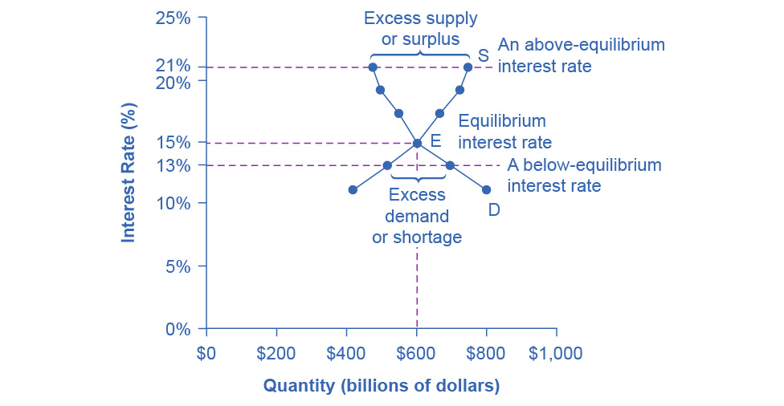
Demand and Supply for Borrowing Money
In this market for credit card borrowing, the demand curve (D) for borrowing financial capital intersects the supply curve (S) for lending financial capital at equilibrium (E).
At the equilibrium, the interest rate (the “price” in this market) is 15% and the quantity of financial capital being loaned and borrowed is $600 billion.
At an above-equilibrium interest rate like 21%, the quantity of financial capital supplied would increase to $750 billion, but the quantity demanded would decrease to $480 billion.
At a below-equilibrium interest rate like 13%, the quantity of financial capital demanded would increase to $700 billion, but the quantity of financial capital supplied would decrease to $510 billion.

Slide 12
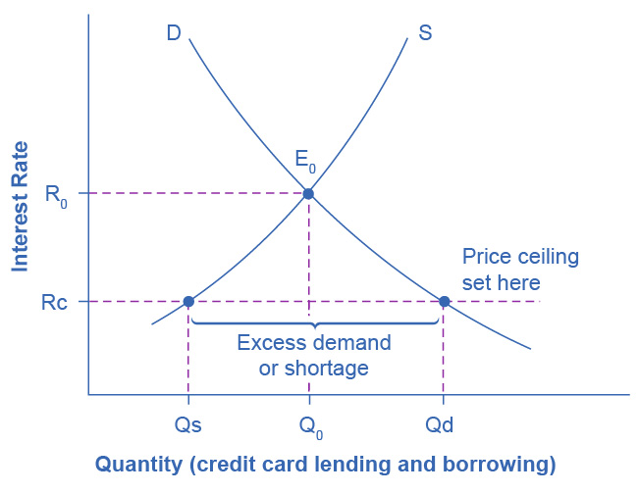
Cap on Credit Card Interest Rates: Price Ceiling
The original intersection of demand D and supply S occurs at equilibrium E₀.
However, a price ceiling is set at the interest rate R_{c}, below the equilibrium interest rate R₀, and so the interest rate cannot adjust upward to the equilibrium.
At the price ceiling, the quantity demanded, Q_{d}, exceeds the quantity supplied, Q_{s}. There is excess demand, also called a shortage.

Slide 13
INTERTEMPORAL CHOICES
Definition: Deciding when to consume—now or later
Examples Across Your Life:
Key Insight: Your decision to save or borrow depends on:
Current vs. expected future income
Confidence in ability to repay
Interest rates (opportunity cost)
Life Stage | Intertemporal Decision
College | Borrow now (consume education) → Pay later with higher income
Working years | Save now (delay consumption) → Spend in retirement
Social Security effect | Government promise of future income → People save less now
Business | Invest in R&D now → Profit in 5-10 years
Notes:
This is one of the most important concepts in personal finance. You're making intertemporal choices constantly, whether you realize it or not. Taking student loans? You're borrowing against your future higher income. Saving for retirement? You're sacrificing consumption today for comfort later. Here's a controversy: some economists argue Social Security reduces private saving because people think, "Government will take care of me in retirement, so why save?" Businesses make these choices too: Apple invests billions in R&D today for products that won't generate revenue for years. The interest rate is crucial—it's the "price" of moving money through time.

Slide 14
SHIFTS IN FINANCIAL MARKETS
What Shifts Demand for Financial Capital?
What Shifts Supply of Financial Capital?
Factor | Example | Demand Shift
Business confidence ↑ | Late 1990s tech boom | → Right (more borrowing)
Business confidence ↓ | 2008-09 recession | ← Left (less borrowing)
Consumer confidence ↑ | Strong job market | → Right (borrow for homes/cars)
Factor | Example | Supply Shift
Income increases | Workers earn more | → Right (more saving)
Future uncertainty ↑ | Recession fears | → Right (precautionary saving)
Investment becomes riskier | Stock market crash | ← Left (shift from stocks to bonds)
Notes:
Financial markets shift based on confidence and expectations. Think about the late 1990s internet boom—businesses were wildly optimistic about tech investments. Demand for loans surged right, pushing interest rates up. Then 2008 hit—confidence collapsed, demand shifted left, and even with lower interest rates, businesses weren't borrowing. On the supply side, if you get a raise, you'll probably save more (supply shifts right). If the stock market crashes, people move savings from stocks to safer bonds—that's a shift in supply across different financial instruments.

Slide 15
U.S. AS GLOBAL BORROWER
The Foreign Investment Story:
Current Reality (Q3 2021):
Foreign investors own $50.53 trillion of U.S. assets
U.S. investors own $34.45 trillion of foreign assets
Net: U.S. depends on $16 trillion foreign capital inflow
What if Foreign Confidence Falls?
Analogy: Like a restaurant that depends on one major supplier—if that supplier leaves, you're scrambling and paying premium prices to others.
Step | Analysis
1. Scenario | Investors fear growing U.S. debt
2. Which curve? | Supply of capital shifts (foreign lenders pull out)
3. Direction? | ← Left (less capital available)
4. New equilibrium | ↑ Higher interest rates, ↓ Less investment
5. Impact | U.S. borrowers pay more; harder to finance homes, cars, businesses
Notes:
This is a huge macroeconomic vulnerability. The U.S. runs on foreign capital—we borrow more from abroad than we lend. Why do foreigners invest here? Historically, the U.S. has been seen as stable, safe, and profitable. But what if that changes? Say foreign investors worry about U.S. government debt levels and pull their money out. Supply of financial capital shifts left—now there's less money available to borrow. Basic supply and demand: interest rates rise, quantity of investment falls. Every American trying to buy a house, finance a car, or start a business faces higher costs. This is why fiscal responsibility matters at the national level.

Slide 16
USURY LAWS (PRICE CEILING)
Price Ceiling on Interest Rates:
Market Without Control:
Equilibrium: 15% interest rate, $600B borrowed
With Usury Law at 13%:
Quantity demanded: $700B (more want to borrow at lower rate)
Quantity supplied: $510B (lenders offer less at lower rate)
Result: $190B credit shortage
Who's Affected?
❌ People denied credit cards despite willingness to pay market rate
✅ Those who get cards at lower rate benefit
Reality Check: Most state usury laws set limits well above market rates (e.g., 30%), making them non-binding.
Notes:
Price ceilings in financial markets are called usury laws—caps on interest rates. Sounds consumer-friendly, right? But let's apply supply and demand. At below-equilibrium rates, quantity demanded exceeds quantity supplied—a shortage. Credit card companies simply deny more applications. They'll lend to the safest borrowers but reject riskier ones. The people who most need access to credit—those with imperfect credit histories—are shut out entirely. Ironically, the law intended to help them may hurt them most. Most usury laws are set so high they don't bind anyway—30% is common, well above typical market rates.

Slide 17
Prices as information
Markets as Decentralized Information Processors
How Prices Communicate:
The Danger of Price Controls:
Like killing the messenger—doesn't change underlying reality
Deprives buyers and sellers of critical market information
Historic example: China's Great Leap Forward (1950s) kept food prices artificially low → 30-40 million starved
Price Signal | Consumer Response | Producer Response
High plane ticket | "Maybe I'll travel different week" | "Let's add more flights—demand is strong!"
High oat prices | "I'll switch to wheat cereal" | "I'll plant more oats this season"
High wages for nurses | "Maybe I'll go to nursing school" | "Let's hire more nurses"
Notes:
This is perhaps the most profound economic insight: prices are information. You don't need to know why plane tickets are expensive during Thanksgiving—maybe fuel costs rose, maybe demand spiked. You just see the price and adjust your behavior. Same for producers—the oat farmer doesn't need a committee to tell him to plant more oats. The price signal tells him everything he needs to know. Price controls—whether floors or ceilings—silence these signals. China's Great Leap Forward is a tragic example: the government kept food prices low to look pro-worker. Result? Farmers stopped producing because it wasn't profitable. 30-40 million people starved. Prices aren't optional suggestions—they're critical information systems.

Slide 18
BABY BOOMERS & HEALTHCARE CASE
The Aging America Challenge:
Demographics:
22% of U.S. population is 60+ (74 million people)
71 million baby boomers (born 1946-1964) at/near retirement
Increased need: heart conditions, arthritis, Alzheimer's
Supply & Demand Analysis on Nursing:
Prediction: Higher nursing salaries (both curves shift), but uncertain quantity (depends on relative shifts)
Factor | Effect on Demand | Effect on Supply
Aging population | → Right (more care needed) | No change
Affordable Care Act | → Right (more access) | No change
Nurses retiring | No change | ← Left (fewer available)
Rising tuition | No change | ← Left (fewer new nurses)
Notes:
Let's apply everything we've learned to a real-world case. Baby boomers—that massive generation born after WWII—are aging. They need healthcare. Demand for nurses shifts right. Simultaneously, current nurses are retiring, and nursing school is expensive, so supply shifts left. What happens to wages? Definitely rise—both shifts push wages up. But what about the quantity of nurses? That's ambiguous—depends on which shift is larger. If demand increases more than supply decreases, we'll have more nurses (but at higher salaries). If supply decreases more than demand increases, fewer nurses (also at higher salaries). Either way, nursing is a great career choice from a supply-demand perspective!

Slide 19
KEY TAKEAWAYS
Universal Principles:
Supply & demand apply to ALL markets (goods, labor, financial)
Equilibrium prices coordinate millions of independent decisions
Price controls create predictable distortions (shortages, surpluses, unemployment)
Technology reshapes markets unevenly (winners & losers)
Information matters more than intentions in policy design
Your Economic Toolkit:
Identify demanders vs. suppliers in ANY market
Predict effects of shifts in demand or supply
Analyze price floors (minimum wage) and ceilings (usury laws)
Understand labor markets (your career) and financial markets (your loans)
Notes:
These aren't just abstract graphs—these are the tools that will help you understand your salary negotiations, your student loan terms, your investment choices, and the economic news you read every day. When politicians propose minimum wage hikes, you can analyze the tradeoffs. When the Fed raises interest rates, you understand the impact on your ability to borrow. When you choose a career, you can think about supply and demand for those skills. Master these principles, and you have a lifetime analytical toolkit.

