Slide 1

Chapter 5
Elasticity
Measuring Market responsiveness
Notes:
Welcome to Chapter 5 on Elasticity. This chapter examines one of the most practical concepts in economics—how responsive buyers and sellers are to price changes. Understanding elasticity helps explain everything from why Netflix can raise prices without losing all its customers, to why cigarette taxes generate revenue but don't stop people from smoking, to why farmers can have a great harvest but earn less money. We'll explore how businesses use elasticity to make pricing decisions and how governments use it to design effective policies.

Slide 2
What is Elasticity?
ELASTICITY: Measuring Responsiveness
Definition: How much one variable responds to changes in another variable
Analogy: Drop a tennis ball and a brick from the same height
Tennis ball bounces high → highly elastic
Brick barely bounces → highly inelastic
In Economics: How much does quantity demanded or supplied change when price changes?
Notes:
Elasticity is fundamentally about responsiveness. Think about dropping a tennis ball versus a brick—the tennis ball bounces back dramatically, while the brick barely moves. In economics, we use the same concept. When a price changes, some goods see huge changes in quantity demanded—like restaurant meals—while others, like electricity or housing, see very little change. The tennis ball is like restaurant meals (elastic), and the brick is like electricity (inelastic). This responsiveness determines business strategies and policy outcomes.

Slide 3
Price Elasticity of Demand
PRICE ELASTICITY OF DEMAND
Formula: PED = % Change in Quantity Demanded ÷ % Change in Price
The Midpoint Method (for accuracy): PED = [(Q₂ - Q₁) / (Q₂ + Q₁)/2] ÷ [(P₂ - P₁) / (P₂ + P₁)/2]
Key Point: Always reported as absolute value (ignore negative sign)
Notes:
Price elasticity of demand measures how much quantity demanded responds to price changes. We calculate it as the percentage change in quantity divided by percentage change in price. Economists use the midpoint method because it gives the same elasticity whether price goes up or down—it uses the average of the two prices and quantities as the base. Technically, PED is negative because price and quantity move in opposite directions, but by convention we report it as an absolute value. A PED of 2.0 means a 1% price increase causes a 2% decrease in quantity demanded.

Slide 4
Example – Spotify Subscription
CALCULATING PED: SPOTIFY EXAMPLE
Scenario: Spotify raises price from $10 to $12 per month Subscribers drop from 100,000 to 80,000
Midpoint Method:
Step 1: % Change in Quantity = [(80K - 100K)/(90K)] = -22.2%
Step 2: % Change in Price = [($12 - $10)/($11)] = 18.2%
Step 3: PED = |-22.2% ÷ 18.2%| = 1.22
Result: Elastic demand (PED > 1) - subscribers are price-sensitive
Notes:
Let's work through a real-world example. When Spotify increased its monthly price from ten to twelve dollars—a 20% increase—they lost 20,000 subscribers out of 100,000. Using the midpoint method, the percentage change in quantity is negative 22.2%, and the percentage change in price is 18.2%. Dividing these gives us an elasticity of 1.22. Since this is greater than one, demand is elastic—meaning customers are quite responsive to the price change. For every 1% price increase, Spotify loses 1.22% of subscribers. This tells Spotify they need to be careful with price increases or they'll lose significant market share.

Slide 5
Three Categories of Elasticity
THREE TYPES OF ELASTICITY
Rule of Thumb: Necessities are inelastic; luxuries are elastic
Type | Value | Meaning | Example
Elastic | > 1 | High responsiveness | Restaurant meals (2.27)
Unit Elastic | = 1 | Proportional response | Off-peak rail transit (1.00)
Inelastic | < 1 | Low responsiveness | Electricity (0.20)
Notes:
Elasticity falls into three categories. Elastic demand, greater than one, means quantity is very responsive to price changes—like restaurant meals with an elasticity of 2.27. A 10% price increase causes a 22.7% drop in quantity. Unit elastic, exactly one, means percentage changes are proportional. Inelastic demand, less than one, means quantity barely responds—like electricity at 0.20. A 10% price increase only reduces quantity by 2%. The pattern is clear: necessities like housing, electricity, and gasoline are inelastic because people need them regardless of price. Luxuries like restaurant meals, premium cable TV, and new computers are elastic because they're discretionary—consumers can easily cut back when prices rise.

Slide 6
Price Elasticity of Supply (PES)
PRICE ELASTICITY OF SUPPLY
Formula: PES = % Change in Quantity Supplied ÷ % Change in Price
Example: Electric Truck Startup
Price rises from $40,000 to $50,000
(50,000 – 40,000)/45,000 = 0.222
Production increases from 1,000 to 1,400 trucks
(1400 – 1000)/1200 = 0.333
PES = 1.5 (elastic supply)
33.3%/22.2%
Interpretation: Producers can ramp up production when prices rise
Notes:
Price elasticity of supply measures how responsive producers are to price changes. Let's look at an electric truck manufacturer. When market price increases from forty to fifty thousand dollars, they boost production from one thousand to fourteen hundred trucks. Using the midpoint method, the percentage change in quantity is 33.33%, and the percentage change in price is 22.22%. Dividing these gives an elasticity of 1.50—elastic supply. This makes sense for a startup: they probably have excess capacity and can hire more workers or add shifts when it's profitable. In contrast, diamond mines or prime Manhattan real estate have inelastic supply—no matter how much price increases, you can't quickly produce more diamonds or create more apartments facing Central Park.

Slide 7
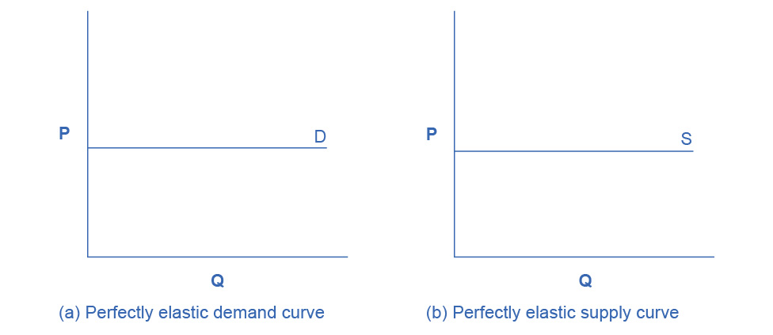
Perfect Elasticity
POLAR CASE 1: PERFECTLY ELASTIC (Horizontal Curves)
Characteristics:
Elasticity = ∞ (infinity)
Quantity changes infinitely for any price change
Horizontal demand or supply curve
Real-World Approximations:
Commodities in perfectly competitive markets (wheat, corn from one farmer)
Goods with perfect substitutes at same price
Notes:
Perfect elasticity is an extreme case where the demand or supply curve is completely horizontal. Think of a wheat farmer in a competitive market. If they try to charge even one penny more than the market price, they'll sell zero bushels—consumers will buy from other farmers selling at the market price. But at the market price, they can sell as much as they produce. While true perfect elasticity is rare, many competitive commodity markets approximate this behavior. The horizontal curve means consumers or producers are infinitely responsive to even the tiniest price change.

Slide 8
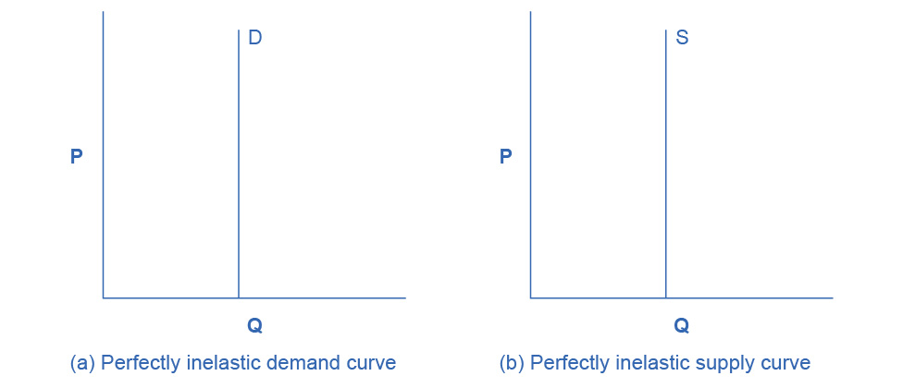
Perfect inElasticity
POLAR CASE 2: PERFECTLY INELASTIC (Vertical Curves)
Characteristics:
Elasticity = 0 (zero)
Quantity doesn't change regardless of price
Vertical demand or supply curve
Real-World Approximations:
Life-saving medications (insulin for diabetics)
Housing in fixed locations (Manhattan apartments)
Addictive substances (short-run)
Notes:
Perfect inelasticity is the opposite extreme—a vertical curve where quantity doesn't change at all regardless of price. Think of insulin for diabetics. Whether the price is $50 or $500, they need the same amount to survive—their demand is perfectly inelastic. Similarly, there's a fixed supply of apartments facing Central Park in New York—no matter how high the price goes, you can't create more of them. While perfect inelasticity is rare, many necessities and life-saving goods approximate this behavior. Understanding this helps explain why pharmaceutical companies can charge high prices for patented medications—demand is extremely inelastic.

Slide 9
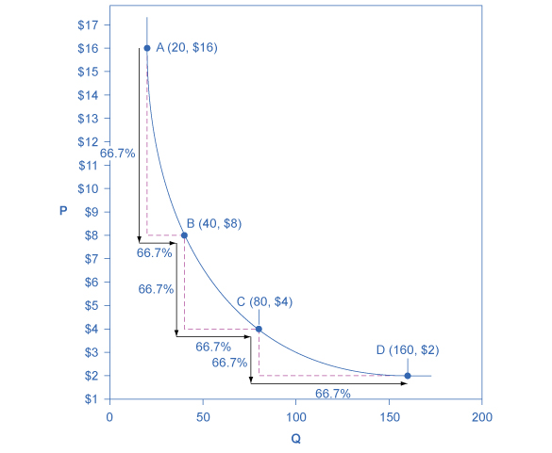
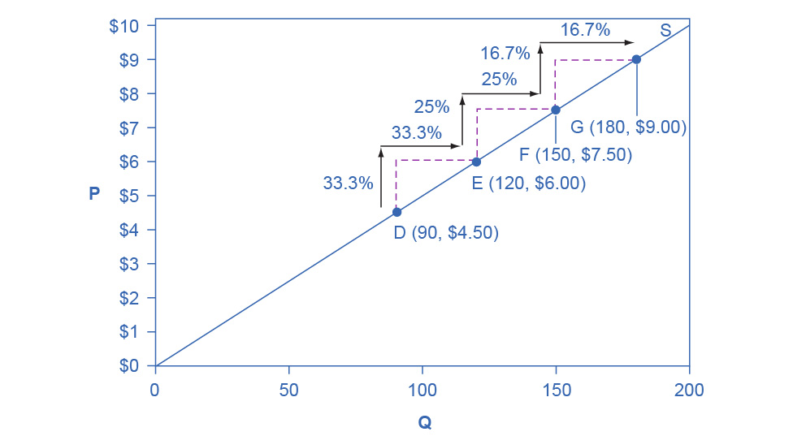
Constant Unitary Elasticity
CONSTANT UNITARY ELASTICITY
Characteristics:
Elasticity = 1 at all points
1% price change → 1% quantity change
Demand curve: Curved (rectangular hyperbola)
Supply curve: Straight line through origin
Significance: Price and quantity changes always proportional
Notes:
Constant unitary elasticity is a special case where elasticity equals exactly one at every point on the curve. For every 1% change in price, quantity changes by exactly 1% in the opposite direction. Interestingly, unitary elastic demand curves are curved—they form what's called a rectangular hyperbola. Unitary elastic supply curves are straight lines that pass through the origin. This is rare in the real world but represents a perfect balance point. When demand is unit elastic, total revenue stays constant regardless of price—raising price by 10% reduces quantity by exactly 10%, leaving revenue unchanged.

Slide 10
Determinants of elasticity
WHAT MAKES DEMAND ELASTIC OR INELASTIC?
More Elastic When:
Many close substitutes available
Luxury or discretionary item
Large portion of consumer budget
Longer time horizon (long-run)
More Inelastic When:
Few or no substitutes
Necessity (food, medicine, housing)
Small portion of budget
Shorter time horizon (short-run)
Notes:
Several factors determine whether demand is elastic or inelastic. First, substitutes: if close alternatives exist, demand is elastic—consumers easily switch. Restaurant meals have many substitutes, so elasticity is high at 2.27. But electricity has no good substitutes, giving it an elasticity of only 0.20. Second, necessity versus luxury: people cut luxuries when prices rise but not necessities. Third, budget share: a 10% increase in salt prices barely affects your budget, but a 10% increase in rent does. Finally, time matters: in the short run, it's hard to change consumption patterns. After the 1973 oil crisis, demand was inelastic initially. But over a decade, people bought fuel-efficient cars, insulated homes, and moved closer to work—demand became much more elastic.

Slide 11
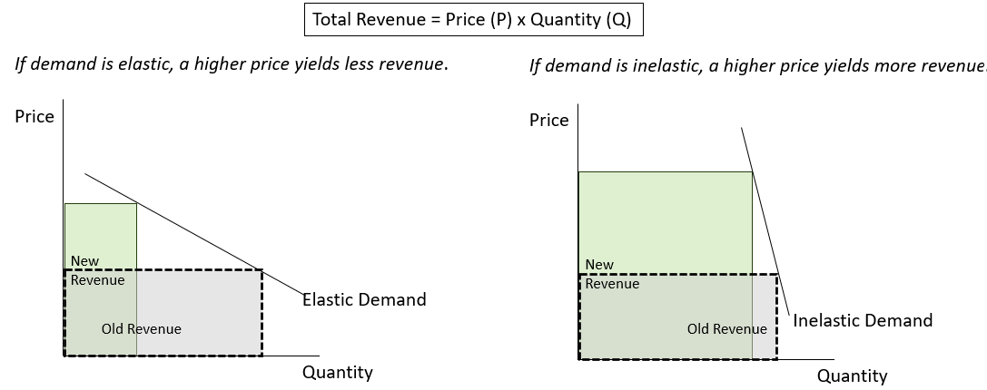
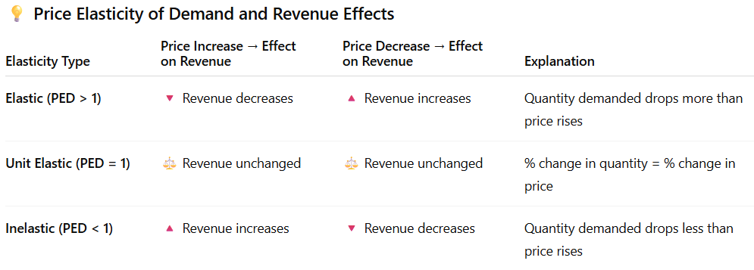
Elasticity and Total Revenue
THE REVENUE TEST
Key Business Question: Should we raise prices or lower them?
Strategy: Know your elasticity before changing prices!
Notes:
This is where elasticity becomes powerfully practical for businesses. The relationship between elasticity and total revenue determines pricing strategy. If your demand is elastic—like premium cable TV at 1.77—raising prices backfires. The percentage drop in quantity sold exceeds the percentage price increase, so revenue falls. You should lower price to boost revenue. But if demand is inelastic—like gasoline at 0.35—raising prices increases revenue because quantity barely drops. The price increase more than compensates for the small loss in sales. Unit elastic demand is the breakeven point where revenue doesn't change. Smart businesses estimate their elasticity before making pricing decisions.

Slide 12
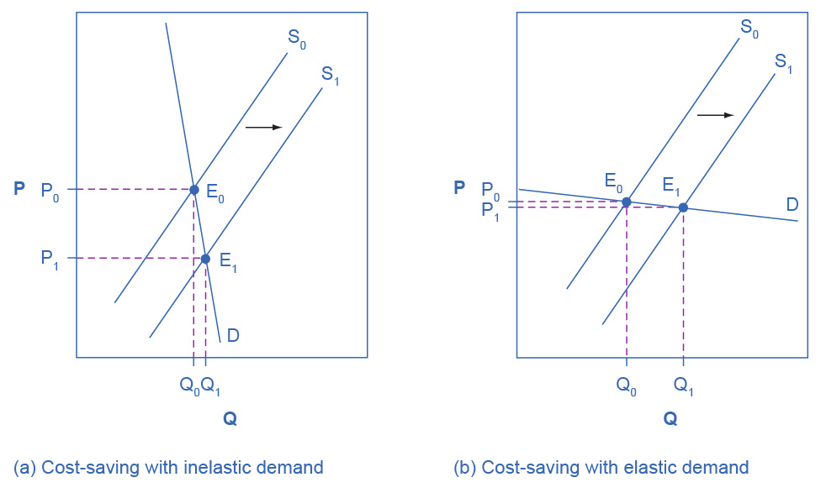
Passing Cost Savings to Consumers - Technology
COST SAVINGS + INELASTIC DEMAND = LOWER PRICES
Scenario: Technological improvement reduces production costs → Supply shifts right
Outcome depends on elasticity:
Inelastic demand: Prices fall dramatically; quantity increases slightly
Elastic demand: Prices fall slightly; quantity increases dramatically
Who benefits more? Consumers benefit more with inelastic demand (bigger price drop)
Notes:
Let's explore how elasticity affects who benefits when costs change. Imagine aspirin manufacturers achieve a technological breakthrough that cuts production costs. This shifts supply to the right—at every price, firms want to supply more. But the outcome depends on demand elasticity. If demand is inelastic—like aspirin, a necessity—the price drops substantially but quantity barely increases. Consumers get much lower prices. But if demand is elastic, the lower cost results in only slightly lower prices but a huge increase in quantity sold. Here's the paradox: when demand is inelastic, the technological improvement might actually hurt producer revenues because prices fall so much. This explains why farmers sometimes destroy crops—a bumper harvest with inelastic demand crashes prices and reduces their income.

Slide 13
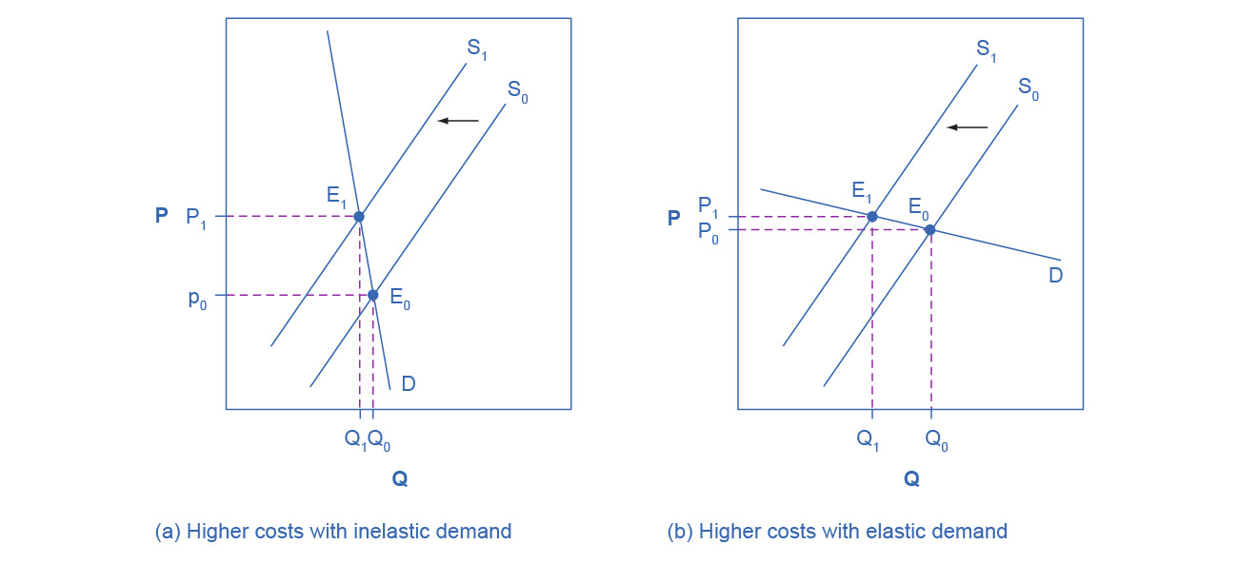
Passing Costs to Consumers - Taxes
TAX INCREASES + INELASTIC DEMAND = HIGHER CONSUMER PRICES
Scenario: Government imposes tax (cigarettes) → Supply shifts left
Outcome depends on elasticity:
Inelastic demand: Firms pass tax to consumers (higher prices); quantity barely falls
Elastic demand: Quantity falls dramatically; prices rise only slightly
Policy implication: Cigarette taxes raise revenue but don't reduce smoking much
Notes:
Now let's flip the scenario—what happens when costs increase due to taxes? Cigarette taxes are a perfect example. When government raises cigarette taxes, supply shifts left. But because cigarette demand is inelastic—around 0.3 for adults—smokers don't quit much when prices rise. Producers simply pass most of the tax to consumers as higher prices. A 10% price increase from taxes only reduces adult smoking by 3%. This is great for government revenue but frustrating for public health officials. If the goal is reducing smoking, taxes alone won't work well with inelastic demand. You need to shift demand itself through education, addiction treatment, or advertising restrictions. Interestingly, youth smoking is more elastic than adult smoking, so taxes are more effective at preventing young people from starting.

Slide 14
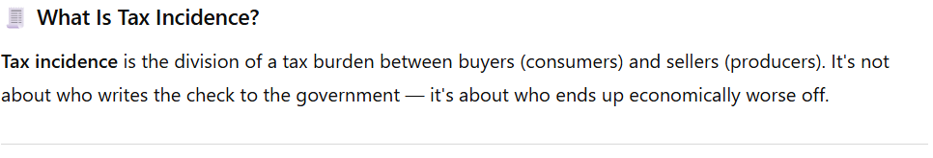
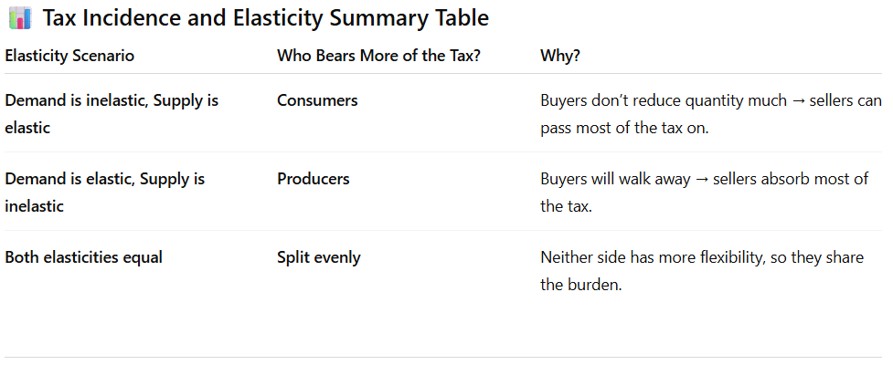

Tax Incidence
Notes:
Tax incidence reveals who actually pays a tax, regardless of who legally writes the check to the government. The key principle: the more inelastic side of the market bears more of the tax burden. Why? Because they can't easily change their behavior. Cigarette smokers have inelastic demand—they're somewhat addicted—so they can't reduce consumption much. Producers pass most of the tax to them. But consider beachfront hotels. Demand is elastic—tourists have many vacation options—but supply is perfectly inelastic. You can't move a beachfront hotel inland. So even though tourists might pay the tax at checkout, the hotels bear the burden through lower revenues. They can't escape. This explains why it's nearly impossible for businesses to "pass along costs"—it depends entirely on relative elasticities, not on who the law says pays.

Slide 15
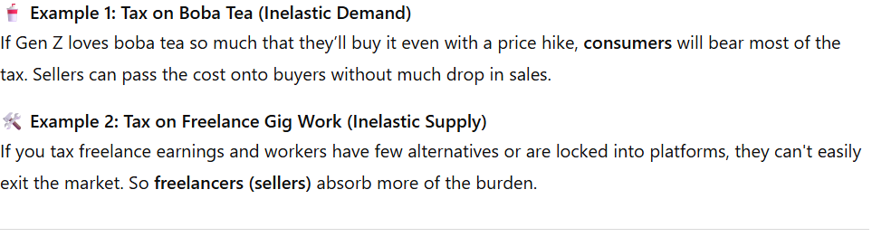
Example: Elasticity and Tax Incidence

Slide 16
Short-Run vs Long-Run Elasticity
TIME MATTERS: ELASTICITY INCREASES OVER TIME
Short-Run (months):
Harder to adjust consumption/production
More inelastic
Prices change more; quantities change less
Long-Run (years):
Easier to adjust (new technology, habits, infrastructure)
More elastic
Quantities change more; prices stabilize
Example: 1973 Oil Crisis - Initially inelastic demand; became elastic over decade
Notes:
One of the most important insights about elasticity is that it changes with time. In the short run, both demand and supply tend to be more inelastic because people and businesses can't adjust quickly. The 1973 oil crisis is the classic example. When OPEC cut oil exports, the U.S. initially had very inelastic demand—people still needed to drive to work, heat their homes, and run factories. Prices doubled from twelve to twenty-five dollars per barrel, but quantity demanded dropped only slightly. However, over the next decade, demand became much more elastic. People bought fuel-efficient cars, insulated their homes, businesses relocated closer to workers, and new technologies emerged. By 1983, oil consumption was lower despite a 25% larger economy. This pattern applies broadly: in the short run, prices bounce dramatically. In the long run, quantities adjust more and prices stabilize.

Slide 17
Real-world elasticities
ELASTICITY IN THE REAL WORLD
Highly Inelastic (<0.5):
Housing: 0.12
Electricity: 0.20
Gasoline: 0.35
Moderately Elastic (0.5-1.5):
Beef: 0.59
Wine: 0.55
New vehicles: 0.87
Highly Elastic (>1.5):
Restaurant meals: 2.27
Premium cable TV: 1.77
Computers: 1.44
Notes:
Let's look at actual elasticity estimates from economic research. At the inelastic end, housing has an elasticity of only 0.12—a 10% rent increase reduces quantity demanded by just 1.2%. People need somewhere to live and can't easily relocate. Electricity at 0.20 and gasoline at 0.35 are similarly inelastic necessities. In the middle range, beef, wine, and new vehicles have elasticities between 0.5 and 1. These are somewhat discretionary but still important to consumers. At the elastic end, restaurant meals at 2.27 are highly responsive to price—a 10% price increase causes a 22.7% drop in demand because eating out is a luxury with many substitutes, including eating at home. Premium cable TV at 1.77 is similarly elastic—consumers can easily cancel or downgrade. These numbers guide real pricing decisions for businesses in these industries.

Slide 18
Key takeaways
ELASTICITY: KEY INSIGHTS
Elasticity measures responsiveness - not just direction of change
Necessities are inelastic; luxuries are elastic
Business pricing strategy depends on elasticity
Elastic → Lower prices to boost revenue
Inelastic → Raise prices to boost revenue
Tax incidence falls on the less elastic side
Elasticity increases over time (short-run vs long-run)
Use midpoint method for accurate calculations
Notes:
Let's summarize the key insights from this chapter. First, elasticity is about how much things respond, not just whether they respond—the magnitude matters enormously for decisions. Second, there's a clear pattern: necessities with few substitutes are inelastic, while luxuries with many alternatives are elastic. Third, businesses must know their elasticity before changing prices. If demand is elastic, lower prices to increase revenue. If inelastic, raise prices. Fourth, tax incidence doesn't depend on who legally pays the tax—it falls on whoever can't easily adjust their behavior. Fifth, time matters crucially. What appears inelastic in the short run often becomes elastic as people adapt over years. Finally, always use the midpoint method for elasticity calculations—it gives consistent answers regardless of direction. Understanding elasticity transforms you from someone who knows demand curves slope downward to someone who can predict exactly how much quantity will change and what that means for revenue, pricing, and policy.

