Slide 1

Chapter 9
Monopoly
“When One Firm Rules the Market”
Notes:
Welcome to Chapter 9 on Monopoly. In this chapter, we'll explore what happens when a single firm dominates an entire market. Unlike perfect competition where many firms compete on price, monopolies have significant market power. We'll examine how monopolies form, how they decide on pricing and output, and why economists consider them inefficient. Think of monopolies as the opposite extreme from perfect competition—instead of being price takers, monopolies are price makers.

Slide 2
What is a Monopoly
Content:
Monopoly: One firm produces all market output
Key characteristic: The firm IS the market
Market power: Can influence price (not a price taker)
Analogy: Think of a monopoly like being the only restaurant in a small airport terminal—you set the menu prices because travelers have no alternatives.
Notes:
A monopoly exists when a single firm produces all or nearly all of the output in a market. The critical difference from perfect competition is that the monopolist's demand curve IS the market demand curve. This gives the firm market power—the ability to influence price by controlling quantity. However, even monopolies face constraints: they can't force consumers to buy. They must work within the limits of market demand. The U.S. Department of Justice often uses a practical definition: a firm with very high market share, even if not technically the only firm.

Slide 3
Barriers to Entry—The Moat Around the Castle
Barriers to entry: Legal, technological, or market forces that prevent competition
Five Types:
Natural monopoly (economies of scale)
Control of physical resources
Legal monopoly (government-created)
Intellectual property (patents, copyrights)
Intimidation (predatory pricing)
Analogy: Barriers to entry are like a medieval castle's moat—they keep competitors from storming your market.
Notes:
Barriers to entry explain why monopolies persist despite earning high profits that would normally attract competitors. Think of these barriers as the "moat" protecting a castle. Natural monopolies arise from cost structures. Resource control means owning something scarce (like DeBeers and diamonds, or ALCOA's historical bauxite control). Legal monopolies are government-sanctioned, like the USPS for first-class mail. Intellectual property protects innovation—patents last 20 years in the U.S. Finally, intimidation tactics like predatory pricing discourage entry, though they're illegal and hard to prove. These barriers aren't always permanent—technology and policy changes can erode them.

Slide 4
Natural Monopoly—Why Duplication Doesn't Make Sense
Natural monopoly: Economies of scale make one provider most efficient
Characteristics:
High fixed costs (infrastructure: pipes, wires, rails)
Low marginal costs (serving one more customer is cheap)
Inefficient to duplicate systems
Examples: Water utilities, electric grids, natural gas delivery
Analogy: Building a second water pipe system in your city is like building a second interstate highway system parallel to I-95—massively wasteful.
Notes:
Natural monopolies emerge when it's most efficient for one firm to serve the entire market. The classic example is water utilities. Once you've invested billions in underground pipes, the marginal cost of serving one additional household is minimal. Building a competing pipe network would be enormously wasteful. This is why we don't have competing water companies digging up streets to lay duplicate infrastructure. Key insight: "natural" doesn't mean permanent. Technology can erode natural monopolies—mobile phones disrupted landline monopolies, and solar power plus batteries may reduce dependence on centralized electric grids. Natural monopolies are often privately owned but heavily regulated to prevent price gouging.

Slide 5
Legal Monopoly—Government Protection
Legal monopoly: Government prohibits or limits competition
Can overlap with natural monopoly
Example: City water utility
Natural monopoly (duplicating pipes is wasteful)
Legal monopoly (city grants exclusive franchise)
Why? Utilities are socially beneficial; government ensures access and regulates prices
🚨 Caveat: Legal ≠ Permanent Protection
A natural monopoly can lose its legal monopoly if laws change:
Telecom deregulation in the 1990s ended AT&T’s legal monopoly.
Some electric utilities now face competition in generation but not distribution.
Notes:
Legal monopolies exist when government creates barriers by law. Often these overlap with natural monopolies—it makes sense for government to grant exclusive rights when duplication is inefficient. Your local water and electric companies are typically both natural and legal monopolies. Historically, the U.S. had more legal monopolies: AT&T was the only legal phone company for most of the 20th century, airlines faced route and price restrictions from the 1930s-1970s, and banks had interest rate caps. Deregulation began in the late 1970s as technology changed and markets proved capable of providing services. The AT&T breakup in 1982 unleashed innovation—suddenly we got call waiting, caller ID, mobile phones, and phones in colors other than black! This shows that legal monopolies can stifle innovation.

Slide 6
Intellectual Property—Rewarding Innovation
The innovation problem: Without protection, competitors copy inventions without R&D costs
Solutions:
Patents: 20-year exclusive rights on inventions
Copyrights: Life of author + 70 years for creative works
Trademarks: Renewable protection for brand symbols
Trade secrets: Protected formulas (e.g., Coca-Cola)
Analogy: Patents are like a 20-year head start in a race—you get to profit from your innovation before competitors can join.
Notes:
Intellectual property law creates temporary legal monopolies to encourage innovation. Here's the problem: if a firm spends billions developing a cure for cancer, but competitors can immediately copy it and undercut prices (since they didn't bear R&D costs), firms won't invest in research. The U.S. Constitution explicitly addresses this, granting Congress power "to promote the progress of science and useful arts" by protecting inventors. Patents give 20 years of exclusive rights—enough to recoup R&D investments, but not forever. Copyrights last much longer because the social cost is lower. Trade secrets aren't time-limited but require keeping the formula actually secret. This creates a balance: temporary monopoly power to reward innovation, but eventual competition once protection expires. The pharmaceutical industry depends heavily on this system.

Slide 7
Predatory Pricing—The Monopolist's Threat
Predatory pricing: Using threat of sharp price cuts to discourage competition
The strategy:
New competitor enters market
Incumbent slashes prices below cost
New entrant can't survive, exits market
Incumbent raises prices again
Potential entrants see the pattern and stay away
Status: Illegal under U.S. antitrust law, but difficult to prove
Analogy: Like a schoolyard bully who beats up anyone who tries to sit at their lunch table—eventually nobody even tries.
Notes:
Predatory pricing is an intimidation strategy to deter competition. Here's the classic airline example: a large carrier dominates a route. A small startup enters the market. The incumbent immediately slashes prices to bone—below cost—making it impossible for the newcomer to profit. The startup fails. The incumbent then raises prices again. After repeating this once or twice, potential competitors decide not to even try. Small airlines have frequently accused larger carriers of this practice. It's illegal, but proving it requires showing the incumbent intended to drive out competition and then raise prices—a high bar legally. Large advertising budgets can serve a similar function: if launching a cola requires outspending Coca-Cola and Pepsi, few will try. Strong brand names create formidable barriers that are perfectly legal but economically similar to predatory pricing.

Slide 8
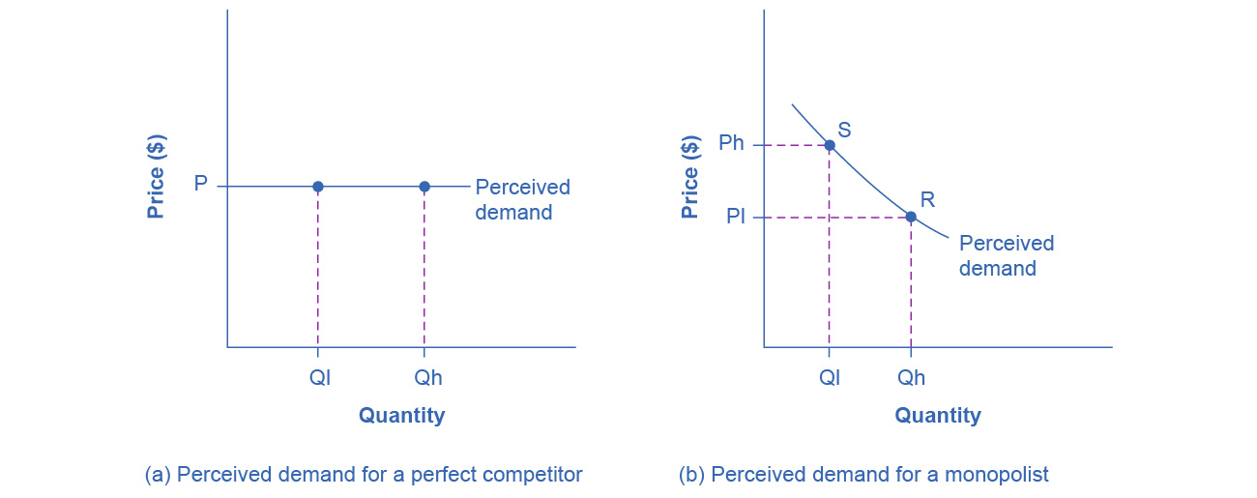
Monopolist's Demand Curve vs. Perfect Competition
Perfect competition: Demand curve is horizontal (price taker)
Can sell any quantity at market price
Monopoly: Demand curve slopes downward (price maker)
Higher quantity requires lower price
Lower quantity allows higher price
Trade-off: Price vs. quantity
Analogy: Perfect competitor is like a farmer at a farmers market (take the going rate for tomatoes). Monopolist is like the only pharmacy in town (you choose whether to sell more at lower prices or less at higher prices).
Notes:
This is the fundamental difference between perfect competition and monopoly. A perfectly competitive firm is a price taker—it faces a horizontal demand curve at the market price. It can sell 100 units or 1,000 units at exactly the same price. The monopolist faces the entire downward-sloping market demand curve. To sell more, it must lower price; to charge more, it must accept selling less. This creates the monopolist's central challenge: finding the profit-maximizing balance between price and quantity. The monopolist has market power but can't escape the law of demand. Setting price too high means few sales and low revenue. Setting price too low means high sales but low revenue per unit. Profit maximization requires finding the sweet spot.

Slide 9
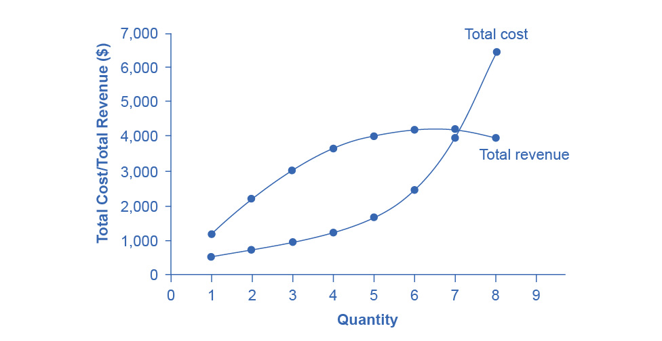
Total Revenue and Total Cost—Finding Maximum Profit
Key insight: Maximum profit occurs where total revenue exceeds total cost by the greatest amount
HealthPill Monopoly example:
Total revenue: rises, peaks, then falls (hill-shaped)
Total cost: steadily rises (upward-sloping)
Maximum profit: where vertical distance is greatest
Why TR has hill shape:
Low output → low revenue (small quantity)
High output → low revenue (low price)
Notes:
Let's examine profit maximization using our HealthPill monopoly example. Total cost behaves as expected—it rises as output increases, growing steeper due to diminishing returns. Total revenue is more interesting. At low output levels, revenue is low because quantity is small, even though price is high. At high output levels, revenue is also low because price has fallen so much. Total revenue has a hill shape—rising, peaking, then falling. The highest profit occurs where total revenue is farthest above total cost. Critically, this is NOT where revenue is maximized. Why? Because profits consider costs, not just revenue. The revenue-maximizing output would ignore rising costs. This graph shows the concept, but in practice, firms use a marginal approach because they rarely have complete information about their entire cost and revenue curves.

Slide 10
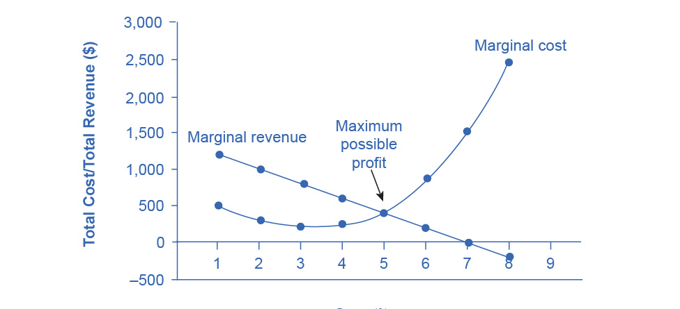
Marginal Revenue and Marginal Cost—The Practical Approach
MR = MC rule: Produce where marginal revenue equals marginal cost
Why this works:
If MR > MC → produce more (adding to profit)
If MR = MC → at maximum profit
If MR < MC → produce less (losing money on marginal units)
Monopolist's MR curve: Always below demand curve
Analogy: Like climbing a hill in fog—you keep going up (MR > MC) until the ground levels out (MR = MC). Going further would mean going downhill (MR < MC).
Notes:
In reality, monopolists don't have perfect information about their entire revenue and cost curves. But they do know from experience how small changes in output affect marginal revenue and marginal cost. This makes the marginal approach practical. The rule is simple: produce where MR equals MC. Why? If marginal revenue from one more unit exceeds its marginal cost, producing it adds to profit—do it. If marginal cost exceeds marginal revenue, producing it reduces profit—don't do it. The profit-maximizing output is exactly where these balance. Note the key difference from perfect competition: for perfect competitors, MR equals price. For monopolists, MR is less than price because selling more requires lowering price on ALL units sold, not just the additional unit. This is why the MR curve lies below the demand curve.

Slide 11
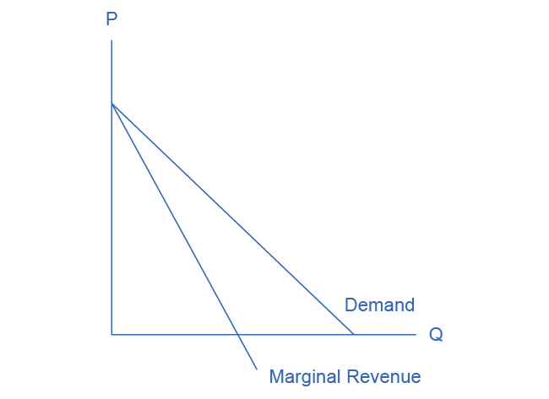
Why Marginal Revenue Lies Below Demand
Two opposing effects when monopolist sells one more unit:
Gain: Revenue from selling the additional unit at new (lower) price
Loss: Revenue lost because ALL previous units now sell at lower price
Result: MR < Price
Mathematical pattern (straight-line demand):
MR and demand share same vertical intercept
MR falls twice as fast as demand
MR's horizontal intercept is halfway to demand's
Notes:
This is a crucial concept. Why is the monopolist's marginal revenue less than price? Consider what happens when you increase quantity by one unit. You move down the demand curve—slightly higher quantity, slightly lower price. But here's the key: the demand curve is conditional. You don't sell the first units at a high price and then later units at a lower price. You sell ALL units at the same price. So when you increase quantity by one unit, two things happen. First, you gain revenue from that additional unit at the new, lower price. Second, you lose revenue on all the previous units because they now sell for less instead of the higher price. The net effect—marginal revenue—is less than the price of that last unit. For a straight-line demand curve, MR falls twice as fast as demand and hits the horizontal axis halfway to where demand does. This relationship is mathematical and predictable.

Slide 12
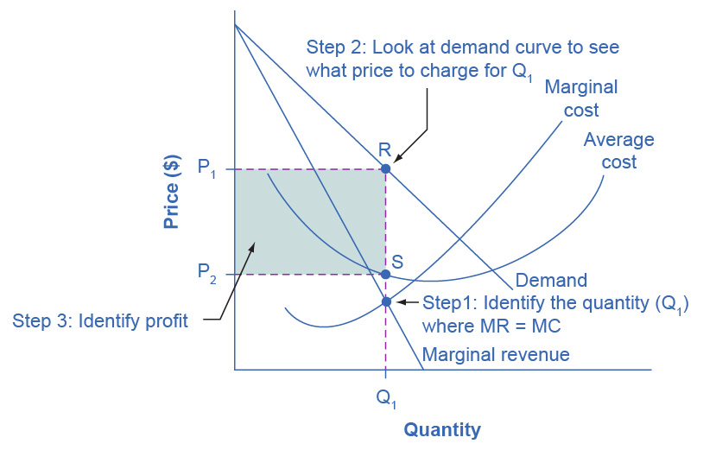
Three Steps to Profit Maximization
Step 1: Find quantity where MR = MC
Step 2: Go up to demand curve to find price consumers will pay at that quantity
Step 3: Calculate profit
Total Revenue = Price × Quantity
Total Cost = Average Cost × Quantity
Profit = TR - TC
Notes:
The monopolist follows a three-step process. Step one: Find where the MR and MC curves intersect—this is the profit-maximizing quantity. Step two: Draw a vertical line from that quantity up to the demand curve—this shows the maximum price consumers will pay for that quantity. Step three: Calculate profit. Total revenue is the big rectangle: price on vertical axis times quantity on horizontal axis. Total cost is the smaller rectangle: average cost times quantity. Profit is the difference—the darkly shaded box between them. If price exceeds average cost, the firm earns positive economic profit. In perfect competition, entry would erode these profits in the long run. But with barriers to entry, monopoly profits can persist year after year. This is one signal of monopoly power—sustained high profits doing the same thing without new competition.

Slide 13
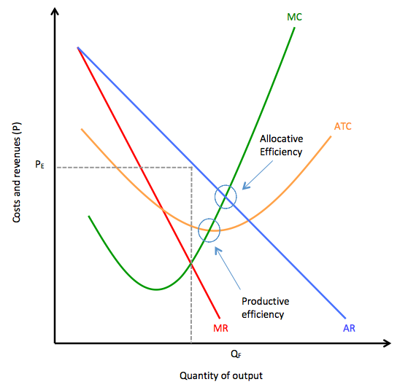
The Inefficiency of Monopoly
Monopolies are neither productively nor allocatively efficient
Compared to perfect competition:
Produce LESS output
Charge HIGHER prices
P > MC (allocative inefficiency)
Broader concern: Less incentive to innovate—"The best of all monopoly profits is a quiet life" (John Hicks)
Example: Pre-1982 AT&T: any color phone you want, as long as it's black. Post-breakup: explosion of innovation (call waiting, caller ID, mobile phones, voicemail, varied pricing)
Notes:
Economists criticize monopolies not primarily because of high prices, but because of inefficiency. Allocative efficiency requires producing where price equals marginal cost—where the marginal benefit to society equals the marginal cost. Perfect competitors achieve this. Monopolists always produce where price exceeds marginal cost, meaning society values additional units more than they cost to produce, but the monopolist won't make them. Result: too little output at too high a price. But inefficiency runs deeper. Without competitive pressure, monopolies can become complacent. Nobel Prize winner John Hicks said, "The best of all monopoly profits is a quiet life"—a criticism, not a compliment. The AT&T example is instructive. Before the 1982 breakup, phones barely changed. After deregulation, innovation exploded. Competition forced firms to please customers. Monopolies can just collect profits without innovating. This dynamic inefficiency may be more harmful than static pricing inefficiency.

Slide 14
Summary—Key Takeaways
Monopolies exist due to barriers to entry (natural, legal, resources, IP, intimidation)
Natural ≠ permanent—technology erodes monopolies
Profit maximization: MR = MC (produce where marginal revenue equals marginal cost)
Price setting: Go to demand curve after finding quantity
Inefficiency: Monopolies produce too little at too high a price
Dynamic harm: Less innovation without competitive pressure
Notes:
Let's summarize the key concepts. Monopolies form because barriers prevent competitors from entering, despite high profits. These barriers take five forms: natural monopolies from economies of scale, control of scarce resources, government-created legal monopolies, intellectual property protection, and intimidation tactics. Remember that natural monopolies aren't permanent—technology can erode them. Monopolists maximize profit by producing where MR equals MC, then charging whatever price the demand curve shows at that quantity. Unlike perfect competitors who are price takers, monopolists are price makers with market power. However, this power comes at a social cost: monopolies are allocatively inefficient, producing too little output at too high a price. Beyond static inefficiency, monopolies may also underinvest in innovation since they face no competitive pressure. Understanding monopoly helps us analyze real-world markets and evaluate public policy toward market power.

