Slide 1

Chapter 10
Monopolistic Competition and Oligopoly
“The Middle Ground Between Perfect Competition and Monopoly”
Notes:
Welcome to Chapter 10, where we explore the two market structures that exist between perfect competition and monopoly. These "imperfectly competitive" markets represent the vast majority of businesses you encounter daily—from your local restaurants to smartphone manufacturers. Understanding these structures helps explain why firms advertise, why prices differ across similar products, and why some industries have only a few dominant players.

Slide 2
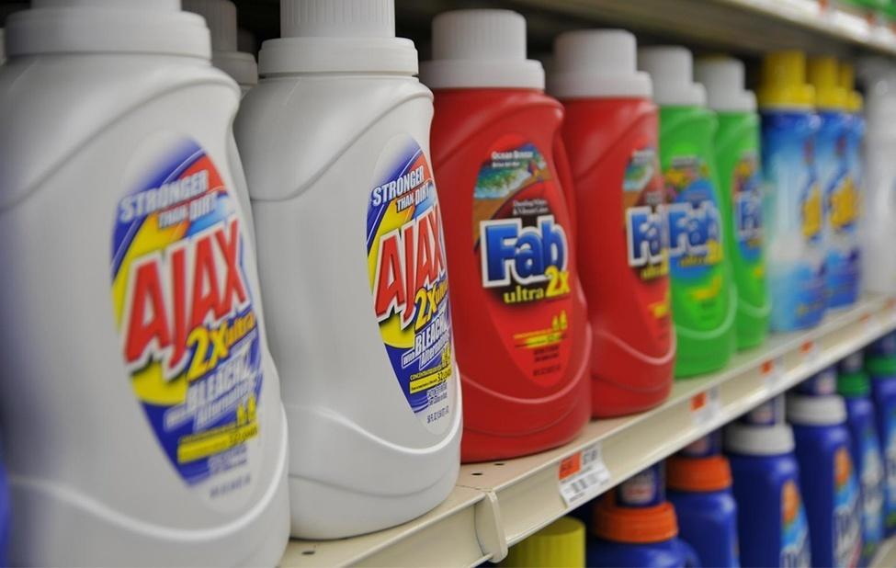
The Soap Opera: When Competitors Meet in Secret
French Detergent Makers (1997-2004):
4 firms controlled 90% of market
Secret meetings in Parisian cafés
Goal: Eliminate competition, fix prices
Result: €361 million in fines
Key Question: Why would competitors risk illegal collusion?
Notes:
Let's start with a real case. Between 1997 and 2004, executives from Procter & Gamble, Henkel, Unilever, and Colgate-Palmolive met secretly around Paris—not in boardrooms, but in small, out-of-the-way cafés. Their goal was to stamp out competition and set prices, essentially creating a monopoly. Similarly, five Midwestern ice makers conspired to divide up the bagged ice market. Both groups faced the same dilemma: they could earn higher profits by cooperating like a monopoly, but each firm was also tempted to cheat for individual gain. This tension between cooperation and competition defines oligopolistic behavior. We'll return to this case, but it illustrates why understanding these market structures matters—they're everywhere, and the stakes are high.

Slide 3
Market Structure Spectrum
Where Do Most Real-World Firms Compete?
Most retail markets = Monopolistic Competition
Most manufacturing/tech = Oligopoly
Perfect Competition | Monopolistic Competition | Oligopoly | Monopoly
Many identical sellers | Many differentiated sellers | Few large sellers | Single seller
Zero market power | Some market power | Significant market power | Maximum market power
Notes:
Think of market structures on a spectrum. At one extreme is perfect competition—many firms selling identical products with zero pricing power. At the other extreme is monopoly—one firm with complete pricing control. But where do most real businesses operate? In the middle. Monopolistic competition describes restaurants, clothing stores, coffee shops—places with many competitors but differentiated products. Oligopoly describes industries with a few dominant firms: airlines, smartphones, soft drinks. These structures are neither perfectly competitive nor monopolistic, which creates unique strategic challenges and opportunities.

Slide 4
Monopolistic Competition Defined
Key Characteristics:
Many competing firms (low concentration)
Differentiated products (perceived uniqueness)
Easy entry/exit (low barriers)
Some pricing power (downward-sloping demand)
Analogy: Like a neighborhood with many coffee shops—each has unique atmosphere, quality, location, but all sell coffee and compete for customers.
Notes:
Monopolistic competition combines elements of both monopoly and competition—hence the name. There are many firms, like in perfect competition, but each sells a product that's distinctive in some way. Consider restaurants: there are over 600,000 in the United States. Each restaurant differentiates itself through cuisine, atmosphere, location, or service quality. This differentiation gives each firm a "mini-monopoly" over its particular style, allowing some pricing power. But they still face intense competition from other restaurants offering different experiences. The Mall of America example from your textbook is perfect: 24 stores selling women's ready-to-wear clothing, each competing yet each offering something different.

Slide 5
Product Differentiation Strategies
Four Differentiation Methods:
Physical: Features (unbreakable, extra spicy, redesigned)
Location: Convenience (busy intersection, near factory)
Intangible: Service (guarantees, free delivery, financing)
Perception: Branding (advertising creates preferences)
Example: Golf balls—1,800 meet USGA standards, yet companies spend $500M/year convincing you they're different.
Notes:
Firms differentiate products in four key ways. Physical differentiation includes actual features—think of "non-stick," "freezer-to-microwave," or "extra spicy." Location matters: a gas station at a busy intersection sells more simply due to traffic. Intangible aspects include reputation, guarantees, or services like free delivery. Finally, perceived differentiation exists in buyers' minds—many people couldn't tell ketchup brands apart blindfolded, but advertising creates strong preferences. The golf ball example is fascinating: over 1,800 balls from 100+ companies meet strict USGA standards, making them remarkably similar. Yet manufacturers spend millions convincing golfers that their choice matters enormously. For average golfers who lose balls in the woods, they're nearly indistinguishable—but differentiation drives sales.

Slide 6
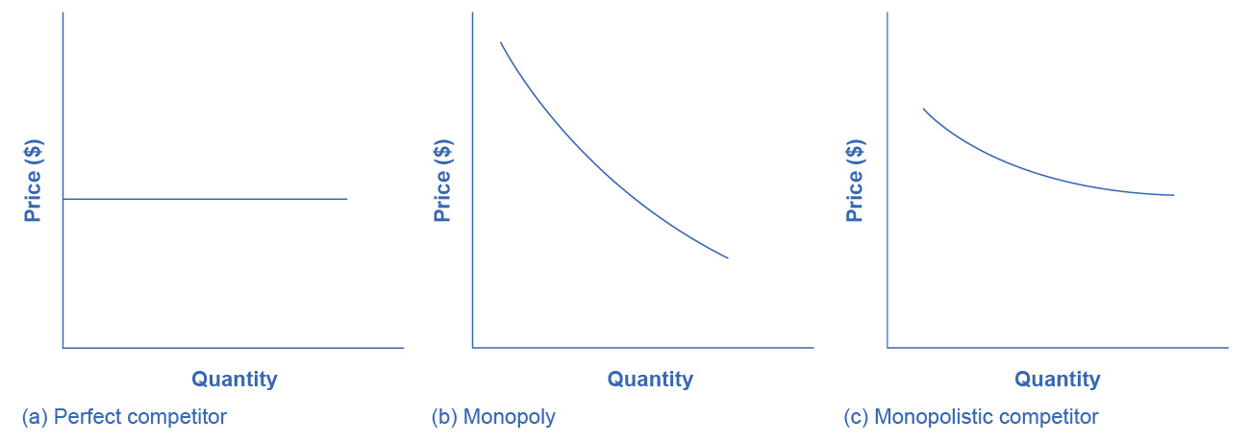
Demand Curves Compared
Market Structure | Demand Curve | Meaning
Perfect Competition | Perfectly elastic (flat) | No pricing power—take market price
Monopolistic Competition | Downward-sloping | Raise price = lose some customers
Monopoly | Downward-sloping (market demand) | Raise price = lose some sales
Notes:
Understanding demand curves reveals market power. A perfectly competitive firm faces a flat, perfectly elastic demand curve—if it raises price even slightly, it loses all customers to identical competitors. A monopolist faces the entire market demand curve—it can raise prices, though it will sell less. A monopolistically competitive firm falls in between: it faces a downward-sloping demand curve, but more elastic than a monopolist's. Why? Substitutes exist. If your local coffee shop raises prices, some customers will stop buying coffee, but others will switch to a nearby café. The monopolistic competitor loses customers to substitutes, while a monopoly raises prices knowing consumers have no close alternatives. This difference in demand elasticity fundamentally shapes pricing strategy.

Slide 7
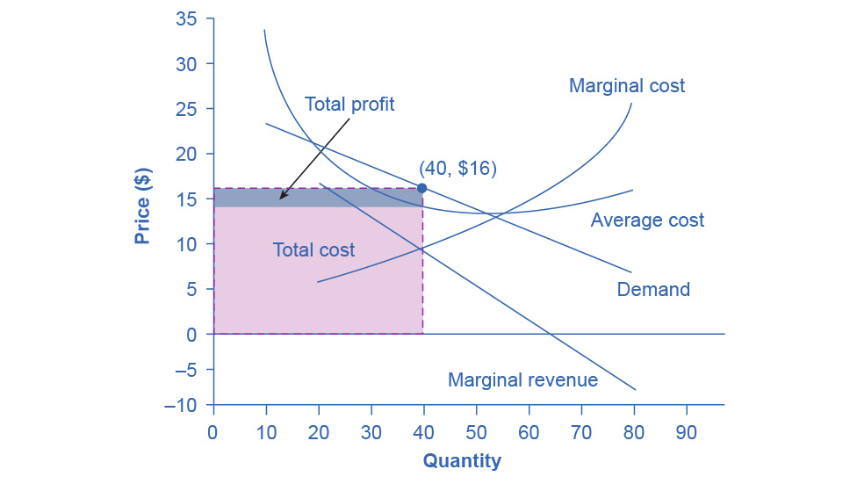
Profit Maximization
How Monopolistic Competitors Choose Price and Quantity
Decision Process (Same as Monopoly):
Find profit-maximizing quantity: Where MR = MC
Find price: Go up to demand curve at that quantity
Calculate profit: (Price – AC) × Quantity
Short Run: Can earn economic profit
Long Run: Entry drives profit to zero
Notes:
Monopolistic competitors maximize profit using the same two-step process as monopolists. First, find where marginal revenue equals marginal cost—that's your profit-maximizing quantity. Second, look up to your demand curve to find the highest price customers will pay for that quantity. The textbook's "Authentic Chinese Pizza" example illustrates this: at quantity 40, MR equals MC. Moving up to the demand curve, they can charge $16. With average cost of $14.50, they earn $60 profit. But here's the crucial difference from monopoly: these profits attract entry. Unlike monopolists protected by barriers, monopolistic competitors face new entrants who see those profits and want in. As competitors enter, your demand curve shifts left, reducing quantity and price until profits disappear.

Slide 8
Long-Run Equilibrium
Entry and Exit Drive Zero Economic Profit
When Profits Exist: → Entry → Supply shifts right → Price falls → Each firm’s demand shifts left → Profit eliminated
When Losses Exist: → Exit → Supply shifts left → Price rises → Each firm’s demand shifts right → Losses eliminated
Long-Run Outcome:
Price = Average Cost (zero economic profit)
Price > Minimum AC (productive inefficiency)
Price > MC (allocative inefficiency)
Trade-off: We sacrifice efficiency for variety and innovation.
Notes:
The long-run equilibrium in monopolistic competition looks different from perfect competition. When firms earn economic profits, competitors enter, shifting each firm's demand left until profits vanish. When firms suffer losses, some exit, shifting remaining firms' demand right until losses disappear. The endpoint: price equals average cost, meaning zero economic profit. But notice two inefficiencies. First, productive inefficiency: firms don't produce at the minimum of their average cost curve—they operate on the downward-sloping portion, meaning higher costs per unit than possible. Second, allocative inefficiency: price exceeds marginal cost, meaning consumers value additional units more than they cost to produce, but firms don't make them. However, we get benefits too: product variety, innovation, competition on quality and service. Most people prefer living in a world with diverse restaurants, clothing styles, and experiences rather than perfect competition's uniformity.

Slide 9
Monopolistic Competition and Efficiency
In monopolistic competition, the result of entry and exit:
Firms end up with a price that lies on the downward-sloping portion of the AC curve, not at the very bottom of the AC curve.
Thus, monopolistic competition will not be productively efficient.

Slide 10
Oligopoly Defined
Key Characteristics:
Few large firms dominate (high concentration)
High barriers to entry (economies of scale, patents, capital)
Mutual interdependence (strategic decision-making)
Can compete or collude
Analogy: Like chess players—each move depends on anticipating opponents' responses.
Notes:
Now we shift to oligopoly, where a small number of large firms dominate an industry. Commercial aircraft is the textbook example: Boeing and Airbus each produce about 50% of large commercial aircraft worldwide. The U.S. soft drink industry is another: Coca-Cola and Pepsi dominate. What makes oligopoly unique is mutual interdependence—each firm's decisions on output, pricing, and advertising depend on rivals' decisions. This creates a chess-like strategic environment. Oligopolies arise from barriers to entry combined with economies of scale. The market might be large enough for two or three efficient firms, but not more. Smaller firms have higher average costs and can't compete; larger firms would produce more than they could profitably sell. This combination of scale economies and market size creates the barrier.

Slide 11
Oligopoly Examples
Industry / Market | Major Firms | Barriers to Entry | Price Control | Competition Type | Example of Strategic Behavior
Smartphones | Apple, Samsung, Xiaomi, Oppo, Huawei | High R&D costs, patents, brand loyalty | Moderate – prices influenced by product differentiation | Non-price competition (features, design, ecosystem) | Annual flagship launches timed competitively
Commercial Aircraft | Boeing, Airbus | Massive capital investment, government regulation | Moderate – prices negotiated with airlines | Non-price (performance, delivery timelines) | Matching new aircraft features when rival launches
Soft Drinks | Coca-Cola, PepsiCo | Brand loyalty, distribution networks, marketing spend | Moderate | Non-price (branding, sponsorships) | Heavy advertising during rival campaigns (e.g., Super Bowl)
Media & Entertainment | Disney, Comcast, Warner Bros. Discovery, Paramount | Content libraries, IP rights, production costs | Moderate – subscription and licensing fees | Both price and non-price | Competing streaming service bundles
Video Game Consoles | Sony, Microsoft, Nintendo | R&D, exclusive game libraries, network effects | Moderate – hardware often sold near cost | Non-price (exclusive titles, online services) | Exclusive game releases to lock in users
Airlines (U.S.) | American, Delta, United, Southwest | Fleet costs, gate slots, regulation | Moderate – affected by fuel costs and demand | Both price and non-price | Coordinated flight route adjustments
Credit Card Networks | Visa, Mastercard, AmEx, Discover | Network infrastructure, merchant acceptance | Low direct price competition (fees set to merchants) | Non-price (rewards programs, partnerships) | Exclusive bank partnerships
Oil & Gas Majors | ExxonMobil, Chevron, Shell, BP, TotalEnergies | Exploration costs, infrastructure, geopolitical barriers | Some influence but tied to global oil prices | Both price and non-price | Coordinated investment in refining capacity

Slide 12
The Oligopolist's Dilemma
Two Conflicting Temptations
Option 1: COLLUDE (Act like monopoly) → Restrict output, raise prices, share monopoly profits → But illegal in most countries
Option 2: COMPETE (Act like perfect competition) → Expand output, cut prices, drive profits to zero → But worse for all firms
Reality: "Cats in a bag"—scratch each other or cuddle up?
Notes:
Oligopolists face a fundamental dilemma. If they cooperate—restricting output and raising prices—they can act like a monopoly and earn high profits. But if they compete aggressively—expanding output and cutting prices—they drive profits down toward zero, like perfect competitors. Adam Smith observed in 1776: "People of the same trade seldom meet together, even for merriment and diversion, but the conversation ends in a conspiracy against the public, or in some contrivance to raise prices." The textbook describes oligopolists as "cats in a bag"—they can either scratch each other to pieces through competition or cuddle up comfortably through collusion. The challenge: even when cooperation benefits the group, each individual firm is tempted to cheat by producing slightly more to capture extra profits.

Slide 13
Game Theory and the Prisoner's Dilemma
Understanding Strategic Interdependence
Prisoner's Dilemma:
Two suspects arrested, interrogated separately.
Dominant Strategy: Confess (regardless of partner's choice)
Outcome: Both confess (5 years each)
Irony: Both silent = only 2 years each (better outcome)
 | Prisoner B: Silent | Prisoner B: Confess
Prisoner A: Silent | Both get 2 years | A gets 8 years, B gets 1 year
Prisoner A: Confess | A gets 1 year, B gets 8 years | Both get 5 years
Notes:
To understand oligopoly behavior, economists use game theory—the mathematics of strategic decision-making. The prisoner's dilemma illustrates the problem perfectly. Two suspects are arrested and interrogated separately. If both stay silent, weak evidence means only 2 years each. If both confess, they each get 5 years. But if one confesses while the other stays silent, the confessor gets only 1 year while the silent partner gets 8 years. Here's the dilemma: from Prisoner A's perspective, confessing is best regardless of B's choice. If B confesses, A should confess too (5 years vs. 8 years). If B stays silent, A should still confess (1 year vs. 2 years). Confessing is the dominant strategy. But when both follow this logic and confess, they each get 5 years—worse than if both had cooperated by staying silent for only 2 years each. Cooperation yields better outcomes, but individual incentives drive non-cooperation.

Slide 14
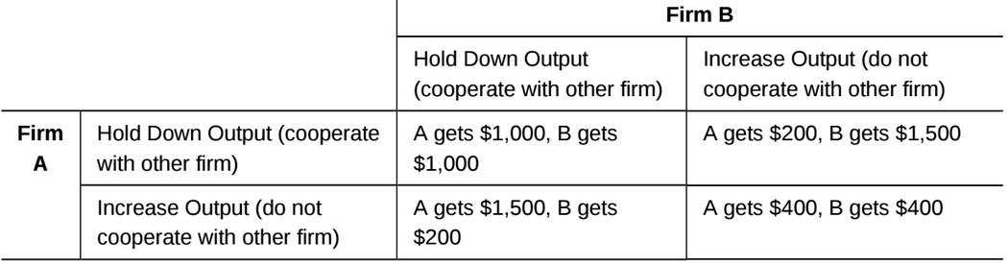
Oligopoly Prisoner's Dilemma
The Duopoly Game
Two firms choose output levels:
Dominant Strategy: High output (compete) Outcome: Both earn only $400 Irony: Both restricting output = $1,000 each (collusion)
Notes:
Now apply the prisoner's dilemma to oligopoly. Imagine two firms forming a duopoly. If both restrict output, they act like a monopoly and each earns $1,000 profit. But each faces temptation. If Firm A thinks B will restrict output, A can expand output and earn $1,500 while B earns only $200. If A thinks B will expand output, A should expand too—earning $400 is better than the $200 from restricting output while B expands. The dominant strategy is to expand output regardless of what the rival does. The result: both expand, both earn only $400—worse than the $1,000 each could have earned through cooperation. This explains why cartels are unstable even when illegal. The Lysine cartel from your textbook collapsed because individual firms were tempted to cheat for extra profits.

Slide 15
Real-World Collusion: The Lysine Cartel
When Oligopolists Cuddle Up
Lysine (animal feed additive) producers, 1990s:
Met in hotels to fix prices and divide market
FBI wiretapped meetings
Executive quote: "Your competitors are your friends. Your customers are the enemy."
Result:
Prices doubled during cartel
ADM fined $100 million
Executives imprisoned 24-30 months
Lesson: Strong temptation to collude, but cartels eventually collapse.
Notes:
The lysine cartel provides a perfect real-world example. Lysine is an amino acid used in animal feed—a $600 million industry. In the early 1990s, major producers including Archer Daniels Midland met in hotel conference rooms to decide how much each would sell and what they'd charge. The FBI learned of the meetings and wiretapped them. In one recording, ADM's corn processing president said to competitors: "You are my friend. I wanna be closer to you than I am to any customer. Cause you can make us money." ADM's slogan, which "penetrated the whole company," was: "Our competitors are our friends. Our customers are the enemy." That could be the motto of cartels everywhere. During the cartel, lysine prices doubled. But the cartel was unstable—firms were tempted to cheat. When confronted with FBI tapes, ADM pled guilty and paid a $100 million fine. Executives were imprisoned. This illustrates both the temptation to collude and why cartels are difficult to maintain.

Slide 16
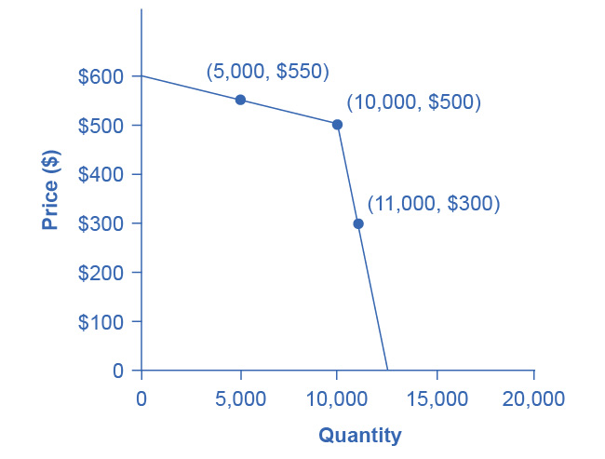
Enforcing Cooperation: The Kinked Demand Curve
Silent Collusion Without Written Agreements
Strategy: Match all price cuts, ignore price increases
If firm cuts price: Rivals match immediately → Small sales gain If firm raises price: Rivals don't match → Large sales loss
Result: No incentive to change price—"kink" at agreed price
Analogy: Mutually Assured Destruction (MAD) in Cold War—cooperation through threat of retaliation
Notes:
Since explicit cartels are illegal, oligopolists develop tacit ways to encourage cooperation. The kinked demand curve model shows how. Imagine an oligopolist agrees to produce 10,000 units at $500. Other firms can discipline this behavior through a simple strategy: match all price cuts but not price increases. If the firm expands output to 11,000 and cuts price to $300, rivals immediately cut their prices too, so the firm gains few extra sales. But if the firm raises price to $550, rivals don't follow, so the firm loses substantial sales as customers switch to cheaper competitors. This creates a "kink" in the demand curve at the agreed price. Neither raising nor lowering price is attractive, so firms stick to the agreement without any written contract. It's like Mutually Assured Destruction during the Cold War—cooperation emerges from the threat of retaliation, not from trust.

Slide 17
Market Structure Comparison
Feature | Perfect Competition | Monopolistic Competition | Oligopoly | Monopoly
# of Firms | Many | Many | Few | One
Entry Barriers | None | Low | High | Very High
Product Type | Identical | Differentiated | Similar/Differentiated | Unique
Market Power | None | Some | Moderate-High | Maximum
Long-Run Profit | Zero | Zero | Possible | Possible
Efficiency | Productive & Allocative | Neither | Neither | Neither
Notes:
Let's consolidate what we've learned by comparing all four market structures. Perfect competition features many firms selling identical products with no barriers to entry and zero market power—firms are price takers. Monopolistic competition has many firms selling differentiated products with low entry barriers and some market power, but entry drives long-run profits to zero. Oligopoly involves few firms with high entry barriers, moderate to high market power depending on whether they compete or collude, and potential for sustained profits. Monopoly features a single firm with very high barriers, maximum market power, and potential for sustained profits. Only perfect competition achieves both productive efficiency (producing at minimum average cost) and allocative efficiency (price equals marginal cost). The other structures sacrifice efficiency for various reasons—but they also provide benefits like variety, innovation, and in oligopoly's case, economies of scale.

Slide 18
Policy Implications
How Should Government Respond?
Benefits of Imperfect Competition:
Product variety and innovation (monopolistic competition)
Economies of scale, lower costs (oligopoly)
R&D investment and technological progress
Costs of Imperfect Competition:
Higher prices than perfect competition
Allocative and productive inefficiency
Excessive advertising spending (wasteful?)
Policy Challenge: Encourage beneficial behavior, discourage anti-competitive collusion
Notes:
Public policy toward imperfect competition must balance competing considerations. Monopolistic competition provides powerful incentives for innovation as firms seek short-run profits, and entry ensures long-run competitive discipline. But firms may engage in excessive advertising and marketing—is society better off with dozens of athletic shoe brands, or would we be fine with fewer options at lower prices? Oligopolies can benefit consumers through economies of scale and lower average costs, but they can also collude to raise prices and restrict output. The policy task is to encourage beneficial innovation and scale economies while discouraging anti-competitive collusion. This requires careful enforcement of antitrust laws—agencies like the Justice Department and Federal Trade Commission must find hard evidence of collusion while allowing legitimate business practices. It's a delicate balance requiring ongoing judgment calls.

Slide 19
Key Takeaways
Monopolistic Competition:
Many firms, differentiated products, easy entry
Some market power in short run; zero profit in long run
Inefficient but provides variety and innovation
Oligopoly:
Few firms, high barriers, strategic interdependence
Face dilemma: compete or collude?
Can benefit consumers (scale) or harm them (collusion)
Both structures dominate real-world markets—understanding them is essential.
Notes:
Let's recap the key points. Monopolistic competition describes markets with many firms selling differentiated products. Easy entry means firms can't sustain economic profits long-term, but differentiation provides some short-run market power. While monopolistic competition doesn't achieve perfect efficiency, it delivers product variety and innovation that most consumers value. Oligopoly describes markets with few dominant firms facing strategic interdependence. They're caught between cooperating for higher profits and competing for market share. High barriers allow sustained profits, but whether oligopoly benefits or harms consumers depends on whether firms compete or collude. Together, these structures describe most markets you encounter—from restaurants and retail to airlines and smartphones. Understanding them helps explain pricing strategies, advertising decisions, and why some industries have many players while others have only a few. As a classical liberal, I'd note that these market structures can generate prosperity when entry is relatively free and collusion is prevented, but require vigilant antitrust enforcement to protect consumers from anti-competitive behavior.

