Slide 1

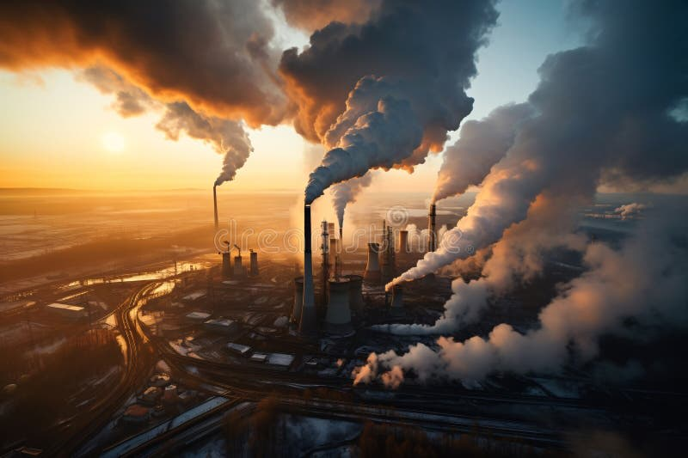
Chapter 12
Environmental Protection and Negative Externalities
Notes:
Welcome to Chapter 12 on Environmental Protection and Negative Externalities. This chapter explores one of the most important applications of microeconomic theory: how we balance economic growth with environmental quality. We'll see how markets sometimes fail to account for pollution costs, and examine both traditional government regulations and innovative market-based solutions. Think of this as answering the question: "Who pays for clean air and water, and what's the most efficient way to achieve it?"

Slide 2
The Progress and Challenges
U.S. Environmental Progress Since 1970
Key Achievement: Coal CO₂ emissions ↓ 66% (1990-2023)
Despite 38% population growth and 3.5× economic expansion
Air and water pollution significantly improved
Remaining Challenges:
Hazardous waste disposal
Habitat destruction
Public health impacts
Notes:
Think of environmental progress like renovating an old house—you've fixed the roof and foundation, but there's still work to do on the plumbing and electrical. Since 1970, America has made remarkable progress: coal emissions dropped 66% even as our population and economy grew dramatically. This is like running faster while getting lighter—normally you'd expect the opposite! But we still face significant challenges. The job isn't done; we've just moved from emergency crisis management to long-term maintenance and improvement.
Analogy: The U.S. economy is like a car that's been upgraded from belching black smoke to running much cleaner, but we're still not at zero emissions. Progress, not perfection.

Slide 3
Understanding Externalities
What Are Externalities?
Externality = Market exchange affecting uninvolved third parties
Two Types:
Negative Externality Third party suffers from others' transaction Example: Your neighbor's late-night band practice
Positive Externality Third party benefits from others' transaction Example: Neighbor's beautiful garden increases your property value
Notes:
Externalities are like economic "secondhand smoke"—someone else's transaction affects you even though you had no say in it. Imagine you're trying to sleep, and your neighbor throws a loud party. The neighbor and their guests are happy (they made a voluntary exchange: host provides space, guests bring fun), but you're suffering. That's a negative externality—you're the third party bearing a cost you didn't agree to.
Classroom analogy: When someone wears strong cologne in class, everyone else experiences an externality—positive if you like the scent, negative if you don't. The wearer made a personal choice, but it spills over to others.
The key insight: markets are excellent at coordinating exchanges between buyers and sellers, but they often ignore effects on third parties. That's where problems begin.

Slide 4
Pollution = Negative Externality
The Core Problem
Pollution = Classic negative externality
Additional External Costs: Costs imposed on third parties when output is produced
Health impacts, property damage, ecosystem harm
Social Costs = Private Costs + External Costs
When firms ignore external costs, they overproduce and underprice goods.
Notes:
Here's the fundamental problem: When a refrigerator factory produces, it pays for labor, materials, and electricity—those are private costs. But if it also emits pollutants that give nearby residents asthma, that's an external cost. The factory doesn't pay that cost; the residents do through medical bills and suffering.
Powerful analogy: Imagine you're at a restaurant and you can order food, but someone else gets stuck with part of your bill. You'd probably order more food than if you paid the full price yourself! That's exactly what polluting firms do when they don't pay external costs—they "order" too much production because they're not paying the full "bill."
Social costs are simply the complete bill: what the firm pays PLUS what society pays. Efficient markets require that decision-makers face the full costs of their choices.

Slide 5
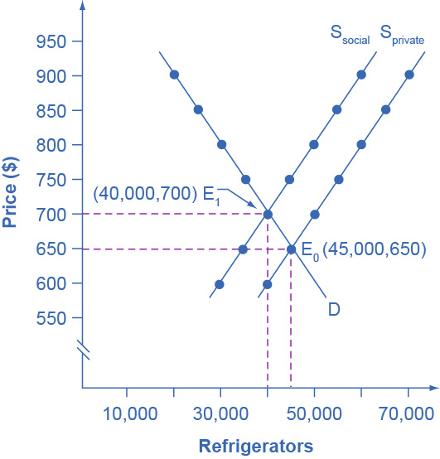
The Supply Shift Model
When Firms Internalize Social Costs
Private Cost Scenario (S-private): Equilibrium at E₀: Price = $650, Quantity = 45,000
Adding External Costs (+$100/unit): Supply shifts left to S-social New equilibrium at E₁: Price = $700, Quantity = 40,000
Result: Higher price, lower quantity, less pollution
Notes:
This graph tells the pollution story in economic terms. Initially, firms consider only private costs, producing 45,000 refrigerators at $650 each (point E₀). But each refrigerator creates $100 in pollution damage. When we force firms to account for this—maybe through regulation or taxes—it's like adding $100 to their production cost. The supply curve shifts upward (leftward) because production just got more expensive.
At the new equilibrium (E₁), price rises to $700 and quantity falls to 40,000. Notice what happened: consumers pay more, firms produce less, and pollution decreases. The market is now telling the truth about the real cost of refrigerators.
Think of it this way: Previously, refrigerators were "on sale" because society was subsidizing them by accepting free pollution. Now they're full price, and we naturally buy fewer.

Slide 6
Market Failure
When Markets Get It Wrong
Market Failure = Markets fail to allocate resources efficiently when social costs ≠ private costs
The Pollution Problem:
Without regulation: Firms overproduce
Too much pollution, quantity exceeds social optimum
Price too low (doesn't reflect full cost)
Solution: Force firms to internalize external costs → Less pollution, higher price, lower quantity
Notes:
Market failure is like a broken thermostat—the signal is wrong, so you get the wrong temperature. Normal markets are brilliant: prices act as signals that coordinate millions of decisions. But when externalities exist, prices lie. They don't reflect true costs.
Without intervention, polluting firms produce where private marginal cost equals demand, but social efficiency requires producing where social marginal cost equals demand. The gap between these two points is the market failure—we get too much production and too much pollution.
Analogy for students: Imagine if your bank account only showed half your spending. You'd overspend! That's what happens when firms only see private costs—they "overspend" on production.
The solution isn't to ban production, but to fix the price signal by making firms account for external costs. This naturally leads them to produce the socially optimal amount.

Slide 7
Command-and-Control Regulation
The Traditional Approach
Command-and-Control = Government mandates:
Emission limits per facility
Required pollution-control technology
Penalties for exceeding limits
Example: Clean Air Act (1970), Clean Water Act (1972)
How it works: Forces firms to install equipment → raises costs → firms internalize social costs
Notes:
Command-and-control is the "parent telling child what to do" approach to regulation. The government says: "You can emit only X tons per year" or "You must install this specific scrubber on your smokestack." It's direct, simple, and was necessary in the 1970s when pollution was so bad that Ohio's Cuyahoga River literally caught fire.
This approach has been highly successful—America's air and water are dramatically cleaner than 50 years ago. The EPA was created in 1970 specifically to enforce these rules. Without these laws, we'd likely still have rivers catching fire and cities where you need headlights at noon because of smog.
Analogy: Command-and-control is like a strict building code that says every house must have smoke detectors in specific locations. It works, everyone knows the rules, and it's easy to enforce.
But as we'll see next, this approach has limitations.

Slide 8
Problems with Command-and-Control
Three Major Limitations
1. No incentive to exceed standards Once firms meet the target → innovation stops
2. Inflexibility Same rules for all polluters regardless of cost (Expensive for some firms, cheap for others)
3. Political compromises Loopholes, exemptions, grandfather clauses Existing firms often exempted; new firms face stricter rules
Notes:
While command-and-control works, it's like using a sledgehammer when you need a scalpel. Three key problems:
First, no incentive to improve beyond the standard. If the law says "emit no more than 100 tons," and you achieve 100 tons, why go to 80? You won't be rewarded. It's like telling students "anything above 70% is passing"—many will aim for exactly 70%.
Second, inflexibility. Imagine two factories: Factory A can reduce pollution for $500/ton, Factory B would cost $5,000/ton because of old equipment. Command-and-control says "both of you cut by 50%." That's inefficient! We could get more pollution reduction if A cuts more and B cuts less.
Third, political reality. Real environmental laws are written by legislators who face lobbying. Existing firms often negotiate exemptions: "Don't make us comply, just make new firms comply." The result? Laws full of fine print and loopholes.
Better analogy: It's like requiring every student to study exactly 2 hours per night, regardless of whether they're a fast or slow learner. A one-size-fits-all rule wastes effort.

Slide 9
Market-Oriented Tools Overview
A Flexible Alternative
Three market-based approaches:
1. Pollution Charges (Taxes) Tax per unit of pollution emitted
2. Marketable Permits (Cap-and-Trade) Set total cap, let firms trade emission rights
3. Better-Defined Property Rights Clarify who owns what, enable negotiation
Core principle: Give firms flexibility in HOW to reduce pollution, while achieving the SAME environmental goal at LOWER cost.
Notes:
Now we shift to market-oriented tools—these are like giving firms a budget and letting them decide how to spend it, rather than telling them exactly what to buy.
All three approaches harness the power of incentives. Instead of saying "you must install this specific technology," we create incentives for firms to find the cheapest way to reduce pollution. The environmental goal is the same, but we achieve it more efficiently.
Key insight: Different firms have different costs for reducing pollution. Market tools let cheap-reducers do more and expensive-reducers do less, which minimizes total societal cost.
Analogy: Imagine trying to lose weight. Command-and-control says "everyone must eat exactly 1800 calories." Market approach says "here's your calorie budget; you choose whether to exercise more, eat less, or both." Same weight loss goal, more flexibility in achieving it.
These tools respect that firms know their own costs better than regulators do.

Slide 10
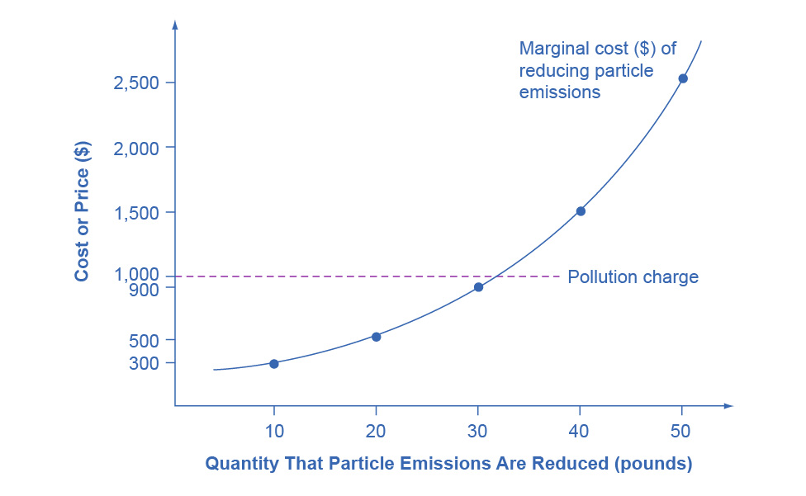
A Pollution Charge Example
How Pollution Taxes Work
Pollution Charge = Tax per unit of pollution emitted
Example: $1,000 tax per 10 pounds of particulates
Firm's decision:
If abatement cost < tax → reduce pollution
If abatement cost > tax → pay tax
Outcome:
Firm reduces first 30 pounds (costs $300, $500, $900)
Stops when marginal cost ($1,500) exceeds tax ($1,000)
Notes:
Pollution charges are beautifully simple: tax pollution, and firms will reduce it whenever doing so is cheaper than paying the tax.
Look at this example: A firm emits 50 pounds of particles. We tax them $1,000 per 10 pounds. The firm can:
Cut first 10 lbs for $300 → saves $700, so DO IT
Cut second 10 lbs for $500 → saves $500, so DO IT
Cut third 10 lbs for $900 → saves $100, so DO IT
Cut fourth 10 lbs for $1,500 → COSTS $500 extra, so PAY THE TAX instead
The firm naturally reduces 30 pounds and emits 20 pounds while paying tax on those 20. The tax created the incentive; the firm found the cheapest solution.
Real-world examples: Gasoline taxes discourage driving and pollution. "Pay-as-you-throw" garbage fees (charged per bag) encourage recycling. Bottle deposits reduce litter.
Analogy: It's like a gym membership that charges per day you don't go. You'd find cheap ways to exercise more! Pollution taxes charge for pollution, so firms find cheap ways to pollute less.

Slide 11
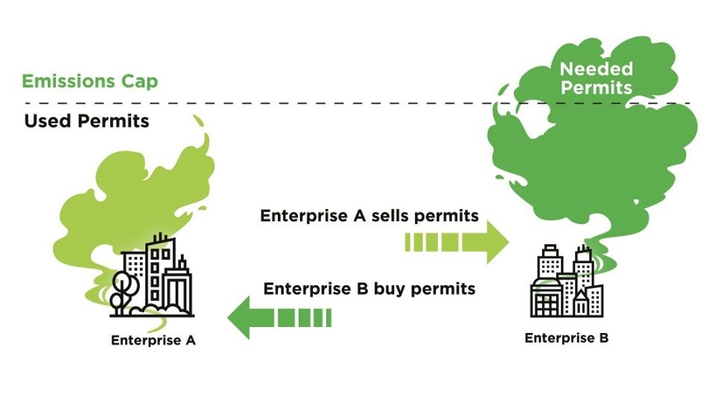
Marketable Permits (Cap-and-Trade)
Real-World Success: U.S. Acid Rain Program
The System:
Cap: Government sets total emissions limit (8.95M tons SO₂ by 2010)
Permits: 1 permit = right to emit 1 ton
Trade: Firms can buy, sell, or bank permits
Shrinking: Cap decreases over time
Why Trading Works: Firms with cheap abatement reduce more, sell extra permits Firms with expensive abatement buy permits instead
Result: Same environmental goal at half the expected cost
Notes:
Cap-and-trade is the "economist's favorite" environmental tool because it guarantees an environmental outcome (the cap) while minimizing cost (through trading).
Here's how it works: Congress says "The nation can emit 8.95 million tons of SO₂, period." They print permits for exactly that amount and give them to power plants. Over time, the cap shrinks—permits allow less each year.
Now comes the magic: trading. Plant A can reduce emissions cheaply ($300/ton). Plant B has old equipment; reducing costs $900/ton. If permit price is $600:
Plant A reduces extra tons, sells permits at $600 → makes money
Plant B buys permits at $600, avoids $900 cost → saves money
Environment gets the same total reduction
Society saves resources
Real outcome: The Acid Rain Program worked spectacularly. Acid rain decreased dramatically, compliance was nearly 100%, and costs came in far below 1990 predictions.
Analogy: Imagine a household with a phone data cap. The teenager uses lots of data (high-value user), but grandma doesn't (low-value user). They can "trade"—grandma gives her data to the teen for a monthly allowance. Same total usage, but allocated to whoever values it most. That's cap-and-trade.

Slide 12
Trading Example - The Math
Why Trading Cuts Costs in Half
Scenario: Two plants must cut 10,000 tons total
Without Trading (each cuts 5,000):
Plant A: 5,000 × $300 = $1.5M
Plant B: 5,000 × $900 = $4.5M
Total cost = $6.0M
With Trading (at $600/ton permit price):
Plant A cuts all 10,000 for $3.0M, sells 5,000 permits for $3.0M (nets $0)
Plant B cuts 0, buys 5,000 permits for $3.0M
Total resource cost = $3.0M (only A's abatement)
Trading saves $3M while achieving identical environmental outcome
Notes:
Let's walk through the math to see exactly why economists love this system.
Without trading, regulators might say "everyone cuts 50%." That forces both plants to cut 5,000 tons each. Plant A spends $1.5M (cheap for them), Plant B spends $4.5M (expensive because of old equipment). Total societal cost: $6 million.
Now add trading at a market price of $600/ton. Plant A thinks: "I can cut a ton for $300 and sell the permit for $600—I make $300 profit per ton!" So Plant A cuts all 10,000 tons, costing them $3M, and sells 5,000 permits for $3M. Plant A breaks even or makes a small profit.
Plant B thinks: "Cutting costs me $900/ton, but I can buy a permit for $600. I'll buy permits and avoid expensive abatement." Plant B buys 5,000 permits for $3M.
Total: The environment gets the same 10,000-ton reduction, but the real resource cost is only $3M (Plant A's actual abatement work). The $3M Plant B paid to Plant A is just a transfer—money changing hands, not resources consumed.
Key insight: Trading doesn't change the environmental outcome; it changes who reduces pollution, shifting the burden to whoever can do it cheapest.

Slide 13
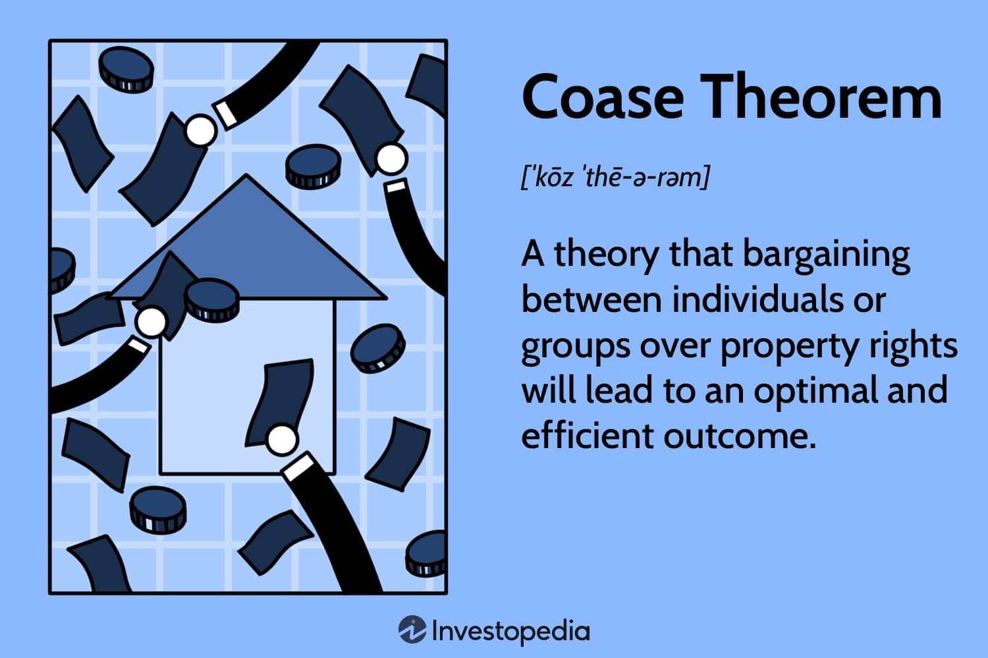
Property Rights - Coase Theorem
When Negotiation Solves Externalities
Property Rights = Legal ownership that others can't infringe without compensation
Coase Theorem: With clear property rights and low bargaining costs, parties negotiate to the efficient outcome—regardless of who initially owns the rights
Three Real Examples:
NYC watershed: City paid upstate farmers to reduce runoff
SO₂ cap-and-trade: Government defined emission rights, firms traded
Airport noise: Airports buy easements or soundproof homes
Notes:
Ronald Coase won the Nobel Prize for a deceptively simple idea: if you clearly define who owns what, people will bargain their way to an efficient outcome.
His famous example: A railroad emits sparks that burn a farmer's field. Who should pay to fix the problem? Coase said it doesn't matter who has the property right, as long as someone clearly does.
If the farmer has the right to an unburned field, the railroad will pay for a spark-arresting smokestack (if that's cheaper than compensating the farmer). If the railroad has the right to emit sparks, the farmer will pay for the smokestack (if that's cheaper than constant crop loss). Either way, the smokestack gets installed if it's the efficient solution.
NYC watershed example: New York City faced expensive drinking water regulations. Upstate farms were creating runoff pollution. Instead of building a $6-8 billion filtration plant, NYC paid farmers to change practices—conservation easements, manure management, etc. NYC essentially "bought" clean water from the polluters. Same result as regulation, achieved through contracts. That's Coasean.
Critical limitation: This works when bargaining is cheap. NYC can negotiate with a few dozen farmers. It cannot negotiate with millions of individual drivers about car emissions. That's when we need pollution taxes or cap-and-trade.

Slide 14
Benefits of Environmental Protection
Four Categories of Benefits
1. Health & Longevity People live healthier, longer lives
2. Industry Benefits Farming, fishing, tourism thrive with clean environment
3. Property Values Higher real estate values in clean areas
4. Intrinsic Value People value clean environment beyond market transactions (e.g., satisfaction knowing Grand Canyon has clear air)
Notes:
When economists evaluate environmental regulations, we try to measure benefits in dollar terms—not because nature only matters in dollars, but because comparing benefits to costs helps us make informed decisions.
Health benefits are most concrete: Fewer asthma attacks, less cancer, longer life expectancy. The EPA values a statistical life at $10.5 million (2022 dollars), based on how much people demand in wages for risky jobs.
Industry benefits are market-based: Clean water helps fisheries and tourism. These are easier to measure because we can observe market prices.
Property values reveal preferences: People pay more for homes in areas with clean air and low pollution. This difference reflects the value they place on environmental quality.
Intrinsic value is hardest to measure but real. People donate to environmental causes and express satisfaction from knowing wilderness exists, even if they never visit it. Economists use surveys and statistical methods to estimate these "non-use values."
Important finding: EPA studies show Clean Air Act benefits exceeded costs by ratios of 4-to-1 or even 44-to-1. Not every regulation is worth it, but overall, we've gotten huge value.

Slide 15
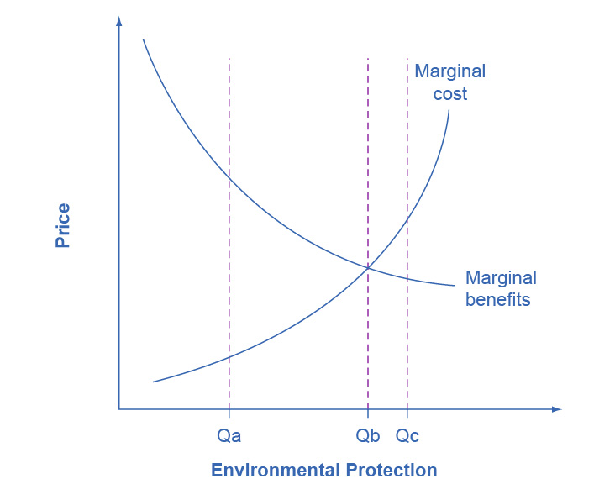
Marginal Analysis of Pollution
Finding the Optimal Level
Key Insight: Optimal pollution is not zero (Zero pollution means zero production—starvation is worse than pollution)
Marginal Benefit of reducing pollution:
High when pollution is extensive (low-hanging fruit)
Decreases as environment gets cleaner
Marginal Cost of reducing pollution:
Low initially (cheap methods used first)
Increases as cleaner environment requires costly methods
Optimal point (Qb): MB = MC
Notes:
Here's a controversial but important truth: the optimal amount of pollution is not zero. Zero pollution would mean zero production—no cars, no electricity, no modern medicine. We'd all starve. The question is how much pollution to reduce, not whether to eliminate it entirely.
Think of cleaning your house. The first 10 minutes of tidying gives huge benefits—you can walk without tripping. The marginal benefit is high. The next hour brings moderate benefits. But at some point, you're using a toothbrush on grout lines for minimal improvement. The marginal cost (your time) exceeds the marginal benefit (slightly cleaner grout).
Same with pollution. When pollution is extensive (point Qa on the graph), there are cheap, easy ways to reduce it with huge benefits. It's worth doing! As we reduce pollution toward Qb, the gap narrows. At Qb, marginal benefit equals marginal cost—that's optimal.
Beyond Qb, at Qc, marginal costs exceed marginal benefits. We're spending $5 to get $1 of benefit. That's wasteful—we're forfeiting resources (healthcare, education, etc.) for minimal environmental gain.
Analogy: Medicine dosing. Too little antibiotic doesn't cure the infection; too much causes harmful side effects. There's an optimal dose where benefits exceed costs.

Slide 16
International Environmental Issues
Global Externalities Require Global Solutions
Problems that cross borders:
Climate change (CO₂ emissions)
Biodiversity loss
Ocean pollution
The Challenge: No nation acting alone can solve these → Requires international cooperation
Tension: High-income countries lecture low-income countries, but high-income created the problem historically
Notes:
Some externalities don't respect borders—carbon dioxide mixes globally in the atmosphere, and biodiversity exists worldwide. This creates a coordination problem.
Imagine if pollution from North Carolina drifted into South Carolina, but NC made all the environmental rules. South Carolina would be frustrated! That's the international situation: China's emissions affect the whole world, Brazil's deforestation affects global biodiversity, but each nation controls its own policies.
The moral tension is real: The U.S. and Europe industrialized first, burning fossil fuels for 150+ years. Now we tell developing countries "don't do what we did—it causes climate change." Their response: "You got rich by polluting; now you want to keep us poor?" That's understandable frustration.
Example: China and India argue they should be allowed to burn fossil fuels like the West did. The West argues everyone must cut emissions now because climate change is urgent. Both perspectives have merit.
The solution likely involves transfers: Rich countries help fund clean technology for poor countries. It's saying "we'll pay part of the cost of you leapfrogging to clean energy."

Slide 17
The Paris Climate Agreement
Global Cooperation Attempt
Paris Agreement (2015): 196 countries committed to CO₂ emission limits
Key Players: China and U.S. (world's two largest emitters) signed on
U.S. Approach: Clean Power Plan targeted 32% power plant emission reduction by 2030
Political challenges: Trump admin withdrew (2017), Biden admin rejoined (2021), Trump admin withdrew (2025)
Market-oriented approaches likely only practical international solution
Notes:
The Paris Climate Agreement represents the most ambitious attempt at global environmental cooperation. 196 entities signed on, including the world's biggest polluters—China and the U.S.
The agreement is flexible: each country sets its own targets ("Nationally Determined Contributions"). This is more practical than a world government imposing command-and-control regulation globally—imagine trying to enforce the same rules in Norway, Nigeria, and Nepal. It won't work.
The U.S. committed to the Clean Power Plan: reducing power plant CO₂ emissions 32% by 2030 compared to 2005 levels. That's significant.
Political reality: Environmental agreements face domestic political challenges. Trump withdrew, calling it unfair to American workers. Biden rejoined on his first day. This back-and-forth illustrates the difficulty: environmental protection competes with other priorities (jobs, economic growth), and different leaders weigh these differently.
Why market tools matter here: International command-and-control is impossible—no world police force exists. But market mechanisms (carbon taxes, international permit trading) can work across borders because they respect national sovereignty while coordinating incentives.
Analogy: The Paris Agreement is like neighbors agreeing to keep their lawns maintained without forming an HOA. Each commits to standards, but enforcement is voluntary and based on reputation and self-interest.

Slide 18
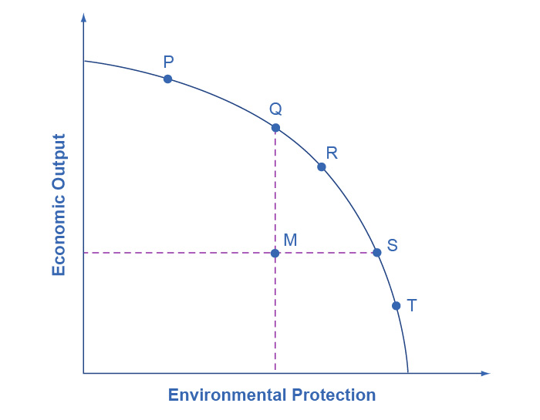
The Economic-Environmental Tradeoff
Production Possibility Frontier (PPF)
PPF shows tradeoff: Economic output vs. Environmental protection
Point P: High output, low environmental protection
Point T: High environmental protection, low output
Point M (OFF frontier): Inefficient—wastes resources
Key insight: Market-oriented tools move us FROM inefficient point M TO the frontier (points Q, S)
→ Same environment at lower cost, OR cleaner environment at same cost
Notes:
The Production Possibility Frontier shows the fundamental tradeoff: resources spent on environmental protection can't simultaneously be spent on producing other goods.
At point P, society chooses lots of production and minimal environmental protection. Think of China in the 1990s—rapid growth, terrible pollution. At point T, society chooses pristine environment but limited production. Think of a subsistence economy—no factories, but also no modern medicine or education.
The critical insight: Points on the frontier are efficient (no waste), but we can prefer different points based on values. Poor countries rationally emphasize point P (need food and shelter). Rich countries can afford point S or T (already have necessities).
But point M is always wrong—it's off the frontier, meaning we're wasting resources. We could have the same environment with more output (move to Q), or better environment with same output (move to S). Nobody should want M.
Command-and-control often puts us at M because it's inflexible and expensive. Market-oriented tools move us to the frontier by minimizing cost for any given environmental goal.
Analogy: The PPF is like your personal budget tradeoff between eating out and saving money. Different people make different choices (some eat out more, some save more), but nobody wants to waste money by overpaying for food. Market tools are like using coupons—you get the same meal cheaper, freeing resources for other uses.

Slide 19
Choosing the Right Tool
Matching Policy to Problem
Pollution Charges work best when:
Millions of small polluters (cars, households)
Low transaction costs for collection Examples: Gasoline tax, pay-as-you-throw garbage fees
Marketable Permits work best when:
Dozens to hundreds of large polluters
High interest in trading Examples: Power plants (SO₂), oil refineries (lead)
Property Rights work best when:
Few parties can negotiate directly
Bargaining costs are low Examples: Watershed protection, airport noise
Notes:
Economists don't say "market tools are always better than command-and-control." We say "choose the right tool for the job."
Pollution charges excel when you have millions of polluters—drivers, households, small businesses. You can't set up a cap-and-trade system for every driver; transaction costs would be huge. But a gasoline tax affects everyone automatically and creates incentives to drive less and buy efficient vehicles.
Marketable permits shine when you have a manageable number of parties interested in trading. The SO₂ program worked because there were hundreds of power plants that could monitor emissions and trade allowances. They had strong incentives to find trading partners because the cost differences were significant.
Property rights (Coasean bargaining) works when transaction costs are low—usually meaning few parties. NYC negotiating with upstate farmers? Feasible. NYC negotiating with five million drivers? Impossible.
Real-world wisdom: Often we combine tools. A carbon cap-and-trade for large emitters, plus a carbon tax on gasoline for small emitters, plus property-right solutions for local issues.
Key lesson: Economic theory provides a toolkit, not a one-size-fits-all answer. Context matters.

Slide 20
Key Takeaways
Core Lessons from Chapter 12
Externalities = spillover effects causing market failure
Social costs must be internalized for efficient outcomes
Command-and-control works but is inflexible and costly
Market-oriented tools (taxes, permits, property rights) achieve environmental goals at lower cost
Optimal pollution ≠ zero; find where MB = MC
International cooperation necessary for global externalities
Different tools for different situations—no single solution
The goal: Balance economic output and environmental protection efficiently
Notes:
Let's summarize the chapter's core insights:
Externalities create market failure because prices don't reflect full social costs. The refrigerator factory doesn't account for the asthma it causes. This leads to overproduction and excessive pollution.
The solution is internalizing externalities—forcing decision-makers to face the full costs. We can do this through traditional command-and-control (works, but expensive) or market-oriented tools (more flexible, cheaper).
The key innovation of market tools is recognizing that different firms have different costs. Let the cheap-reducers reduce more; let expensive-reducers reduce less. Same environmental outcome, lower societal cost.
Remember: optimal pollution is not zero. We want to reduce pollution up to the point where marginal benefit equals marginal cost, not beyond.
International environmental issues are the frontier challenge. No world government exists to impose rules, so market mechanisms and voluntary agreements like Paris are likely our best tools.
Finally, choose the right policy tool for the situation. Pollution taxes for many small polluters, cap-and-trade for fewer large polluters, property rights when bargaining is feasible.
Bottom line: Environmental economics isn't about choosing between economy and environment—it's about achieving our environmental goals as efficiently as possible, freeing resources for other important social objectives like health, education, and poverty reduction.

