Slide 1

Chapter 11
Monopoly and Antitrust Policy
“Balancing Market Power with Competition”
Notes:
Welcome to our exploration of monopoly and antitrust policy. This chapter addresses one of the most fundamental questions in modern economics: How should we balance the efficiency gains from large-scale production against the potential losses from reduced competition? Throughout this presentation, we'll examine how government regulators walk this tightrope—allowing companies to grow large enough to capture economies of scale while preventing them from exploiting monopoly power at consumers' expense.

Slide 2
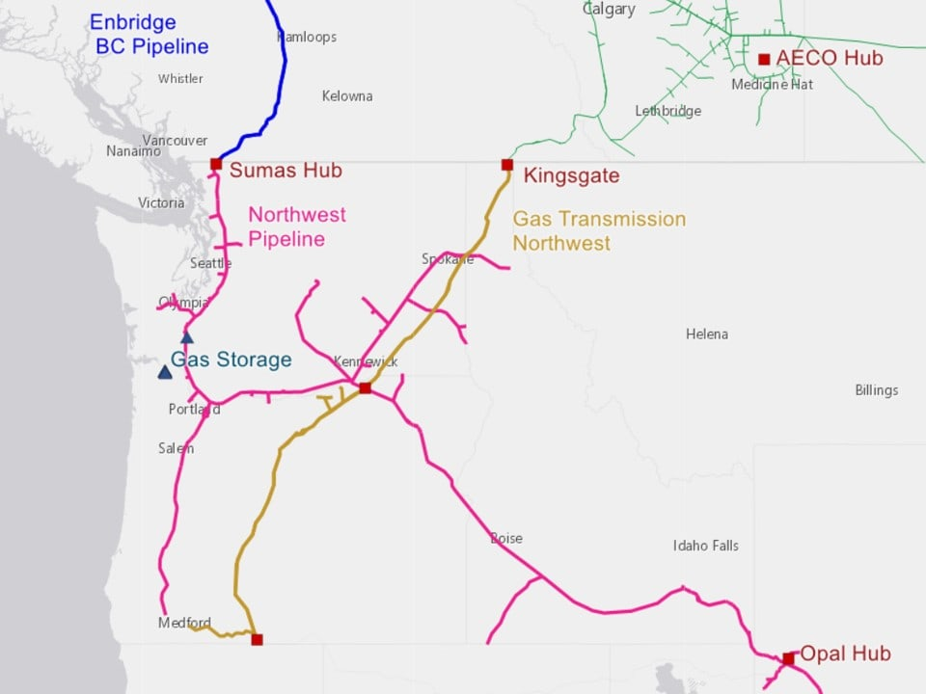
The Central Dilemma
The Balancing Act: Size vs. Competition
The Question: What should the balance be between corporate size and competition, and what role should government play?
The Real-World Example:
Kinder Morgan + El Paso merger (2011): $21.1 billion deal
Result: Control of 80,000+ miles of natural gas pipeline
Promises: Cost savings, efficiency gains
Concern: Would savings reach consumers or create oligopoly power?
Three Key Lessons:
Competition benefits consumers (lower prices, innovation)
Large-scale production dramatically lowers average costs
Real-world markets are rarely perfectly competitive
Notes:
Think of this like a seesaw on a playground. On one side, we have the benefits of bigness—imagine a manufacturing plant that produces millions of widgets per year versus a small shop making hundreds. The large plant spreads its fixed costs over far more units, dramatically lowering the average cost per widget. This is the economies-of-scale argument.
On the other side of the seesaw sits competition. When many firms compete, they fight for customers by lowering prices, improving quality, and innovating. It's like restaurants in a busy downtown—each must offer something compelling or customers will simply walk next door.
The Kinder Morgan case perfectly illustrates this tension. Natural gas flows through America like blood through veins—pipelines are the arteries. When one company controls 80,000 miles of pipeline, they're essentially the circulation system for a vital resource. The company argued the merger would eliminate wasteful duplication—why have two parallel pipelines when one larger one can do the job more efficiently? Critics worried that with such dominance, nothing would stop Kinder Morgan from charging whatever they wanted. Government regulators become the pivot point of our seesaw, trying to keep it balanced.

Slide 3
U.S. Antitrust Law - Historical Foundation
The Birth of Antitrust Policy
The Late 1800s Problem:
Single firms dominated entire industries nationwide
Organized as "trusts" - merged companies run by trustees
Example: Standard Oil controlled ~90% of oil refining
Legislative Response:
1890: Sherman Antitrust Act
First federal antitrust law
Made monopolization and restraint of trade illegal
1911: Standard Oil broken into 34 firms (Exxon, Mobil, Chevron, Amoco)
1914: Clayton Antitrust Act
Prohibited mergers that "substantially lessen competition"
Banned price discrimination and tied sales
Created Federal Trade Commission (FTC)
1950: Celler-Kefauver Act
Restricted vertical and conglomerate mergers
Notes:
Imagine the late 1800s as the "Gilded Age on steroids." Picture John D. Rockefeller's Standard Oil like a massive octopus—its tentacles wrapped around nearly every oil refinery in America. The company didn't just dominate; it controlled 90% of the entire market. This wasn't an accident—it was a deliberate strategy of buying out competitors, undercutting prices to drive rivals out of business, and then raising prices once competition disappeared.
The trust structure was ingenious but anti-competitive. Think of it like the board game Monopoly—except instead of hotels on Boardwalk, real companies merged under "trustees" who ran them as one giant enterprise. The American public grew increasingly frustrated. Small businesses couldn't compete, prices stayed artificially high, and innovation stagnated.
Congress responded with the Sherman Act in 1890, named after Senator John Sherman of Ohio. The law's language was intentionally broad, making it illegal to "monopolize" or "restrain trade." When the Supreme Court broke up Standard Oil in 1911, it was like taking that octopus and cutting it into 34 separate animals—companies we know today like Exxon and Chevron.
The Clayton Act of 1914 was more surgical, targeting specific practices. If Sherman was a general prohibition, Clayton was a detailed playbook of what's not allowed. And the Celler-Kefauver Act closed loopholes that companies had found to merge anyway.

Slide 4
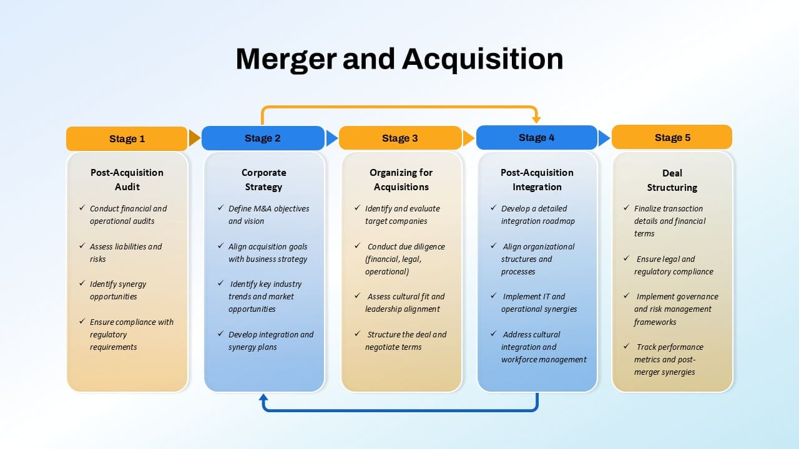
Corporate Mergers - The Basics
Definitions:
Merger: Two formerly separate firms combine to become one
Acquisition: One firm purchases another (may retain original name)
Both result in common ownership
Key Facts:
Mergers follow business cycles (peaked 2007, dropped during Great Recession)
Firms must notify FTC if deal > $101 million (2022 threshold)
In 2012: 26% of transactions exceeded $500 million; 11% exceeded $1 billion
The FTC's Role: ✓ Allow the merger ✓ Prohibit the merger ✓ Allow with conditions (e.g., divest certain assets)
Government Philosophy: "Most mergers actually benefit competition and consumers by allowing firms to operate more efficiently." —FTC
But: "Some are likely to lessen competition... leading to higher prices, reduced availability, lower quality, and less innovation."
Notes:
Let's demystify mergers with an analogy. Think of two small bakeries on opposite sides of town. If they merge, they become one company—perhaps they keep both storefronts but share ovens, bulk-buy flour together, and coordinate delivery routes. That's a merger creating operational efficiency.
Now imagine the business cycle as an economic heartbeat. During boom times—like 2007—companies feel confident and cash-rich, so mergers surge. It's like animals mating season—everyone's feeling optimistic. Then the Great Recession hit, credit froze, and suddenly nobody wanted to make big bets. Merger activity plummeted.
The $101 million threshold exists because regulators don't want to scrutinize every mom-and-pop combination—that would paralyze the economy. But once deals get large enough to potentially affect market dynamics, the FTC wants to know.
Here's a perfect real-world example: When Johnson & Johnson bought Pfizer's consumer health division in 2006, they got household names like Listerine and Sudafed. The FTC said, "Okay, but you're getting too much market power in certain categories." So J&J had to sell off six brands—Zantac heartburn medicine, Cortizone anti-itch cream, and others—to preserve competition. It's like a referee in sports saying, "You can make that trade, but you need to throw in another player to keep the teams balanced."
The FTC's stated position recognizes nuance. Most mergers are beneficial—combining overlapping operations, sharing technology, reducing redundancy. But some create monsters that can dictate terms to consumers.

Slide 5
Measuring Market Concentration - Four-Firm Ratio
Tool #1: The Four-Firm Concentration Ratio
Definition: Sum of market shares of the four largest firms in an industry
Example: Auto Windshield Repair Market
Four-Firm Ratio = 16 + 10 + 8 + 6 = 40%
Interpretation:
Less than 50% → Not highly concentrated
Simple but limited tool
Doesn't distinguish between equal competitors vs. one dominant firm
Company | Market Share
Smooth as Glass Repair | 16%
The Auto Glass Doctor | 10%
Your Car Shield | 8%
7 firms with 6% each | 42% (combined)
8 firms with 3% each | 24% (combined)
Notes:
The four-firm concentration ratio is the "back of the envelope" calculation regulators use as a first pass. It's like checking someone's temperature—it gives you a quick sense of whether something might be wrong, but doesn't tell you what the disease is.
Let's walk through this windshield example like we're economic detectives. Imagine you're in a mid-sized city with 18 windshield repair companies. The four-firm ratio tells us: "What percentage of all windshield repairs do the top four companies handle?"
We add up Smooth as Glass (16%), Auto Glass Doctor (10%), Your Car Shield (8%), and the next-biggest player at 6%. That gives us 40%. Since this is well under 50%, economists would say, "This market looks pretty competitive. The top players don't dominate."
Now imagine two of the smallest firms—each with 3%—want to merge. The four-firm ratio doesn't budge because we're still measuring the same top four companies. The FTC would likely approve without much fuss because market structure hasn't really changed.
But what if the top two firms—Smooth as Glass (16%) and Auto Glass Doctor (10%)—wanted to merge? Now we'd have one firm with 26% market share, and the four-firm ratio jumps to 46%. That starts raising eyebrows, though it's still not extreme.
The limitation? This tool treats all market structures with the same ratio as equivalent, but they're not. More sophisticated analysis is needed.

Slide 6
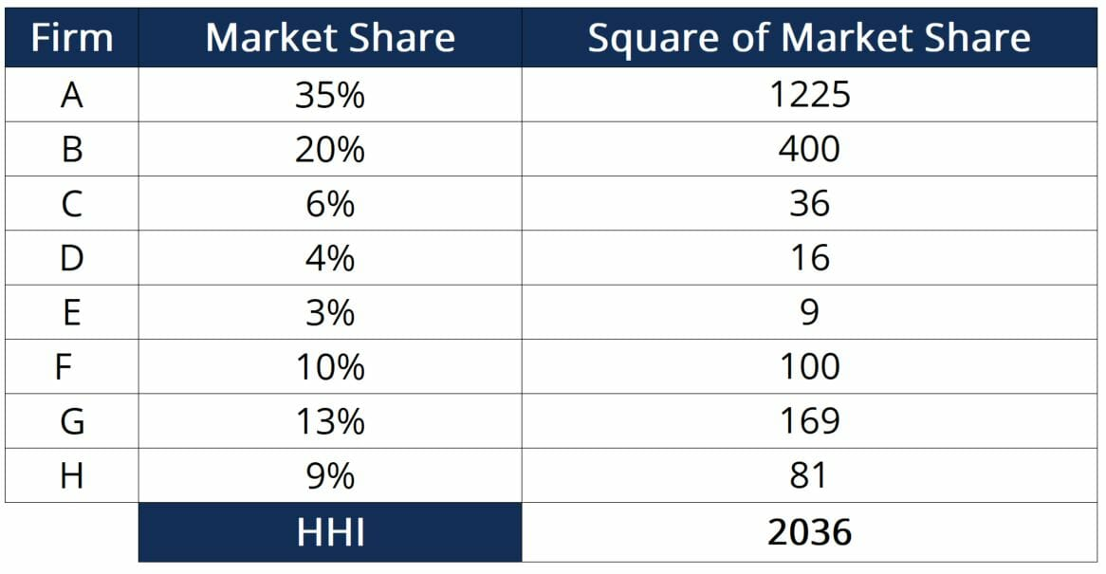
Measuring Market Concentration - HHI
Tool #2: Herfindahl-Hirschman Index (HHI)
Definition: Sum of the squared market shares of all firms in the industry
Formula: HHI = (Market Share₁)² + (Market Share₂)² + ... + (Market Shareₙ)²
Examples:
Pure Monopoly: 100² = 10,000
100 Equal Competitors: 100 × (1²) = 100
Windshield Market: 16² + 10² + 8² + 7(6²) + 8(3²) = 744
Why It's Better: ✓ Gives greater weight to large firms ✓ Distinguishes between equally-sized vs. dominant-firm markets
Example Comparison:
Five firms with 20% each: HHI = 2,000
One firm with 77%, 23 firms with 1%: HHI = 5,952
Both have same four-firm ratio (80%), but very different market dynamics!
FTC Guidelines (1980s):
HHI < 1,000: Likely approve
HHI 1,000-1,800: Case-by-case scrutiny
HHI > 1,800: Likely challenge
Notes:
The HHI is like upgrading from a thermometer to an MRI machine—much more sophisticated diagnostic power. The genius of HHI is the squaring function, which amplifies the weight of large firms.
Think about why we square the numbers. If a firm has 10% market share, its contribution to HHI is 100. But a firm with 20% market share—only twice as large—contributes 400 to the HHI, which is four times as much! This mathematical property means HHI is extremely sensitive to market dominance.
Here's the key insight: Let's compare two industries, both with four-firm concentration ratios of 80%. In Industry A, imagine five companies each control exactly 20% of the market—it's perfectly balanced, like five siblings sharing an inheritance equally. Calculate HHI: 5 × (20²) = 5 × 400 = 2,000.
Now picture Industry B: One massive firm has 77% of the market, and 23 tiny competitors each have just 1%. The four-firm ratio is still 80% (77 + 1 + 1 + 1), but calculate the HHI: 77² + 23(1²) = 5,929 + 23 = 5,952. That's nearly three times higher!
The FTC's guidelines worked like traffic lights. Green light (below 1,000): probably okay. Yellow light (1,000-1,800): proceed with caution, investigate thoroughly. Red light (above 1,800): merger likely gets blocked unless companies can make compelling arguments.
In recent decades, regulators have moved toward more case-by-case analysis rather than rigid thresholds, but HHI remains a crucial starting point.

Slide 7
U.S. Industry Concentration Examples (2016)
Real-World Market Concentration
Key Observations:
Wireless highly concentrated despite multiple major players
Globalization has reduced auto concentration (Toyota, Honda, Nissan, VW compete with Ford/GM/Chrysler)
Technology and global trade reshape traditional market boundaries
Industry | Four-Firm Ratio | HHI
Wireless | 98% | 2,736
Verizon, AT&T, Sprint, T-Mobile, US Cellular
Personal Computers | 76% | 1,234
HP, Lenovo, Dell, Asus, Apple
Airlines | 69% | 1,382
American, Southwest, Delta, United, JetBlue
Automobiles | 58% | 1,099
Ford, GM, Toyota, Chrysler, Nissan
Notes:
These real-world numbers tell fascinating stories about how American industries actually function. Let's decode what we're seeing.
Wireless carriers show the highest concentration. Think about your own phone service—chances are you're with Verizon, AT&T, T-Mobile, or Sprint (now merged with T-Mobile). The four-firm ratio of 98% means these companies handle nearly all wireless business in America. The HHI of 2,736 is well above that 1,800 "red flag" threshold. Why does the government tolerate this? The wireless industry has enormous infrastructure costs—building cell towers nationwide requires billions in capital. It's not quite a natural monopoly, but the barriers to entry are massive. Also, regulators focus on whether prices are declining and service improving, which they generally have been despite high concentration.
Personal computers present a different picture. HP, Lenovo, Dell, Asus, and Apple dominate, but look at that HHI of just 1,234—firmly in the "moderate concentration" zone. This suggests relatively balanced competition among major players. Unlike wireless, manufacturing computers has lower barriers to entry, and global competition is fierce.
Airlines at 69% concentration might surprise you—it feels higher when you're booking flights and seeing mostly the same carriers. The HHI of 1,382 suggests moderate concentration. The industry has seen major consolidation over decades (remember TWA? Pan Am?), but also faces intense price competition.
Automobiles are the globalization story. In the 1970s, Ford, GM, and Chrysler dominated American roads—concentration would have been sky-high. But then Japanese manufacturers proved they could build reliable, fuel-efficient cars, and everything changed. Today's 58% four-firm ratio and 1,099 HHI reflect a genuinely competitive global marketplace.

Slide 8
Modern Challenges in Defining Markets
Two Major Shifts Reshaping Antitrust Analysis
1. Technology Revolution
Internet enables global commerce
Consumers can buy from anywhere in the world
Local retailers now compete with online sellers
Business-to-business websites connect buyers/suppliers globally
2. Globalization
Market boundaries no longer stop at national borders
Industries face global competition
Example: U.S. auto industry
1970s: GM, Ford, Chrysler dominated
2014: These three < 50% of U.S. sales
Global competitors: Toyota, Honda, Nissan, VW, Mitsubishi, Mazda
The Market Definition Problem:
Narrowly defined market → Higher concentration
Broadly defined market → Lower concentration
Example: Microsoft
Computer operating systems: Dominant share
All computer software/services: Only ~14%
New FTC Approach: Less focus on market share calculations, more focus on actual competition data (prices, profits, consumer behavior)
Notes:
Defining the relevant market is like drawing boundaries on a map—where you draw the lines completely changes what you see. This has become exponentially more complex in the 21st century.
Let's start with the technology revolution. Imagine you owned a bookstore in 1985. Your competition was other bookstores within maybe a 20-mile radius—that's as far as customers would drive. Fast forward to today, and your "competitors" include Amazon (all books ever published, delivered in two days), Google (instantly searchable content), audible.com (audiobooks), and Kindle (e-books). The technology didn't just add competitors; it obliterated traditional geographic boundaries entirely.
For business-to-business trade, the change is even more dramatic. A manufacturer in Ohio who once sourced components from Michigan suppliers can now instantly compare prices from suppliers in Mexico, China, Vietnam, and Germany—all through digital platforms. This has demolished local monopolies that existed simply because information was hard to get.
Globalization is the second earthquake. Think about car shopping in 1975. You'd visit a Chevrolet dealership, a Ford dealership, and maybe a Chrysler-Plymouth dealer. That was basically your universe of choices. The idea of buying a reliable Japanese car was still novel. Today, a typical suburban car dealership row includes Honda, Toyota, Hyundai, Nissan, Volkswagen, alongside the traditional American brands. The market has simply exploded with legitimate alternatives.
The Microsoft case from the early 2000s perfectly illustrates the market definition problem. If you define the market narrowly—operating systems for personal computers—Microsoft had a near-monopoly with Windows. But if you define the market broadly—all computer software and services—Microsoft was just one player among thousands. Where you draw that line determines whether Microsoft looks like a dangerous monopoly or just a successful competitor.
The FTC has wisely evolved beyond rigid formulas. Instead of just calculating market shares, they now examine: Are prices falling? Are profits excessive? Do consumers have meaningful choices? When Whole Foods wanted to merge with Wild Oats in 2007, the FTC looked at specific store-level data—what happened to prices when a competitor opened or closed nearby? This granular, evidence-based approach is more work, but it's also more accurate.

Slide 9
Regulating Anticompetitive Behavior - Cartels
Beyond Mergers: Illegal Anticompetitive Practices
What's Illegal: ✗ Forming cartels to fix prices ✗ Rigging bids ✗ Dividing markets (allocating customers, territories, suppliers) ✗ Colluding on output decisions
Classic Case: International Vitamin Cartel (Late 1990s)
The Players:
Hoffman-La Roche (Swiss)
BASF (German)
Rhone-Poulenc (French)
The Scheme:
Agreed on production quantities
Fixed prices artificially high
Allocated customers among themselves
Buyers included General Mills, Kellogg, Purina Mills, Proctor & Gamble
The Penalty:
Hoffman-La Roche: $500 million fine
Top executive: 4 months incarceration
Companies pleaded guilty in 1999
Important Distinction: Having a monopoly is NOT illegal in itself (e.g., from patent). Conspiring to create one IS illegal.
Notes:
Think of a cartel as a secret club where competitors meet in smoky back rooms—except in this case, they're not playing poker; they're dividing up the entire market. It's like if all the gas stations in your town got together and agreed, "Let's all charge $5.00 per gallon, and nobody undercut anyone else." That's precisely what's illegal.
The vitamin cartel case reads like an economic crime thriller. Imagine three of the world's largest pharmaceutical companies—with offices in Basel, Switzerland; Ludwigshafen, Germany; and Paris, France—coordinating a global price-fixing scheme. These weren't street criminals; they were executives in suits making calculated decisions to defraud consumers.
Here's how it worked: Vitamins are inputs for everything from breakfast cereal to animal feed to nutritional supplements. Hoffman-La Roche, BASF, and Rhone-Poulenc would meet and essentially say, "Okay, Hoffman-La Roche, you supply these customers in North America at this price. BASF, you take these European customers at this price. And we'll all restrict production to keep prices high." It was market allocation and price-fixing rolled into one conspiracy.
The victims weren't individuals but companies like General Mills and Kellogg—but ultimately, those higher costs got passed to consumers in cereal prices. When you bought Cheerios in the late 1990s, hidden in that price was the cost of this illegal cartel.
The $500 million fine was massive by 1999 standards—equivalent to roughly $900 million today adjusted for inflation. And critically, an executive went to jail. White-collar crime prosecution sends a message: antitrust violations aren't just regulatory violations; they're crimes with criminal penalties.
Here's a crucial legal distinction: If a company has a monopoly because they invented something revolutionary and patented it, that's legal. The patent system rewards innovation with temporary monopoly power. But if companies conspire together to create or maintain a monopoly through collusion, that's criminal. Intent matters.

Slide 10
Restrictive Practices - The Gray Areas
Complex Cases:
Not Outright Collusion, But Potentially Anticompetitive
1. Exclusive Dealing Agreements
Legal: Ford sells only to Ford dealers, GM only to GM dealers (promotes dealer competition)
Illegal: One retailer gets exclusive rights to distribute all TV brands (reduces retailer competition)
2. Tying Sales
Customer must buy Product A to get Product B
Forces unwanted purchases
Example: Must buy specific TV model to get popular DVD
3. Bundling
Selling multiple products as package deal
Often legal and beneficial (cable + internet + phone bundle)
Can be anticompetitive if used to leverage market power
4. Predatory Pricing
Existing firm drops prices extremely low
Drives new entrant out of business
Then raises prices again after competitor exits
Challenge: Hard to distinguish from legitimate competition
Proposed rule: Selling below average variable cost suggests predatory intent
The Problem: These practices fall in gray areas—legal in some contexts, illegal in others. Regulators must analyze specific circumstances.
Notes:
Welcome to the gray zone of antitrust law, where the same business practice can be perfectly legal in one context and completely illegal in another. It's like the difference between defensive contact in basketball versus a flagrant foul—the referee must judge intent and impact.
Exclusive dealing is the perfect example. When Ford says, "We will only sell our cars through Ford dealerships," that's promoting competition among Ford dealers, who must compete with each other for customers. Each Ford dealer knows they're competing with other Ford dealers in the region, which keeps them honest on pricing and service. Same logic applies to GM, Toyota, and every other manufacturer.
But now imagine Best Buy negotiated exclusive deals with Samsung, Sony, LG, and Panasonic to be the ONLY retailer selling their TVs, computers, and audio equipment. Suddenly, Best Buy is the gatekeeper for all major electronics brands. Other retailers like Target or local electronics stores are frozen out. That exclusive dealing reduces competition at the retail level, and the FTC would likely challenge it.
Tying sales feels intuitively wrong because it forces you to buy something you didn't want. Imagine walking into a store: "I'd like to buy this popular DVD." "Sure, but you must also buy this portable TV." "But I don't want a portable TV!" "Sorry, that's the deal." It's coercive and prevents you from shopping around for the TV you actually want. The connection between the products is artificial.
Bundling seems similar but has important differences. When a cable company offers TV + Internet + Phone for $120 versus $180 if purchased separately, that's often genuinely efficient—one installation visit, one billing system, one customer service relationship. Consumers aren't forced; they can still buy separately. The bundle is just a discount for buying multiple services. However, bundling becomes problematic when a dominant firm uses it to push into new markets by leveraging its power in existing markets.
Predatory pricing is the economics equivalent of a bully on the playground. A well-established airline sees a scrappy new competitor start flying the same route with lower fares. The big airline responds by slashing its prices to $49 one-way—barely covering the cost of fuel. The new airline, lacking deep pockets, can't compete with those prices and goes bankrupt. Once the competitor exits, the big airline jacks prices back up to $299.
The enforcement challenge is enormous: When American Airlines cuts prices to match a new entrant, is that predatory or just normal competition? The proposed rule—selling below average variable cost—provides some guidance. If you're selling below the cost of actually providing the service (not counting fixed costs like the airplane itself, but counting fuel, crew salaries, and maintenance), that suggests you're deliberately losing money to eliminate competition, not competing fairly.

Slide 11
The Microsoft Case - Restrictive Practices in Action
Microsoft: The Most Famous Restrictive Practices Case
The Undisputed Facts:
Windows had near-monopoly in PC operating systems
Windows had many satisfied customers
Microsoft benefited from network effects and compatibility
The Government's Arguments:
1. Anticompetitive Exclusive Dealing
Threatened PC manufacturers: "Don't install Netscape browser, or we won't sell you Windows"
Used OS monopoly to control browser market
2. Illegal Tying
Bundled Windows OS (monopoly product) with Internet Explorer (non-monopoly product)
Forced consumers to take IE to get Windows
3. Predatory Pricing
Gave away software products free as part of Windows
Intent: Drive competitors out of adjacent software markets
The Outcome:
April 2000: Federal court ruled Microsoft crossed the line into unfair competition
Initially: Recommended breaking Microsoft into two competing firms
On appeal: Penalty overturned
November 2002: Settlement—Microsoft agreed to end restrictive practices
The Evolving Nature: Laws are "continually evolving" as firms seek new profit strategies and regulators respond
Notes:
The Microsoft case is the defining antitrust battle of the internet age—think of it as the Standard Oil case of the 1990s. But unlike Standard Oil, which was clearly a monopoly squeezing consumers with high prices, Microsoft's case was far more subtle and controversial.
Let's establish what nobody disputed: Windows was everywhere. By the late 1990s, Windows ran on roughly 95% of personal computers worldwide. That's about as close to a complete monopoly as you can get without being literally 100%. But here's the thing—most users actually liked Windows. It worked well, software developers built programs for it because that's where the users were, and users stayed with it because that's where the software was. This is called network effects—the product becomes more valuable as more people use it.
So if Windows was good and consumers were happy, what's the problem? The government said Microsoft was using its operating system dominance as a weapon to take over other software markets.
The Netscape situation is the smoking gun. In the mid-1990s, Netscape Navigator was the leading web browser. Microsoft saw the internet exploding and wanted Internet Explorer to dominate browsing. According to court evidence, Microsoft told PC manufacturers—Dell, HP, Compaq—essentially: "If you pre-install Netscape on computers, we won't give you favorable Windows licensing terms, or maybe we won't license Windows to you at all." For a PC manufacturer, not having Windows was like a car manufacturer not having engines. It was an existential threat. So manufacturers complied, Netscape was squeezed out, and Internet Explorer became dominant.
The tying allegation worked similarly. Microsoft integrated Internet Explorer so deeply into Windows that you couldn't remove IE without breaking Windows functionality. The government argued this was a forced tie—"You want Windows? You must take IE too." Microsoft counter-argued that IE was simply a feature of Windows, not a separate product, just like a search function or calculator app.
The predatory pricing claim centered on Microsoft giving away software products for free. Sounds great for consumers, right? But the government argued Microsoft was using profits from its Windows monopoly to subsidize other products, intentionally losing money to kill competitors like Lotus 1-2-3 or WordPerfect. Once competitors died, Microsoft could charge whatever it wanted.
The April 2000 ruling was dramatic—break Microsoft into two companies: one for operating systems, one for applications. It was corporate death penalty. But Microsoft appealed, the court reversed the breakup order, and eventually a settlement was reached where Microsoft agreed to license its technology more openly and stop certain restrictive practices.
The case illustrates a fundamental tension: When is a company's behavior legitimate competitive strategy versus illegal monopolistic bullying? Reasonable people disagreed then and still debate it today.

Slide 12
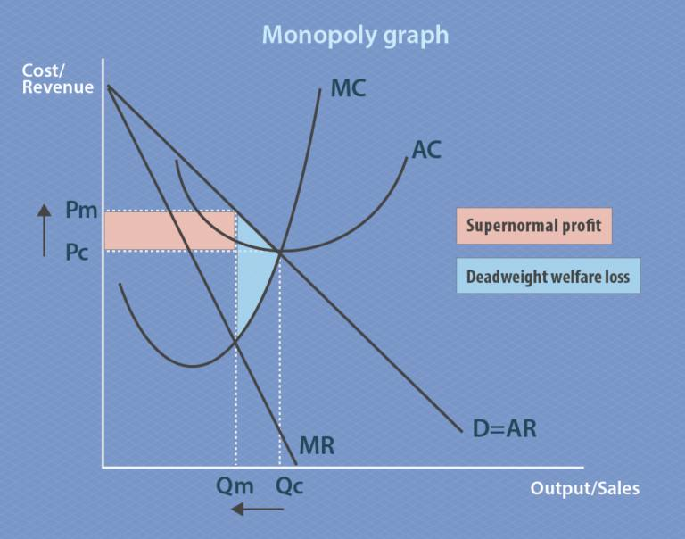
Natural Monopolies - A Different Challenge
When Competition Doesn't Make Sense
Definition: Natural monopoly arises when average costs decline over the entire range of market demand → One firm can supply the market more efficiently than multiple firms
Characteristics:
Extremely high fixed costs relative to variable costs
Splitting the monopoly raises average costs and consumer prices
Classic Examples:
1. Water Utilities
Installing 4-5 competing sets of pipes under a city would be wasteful
Each household choosing separate water company = massive duplication
2. Electricity Distribution
Multiple companies with separate power line networks = inefficient
3. Traditional Telephone Service (pre-wireless)
Multiple phone companies, each with own wires through neighborhood = costly duplication
The Policy Challenge: Competition policy that works for normal industries fails here. We need different regulatory approaches.
Notes:
Natural monopoly is where the usual economic logic flips upside down. Normally, we want more competition—two pizza restaurants are better than one, three are better than two, and so on. But with natural monopolies, trying to force competition makes everyone worse off. It's like trying to make water flow uphill; you're fighting against fundamental economic forces.
Let's make this concrete with the water utility example. Picture your city—imagine the infrastructure required to deliver clean water to every home. You need: A water treatment plant (let's say $50 million), massive underground pipes throughout the city ($200 million), pumping stations ($30 million), maintenance facilities ($10 million). That's roughly $290 million in fixed costs before a single drop of water flows.
Now imagine we said, "Let's have competition! Let's have four water companies!" What happens? Each company must build its own complete parallel system—four separate treatment plants, four complete pipe networks under every street, four sets of pumping stations. We've just quadrupled the infrastructure investment to $1.16 billion. Those costs get passed to consumers, making water vastly more expensive. Plus, imagine city streets torn up constantly as four different companies maintain their separate pipe networks. It's economically absurd.
The key economic principle is declining average costs over the entire range of market demand. Let's use numbers: If the fixed costs are $290 million and the variable cost is $50 per household per year, then:
Serving 100,000 households: Average cost = ($290M / 100,000) + $50 = $2,900 + $50 = $2,950 per household
Serving 200,000 households: Average cost = ($290M / 200,000) + $50 = $1,450 + $50 = $1,500 per household
Serving 500,000 households: Average cost = ($290M / 500,000) + $50 = $580 + $50 = $630 per household
As you serve more customers, you spread those huge fixed costs over more people, dramatically lowering average cost per customer. That's declining average costs. One company serving all 500,000 households at $630 each is far more efficient than two companies each serving 250,000 households at roughly $1,210 each.
Electricity distribution and traditional telephone service followed identical logic—the infrastructure costs are so massive that duplication makes no economic sense.
But here's the rub: If one company must serve the entire market, what stops them from exploiting their monopoly power by charging $5,000 per household when costs are only $630? That's where regulation enters the picture.

Slide 13
Regulating Natural Monopolies - Four Options
Regulatory Choices for Natural Monopolies
Option A: Unregulated Monopoly
Firm maximizes profit where MR = MC
Charges high price, produces low quantity
Earns economic profits
Result: Inefficient, consumers harmed
Option B: Force Competition (Break Up the Monopoly)
Divide one firm into multiple smaller firms
Higher average costs (due to declining AC curve)
Less productive efficiency
Risk: Larger firm eventually dominates or firms collude
Result: Worse than monopoly
Option C: Price = Marginal Cost (Efficient Allocation)
Forces firm to produce where P = MC
Provides efficient resource allocation
PROBLEM: Price below average cost → Firm loses money
Requires ongoing government subsidy to survive
Result: Theoretically optimal but politically problematic
Option D: Price = Average Cost (Most Practical)
Set price where AC intersects demand curve
Firm covers costs and earns normal profit
Prevents monopoly profits while allowing firm to survive
Result: Most commonly used approach
Notes:
Imagine you're the economic czar tasked with regulating the water utility we discussed. You have four basic options, each with significant trade-offs. Let's analyze them as if we're troubleshooting a complex problem.
Option A is the "do nothing" approach. Let the natural monopoly act like a normal monopoly. The firm looks at its cost and revenue curves, finds where marginal revenue equals marginal cost (the profit-maximizing rule for any firm), and produces that quantity. Let's say that's 6 million gallons per day. The firm then looks at the demand curve to see the highest price consumers will pay for that quantity—maybe $3.50 per unit. Since price is above average cost, the firm earns economic profits. The problem? The firm is artificially restricting output and overcharging consumers. It's inefficient and consumers are harmed. This is why we regulate natural monopolies in the first place—left alone, they behave badly.
Option B is the "break them up" approach—the Standard Oil solution. But remember our declining average cost curve? If one large firm producing 8 million gallons has an average cost of $2.00 per unit, splitting into two firms each producing 4 million gallons might give each an average cost of $3.50 per unit. Consumers end up paying more for the same service! Plus, two new problems emerge: Either one firm gradually grows larger and drives out the other (because it has lower costs), or the two firms figure out how to coordinate their behavior and act like one monopoly anyway. Breaking up a natural monopoly doesn't create real competition; it creates inefficiency and instability.
Option C is the economist's theoretical ideal: force the firm to price at marginal cost. In a perfectly competitive market, price equals marginal cost, which gives us allocatively efficient resource use—the value consumers place on the last unit consumed exactly equals the cost of producing it. Sounds perfect! But look at the numbers: If marginal cost is $1.50 per unit at the efficient quantity of 8 million gallons, and average cost is $2.00 per unit, the firm loses $0.50 on every unit sold. Multiply that by 8 million gallons, and the water company is losing $4 million per month. Unless the government provides an ongoing subsidy, the firm goes bankrupt and no one gets water. Government subsidies create their own problems—political battles over funding, incentives for inefficiency (why cut costs if taxpayers cover losses?), and questions of fairness (why should taxpayers subsidize water users?).
Option D is the Goldilocks solution—not too hot, not too cold, but just right for practical governance. Set price where the average cost curve intersects the demand curve. At this point, let's say output is 6 million gallons and price is $2.25 per unit. The firm covers its average costs (including a normal rate of profit for investors) but doesn't earn excessive monopoly profits. Consumers pay more than marginal cost—so it's not perfectly efficient—but they pay far less than under unregulated monopoly. The firm survives without subsidies, and consumers get reasonable prices. This is the standard regulatory approach that most public utilities have followed for decades.

Slide 14
Cost-Plus vs. Price Cap Regulation
Cost-Plus Regulation (Traditional Approach)
How it works:
Calculate average cost of production
Add normal profit rate
Set price accordingly
Problems: ✗ Removes incentive to control costs (just pass them to consumers) ✗ May incentivize building excessive capacity (higher costs = higher allowed prices) ✗ Example: Build huge unnecessary factory because revenue is linked to costs
Price Cap Regulation (Modern Approach - 1980s/1990s)
How it works:
Regulator sets maximum price firm can charge for next few years
Often requires price to decline slightly over time
Firm profits if it cuts costs faster than price caps decline
Firm suffers losses if it can't meet price caps
Advantages: ✓ Strong incentive for efficiency and innovation ✓ Rewards cost-cutting behavior ✓ Can pressure monopoly to match prices in other regions
Challenges: ✗ Requires careful calibration (unrealistically low caps harm firm) ✗ May not work if market conditions change dramatically (e.g., energy price spikes) ✗ Complex to implement and monitor
Notes:
These two regulatory approaches represent fundamentally different philosophies about how to motivate human behavior—and they perfectly illustrate a core economic principle: incentives matter.
Cost-plus regulation is the old-school approach that dominated from the 1930s through the 1970s. Imagine you run a regulated electric utility. At the end of each year, regulators audit your books and say, "Okay, your costs were $100 million. We'll allow you to add 10% profit margin, so you can charge $110 million total to customers." Sounds fair and transparent, right?
But think about the incentives you face as the utility manager. If you find a way to cut costs to $80 million through efficiency improvements, what happens? The regulators say, "Great, your new costs are $80 million, so you can charge $88 million." Your reward for efficiency is... nothing. You still get 10% profit margin, but on a smaller base. In fact, you might face angry investors asking why profits dropped from $10 million to $8 million.
Now flip the scenario: What if you build an expensive, elaborate new headquarters building, hiring consultants, expanding staff, upgrading to gold-plated equipment? Your costs balloon to $150 million. The regulators say, "Okay, you can charge $165 million." Your profit just jumped from $10 million to $15 million! This perverse incentive is called the Averch-Johnson effect—regulated firms have incentive to over-invest in capital (the "rate base") because their allowed profits are calculated as a percentage of their costs.
This doesn't mean utility managers were deliberately wasteful—many were honorable public servants. But the system's incentives pointed in the wrong direction. It's like paying someone by the hour with no oversight—there's little incentive to work quickly.
Price cap regulation flips the script entirely. Imagine regulators tell you in 2025: "For the next three years, you can charge no more than $3.50 per unit in Year 1, $3.40 in Year 2, and $3.30 in Year 3." Now your incentives are completely different. If you currently have costs of $3.00 per unit, you're making $0.50 profit per unit in Year 1. But if you can slash costs to $2.50 per unit through innovation and efficiency, you're now making $1.00 profit per unit—you've doubled your profit margin! You have every incentive to cut costs, innovate, negotiate better contracts, and improve operations.
The risk cuts both ways, though. If you can't keep up with the declining price caps—maybe equipment breaks down unexpectedly, or energy costs spike globally—you could face losses. You're no longer guaranteed that comfortable cost-plus profit margin. Some firms might even go bankrupt if they're badly managed or unlucky.
The modern approach often compares your utility's prices to similar utilities in other cities, creating implicit competition even in a monopoly setting. "The water utility in City B charges $3.00 per unit. Why are you charging $4.00? Either find efficiencies or we'll set a price cap closer to $3.00." This creates pressure to match industry best practices.
Price cap regulation is trickier to implement—it requires sophisticated regulatory judgment about what price caps are achievable but not impossible. Set them too low and you bankrupt the utility; set them too high and you've just given them monopoly profits without earning it. But when done well, it harnesses market-like incentives even in the absence of actual competition.

Slide 15
The Great Deregulation Experiment
Questioning Price Regulation: The Shift Beginning in the 1970s
The Recognition: Existing price regulation was not working well across many industries
The Experiment: Remove government controls over prices and quantities in:
Airlines
Railroads
Trucking
Intercity bus travel
Natural gas
Bank interest rates
The Risk:
Regulatory Capture - when regulated firms end up controlling the regulatory process
How Capture Happens:
Industry suggests appointees to regulatory board
Industry lobbyists argue with board
Industry provides most information for board decisions
Industry offers well-paid jobs to departing board members
Result of Capture: Government regulation becomes a way for existing competitors to limit competition, raise prices, and restrict output
Notes:
By the 1970s, a bipartisan consensus emerged that something had gone deeply wrong with American economic regulation. This wasn't a left-wing or right-wing revelation—economists and policymakers across the political spectrum recognized that decades of price controls and quantity regulations had created sclerotic, inefficient industries that served producers far better than consumers.
Think of regulatory capture as a slow-motion corporate coup of government agencies. The Civil Aeronautics Board, created in 1938 to regulate airlines, is the textbook example. Here's how capture worked in practice:
Imagine you're appointed to the CAB. Your job is regulating airline fares, routes, and entry. Where do you get information about whether airlines need to raise fares, or whether new routes are viable? You ask the airlines! They're the industry experts. So airline executives regularly meet with CAB officials, providing data, analysis, and "expert testimony" about market conditions.
The airlines also hire lobbyists—former CAB officials who "retired" into lucrative private-sector jobs. These lobbyists have personal relationships with current board members and understand exactly how the agency thinks. They're incredibly effective at shaping decisions.
Now imagine you're a CAB board member thinking about your future. You're a talented professional making a government salary. Airlines are dangling six-figure consulting positions or board seats at the end of your term. The temptation to view issues sympathetically to industry interests is enormous—not necessarily through corrupt intent, but through subtle bias and the "revolving door" between regulator and regulated.
The result? From 1938 to 1978—40 years—the CAB approved exactly zero new airlines on major routes. Think about that. For an entire generation, the same handful of airlines flew the same routes with no new competition. Why would the CAB approve new entrants? The existing airlines would argue, "New competition will lead to 'destructive competition,' bankruptcies, and unsafe practices. The current system is stable and safe." And the captured CAB would nod along.
Meanwhile, airfares were sky-high (pun intended), planes flew half-empty because prices were too high to fill seats, and service to smaller cities was minimal because there was no competitive pressure to expand. The regulation that was supposed to protect consumers had become a cartel enforcement mechanism.
This same pattern repeated across industries. Trucking regulations protected existing trucking companies from competition. Railroad regulations preserved inefficient rail carriers. Bank interest rate regulations (Regulation Q) prevented banks from competing for deposits even as inflation eroded savers' wealth.
The deregulation experiment was radical: What if we just... let markets work? Let airlines set their own prices and routes. Let trucking companies compete freely. Let banks offer whatever interest rates attract customers. Could competition do better than regulation?
The answer, as we'll see in the next slide, was largely yes—but with important caveats.

Slide 16
Case Study - Airline Deregulation
Airline Industry: From Heavy Regulation to Competition
The Regulated Era (1938-1978):
Civil Aeronautics Board (CAB) controlled all fares, routes, and entry
Zero new airlines entered major routes for 40 years
Planes averaged 50% full
High prices, limited service
1978: Airline Deregulation Act
The Shakeup:
Famous old airlines disappeared: Pan Am, Eastern, Braniff (bankruptcy)
New airlines emerged and vanished: People Express
Industry turmoil and job losses for some
The Benefits: ✓ Airfares dropped by ~1/3 over next two decades ✓ Planes now fly 2/3 full (much more efficient) ✓ Hub-and-spoke systems created better connectivity ✓ Service expanded to more cities ✓ Number of air passengers doubled (late 1970s to early 2000s) ✓ Industry jobs doubled ✓ Air travel continued getting safer with government oversight
Current Concerns: Recent mergers have raised new competition concerns
Notes:
The airline deregulation story is American capitalism's greatest "controlled experiment"—what happens when you remove 40 years of price controls and let competition rip? The results are mixed but largely positive, with important lessons for economic policy.
Let's time-travel to 1977, just before deregulation. You want to fly from New York to Los Angeles. The CAB has approved a specific fare—let's say $350 one-way (about $1,750 in today's dollars). All airlines charge exactly the same price because the CAB sets it. The plane is half-empty because at $350, many people can't afford to fly. Airlines don't compete on price—they can't—so they compete on service: fancy meals, spacious seats, extensive legroom. Sounds nice, but you're paying for it whether you want it or not.
Then 1978 hits and deregulation passes. Suddenly airlines can charge whatever they want and fly wherever they want. The first few years are chaos—creative destruction in action. Pan American, once the most glamorous airline in the world with its iconic blue globe logo, couldn't adapt to competitive pricing and went bankrupt in 1991. Eastern Airlines, another giant, failed in 1989. Braniff, which had aggressively expanded, collapsed in 1982.
But new airlines emerged. People Express pioneered ultra-low-cost flying—bare-bones service, pay for everything separately, but ticket prices were 50-70% lower than traditional airlines. Southwest Airlines expanded nationwide with its point-to-point model and employee-focused culture.
The competitive pressure drove innovation. Airlines realized flying half-empty planes was wasteful. They developed sophisticated yield management systems (early AI, essentially)—charge high prices for business travelers booking last-minute, low prices for leisure travelers booking months ahead. This filled seats and maximized revenue. Planes went from 50% full to 67% full—that's a 34% improvement in resource utilization.
Hub-and-spoke systems emerged as the dominant model. Instead of airlines flying direct from every city to every other city (which requires n(n-1)/2 routes for n cities), they flew everyone to a central hub, then out to destinations. Delta built a hub in Atlanta; United in Chicago; American in Dallas. This meant you might need to connect through a hub, but it also meant even small cities got service because they were spokes.
The consumer benefits were enormous. Fares dropped by roughly one-third in real terms—that $350 NY-LA ticket became $120-$200 depending on when you booked. Double the number of passengers flew because prices made air travel accessible to middle-class families, not just business travelers and the wealthy. And critically, safety improved throughout this period because the FAA continued rigorous safety oversight even as economic regulation disappeared. Deregulation didn't mean no regulation; it meant replacing price controls with market competition while maintaining safety standards.
Jobs doubled because passenger volume doubled. Yes, some airline workers lost jobs when carriers failed, but the expanding industry created far more opportunities than it destroyed.
The current wrinkle? A wave of mergers in the 2000s-2010s (Delta-Northwest, United-Continental, American-US Airways) has reconsolidated the industry. Four major carriers now dominate U.S. air travel. Some critics worry we're drifting back toward oligopoly, with less competition and rising fees (checked bag fees, seat selection fees, etc.). The debate continues: Has deregulation run its course, or do we need better merger oversight?

Slide 17
Lessons from Deregulation
The Deregulation Balance Sheet
Positive Outcomes: ✓ Lower prices for consumers in most deregulated industries ✓ Increased efficiency and innovation ✓ Greater variety of service options ✓ Expansion of access to previously expensive services
Negative Outcomes: ✗ Increased firm bankruptcies and market exits ✗ Worker layoffs and job displacement ✗ Market instability during transition periods ✗ Need for ongoing vigilance (e.g., accounting scandals, financial crisis)
Important Safeguards Still Needed:
Sarbanes-Oxley Act (2002)
Response to Enron, WorldCom, Tyco accounting scandals
Increased financial transparency and accountability
Dodd-Frank Act (2010)
Response to Great Recession and financial crisis
Reformed financial system to prevent "too big to fail"
Aimed to end bailouts and protect consumers from abusive practices
Core Principle: Markets need legal framework: contract enforcement, taxes, health/safety/environmental protection, and competition-enhancing policies
Notes:
Deregulation is not a simple success or failure story—it's a complex rebalancing that created winners and losers while teaching important lessons about the proper role of government in markets.
The successes are undeniable. Beyond airlines, look at trucking: deregulation in 1980 transformed logistics. Shipping costs fell dramatically. Walmart's rise as a retail giant was partly enabled by efficient, competitive trucking that could deliver goods cheaply anywhere in America. The just-in-time manufacturing revolution depended on reliable, affordable freight. Interstate bus travel saw new competitors like Megabus offering $1 fares on some routes—unthinkable under regulation.
Telecommunications deregulation—breaking up AT&T's monopoly in 1982—unleashed innovation we now take for granted. The regulated AT&T wouldn't let consumers own their own phones (you leased them!). Post-breakup, we got answering machines, cordless phones, fax machines, modems, and eventually the mobile revolution. Competition spurred innovation that regulation had stifled.
But let's not sugarcoat the costs. Deregulation creates what economist Joseph Schumpeter called "creative destruction." Old firms die; workers lose jobs. When airlines went bankrupt, pilots, flight attendants, and mechanics faced unemployment. Some found new jobs quickly; others struggled. Entire communities built around regulated industries—like railroad towns—suffered when those industries contracted. Market competition is indeed "full-contact sport," and real people get hurt.
The 2001-2002 accounting scandals revealed deregulation's dark side. Enron, once hailed as an innovative energy company, turned out to be a house of cards built on fraudulent accounting. When it collapsed, employees lost not just jobs but retirement savings invested in company stock. WorldCom's $11 billion accounting fraud was the largest in history at that time. Tyco's executives looted the company. These weren't failures of deregulation per se, but they highlighted that reduced price regulation doesn't mean no oversight. You still need strong accounting standards, auditing requirements, and fraud prosecution.
The 2007-2008 financial crisis was more directly linked to deregulation. The repeal of Glass-Steagall Act provisions in 1999 allowed commercial banks, investment banks, and insurance companies to merge, creating massive "too big to fail" institutions. Meanwhile, exotic financial instruments—collateralized mortgage obligations, credit default swaps—operated in largely unregulated "shadow banking" markets. When the housing bubble burst, these interconnected risks nearly collapsed the global financial system.
Lehman Brothers, a 158-year-old investment bank, failed in September 2008—the largest bankruptcy in U.S. history. The government bailed out AIG, Citigroup, and others at taxpayer expense. The irony? Deregulation was supposed to eliminate the need for government intervention, but excessive deregulation created risks so systemic that massive government rescue became necessary.
The Dodd-Frank Act of 2010 was Congress's response—a 2,300-page law attempting to re-regulate financial markets. It created the Consumer Financial Protection Bureau, imposed "stress tests" on big banks, restricted risky proprietary trading, and tried to end too-big-to-fail. Whether it succeeded remains debated, and some provisions have been rolled back.
The core lesson? Markets don't operate in a vacuum. They need infrastructure: rule of law, contract enforcement, property rights, bankruptcy procedures, consumer protection, workplace safety, environmental standards. The question isn't regulation versus no regulation—it's what kind of regulation and how much. Smart regulation enhances competition and protects consumers without stifling innovation. Bad regulation protects incumbents and raises costs without corresponding benefits.

Slide 18
Key Takeaways
Monopoly and Antitrust Policy: Core Principles
1. The Fundamental Tension Large-scale production creates efficiency, but reduced competition harms consumers
2. Antitrust Tools
Block anticompetitive mergers
Prosecute cartels and price-fixing
Regulate restrictive practices (case-by-case analysis)
Use HHI and four-firm ratios as starting points, not rigid rules
3. Natural Monopolies Require Different Approach
Competition doesn't work when one firm is most efficient
Regulation needed: traditional cost-plus vs. modern price cap
Balance: Allow firm to survive while protecting consumers
4. Deregulation Can Work When Done Right
Remove price controls where competition can thrive
Maintain safety, environmental, and fraud protections
Monitor for market power concentration
Adapt regulations as markets evolve
5. Ongoing Challenge Technology and globalization continuously reshape market boundaries—regulation must evolve accordingly
Notes:
As we conclude, let's synthesize the key insights that should guide economic policymaking around monopoly and competition.
The fundamental tension hasn't changed since the Sherman Act in 1890: We want companies large enough to achieve economies of scale—spreading massive fixed costs over large production volumes to lower per-unit costs—but not so large that they can exploit market power by raising prices and restricting output. This is the economic equivalent of Goldilocks: not too small, not too large, but just right. The challenge is that "just right" differs across industries and changes over time.
Antitrust enforcement has matured significantly. Early regulators focused heavily on market share percentages and concentration ratios—if your HHI exceeds 1,800, merger denied. Modern regulators use those tools as screens, not verdicts. They conduct detailed analyses: What happens to prices when a competitor enters or exits a market? Do consumers have meaningful alternatives? Is innovation occurring? This evidence-based approach is more work, but it's also more accurate and fair.
The Microsoft case, the vitamin cartel prosecution, and merger reviews like Kinder Morgan/El Paso show regulators examining specific market dynamics rather than applying cookie-cutter formulas. This is good—economic reality is messy and context-dependent.
Natural monopolies remain the exception proving the rule. When infrastructure costs are so massive that duplication is wasteful—water pipes, electric grids—trying to force competition is counterproductive. The regulatory challenge shifts from promoting competition to simulating competition through smart regulation. Price cap regulation represents an evolution in thinking: instead of guaranteeing utilities a comfortable cost-plus return, create incentives for efficiency as if they faced competitive pressure. It's not perfect, but it's better than the alternative.
The deregulation experiment's mixed record teaches humility. Airline deregulation broadly succeeded—lower prices, more passengers, continued safety improvements. Financial deregulation contributed to the 2008 crisis—the worst economic disaster since the Great Depression. The difference? Airlines still faced safety regulation and consumer protection. Financial markets' "light touch" regulation allowed risks to metastasize unchecked. The lesson: Removing price controls can unleash beneficial competition, but you need guardrails against fraud, systemic risk, and market failure.
Finally, economic policymakers must embrace ongoing adaptation. The 1911 Supreme Court deciding whether Standard Oil was a monopoly faced different questions than 2002 regulators analyzing Microsoft, who faced different questions than 2024 regulators examining Amazon, Google, or Facebook. Each era presents novel business models, technologies, and market structures. Regulation can't be static; it must evolve as quickly as the markets it governs.
The enduring question remains: Where should the line be drawn between allowing firms to grow large and successful versus preventing them from exploiting market power? There's no permanent answer—it's a constant negotiation, requiring vigilance, analysis, and judgment. Done well, antitrust and competition policy protect consumers while allowing the innovation and efficiency that make economies prosperous. Done poorly, it either stifles legitimate business success or allows monopolistic abuse. Getting that balance right is one of government's most important economic functions.

Slide 19
Summary
Corporate Mergers
Regulators assess using four-firm ratio and HHI
Most mergers approved; some blocked or conditioned
Modern analysis focuses on actual competitive effects, not just market share
Regulating Anticompetitive Behavior
Cartels and price-fixing are illegal (vitamin cartel case)
Restrictive practices evaluated case-by-case (Microsoft case)
Gray areas: exclusive dealing, tying, bundling, predatory pricing
Regulating Natural Monopolies
Competition impossible/inefficient due to cost structure
Options: unregulated monopoly, break up, P=MC, P=AC
Regulation evolved from cost-plus to price cap approaches
The Great Deregulation Experiment
1970s-present: removed price controls in airlines, trucking, etc.
Largely successful but requires ongoing oversight
Market economies need legal framework and smart regulation
Notes:
This slide provides a comprehensive summary of everything we've covered. Use this as your reference to recall the four major sections: corporate mergers and how they're evaluated, the regulation of anticompetitive behavior beyond mergers, the unique challenges of natural monopolies, and the historical shift toward deregulation with its lessons learned. Each section represents a different aspect of how government attempts to balance the benefits of large-scale production with the necessity of competitive markets. The ultimate goal is consumer welfare—lower prices, better quality, more innovation—achieved through the right mix of market forces and regulatory oversight.

