Slide 1

Chapter 8
Perfect Competition
“When You Are One Among Thousands”
Notes:
Welcome to Chapter 8 on Perfect Competition. This chapter explores a market structure where firms are "price takers"—they have no power to set their own prices and must accept whatever the market dictates. Think of it like being a single vendor at a massive farmer's market where everyone sells identical tomatoes. You can't charge more than your neighbors, or customers will simply walk two steps to the left. We'll explore how firms make decisions in this highly competitive environment, including what quantity to produce, when to stay in business, and when to exit the market.

Slide 2
Market Power Classify these examples on a continuum of “no control over price” to “a lot of control over price”.
A wheat farmer
Google Search
Apple iPhone
Comporium
York Natural Gas
a soybean farmer
Dominos
Nike
Local farmer’s market stall
American Airlines
Boeing
Duke Energy
McDonalds
Sportclips
Zara
J. Crew

Slide 3

What is Perfect Competition
The "Identical Twins Convention" Market
4 Essential Criteria:
Many firms sell identical products
Many buyers & sellers (free entry/exit)
Perfect information for all participants
No barriers to entry or exit
Result: Firms are price takers
Notes:
Imagine attending a convention where everyone looks absolutely identical—same height, same clothes, same everything. That's perfect competition: products are so similar that buyers can't tell them apart. Four conditions define this market: First, many firms produce identical goods—winter wheat is winter wheat, regardless of who grows it. Second, numerous buyers and sellers exist with freedom to enter or leave. Third, everyone has complete information about prices and quality—no secrets. Fourth, there are no barriers preventing new firms from entering or existing firms from leaving. When all these conditions exist, individual firms become "price takers"—they must accept the market price because raising prices even slightly means losing all customers to identical competitors.

Slide 4
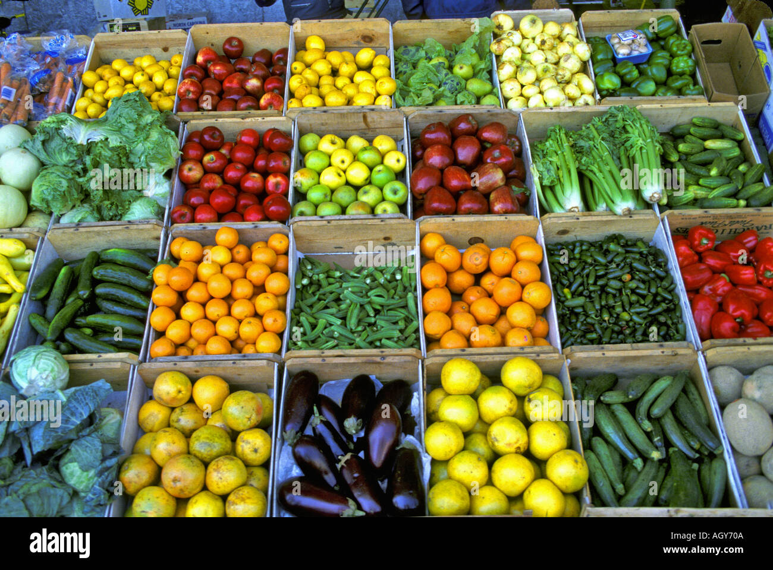
Real World Examples
Where Perfect Competition Exists:
Agricultural commodities (corn, wheat, soybeans)
Stock markets (shares of identical stock)
Foreign currency exchange
Roadside produce stands
Analogy: Selling bottled water outside a concert—you charge what everyone else charges
Notes:
Perfect competition is rare but approximated in several markets. Agricultural commodities are the classic example: a bushel of #2 yellow corn from Iowa is identical to one from Illinois. In December 2021, U.S. corn farmers received an average of $5.47 per bushel—try charging $6.00 and you'll find zero buyers. Stock markets also approach perfect competition: one share of Apple stock is identical to any other share. Currency exchanges work similarly. My favorite real-world analogy? Imagine selling bottled water outside a stadium on a hot day. If ten vendors are there selling identical bottles, you charge what everyone else charges—maybe $2. Charge $3 and you sell nothing. Charge $1.50 and you'll be mobbed, but why would you when people will pay $2? That's the essence of being a price taker.

Slide 5
The One Big Decision
What quantity should I produce?
The Firm's Challenge:
Cannot control price (market sets it)
Can only decide how much to produce
Goal: Maximize profit (or minimize loss)
Key Rule: Produce where MR = MC
Notes:
Perfectly competitive firms face exactly one major strategic decision: what quantity to produce? They're like musicians who must play at a venue's preset ticket price—they can't change the price, only decide whether to perform and how many shows to book. The firm accepts the market price as given and focuses entirely on the quantity decision. The profit-maximizing rule is beautifully simple: produce where marginal revenue equals marginal cost—where MR equals MC. Marginal revenue is the additional revenue from selling one more unit; marginal cost is the cost of producing one more unit. When these are equal, profit is maximized. Produce less and you're leaving money on the table. Produce more and each additional unit costs more than it earns. This MR = MC rule is the firm's North Star for decision-making.

Slide 6
Marginal Revenue and Marginal Costs
Marginal revenue (MR) - the additional revenue gained from selling one more unit.
Marginal cost (MC) - the cost per additional unit sold.
The profit-maximizing choice for a perfectly competitive firm will occur at the level of output where MR = MC.

Slide 7
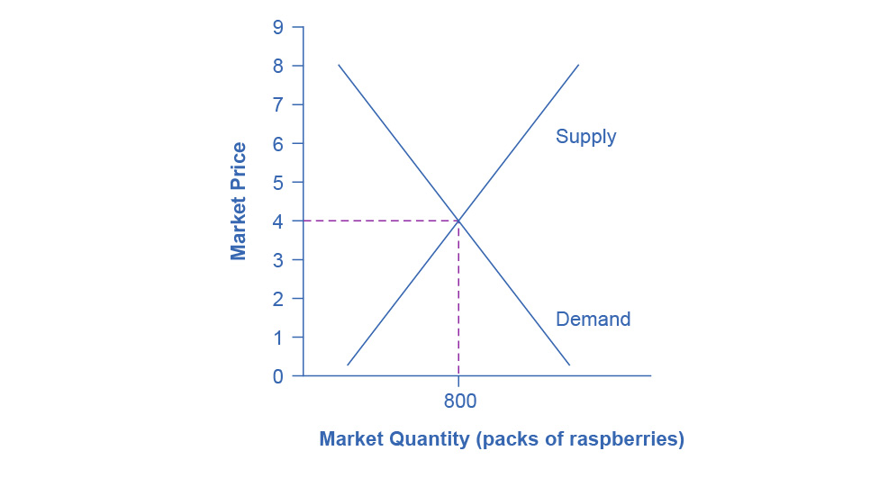
Market Price of Raspberries
The equilibrium market price of raspberries is determined through the interaction of market supply and market demand at $4.00.
An individual raspberry farmer must accept the market price. He cannot change it himself.

Slide 8
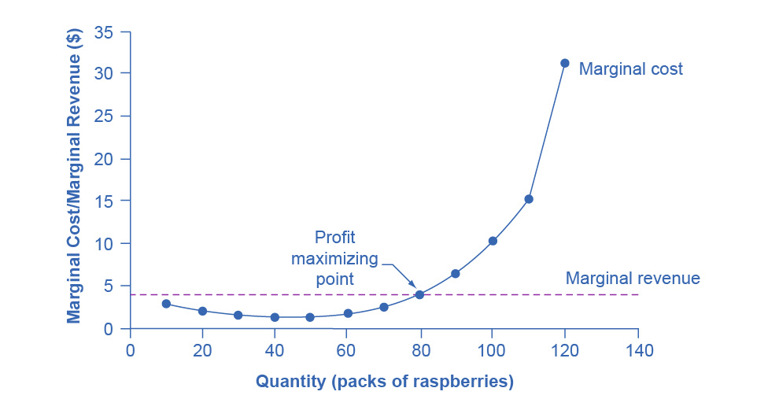
Raspberry Farm Example
Market Price: $4.00/pack
Profit-Maximizing Output: 80 packs, where MR = MC = $4
Total Revenue: $320
Total Cost: $230
Profit: $90
Notes:
Let's make this concrete with a raspberry farmer. The market determines raspberries sell for $4 per pack—our farmer is a price taker and cannot change this. The farmer's decision is purely about quantity. Looking at the data, at 80 packs, marginal revenue (which equals the $4 price) intersects marginal cost at exactly $4. This is the sweet spot. Total revenue is $320 (80 packs times $4), total cost is $230, yielding a profit of $90. Why not produce 90 packs? Because marginal cost at 90 is $6.60—much higher than the $4 revenue each pack brings in. Producing that 90th pack loses $2.60. Why not produce only 70? Because marginal cost at 70 is $2.50—still below the $4 price, meaning we're leaving $1.50 of profit on the table. The 80-pack output is where profit maximization occurs.

Slide 9
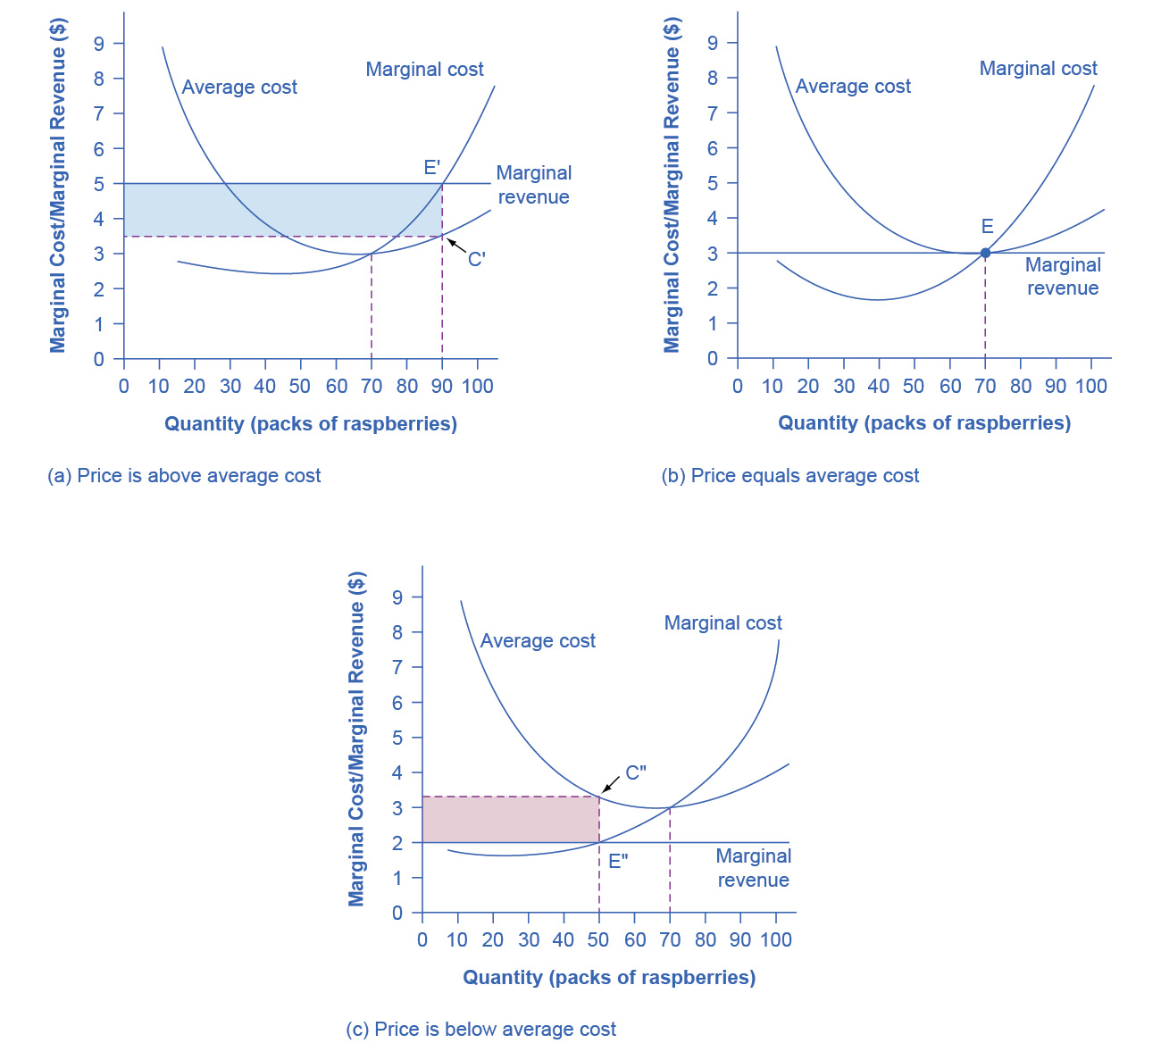
Possible Outcomes at the Raspberry Farm
1. Profit Zone: Price > Average Cost
Firm earns economic profit
2. Break-Even Point: Price = Average Cost
Firm earns zero economic profit
3. Loss Zone: Price < Average Cost
Firm experiences losses (but may continue operating)
Notes:
Even when firms produce at the profit-maximizing quantity where MR equals MC, three scenarios are possible depending on the relationship between price and average total cost. First, the profit zone: if market price exceeds average cost, the firm earns economic profits—this is the happy scenario. Each unit sold brings in more revenue than its average cost, creating a profit margin. Second, the break-even point: price exactly equals average cost. The firm makes zero economic profit—it's covering all its costs including opportunity costs, but not making extra. Think of this like a restaurant that pays all bills including the owner's salary but has nothing left over. Third, the loss zone: price falls below average cost. The firm loses money on each unit sold. But here's the surprising part—the firm may continue operating despite losses. Why? Because it might still cover variable costs and contribute something toward fixed costs that must be paid anyway.

Slide 10
The Shutdown Decision
The "Sunk Costs" Dilemma
Should the firm shut down when losing money?
NO if Price > Average Variable Cost
Covers workers, materials, utilities
Reduces total losses
YES if Price < Average Variable Cost
Can't even pay workers
Immediate shutdown
Analogy: Like staying in a bad movie because you paid for the ticket
Notes:
Here's one of economics' most counterintuitive insights: firms sometimes should keep operating even when losing money. The key is distinguishing between fixed costs (already paid, like rent) and variable costs (like wages and materials). Imagine a yoga studio with a $10,000 monthly rent already committed. If they shut down, they lose $10,000. If they stay open and earn $20,000 in revenue with $15,000 in instructor costs, they lose only $5,000—that $20,000 revenue pays all the instructors and chips away $5,000 of the rent. Better to lose $5,000 than $10,000. The shutdown point is where price falls below average variable cost—meaning the business can't even pay its workers. At that point, shutting down immediately is better. It's like the sunk cost fallacy in reverse: you paid for the movie ticket (fixed cost), but if the movie is terrible, should you stay? Only if you get some enjoyment (variable benefit) from staying.

Slide 11
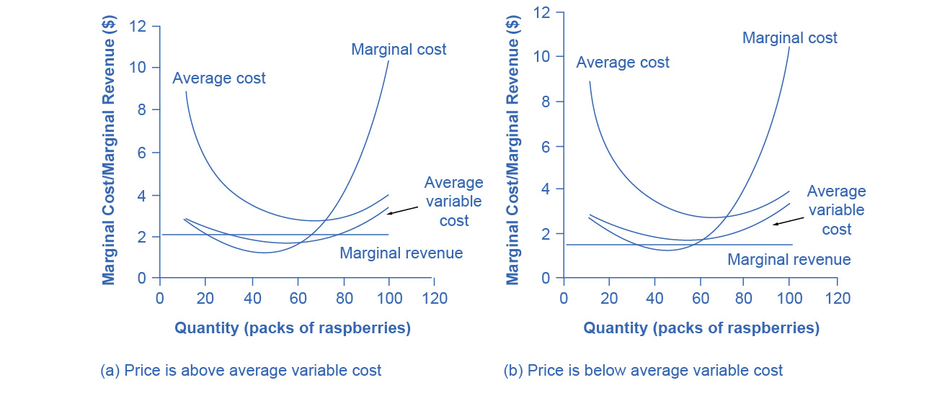
The Shutdown Point for the Raspberry Farm
In (a), the farm produces at a level of 65. It is making losses, but price > AVC, so it continues to operate.
In (b), the farm produces at a level of 60. This price < AVC for this level of output.
If the farmer cannot pay workers (the variable costs), then it has to shut down.

Slide 12
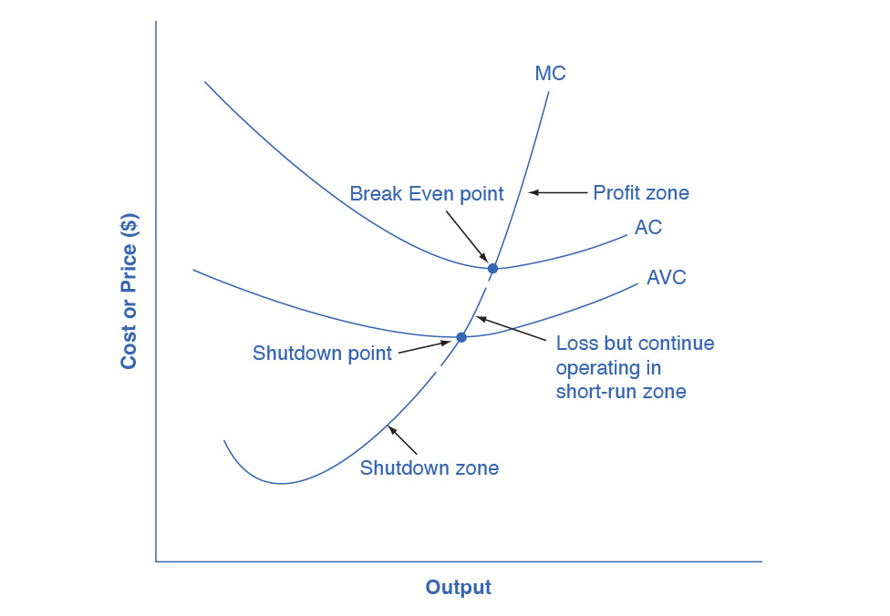
Short-Run Outcomes for Perfectly Competitive Firms, Part 1
We can divide the MC curve into 3 zones, based on where it is crossed by the AC and AVC curves.
We call the point where MC crosses AC the break even point.
If the firm is operating where price > break even point, then price > AC and the firm is earning profits.
If the price = break even point, then the firm is making zero profits.
Break even point - level of output where the MC intersects the AC curve at the minimum point of AC; if the price is at this point, the firm is earning zero economic profits.

Slide 13
Short-Run Outcomes for Perfectly Competitive Firms, Part 2
If shutdown point < price < break even point,
the firm is making losses
but will continue to operate in the short run,
since it is covering its variable costs, and more if price is above the shutdown-point price.
If price < shutdown point, then the firm will shut down immediately, since it is not even covering its variable costs.

Slide 14
Long run entry and Exit
When firms earn profits → New firms enter When firms suffer losses → Existing firms exit
Long-Run Equilibrium:
Zero economic profit for all firms
No incentive to enter or exit
P = MR = MC = AC
Analogy: Gold rush towns—booms attract prospectors, busts cause departures
Notes:
Perfect competition has a self-correcting mechanism over time. When firms earn economic profits, it's like finding gold in a stream—word gets out and new prospectors rush in. In markets, new firms enter when they see profits, increasing supply and driving down market price until profits disappear. Conversely, when firms lose money, they exit the market like prospectors leaving a depleted gold field. Firms leaving reduces supply, raising market price until losses stop. The long-run equilibrium occurs when all firms earn exactly zero economic profit. This doesn't mean they're struggling—zero economic profit means they're covering all costs including opportunity costs, earning a normal return. At this point, no new firms want to enter (no extra profits to attract them) and no existing firms want to leave (they're earning enough to stay). The equilibrium condition is price equals marginal revenue equals marginal cost equals average cost—a beautiful equality.

Slide 15
Industry Types in the Long run
Constant-Cost Industry
Demand ↑, Costs stay same → Price unchanged
Increasing-Cost Industry
Demand ↑, Costs rise → Price rises
(Scarce inputs, higher wages)
Decreasing-Cost Industry
Demand ↑, Costs fall → Price falls
(Technology improvements, economies of scale)
Notes:
Industries respond differently to increased demand in the long run, depending on what happens to production costs. In a constant-cost industry, when demand increases, firms can expand output without costs changing—imagine farming on unlimited flat land where new farms cost exactly the same as existing ones. Price returns to its original level after the adjustment. In an increasing-cost industry, expansion raises costs—perhaps skilled workers become scarce or key inputs like lithium for batteries become expensive as more firms compete for them. Long-run price rises to reflect these higher costs. In a decreasing-cost industry—the most interesting case—expansion actually lowers costs, perhaps through technological improvements or economies of scale that benefit all firms. Think of computer chip manufacturing: as the industry grew, technology improved, and long-run prices fell dramatically. Most agricultural markets approximate constant-cost industries; many manufacturing sectors are increasing-cost; and high-tech industries often exhibit decreasing costs.

Slide 16
Efficiency in Perfect competition
Two Types of Efficiency:
Productive Efficiency
Producing at lowest possible cost
P = minimum AC
Allocative Efficiency
Resources allocated to highest-valued uses
P = MC (social benefit = social cost)
Result: Perfect competition maximizes social welfare

Slide 17
Perfect Competition vs. Reality
Perfect Competition = Hypothetical Benchmark
Real Markets Include:
Pollution and externalities
Innovation and new technology
Income inequality
Imperfect information
Government intervention
Market power and discrimination
Value: Useful comparison point for policy analysis
Notes:
Perfect competition is a theoretical ideal—like a perfect vacuum in physics or a frictionless plane in mechanics. Real markets diverge in important ways. Pollution represents an externality not captured in our model—the social cost exceeds private cost. Innovation constantly disrupts markets, giving temporary advantages to innovators. Income inequality means some people can't afford basic necessities even when markets function efficiently. Buyers and sellers rarely have perfect information—think about choosing a doctor or evaluating product quality. Governments intervene through regulations, taxes, and subsidies. And most markets feature some degree of market power rather than price-taking behavior. Despite these limitations, perfect competition remains incredibly valuable as a benchmark. It helps us identify market failures and evaluate policy interventions. When markets deviate from perfect competition, we can analyze why, assess the consequences, and consider whether intervention might improve outcomes. It's not a perfect description of reality, but rather a powerful analytical tool.

Slide 18
Key takeaways
Perfect Competition Insights:
Firms are price takers with one decision: quantity
Maximize profit where MR = MC
May operate at a loss if P > AVC
Long-run: zero economic profit equilibrium
Achieves productive and allocative efficiency
Rare in reality but valuable as benchmark
Notes:
Let's consolidate the key insights from this chapter. Perfect competition teaches us six fundamental lessons. First, when firms face many competitors selling identical products, they become price takers—their only strategic decision is quantity. Second, the profit-maximizing rule is elegantly simple: produce where marginal revenue equals marginal cost. Third, firms may rationally operate while losing money if they're covering variable costs and minimizing losses. Fourth, the long run brings a zero-profit equilibrium as entry and exit eliminate profits and losses. Fifth, perfect competition uniquely achieves both productive efficiency—producing at minimum cost—and allocative efficiency—producing the right goods in the right quantities. Sixth, while perfect competition rarely exists in pure form, it provides an essential benchmark for understanding real markets and evaluating policy interventions. These principles form the foundation for analyzing more realistic market structures like monopolistic competition and oligopoly in subsequent chapters.

