Slide 1

Chapter 2
Choice In A World Of Scarcity
Notes:
Welcome to Chapter 2. This chapter explores the fundamental economic problem: unlimited wants versus limited resources. We'll examine how individuals and societies make choices when they can't have everything they want. The chapter covers three main areas: individual budget constraints, societal production possibilities, and common objections to economic thinking.

Slide 2
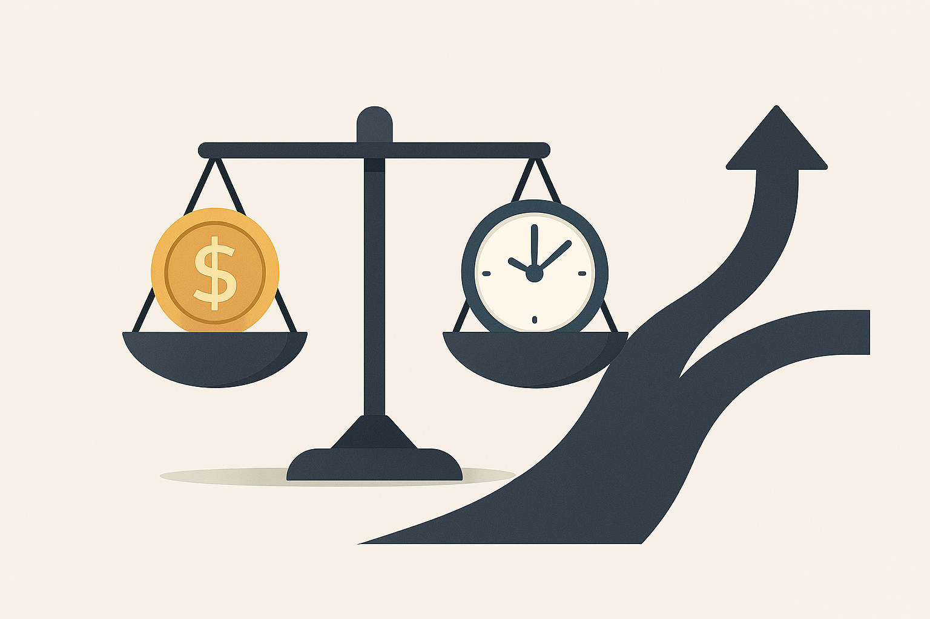
The Central Problem of Economics
SCARCITY FORCES CHOICES
Only 24 hours in a day
Limited income to spend
Finite resources for society
Key insight: Choosing one thing means giving up another
"Scarcity of means to satisfy given ends is an almost ubiquitous condition of human nature." — Lionel Robbins (1932)
Notes:
Scarcity is the foundation of economics. As economist Lionel Robbins noted in 1932, we always face limitations. Think of your daily life: you can't study for every class 8 hours each, work full-time, exercise 2 hours daily, AND sleep 8 hours—there simply aren't enough hours. Similarly, you can't buy everything you want with your income. This universal condition forces individuals and societies to make choices, which is what economics studies. The Rolling Stones song "You Can't Always Get What You Want" captures this economic reality perfectly!

Slide 3
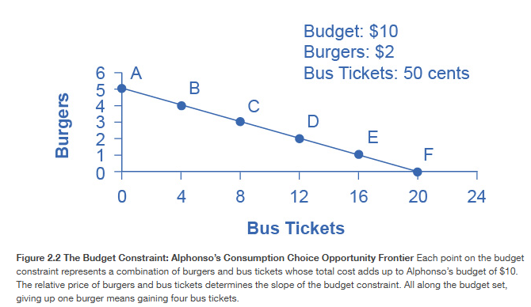
The Budget Constraint
HOW INDIVIDUALS MAKE CHOICES
Example: Alphonso's Weekly Budget
Income: $10/week
Burgers: $2 each
Bus tickets: $0.50 each
The Tradeoff:
Every burger costs 4 bus tickets
Every 4 bus tickets cost 1 burger
Notes:
The budget constraint shows all combinations of goods a person can afford given their income and prices. Alphonso can buy 5 burgers and no bus tickets, 20 bus tickets and no burgers, or any combination in between. The budget line is straight because prices are fixed. The slope (-0.25) reveals the opportunity cost: to get one more burger, Alphonso must give up 4 bus tickets. This is like a student choosing between textbooks and streaming subscriptions—every dollar spent on entertainment is a dollar not spent on education materials. The budget constraint makes visible the invisible tradeoffs we face constantly.

Slide 4
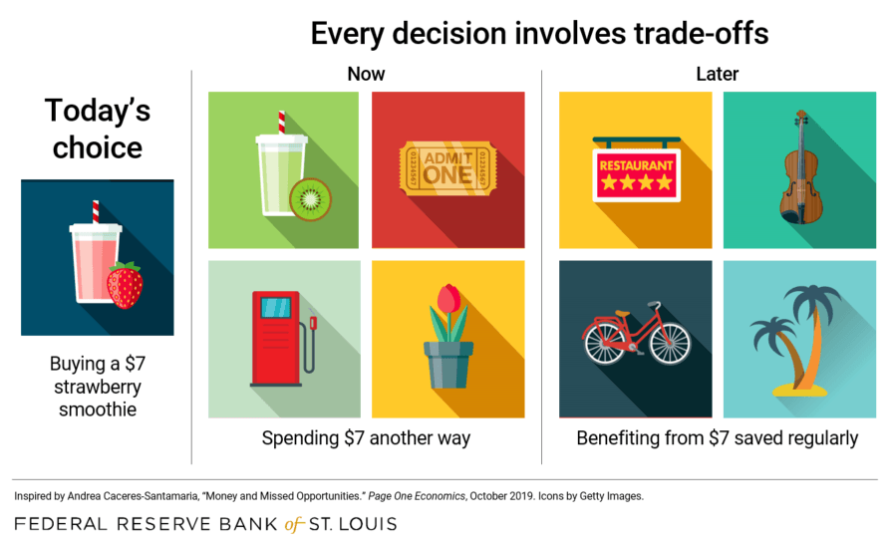
Opportunity Cost
THE TRUE COST OF CHOICES
Definition: The value of the next best alternative given up
Real-World Examples:
College attendance = tuition + lost earnings from not working
Airport security delays = $8 billion/year in passenger waiting time
Daily $8 restaurant lunch = $1,250/year (cost of a vacation)
Key principle: Every choice has both visible and hidden costs
Notes:
Opportunity cost is THE central concept in economics. It's not just the dollar price you pay—it's what you give up to make that choice. Consider college: you pay tuition, but you also give up 4 years of income you could have earned. The government example is striking: after 9/11, enhanced airport security's biggest cost wasn't equipment ($2 billion) or sky marshals ($3 billion)—it was 895 million passengers each spending an extra 30 minutes waiting, valued at $8 billion annually! This illustrates how economists think: they convert everything to comparable terms. The daily lunch example shows how small recurring costs add up—framing it as "a vacation" versus "$5/day" might change your behavior. Opportunity cost is all around us.

Slide 5
Marginal Analysis
THINKING AT THE MARGIN
Marginal Analysis = Comparing benefits and costs of "a little more" or "a little less"
Not: "Should I eat?" (all-or-nothing) But: "Should I eat one more slice?" (incremental)
Application: Alphonso doesn't choose all burgers or all bus tickets—he evaluates each additional unit
📺 Watch another episode vs. sleep: fun vs. grogginess
🍰 Add cake pop to coffee: treat vs. $3 cost
💼 Work extra shift vs. attend event: $60 vs. networking
Decide based on what matters more to you
Notes:
People rarely make all-or-nothing decisions. You don't choose between eating all the pizza or none of the pizza—you choose how many slices. This is marginal analysis: examining the benefit and cost of one additional unit. The first slice of pizza when you're hungry provides enormous satisfaction. The sixth slice? Much less. Similarly, Alphonso doesn't buy all burgers or all bus tickets. He asks: "Is this next burger worth giving up four bus tickets?" Think of it like your study time: the first hour studying for an exam is extremely valuable, but the sixth hour might provide diminishing returns—maybe you'd get more benefit spending that hour on a different subject. Economists call this "marginal analysis" or "change analysis," and it's used throughout economics because it reflects how people actually make decisions.

Slide 6
Law of Diminishing Marginal Utility
WHY WE DON'T CHOOSE "ALL OR NOTHING"
Pattern: As you consume more of something, each additional unit provides less satisfaction
Examples:
1st slice of pizza > 6th slice of pizza
1st hour of leisure > 8th hour of leisure
1st bus ride (to job interview) > 20th bus ride (killing time)
Result: People seek variety and balance, not extremes
Notes:
This law explains why you don't eat only your favorite food forever or why workers don't choose "all leisure and no work." Each additional unit of consumption provides less additional satisfaction—that's diminishing marginal utility. The first ice cream cone on a hot day is amazing. The fifth? You might feel sick. Alphonso's first few bus rides might get him to crucial appointments, providing high utility. Later rides just kill time. This principle is universal: the first dollar you earn is more valuable than your millionth dollar; the first hour of studying is more productive than your tenth consecutive hour. This is why rational people seek balanced combinations rather than extremes. It also explains why people consume diverse goods rather than spending everything on one item.

Slide 7
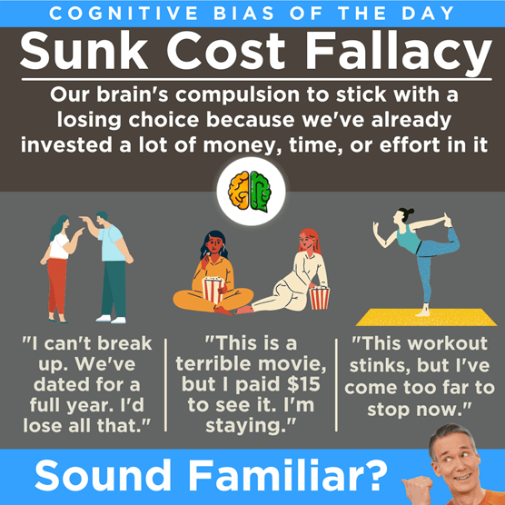
Sunk Costs
FORGET THE PAST, FOCUS ON THE FUTURE !
Sunk Cost = Money or time already spent that cannot be recovered
Example: Selena pays $8 for a terrible movie
Staying: "I paid for it, so I should watch it"
Leaving: "The money's gone anyway—should I waste 90 more minutes?"
Rule: Ignore sunk costs; make decisions based on future costs and benefits
Notes:
This is one of the hardest lessons in economics because it requires admitting past mistakes. Sunk costs are gone—you can't get them back—so they shouldn't influence current decisions. Selena can't recover her $8 movie ticket, so the real choice is: "Do I waste 90 more minutes on this terrible movie, or do something better with my time?" Businesses struggle with this constantly. Companies that invested millions developing a failing product often throw good money after bad because they "already invested so much." But rational decision-making ignores sunk costs. Think of it this way: if someone offered you free tickets to that terrible movie, would you go? If not, why stay just because you paid? Your past payment is irrelevant to the current decision. Focus on forward-looking costs and benefits only.

Slide 8
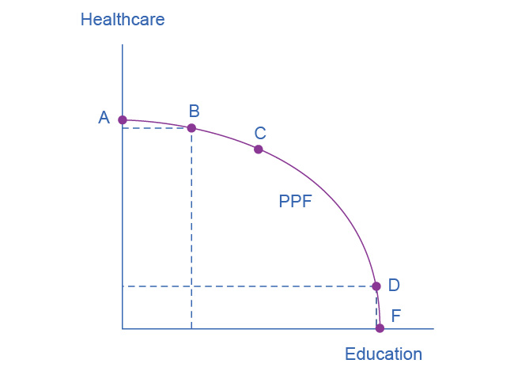
The Production Possibilities Frontier (PPF)
SOCIETY'S BUDGET CONSTRAINT
Shows maximum combinations society can produce with available resources
Key Features:
Points ON the curve = maximum possible production (efficient). Points A, B C D, F
Points INSIDE = underusing resources (inefficient)
Points OUTSIDE = impossible with current resources
Shape: Curved (bows out) due to law of increasing opportunity cost
Outside
Inside
Notes:
The PPF is to society what the budget constraint is to individuals—it shows the limits of what's possible. Imagine society producing only two things: healthcare and education. With fixed resources (labor, land, capital), there's a maximum amount of each combination we can produce. Every point on the frontier represents productive efficiency—we can't make more of one without making less of the other. Points inside the curve represent waste—unemployment or underused resources. Points outside are unattainable with current resources. Unlike the budget constraint's straight line, the PPF curves because of increasing opportunity cost—some resources are better suited for healthcare, others for education. As we move resources from one sector to another, we use increasingly unsuitable resources, making each additional unit more costly to produce.

Slide 9
Law of Increasing Opportunity Cost
WHY THE PPF CURVES OUTWARD
The Pattern:
Moving from education → healthcare: First resources shifted provide large healthcare gains for small education losses
Moving from healthcare → education: Last resources shifted provide small education gains for large healthcare losses
Real-world analogy:
Last few doctors becoming teachers vs. first few doctors becoming teachers
Notes:
This explains why the PPF bows outward rather than being a straight line. Imagine society devotes everything to healthcare—people see doctors daily but have zero education. Moving some resources to education causes little healthcare loss because those last marginal healthcare dollars weren't producing much benefit anyway. But they produce huge education gains because education starts from zero. Now reverse it: if society devotes everything to education and starts shifting resources to healthcare, those first healthcare resources produce large gains. The analogy makes it concrete: the last few emergency rooms becoming kindergartens produces tiny education gains but large healthcare losses. But the first few underutilized medical facilities becoming schools? Large education gains, small healthcare losses. This is why economists say resources aren't perfectly substitutable—some resources are better suited for specific purposes. It's like asking a professional basketball player to become a ballet dancer—possible, but not as effective.

Slide 10
Productive vs. Allocative Efficiency
TWO TYPES OF EFFICIENCY
Productive Efficiency:
Producing on the PPF
Can't make more of one good without less of another
Question: "Are we using resources fully?"
Allocative Efficiency:
Producing the "right" combination on the PPF
The combination society most prefers
Question: "Are we producing what people actually want?"
Notes:
These are distinct concepts. Productive efficiency is about not wasting resources—it means producing on the PPF, not inside it. Any point on the curve is productively efficient. But allocative efficiency asks: "Of all the productively efficient points, which one should we choose?" This depends on society's preferences. Imagine two scenarios: both produce efficiently, but one devotes 90% to healthcare and 10% to education, while the other does the reverse. Both are productively efficient, but only one is allocatively efficient—the one society actually wants. Markets help achieve allocative efficiency because producers respond to consumer demand. Think of it like a restaurant kitchen: productive efficiency means no wasted ingredients and no idle cooks (using resources fully). Allocative efficiency means making the dishes customers actually ordered (producing what's wanted). You need both for optimal outcomes.

Slide 11
Comparative Advantage
SPECIALIZATION AND TRADE
Comparative Advantage: Producing goods at lower opportunity cost than others
Example: US vs. Brazil
Brazil: Low opportunity cost for sugar cane (great climate)
US: Low opportunity cost for wheat (different climate)
Result: Each country specializes in what it does relatively best, then trades
Key insight: Both countries benefit from specialization + trade
Produce at lower opportunity cost than others
Even if one is better at everything, trade helps both
Specialize in what you do best, trade for the rest
Example: You're great at math and okay at writing—tutor math and hire help for writing
Notes:
Comparative advantage is why countries trade. It's about opportunity cost, not absolute productivity. Brazil might produce more sugar cane per acre and the US might produce more wheat per acre—that's absolute advantage. But what matters is comparative advantage: Brazil's opportunity cost of producing sugar cane (in terms of wheat given up) is lower than America's opportunity cost. The US has a lower opportunity cost producing wheat. So Brazil should specialize in sugar cane, the US in wheat, then they trade. Both countries end up with more of both goods than if each tried to produce everything itself. This principle applies beyond countries: it explains why doctors hire accountants rather than doing their own taxes, even if the doctor could learn accounting. The doctor's opportunity cost of doing taxes is very high (lost patient income), so specialization and trade benefits both parties. David Ricardo's insight about comparative advantage remains one of economics' most powerful and counterintuitive ideas.

Slide 12
Objection 1 - People Don't Really Act This Way
THE "UNREALISTIC" CRITIQUE
Objection: People don't draw budget constraints or calculate opportunity costs before every decision
Response: The Basketball Pass Analogy
Physicist can calculate the perfect pass trajectory
Good players throw accurate passes without calculations
Both descriptions are valid!
Economic models describe patterns of behavior, not conscious calculations
Notes:
Critics argue economic models are unrealistic because people don't consciously perform these calculations. But this misunderstands how models work. When a basketball player throws a perfect bounce pass, they're not solving physics equations—they're using practiced intuition. Yet the physics equations accurately describe the pass. Similarly, shoppers don't draw budget constraints, but they do make consistent tradeoffs between goods based on prices and income—which is exactly what budget constraint analysis predicts. Democratic governments don't formally calculate PPFs, but they do face tradeoffs and respond to voter preferences. Economic models describe patterns in behavior, not the conscious thought process. They're tools for analyzing tradeoffs, predicting behavior, and understanding outcomes. The test of a model isn't whether people explicitly think through its logic, but whether it accurately predicts behavior and illuminates tradeoffs. Economics, like physics, provides a useful analytical framework even when people act intuitively.

Slide 13
Objection 2 - People Shouldn't Act This Way
THE "SELFISH" CRITIQUE
Objection: Economics assumes people are selfishly motivated
Responses:
Economics is positive, not normative — describes what is, not what should be
Self-interest includes altruism — Adam Smith: people care about "the fortune of others"
Self-interest = freedom — people should make their own choices
Invisible hand — pursuing self-interest often creates social benefits
Notes:
This objection has several responses. First, economics makes a positive statement (describing reality) rather than normative (prescribing what should be). We can test whether people respond to incentives without endorsing selfishness. Second, even Adam Smith—the father of economics—recognized humans aren't purely selfish. His "Theory of Moral Sentiments" opens by noting we care about others' happiness. Self-interest is a useful simplification, not a complete portrait of human nature. Third, we can reframe "self-interest" as "personal freedom"—the ability to make your own choices about work, spending, and saving is a valuable liberty. Some choose high-paying stressful jobs; others choose meaningful low-paying work; others balance both. That freedom matters. Fourth, Smith's "invisible hand" shows how self-interested behavior often creates social benefits—workers create output, businesses meet consumer needs. Finally, people separate economic self-interest from other domains. You might negotiate aggressively for a raise but volunteer generously at a food bank. Self-interest is a starting point for economic analysis, not a complete theory of human motivation.

Slide 14
Positive vs. Normative Statements
FACTS VS. OPINIONS
Positive Statements (Factual — can be tested):
"Raising the minimum wage to $15/hour will reduce employment by 2%"
"People with college degrees earn 67% more than high school graduates"
Normative Statements (Opinion — based on values):
"The minimum wage should be raised to help workers"
"Everyone should go to college"
Economics focuses on positive analysis but informs normative debates
Notes:
Understanding this distinction is crucial. Positive statements are about what is—they're factual claims we can test with evidence. "Raising the minimum wage will cost X jobs" is positive—we can gather data and test it, even if people disagree about the measurement. Normative statements are about what should be—they're value judgments reflecting our beliefs about right and wrong. "We should raise the minimum wage" is normative—it depends on how you weigh helping some workers versus potentially costing others their jobs. Neither positive nor normative analysis alone determines policy. We need positive analysis to understand consequences ("If we do X, Y will happen"), but normative values to decide whether those consequences are desirable ("We care more about Y than Z"). Economics primarily does positive analysis—measuring tradeoffs, predicting behavior, calculating costs and benefits. But this analysis informs normative debates. The key is distinguishing factual disagreements (resolved by evidence) from value disagreements (resolved by democratic deliberation). Good policy needs both rigorous positive analysis and clear normative reasoning.

Slide 15
The Unified Framework
ONE BASIC DIAGRAM, MANY APPLICATIONS
Three Universal Themes:
Scarcity — can't have unlimited amounts of everything
Tradeoffs — getting more of one thing means less of another
Efficiency — maximizing benefits from scarce resources
Same logic applies to:
Individual budget constraints
Societal production possibilities
Environmental protection vs. economic output
Income equality vs. total output
Notes:
Here's the chapter's unifying insight: whether analyzing individual choices or societal production, we're using the same fundamental framework. Both the budget constraint and PPF illustrate scarcity (can't have everything), tradeoffs (more of one means less of another), and efficiency (choosing combinations wisely). The details differ—budget constraints are straight lines determined by fixed prices, while PPFs curve due to increasing opportunity cost—but the core logic is identical. This framework recurs throughout economics because scarcity, tradeoffs, and efficiency are universal. We'll use it to analyze international trade, environmental policy, inequality, and macroeconomic choices between consumption and investment. Don't let different labels confuse you—recognize the common pattern. Every time you see a downward-sloping frontier with two goods, you're seeing this fundamental insight: in a world of scarcity, every choice involves giving up something else. The labels change, but the logic remains constant.

Slide 16
Key Takeaways
CHAPTER 2 CORE CONCEPTS
✓ Scarcity forces choices at all levels ✓ Opportunity cost is the value of the best alternative given up ✓ Marginal analysis examines incremental changes ✓ Law of diminishing marginal utility explains why we seek variety ✓ Budget constraint shows individual consumption limits ✓ PPF shows society's production limits ✓ Efficiency means no waste (productive) and producing what's wanted (allocative) ✓ Economic models are useful even if people don't consciously calculate
Notes:
Let's consolidate what we've learned. Every economic choice—whether by individuals or societies—begins with scarcity. This necessitates tradeoffs, which we measure using opportunity cost. Rather than making all-or-nothing choices, people use marginal analysis to evaluate incremental changes. Diminishing marginal utility explains why we seek balance and variety instead of consuming only one thing. The budget constraint formalizes individual choices given prices and income, while the PPF extends this logic to society's production choices. Efficiency has two dimensions: productive efficiency means using resources fully (producing on the frontier), while allocative efficiency means producing the combination society most prefers. Finally, objections to the economic approach can be addressed: economic models describe patterns accurately even when people don't consciously perform calculations, and self-interested behavior can coexist with altruism and create social benefits. This framework—scarcity, tradeoffs, and efficiency—provides a powerful lens for analyzing choices throughout economics.

