Slide 1
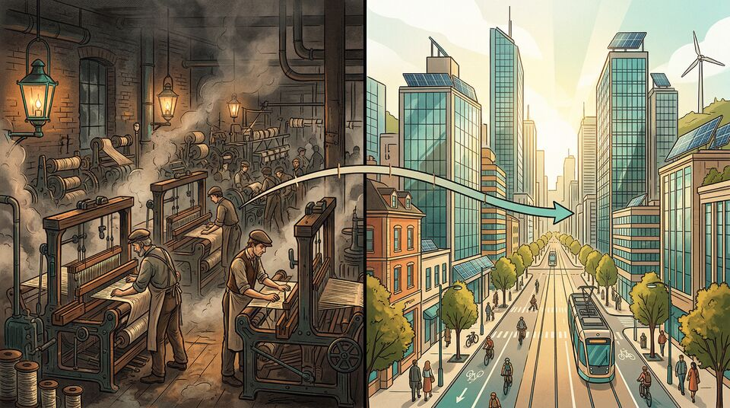
Economic
Growth
Chapter 7
Why Growth Matters and What Drives It
Notes:
Welcome to Chapter 7 on Economic Growth. This is arguably the most important topic in macroeconomics. As Nobel laureate Robert Lucas once said, "The consequences for human welfare involved in questions like these are simply staggering: Once one starts to think about them, it is hard to think about anything else." Today we'll explore why growth is a relatively recent phenomenon, what drives it, and whether poorer nations can catch up.

Slide 2
The Great Enrichment: A Recent Revolution
$3/day
For most of history, living standards barely changed — like a flat EKG that suddenly spikes
The Industrial Revolution (c. 1800) was the defibrillator: steam engines, power looms, railroads
Imagine humanity on a 24-hour clock — modern growth starts at 11:58 PM
"More change in the last 200 years than the previous 2,000 combined"
Average income in 1800 (today's dollars)
$35+/day
Average income today, globally
200 years
Period of explosive growth
Notes:
For thousands of years, the average person lived on the equivalent of about $3 a day. Think about that — whether you lived in ancient Rome, medieval England, or Ming Dynasty China, your daily life was remarkably similar in material terms. Then around 1800, something extraordinary happened. The Industrial Revolution, beginning in Britain with inventions like the steam engine and power loom, set off an explosion of growth. Here's a way to think about it: if all of human history were compressed into a 24-hour day, modern economic growth doesn't begin until about 11:58 PM — the last two minutes. Yet in those two minutes, we've gone from $3 a day to over $35 a day globally. That's the Great Enrichment. [Source: OpenStax Principles of Macroeconomics 3e, Ch. 7 Intro and Section 7.1]

Slide 3
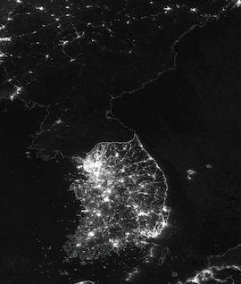
From Poverty to Prosperity: South Korea
1
1950s
South Korea's transformation is like a student going from failing grades to valedictorian in one generation
Grew at >6% annually for four decades
Recipe: education + investment + technology adoption + economic freedom
Now peers with Italy, New Zealand, and Israel
War-torn, GDP per capita $854
2
1960s-70s
Investment surge to 30-35% of GDP
3
1980s
Near-universal secondary education
4
Today
11th largest economy, GDP/cap >$30,000
Notes:
South Korea is perhaps the greatest economic growth story of the 20th century. After the Korean War in the 1950s, it was one of the poorest countries on earth — GDP per capita was just $854 in today's dollars. Most people worked in peasant agriculture. Then Korea executed a remarkable playbook: it achieved universal primary school enrollment by 1965, doubled investment rates from 15% to over 30% of GDP, sent students abroad for technical training, and built partnerships with foreign firms. The result? Over four decades of growth exceeding 6% per year. Today, South Korea is the 11th largest economy in the world with a GDP per capita above $30,000. It's like watching a student go from failing every class to graduating as valedictorian — in a single generation. [Source: OpenStax 7.1 and 7.3]

Slide 4
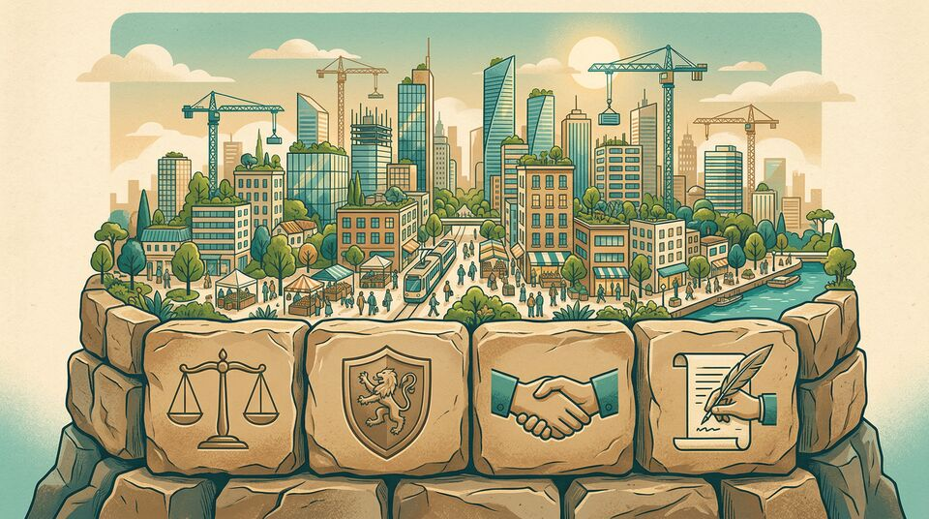
Institutions: The Soil Where Growth Takes Root
Property rights: "Would you plant a crop if anyone could harvest it?"
Rule of law: Magna Carta (1215) → U.S. Constitution → modern legal systems
Contractual rights: Enable trust between strangers — the foundation of markets
Corruption & red tape: Act like friction in an engine — they slow everything down
Countries with weak rule of law (Somalia, South Sudan, Zimbabwe) remain among the poorest. No coincidence.
Notes:
Think of institutions like the soil in a garden. You can have the best seeds — talented workers, great technology, plenty of capital — but if the soil is toxic, nothing grows. Property rights are fundamental: would you plant a crop if anyone could come and harvest it? That's exactly the problem in countries without secure property rights. The rule of law traces back to the Magna Carta in 1215, which established that even kings must follow due process. This principle migrated to the U.S. Constitution and became a cornerstone of market economies. Contractual rights let strangers do business together — if I'm a surgeon and I operate on you, I need to know the legal system will enforce your obligation to pay me. Corruption and excessive red tape act like friction in an engine: they don't stop the machine entirely, but they dramatically reduce its output. Countries at the bottom of the World Bank's rule-of-law rankings — Somalia, South Sudan, the Central African Republic — are also among the poorest on earth. That's not a coincidence. [Source: OpenStax 7.1]

Slide 5
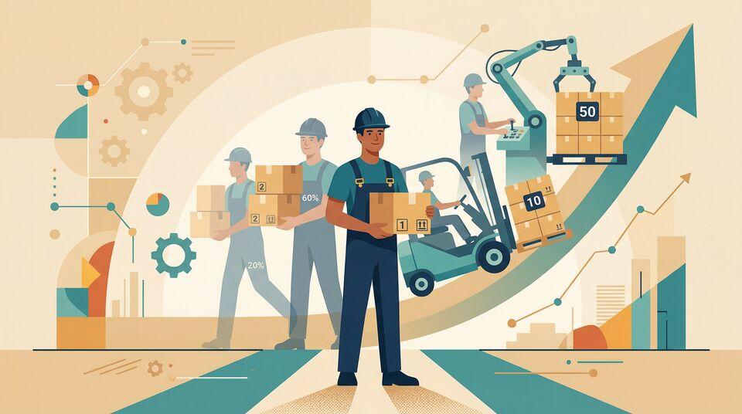
Labor Productivity: The Engine of Growth
Definition: Value each worker creates per unit of input
Analogy: A baker with a wood-fired oven vs. one with an industrial oven — same hours, 10× the bread
U.S. workers have more than doubled productivity since 1977
In the long run, productivity per hour is the most important determinant of the average wage level
Aggregate Production Function
Labor + Physical Capital + Human Capital + Technology → GDP
Notes:
Labor productivity is the engine that drives long-run economic growth. It measures the value each worker creates per unit of input. Here's a simple way to think about it: imagine two bakers. One has a wood-fired oven and can bake 10 loaves per hour. The other has an industrial automated oven and can bake 100 loaves per hour. Same number of hours worked, but 10 times the output. That's what productivity gains look like. Economists use the aggregate production function to organize this thinking: GDP is the output, and the inputs are labor, physical capital, human capital, and technology. In the U.S., workers have more than doubled their productivity since 1977. And here's the crucial connection: in the long run, productivity per hour is the single most important determinant of average wages. Higher productivity doesn't just make the economy bigger — it makes workers richer. [Source: OpenStax 7.2]

Slide 6
The Four Ingredients of Economic Growth
Physical Capital
Human Capital
Tools, machinery, infrastructure
U.S. worker today: ~3× the capital vs. 1950s
Faces diminishing returns
Education, skills, experience
U.S. HS graduation: 50% (1970) → 80%+ (2000s)
Each extra year of education → 10-20% higher wages
Technology & Innovation
Specialization & Trade
"The joker in the deck" — unlimited growth
Ideas don't depreciate, can be shared freely
U.S. issues >150,000 patents annually
Comparative advantage → gains from trade
Access to larger markets → economies of scale
Economic freedom enables all of the above
Notes:
Economic growth has four key ingredients, and they work together like instruments in an orchestra. First, physical capital — tools, machinery, roads, and factories. The average U.S. worker today has access to roughly three times the physical capital of a 1950s worker. But physical capital alone has diminishing returns; each additional unit adds less than the one before. Second, human capital — the knowledge, skills, and experience workers bring. The U.S. high school graduation rate rose from about 50% in 1970 to over 80% by the early 2000s. In low-income countries, each additional year of education increases wages by 10-20%. Third, technology and innovation — what the textbook calls "the joker in the deck." Unlike physical capital, ideas don't wear out, can be shared freely, and often spark even more ideas. The U.S. Patent Office issues over 150,000 patents every year. Finally, specialization and trade allow countries to focus on what they do best, accessing larger markets and achieving economies of scale. These four ingredients don't just add up — they multiply each other. [Source: OpenStax 7.3]

Slide 7
What Matters Most? Growth Accounting
#1
≤50%
=
Technology is the largest contributor to growth
Physical + human capital explain at most half
Human capital is at least as important as physical capital
Growth accounting studies (since late 1950s) decompose GDP growth into its sources
Lesson: You can't just build roads and factories — you need ideas
A restaurant needs a kitchen (physical capital) and trained chefs (human capital), but the recipe (technology) is what makes it Michelin-star
All three factors reinforce each other in a virtuous cycle
Notes:
Since the late 1950s, economists have conducted growth accounting studies — breaking down GDP growth into how much came from physical capital, human capital, and technology. Three big lessons emerge. First, technology is consistently the most important contributor. Physical and human capital together explain at most half of economic growth. Second, human capital investment is at least as important as physical capital. Building factories matters, but so does educating the people who work in them. Third — and this is crucial — these factors reinforce each other. Think of a restaurant: you need a kitchen (physical capital) and trained chefs (human capital), but the recipe (technology) is what turns a diner into a Michelin-star experience. And a great recipe inspires chefs to develop new techniques, which call for better equipment, and so on. It's a virtuous cycle. [Source: OpenStax 7.3]

Slide 8

Why Even 1% Growth Matters
The Rule of 70
Years to double = 70 ÷ Growth Rate
Growth Rate | Years to Double | GDP after 50 Yrs
1% | 70 years | 164
3% | 23 years | 438
5% | 14 years | 1,147
8% | 9 years | 4,690
Like a snowball rolling downhill — small at first, enormous over time — the same formula applies to your savings and investments
Notes:
Here's where growth gets personal. The Rule of 70 is one of the most useful tools in economics: divide 70 by the annual growth rate, and you get the approximate number of years for an economy — or your personal income — to double. At 1% growth, it takes 70 years to double. At 3%, just 23 years. At 5%, only 14. The differences compound dramatically over longer horizons. Start at 100: after 50 years at 1% growth, you reach 164. At 5%, you reach 1,147. At 8%, an astonishing 4,690. Think of it like a snowball rolling downhill — it starts small, but the longer it rolls, the bigger it gets, and the faster it grows. This isn't just abstract GDP math. The exact same formula applies to compound interest on your savings. If your investments grow at 7% per year, they'll double roughly every 10 years. Start investing at 20, and by 50 your money has doubled three times — that's 8x your original investment. Time is your greatest asset. [Source: OpenStax 7.2]

Slide 9
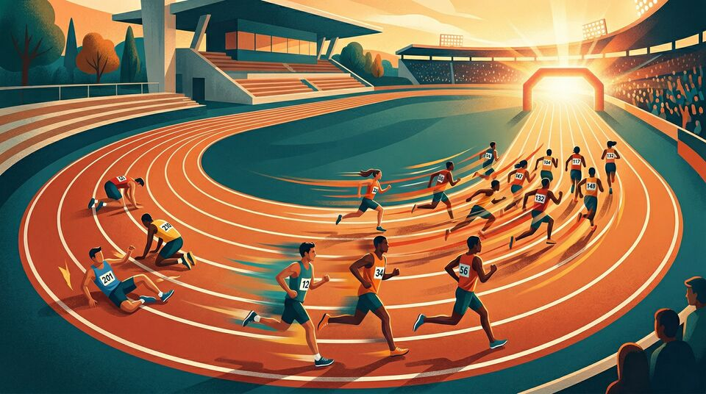
Can Poor Countries Catch Up?
Arguments FOR convergence:
Diminishing returns: Low-income countries get more bang per buck from investment
"Advantages of backwardness": Adopt existing tech rather than invent from scratch
It's easier to follow a trail someone else blazed than to hack through the jungle
Arguments AGAINST:
Requires the right institutions — technology doesn't transfer into a vacuum
New technology offsets diminishing returns in rich countries
Catch-up takes decades even at 7% growth
Notes:
One of the big questions in economics is whether poor countries will eventually catch up to rich ones. Several arguments say yes. First, diminishing marginal returns: when you have very little capital, each new dollar of investment produces a large gain. Going from a dirt road to a paved road transforms a whole region; adding one more lane to a six-lane highway barely moves the needle. Second, low-income countries enjoy what Alexander Gerschenkron called "advantages of backwardness" — they can adopt existing, well-tested technologies rather than having to invent new ones. It's like following a trail someone else already blazed through the jungle rather than hacking through the underbrush yourself. But convergence isn't guaranteed. Adopting technology requires the right institutions — property rights, education systems, and openness to trade. Without those, the "advantages of backwardness" are purely theoretical. Rich countries also keep pushing the frontier with new innovations that offset their own diminishing returns. And the math is humbling: even if a low-income country grows at 7% while a rich one grows at 2%, after 30 years the rich country is still richer. The gap narrows, but it takes a very long time to close. [Source: OpenStax 7.4]

Slide 10
The Scoreboard: Who's Growing Fastest?
Average Real GDP Growth Rates
Country | 1990-2000 | 2010-2019
Fast Growth Club (5%+)
China | 10.6% | 7.3%
India | 6.0% | 6.7%
Vietnam | 7.9% | 6.3%
Cambodia | 7.1% | 7.0%
Slow Growth Club (≤2%)
Japan | 1.3% | 1.3%
France | 2.0% | 1.4%
Italy | 1.6% | 0.3%
For Reference
United States | 3.2% | 2.3%
World Averages
High income | 2.7% | 1.7%
Middle income | 4.7% | 4.0%
Low income | 3.8% | 4.5%
Key insight: Low-income > Middle-income > High-income growth rates — convergence in action
Notes:
Let's look at the actual data. The textbook groups countries into a "Fast Growth Club" — those averaging 5% or more in both the 1990s and 2010s — and a "Slow Growth Club" at 2% or less. The fast growers are mostly low and middle-income nations: China at over 7%, India approaching 7%, Vietnam and Cambodia both above 6%. The slow growers? Japan at 1.3%, France at 1.4%, Italy at just 0.3%. The U.S. sits in between at 2.3%. When we look at the world averages, the pattern is clear: low-income countries grew at 4.5% in the 2010s, middle-income at 4.0%, and high-income at just 1.7%. That's convergence in action — the poorer groups are growing faster. But notice the caveats: the Fast Growth Club is dominated by East and Southeast Asia. Many countries in Sub-Saharan Africa and the Middle East are not converging. Growth requires the right institutions, policies, and investments — there's no automatic pilot. [Source: OpenStax 7.4]

Slide 11
Key Takeaways
1. Modern economic growth began ~1800 — for most of history, living standards were stagnant
2. Institutions (property rights, rule of law, economic freedom) are the foundation
3. Growth comes from physical capital, human capital, technology, and trade — with technology as the most powerful driver
4. Compounding makes small growth differences enormous over time (Rule of 70)
5. Convergence is possible but not guaranteed — it requires the right institutional recipe
"The consequences for human welfare... are simply staggering."
— Robert E. Lucas Jr.
Notes:
Let's wrap up with five key takeaways. First, modern economic growth is remarkably recent — for most of human history, the average person lived on about $3 a day. Second, institutions are the foundation: property rights, rule of law, and economic freedom create the conditions for growth. Third, the four ingredients of growth are physical capital, human capital, technology, and trade — with technology as the most powerful and unlimited driver. Fourth, compound growth is extraordinarily powerful: even a 1% difference in growth rates produces enormous differences over decades. And fifth, while convergence is happening — poor countries are growing faster on average — it's not automatic. It requires the right institutional recipe. As Robert Lucas said, once you start thinking about these questions, it's hard to think about anything else. [Source: OpenStax Principles of Macroeconomics 3e, Chapter 7]

