Slide 1
CHAPTERS
12 & 13
→ Short Run vs. Long Run
→ Aggregate Demand & Supply
→ Sticky vs. Flexible Prices
Keynesian &
Neoclassical
Perspectives
→ Phillips Curve
→ Policy Implications
→ Balancing Both Models
Notes:
Welcome students! Today we're covering two foundational schools of macroeconomic thought: Keynesian and Neoclassical. Think of them as two different GPS systems for navigating the economy—they use different maps and give different directions depending on whether you're looking at traffic right now (short run) or planning a cross-country route (long run). Neither is fully right or wrong; economists blend both in practice.

Slide 2
Two Lenses on the Economy
KEYNESIAN
NEOCLASSICAL
Focus:
Short run
Focus:
Long run
Key Driver:
Aggregate Demand
Key Driver:
Aggregate Supply (potential GDP)
Wages & Prices:
Sticky – adjust slowly
VS
Wages & Prices:
Flexible – markets self-correct
Unemployment:
Demand deficiency → gov't must act
Unemployment:
Natural rate; target structural/frictional
Policy Tool:
Countercyclical fiscal & monetary
Policy Tool:
Stable rules; supply-side reforms
Animal Spirits:
Fear/optimism → unstable demand
Expectations:
Rational → rapid price adjustment
Notes:
SPEAKER NOTES – Two Lenses Analogy: Think of a doctor treating a patient. A Keynesian doctor says "your blood pressure just crashed—give a stimulant NOW." A neoclassical doctor says "your long-term diet is the real issue." Both are right, just on different time scales. • "Animal spirits" is Keynes's term for herd mentality—businesses invest when confident, freeze when scared, regardless of fundamentals. The 2008 financial crisis saw this vividly. • Rational expectations (neoclassical): People use all available information to forecast—they're not fooled by policy repeatedly. Like a casino player who eventually learns the house edge.

Slide 3
What Drives Aggregate Demand?
AD = C + I + G + (X − M)
C Consumption
I Investment
G Government
NX Net Exports
• Disposable income
• Expected profit & confidence
• Federal + state + local spending
• Foreign growth rates
• Expected future income
• Interest rates (↓ rates → ↑ invest.)
• Tax policy
• Relative price levels
• Wealth & credit access
• Energy prices & tax incentives
• Key stabilizer in recessions
• Exchange rate movements
Key Keynesian insight: AD is volatile — businesses invest based on confidence ('animal spirits'), not just cold math.
Notes:
SPEAKER NOTES – AD Components Four engines of the GDP plane — if any one stalls, the plane drops. • Wealth effect example: When stock portfolios fell 40% in 2008-09, households cut spending even without a pay cut — they felt poorer. • Investment collapse: The 2001 dot-com bust cut investment from 21% → 18% of GDP in one year. Multiplied into a larger GDP drop. • Government as shock absorber: In 2020, the federal government sent stimulus checks, boosted unemployment insurance, and propped up state budgets — all to prevent a collapse in C and G simultaneously. • Net exports reminder: When U.S. trading partners (Canada, Germany, Japan) go into recession, they buy fewer U.S. goods — our exports fall even if our economy is healthy.

Slide 4
AD Shift Quick Reference
What moves aggregate demand left or right?
Component | AD DECREASES ← | AD INCREASES →
Consumption (C) | ↑ Taxes | ↓ Income | ↑ Interest rates | ↓ Wealth | Pessimism | ↓ Taxes | ↑ Income | ↓ Interest rates | ↑ Wealth | Optimism
Investment (I) | ↓ Expected profits | ↑ Interest rates | Low confidence | ↑ Expected profits | ↓ Interest rates | High confidence
Government (G) | ↓ Gov't spending | ↑ Taxes (austerity) | ↑ Gov't spending | ↓ Taxes (stimulus)
Net Exports (NX) | ↓ Foreign demand | Dollar appreciates | ↑ Foreign demand | Dollar depreciates
Notes:
SPEAKER NOTES – AD Shift Table Quick navigation tool — a recession is usually driven by multiple factors moving left simultaneously. In 2008: home values fell (↓ wealth → ↓ C), banks froze lending (↑ interest for businesses → ↓ I), state tax revenues collapsed (↓ G). Three of four AD components fell at once. 2020: Government deliberately targeted all four levers at once — stimulus checks boosted C, PPP loans protected I, direct aid supported G, and a weak dollar helped NX somewhat.

Slide 5
Keynesian Building Blocks
Why the economy can get stuck below full employment
Sticky Wages & Prices
Wages resist cuts — bosses fear morale damage; menu costs make repricing expensive. Result: demand falls but price level barely budges.
Coordination Problem
Workers would accept a wage cut IF everyone else did too — but there's no mechanism to coordinate that in a market economy.
Keynesian Zone (flat SRAS)
Below potential GDP, the SRAS curve is nearly horizontal: output falls when AD falls, but the price level barely moves.
Notes:
SPEAKER NOTES – Keynesian Building Blocks Analogy for sticky wages: Imagine trying to convince all the drivers on a highway to simultaneously slow down to 50 mph to reduce congestion — everyone benefits if all do it, but no single driver will go first. That's the coordination problem for wages. Menu costs analogy: Amazon changes prices constantly (algorithmic pricing) — but a local diner doesn't reprint menus every week. For most businesses, changing prices has real costs and customer-relations risks. The flat SRAS zone: Think of an idle factory. When orders rise, you can hire more workers and produce more without raising prices much — you had spare capacity. Once you hit full capacity, prices shoot up. That transition from flat to steep is the boundary of the Keynesian zone.

Slide 6
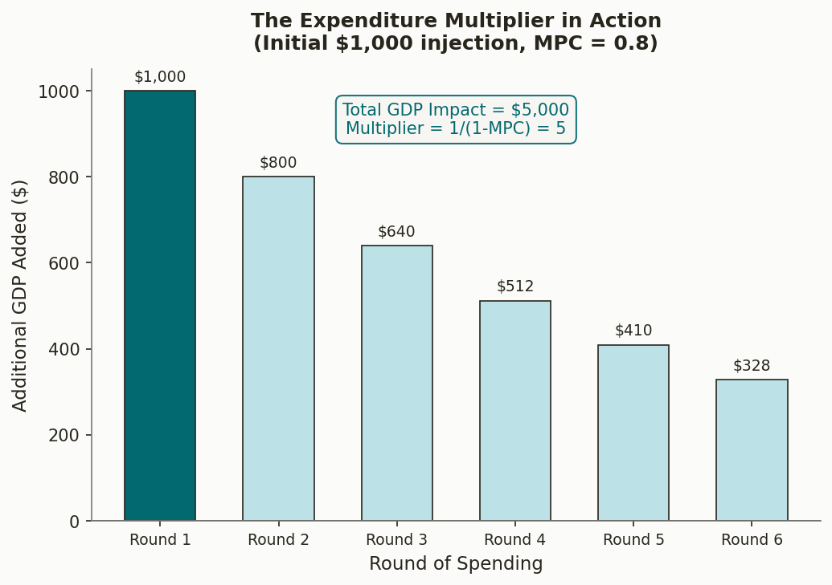
The Expenditure Multiplier
One dollar spent becomes more than one dollar of GDP
The Formula
Multiplier = 1 / (1 − MPC)
If MPC = 0.8: Multiplier = 1/0.2 = 5
$1,000 injection → $5,000 in new GDP
• Works like a ripple: your spending = my income = my spending = their income…
• Works in REVERSE too: investment collapse in 1929 → Great Depression amplified by multiplier.
• Multiplier is SMALLER for tax cuts (wealthy save more; MPC < 0.8 for high earners).
• Obama's 2009 stimulus (~$800B) relied on multiplier to produce ~$1.5–2T in GDP impact.
Notes:
SPEAKER NOTES – Expenditure Multiplier Stone-in-a-pond analogy: Drop a $1,000 stone of government spending into the economic pond. It creates a $1,000 ripple. That $1,000 becomes income for workers who spend 80% — $800 ripple. That $800 becomes $640 in new spending, and so on. The math sum is 1 / (1 - 0.8) = 5. Real-world caveat: Estimated multipliers for government spending range from 0.5 to 2.5 depending on economic conditions. They're LARGER when the economy has idle capacity (during recessions), and SMALLER when the economy is at full employment (just bids up prices instead). The negative multiplier: When investment collapsed by $500B in the Great Depression, the total GDP impact was much larger — this is why a financial panic can spiral into a decade-long depression.

Slide 7
The Phillips Curve
Inflation–unemployment tradeoff — but only in the short run
Short Run (SRPC)
Downward sloping: lower unemployment trades off with higher inflation. Policymakers boost AD → unemployment falls, inflation rises.
Supply Shocks Shift the Curve
1973 oil embargo: SRAS collapsed → both inflation AND unemployment rose simultaneously. "Stagflation" — Keynesian theory had no explanation.
Long Run (LRPC)
Once expectations adapt, the curve shifts up. No lasting tradeoff. Vertical at the natural rate of unemployment.
Notes:
SPEAKER NOTES – Phillips Curve Historical arc: A.W. Phillips (1958) observed data from UK 1861–1957 — lower unemployment correlated with higher wage growth. By the 1960s, U.S. policymakers used this as a policy menu: "choose" your combination. The 1970s shock: OPEC oil embargo (1973) caused production costs to soar → SRAS shifted left → prices rose AND output fell → unemployment went UP while inflation went UP. This broke the simple Keynesian model. Friedman-Phelps insight (1968, predicted before it happened!): The tradeoff only exists when people are surprised by inflation. Once workers expect 10% inflation, they demand 10% raises → the curve shifts up. The only permanent tradeoff is at the natural rate. Analogy: A speed-camera fine (inflation surprise) changes your driving. Once you know where all the cameras are (expectations adjust), you just drive that speed permanently — no net tradeoff.

Slide 8
Keynesian Policy Toolkit
Close the output gap by managing aggregate demand
EXPANSIONARY Fiscal/Monetary POLICY
CONTRACTIONARY Fiscal/Monetary POLICY
Fight a Recession
Fight Inflation
• ↑ Government spending (infrastructure, transfers)
• ↓ Government spending (reduce deficits)
• ↓ Taxes (more disposable income → ↑ C)
⇔
• ↑ Taxes (cool consumer spending)
• Central bank ↓ interest rates → ↑ Investment
• Central bank ↑ interest rates → ↓ Investment
• Goal: shift AD rightward to close recessionary gap
• Goal: shift AD leftward to close inflationary gap
Notes:
SPEAKER NOTES – Keynesian Policy Tools The accelerator vs. the brake: Expansionary = push the gas; Contractionary = apply the brakes. Key limitation Keynesians acknowledge: Government must correctly identify potential GDP (not easy), enact policy fast enough (legislative lag), and target spending efficiently. 2009 ARRA example: Economic Recovery Act of 2009 — $787B in tax cuts, infrastructure spending, and transfers. Economists Blinder & Zandi estimated it prevented GDP from falling an additional 3.3% and saved 8.5 million jobs. Classical liberal tension (relevant to your worldview): Keynesian policy requires trusting government to correctly diagnose, target, and time interventions. Public choice theory warns of political incentives that distort this — stimulus may become permanent spending, not countercyclical.

Slide 9
Neoclassical Foundations
In the long run, supply — not demand — determines output
Vertical LRAS
Potential GDP (Yp) is the anchor. It's set by the stock of labor, capital, technology — not by AD.
Flexible Wages & Prices
Recession → labor surplus → wages fall → SRAS shifts right → economy returns to Yp. No government needed — just time.
Rational Expectations
If people anticipate a policy, they adjust immediately. Example: home prices jump the day a new transit station is announced — before it's built.
Crowding Out
Government borrowing raises interest rates → private investment falls. Fiscal stimulus may be partly or fully offset.
Notes:
SPEAKER NOTES – Neoclassical Foundations Thermostat analogy: The economy has a built-in thermostat (flexible prices/wages). When it gets "cold" (recession), wages fall, businesses rehire, and the economy self-corrects back to 68°F (potential GDP). The debate: how long does that take — 2 years or 10 years? Crowding out explained: Government runs a deficit → borrows in loanable funds market → pushes up interest rates → a private business that was going to build a factory now can't afford the loan → private investment is "crowded out." Full crowding out = multiplier = 0. Rational expectations (Lucas critique): If everyone knows the Fed will boost money supply when unemployment rises, workers pre-emptively demand higher wages, negating the policy effect. This is why central banks prize credibility — surprise is necessary for policy to work.

Slide 10
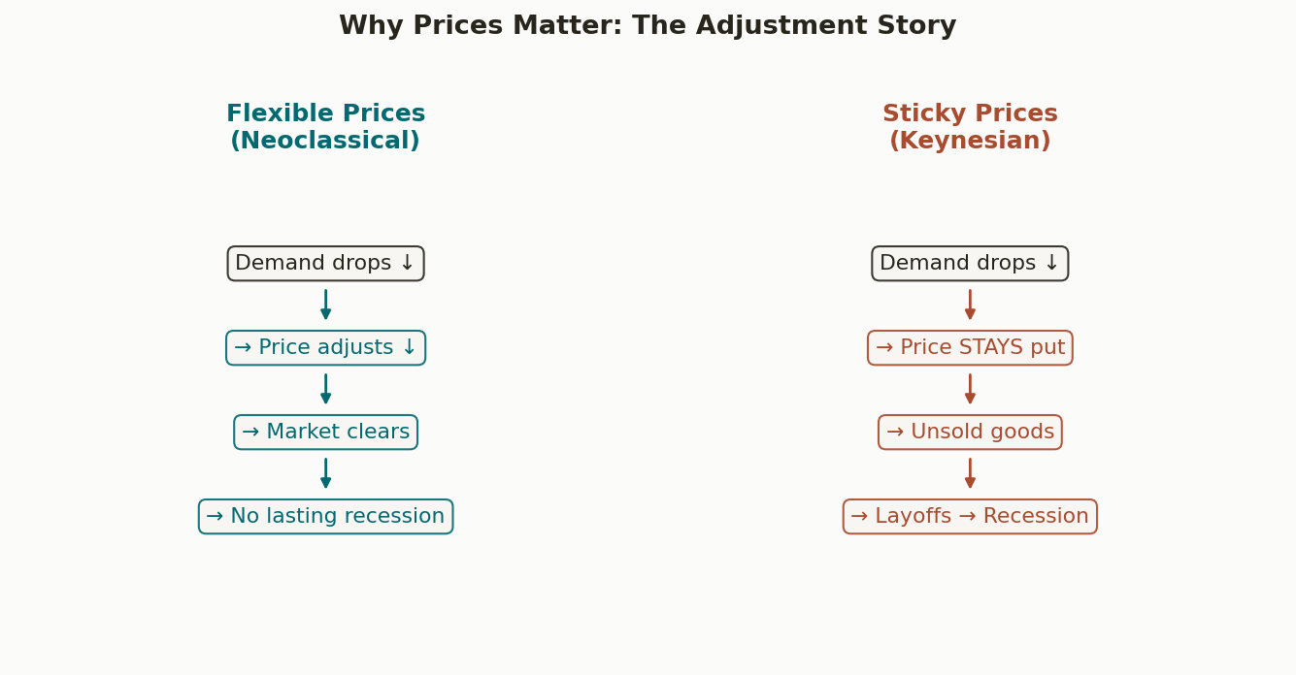
Long-Run Self-Correction
Sticky vs. Flexible: the adjustment mechanism in pictures
The Core Debate
Keynesian:
Adjustment is so slow that by the time markets self-correct, real damage is done — unemployment, lost output, scarred workers.
Neoclassical:
Active intervention creates new problems: inflation, crowding out, and distorted incentives. Self-correction is faster than Keynesians claim.
Empirical verdict:
2-5 years seems to be typical recovery speed in modern economies — meaning both views capture something real.
Notes:
SPEAKER NOTES – Self-Correction Keynes's famous quip: "In the long run we are all dead." He wasn't dismissing the long run — he was saying that a 10-year recession is not a policy success even if equilibrium eventually returns. Neoclassical retort: Prolonged government intervention can extend recessions (policy uncertainty, resource misallocation). Japan's "lost decade" (1990s) is sometimes cited — government stimulus didn't cure the structural problems. Modern synthesis: Most economists today believe adjustment takes 2–5 years in normal recessions, which is long enough that fiscal/monetary stimulus is useful. But in mild slowdowns, market correction may be faster than government response.

Slide 11
What Grows Potential GDP?
Long-run prosperity is a supply-side story
K
H
T
I
Physical Capital
Human Capital
Technology
Institutions
More machines, factories, and infrastructure per worker. The interstate highway system (1950s–70s) boosted productivity for decades.
Education & skills. U.S. college attainment: 2.5% (1900) → 33% (2019). Each degree adds to potential GDP permanently.
The biggest lever. GPS, computers, internet, AI — each shifts LRAS right without needing more workers or capital.
Rule of law, property rights, and stable money. McCloskey's Bourgeois Deal: 'let people have a go' — innovation follows.
Notes:
SPEAKER NOTES – Sources of Long-Run Growth Bathtub metaphor for potential GDP: Think of potential GDP as the SIZE of your bathtub (capacity). Keynesian policy is about how much water (spending) is in it. Neoclassical growth is about building a bigger bathtub. Technology is the magic multiplier: From 1953–1972, U.S. productivity grew 3.2%/year — largely due to the tech boom of electrification, computers, and interstate system. When productivity growth slowed (1973–1992, 1.8%/year), living standards grew slower. McCloskey connection (your Bourgeois Deal framework): Her thesis maps exactly onto the neoclassical growth story — the "Great Enrichment" of 30x living standards since 1800 is primarily an institutions-and-innovation story, not a redistribution story.

Slide 12
Neoclassical Policy Toolkit
Focus on the supply side and structural conditions
Price Stability First
Low & Predictable Taxes
Low, stable inflation is the foundation of long-run growth. Reduces uncertainty for business planning and investment.
Not just level, but stability. Constant tax changes reduce investment confidence. Supply-side: lower marginal rates → more incentive to produce.
01
02
Reduce Natural Unemployment
Rules over Discretion
Target frictional & structural, not cyclical. Better job-matching platforms, retraining programs, streamlined hiring rules.
Credible rules (e.g., inflation targeting, balanced budget rules) beat ad hoc intervention — removes policy uncertainty and anchors expectations.
03
04
Notes:
SPEAKER NOTES – Neoclassical Policy Tools Contrast with Keynesian: Keynesian policy is about the temperature of the water in the bathtub RIGHT NOW. Neoclassical policy is about the plumbing — get the pipes right and the economy flows efficiently on its own. Rules vs. discretion detail: The 2% inflation target adopted by the Fed (and most central banks) is a neoclassical insight. It anchors expectations — businesses sign 3-year contracts knowing inflation will be ~2%. Without rules, every policy change creates uncertainty that depresses investment. Natural unemployment policies: Examples include LinkedIn-style job matching (reduces frictional), community college retraining (reduces structural), deregulating barriers to hiring (reduces structural). These don't show up in the next quarter's GDP but matter enormously over 10 years. Classical liberal note: The neoclassical toolkit aligns well with classical liberal preferences — prefer rules over discretion, rely on markets, limit government activism. But even neoclassicals favor some role for policy in clear market failures.

Slide 13
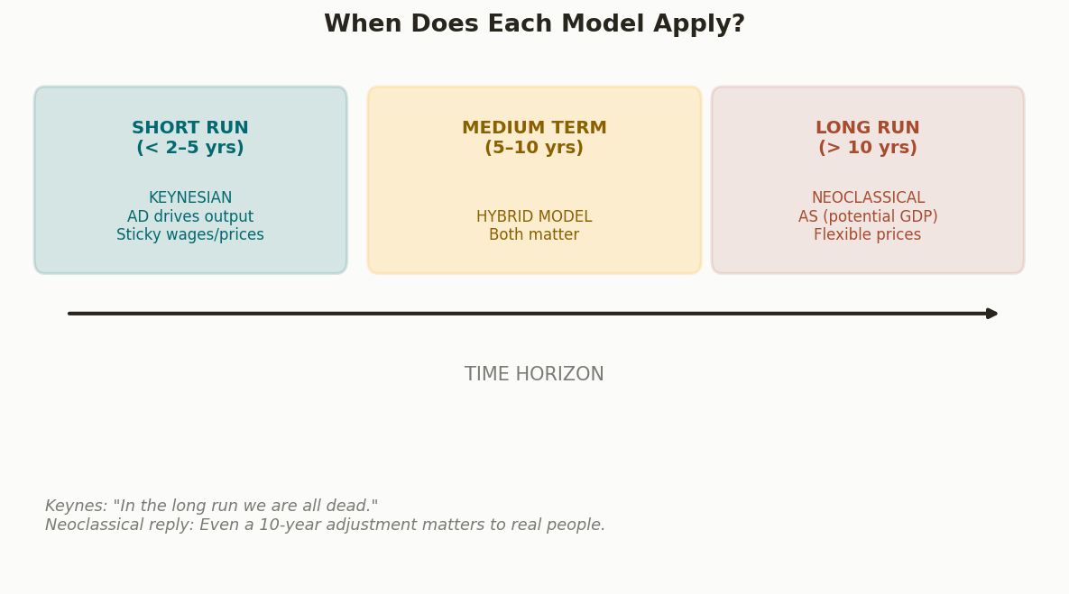
Balancing Both Models
Modern economists don't choose — they blend
Robert Solow's Synthesis
(Nobel 1987)
"At short time scales, something sort of 'Keynesian' is a good approximation.
At very long time scales, neoclassical framework.
At the 5-to-10-year scale, we have to piece things together."
Practical takeaway:
Neither camp fully controls the economic dashboard. Good policy borrows from both.
Notes:
SPEAKER NOTES – Balancing Both Models Two-horse circus analogy from OpenStax: A circus performer riding two horses simultaneously — one leg on each horse. When they run together, you ride fine. When they diverge, you have to shift weight. Modern macroeconomists shift weight between models depending on the economic conditions. Great Recession synthesis: During 2008-09, almost all economists — including neoclassically-oriented ones — supported some form of stabilization policy. The debate was about SIZE and TYPE, not whether to act. 2020 synthesis: The unusually fast Keynesian response (trillions in relief within weeks) was broadly praised. The neoclassical concern emerged later: too much stimulus when the economy was near potential GDP → inflation surge of 2021-22. Final takeaway for students: Don't memorize which "team" you're on. Learn to diagnose the patient first (short-run shock or long-run structural problem?) and apply the right toolkit.

Slide 14
Summary Comparison
Dimension | NEOCLASSICAL | KEYNESIAN
Time focus | Long run | Short run
Prices & wages | Flexible | Sticky
Output determined by | Aggregate Supply (LRAS) | Aggregate Demand
AS curve shape | Vertical | Upward-sloping (flat near Yp)
Phillips curve | Vertical (long run) | Downward-sloping (short run)
Unemployment target | Reduce natural rate (structural/frictional) | Eliminate cyclical via ↑ AD
AD as recession cure? | Only short-run / may cause inflation | Yes — primary tool
Policy style | Rules, supply-side, stability | Active countercyclical stabilization
Notes:
SPEAKER NOTES – Summary Table Use this as your study reference — everything from both chapters in one view. Test question prompt: "If the Fed raises interest rates, which school of thought would predict a larger impact on real GDP — Keynesian or Neoclassical? Why?" Keynesian answer: Rate hike → ↓ investment → multiplied decrease in AD → significant GDP drop (especially if economy is below potential). Neoclassical answer: Rate hike → prices adjust → economy returns to LRAS; only temporary output effect; main result is lower price level.

Slide 15
Key Takeaways
1
Keynesian: AD drives the economy in the SHORT RUN. Sticky prices mean recessions can persist — government must act.
2
Neoclassical: Potential GDP (LRAS) anchors the LONG RUN. Flexible wages/prices self-correct. Focus on structural reform.
3
Expenditure Multiplier: $1 of spending generates >$1 of GDP (if economy has slack). Works in reverse too — be careful.
4
Phillips Curve: Short-run inflation-unemployment tradeoff disappears when expectations adapt. No free lunch from inflation.
5
Stagflation broke the simple Keynesian model. Supply shocks matter — you can't just manage demand.
6
Neither school wins. Modern policy blends both: stimulus for sharp recessions, supply-side reform for long-run growth.
Notes:
SPEAKER NOTES – Key Takeaways Closing thought: Real-world economic debates are messy. During COVID-19, both schools of thought were applied simultaneously — immediate Keynesian stimulus AND neoclassical concern about supply-side labor market disruptions (people leaving the workforce). The classical liberal synthesis (relevant to your worldview): Keynes was right that markets can fail in the short run. But neoclassicals are right that the instinct to "fix" everything with government spending creates its own distortions. The wisdom is in knowing when to act and when to let markets work — and having the humility to acknowledge you might be wrong either way.

