Slide 1
Chapter 15
Monetary Policy and Bank Regulation
The Federal Reserve · Monetary Policy Tools · Bank Regulation
Notes:
Welcome to Chapter 15. This chapter explains how the Federal Reserve was created, how it regulates banks, and how its monetary policy tools pursue the Dual Mandate — maximum employment and price stability. By the end, students should be able to read a Fed news release and trace exactly what is happening and why.

Slide 2
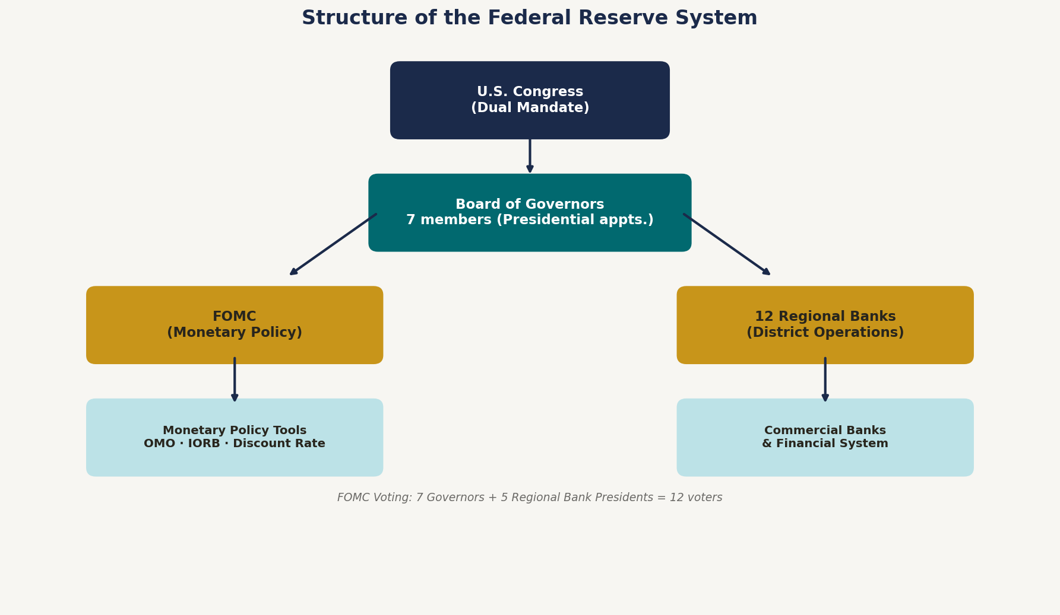
The Federal Reserve ("the Fed")
Central bank: the organization that conducts monetary policy and ensures the financial system runs smoothly.
Founded 1913 — to be the lender of last resort after repeated bank panics.
Bank for banks & government — private citizens have no accounts at the Fed.
Semi-decentralized: 7-member Board of Governors (DC) + 12 regional Federal Reserve Banks.
Analogy: The Banker's Banker
Just as your bank holds your deposits and lends to you, the Fed holds bank reserves and lends to banks in emergencies — shaping every interest rate you pay.
Designated driver analogy: the Fed stays sober (disciplined) when everyone else wants to party.
Operationally independent of the President and Congress day-to-day.
Notes:
The Fed's independence is by design. Politicians face election pressure to stimulate; the Fed can raise rates even when politically unpopular because governors serve staggered 14-year terms. Fact check: Verify current Fed Chair when delivering.

Slide 3
The Twelve Federal Reserve Districts
The Fed is a network — 12 regional banks carry policy out across the country.
Each District Bank...
[INSERT: Federal Reserve District Map]
www.federalreserve.gov/aboutthefed/federal-reserve-system.htm
Districts 1–12 with headquarters:
1 Boston · 2 New York · 3 Philadelphia · 4 Cleveland
5 Richmond · 6 Atlanta · 7 Chicago · 8 St. Louis
9 Minneapolis · 10 Kansas City · 11 Dallas · 12 San Francisco
Alaska & Hawaii → District 12 (San Francisco)
• Supervises commercial banks locally
• Gathers regional economic data
• Contributes presidents to the FOMC
Charlotte → District 5 (Richmond)
Richmond Fed covers VA, MD, NC, SC, WV. Charlotte is the 2nd-largest U.S. banking center — home to Bank of America HQ and Wells Fargo's East Coast hub.
Franchise Analogy
DC HQ sets policy; 12 regional branches execute it. Profits return to the U.S. Treasury (~$80B/year in normal times).
Notes:
The 12-district structure was a 1913 political compromise — Southern and Western legislators didn't want all power in New York. The NY Fed (District 2) is most influential: its president always votes on the FOMC, and its trading desk executes all open market operations. Charlotte note: Richmond Fed supervision decisions directly affect the largest employers in Charlotte's metro area.

Slide 4
What Does the Fed Do? Six Roles
1
Monetary Policy
2
Financial Stability
3
Banking Services
Dual Mandate:
• 2% inflation target
• Max employment (3.5–4.5% unemployment)
Monitor systemic risk; prevent crises from cascading through the financial system.
Banker to commercial banks and to the federal government; runs payment systems.
4
Bank Supervision
5
Consumer Protection
6
Lender of Last Resort
Examine balance sheets; enforce capital and reserve requirements.
Enforce fair lending laws; community development and outreach programs.
Emergency loans to solvent-but-illiquid banks during a financial crisis.
Roles 1 and 6 are the focus of this chapter: Monetary Policy and Lender of Last Resort.
Notes:
Key contrast: The European Central Bank (ECB) has a SINGLE mandate — price stability only. The Fed's dual mandate means it must weigh unemployment alongside inflation. Role 6 was the founding purpose of the Fed in 1913, born from the Panic of 1907 when J.P. Morgan personally organized a private bank bailout. Congress decided the country needed a permanent institution for that role.

Slide 5
Bank Regulation
Goal: Keep banks solvent by constraining excessive risk-taking.
Reserve Requirements
Capital Requirements
Investment Restrictions
Min. % of deposits kept on hand.
Current rate: 0%
(suspended March 2020 — effectively inactive).
Min. equity as % of assets — the bank's loss cushion before depositors are harmed.
Analogy: like a mortgage down payment.
Limits on risky assets — banks can't speculate freely with depositor funds.
Strengthened by Dodd-Frank (2010).
Who Enforces This?
OCC (Office of the
Comptroller of Currency)
NCUA (Nat'l Credit
Union Administration)
The Federal Reserve
Within U.S. Treasury;
oversees national banks
Regulates federally
chartered credit unions
Oversees bank holding
companies & state members
Capital analogy: A down payment means you have skin in the game — making you more careful about risk.
Notes:
The 2008 crisis was largely a capital requirements failure — banks held toxic MBS rated AAA, with equity cushions too thin to absorb losses. Dodd-Frank and Basel III dramatically raised requirements afterward. Discussion: Why did 2008 happen despite regulation? Regulatory gaps (off-balance-sheet vehicles), perverse rating agency incentives, and regulatory capture.

Slide 6
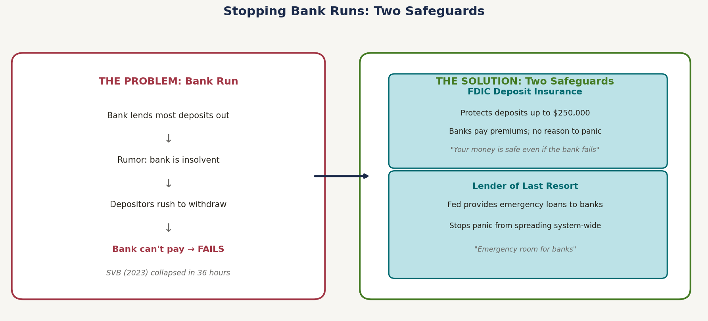
Deposit Insurance and Lender of Last Resort
SVB (March 2023): $42B withdrawn in one day. With $209B in assets, SVB collapsed in 36 hours — the 2nd-largest U.S. bank failure. FDIC covers up to $250,000 per depositor per bank.
Notes:
Bank run = coordination failure / self-fulfilling prophecy. FDIC insurance breaks the cycle — no reason to panic if your deposit is guaranteed regardless of what others do. SVB detail: Long-duration Treasuries lost market value as rates rose 2022–23. Tech startup depositors (many above $250k FDIC limit) communicated via Slack. A prominent VC firm tweeted 'withdraw now' on March 9, 2023; $42B fled in one day. Lender of last resort analogy: like a hospital ER — prevents death, not illness. Key: the Fed lends only to solvent-but-illiquid banks, not insolvent ones.

Slide 7
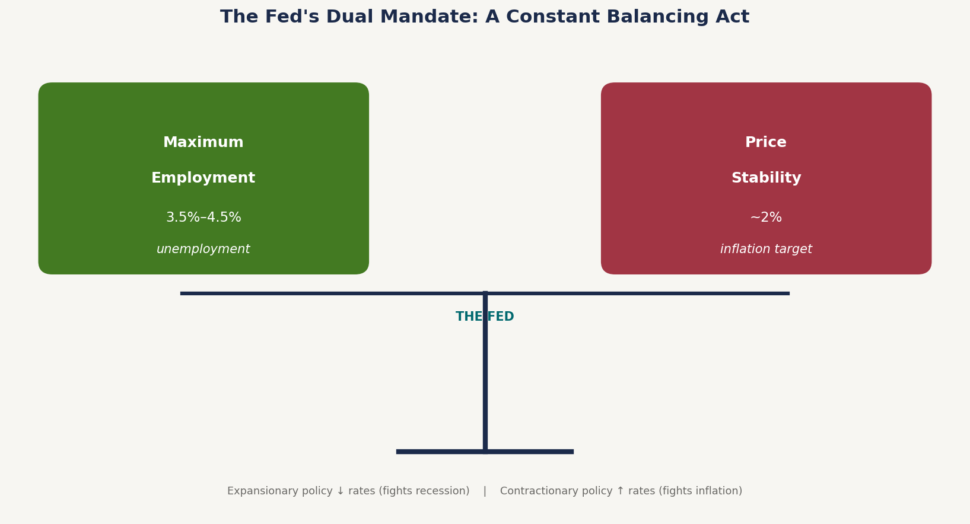
The Purpose of Monetary Policy
EXPANSIONARY — Fight Recession
↓ Interest rates
→ ↑ Borrowing → ↑ C + I Spending
→ ↑ Aggregate Demand
→ ↑ Real GDP, ↓ Unemployment
Trade-off: may ↑ Inflation
CONTRACTIONARY — Fight Inflation
↑ Interest rates
→ ↓ Borrowing → ↓ C + I Spending
→ ↓ Aggregate Demand
→ ↓ Price level, ↓ Real GDP
Trade-off: may ↑ Unemployment
Thermostat analogy: the Fed turns up the heat (↓ rates) in a recession and cools things down (↑ rates) during inflation. Every adjustment has trade-offs — there is no perfect setting.
Notes:
Stress the trade-offs — expansionary risks inflation; contractionary risks unemployment. The Fed judges which threat is more dangerous at any given moment. Real example: The Fed's 2022–23 rate-hiking cycle (fastest since the 1980s) was contractionary policy responding to post-pandemic inflation above 8%. The soft landing outcome — taming inflation without recession — was relatively rare and instructive. Classical liberal perspective: Many favor rules-based policy (Taylor Rule) over pure discretion to reduce uncertainty.

Slide 8
Federal Open Market Committee (FOMC)
The FOMC sets monetary policy — specifically the federal funds rate target range.
FOMC Members
Votes Each Meeting
Meetings Per Year
19
12
8
All 7 Board Governors
+ All 12 Regional Bank Presidents
7 Governors (always)
+ NY Fed President (always)
+ 4 others rotate annually
Every ~6–7 weeks
in Washington, D.C.
Why does NY always vote? The NY Fed executes all open market operations — its president can never sit out monetary policy decisions.
Notes:
After each meeting, the FOMC releases a carefully worded statement. Quarterly it publishes the 'dot plot' — each member's anonymous forecast for the future funds rate. Financial markets analyze every word. Forward guidance — signaling future intentions — is itself a policy tool. It influences long-term rates through expectations without moving the rate today. Fun fact: The FOMC statement goes through dozens of drafts reviewed by lawyers, economists, and communications staff before release.

Slide 9
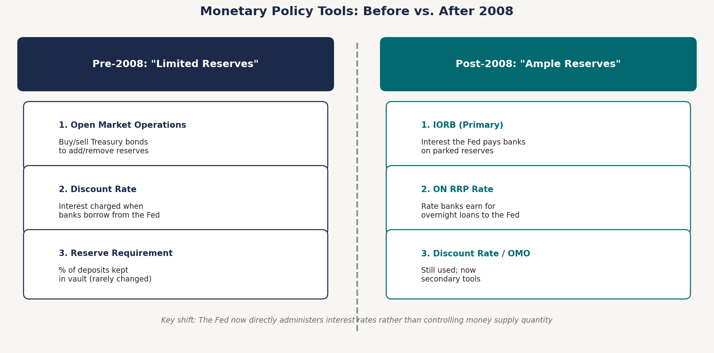
Monetary Policy Tools: Two Eras
2008 turning point: Crisis response flooded banks with reserves (QE). With abundant reserves, quantity-based tools lost traction — the Fed shifted to directly administering interest rates. Same macro destination; different plumbing.
Notes:
Pre-2008: scarce reserves → Fed controls quantity to move the price (rate). Post-2008: abundant reserves → FFR collapses to zero without IORB. The Fed sets the price directly; banks arbitrage the market into line. Analogy: Pre-2008 = a plumber controlling water flow by adjusting the pipe valve (quantity). Post-2008 = a thermostat — just set the temperature (rate) and the system self-adjusts.

Slide 10
Pre-2008 Tools: How They Work
Era of "Limited Reserves" — Fed controls the quantity of reserves to move interest rates.
1
Open Market Operations (OMO)
Expansionary: Fed BUYS bonds → injects reserves → ↑ money supply → ↓ rates
Contractionary: Fed SELLS bonds → drains reserves → ↓ money supply → ↑ rates
Primary pre-2008 tool. Conducted daily by the NY Fed trading desk.
2
Discount Rate
Expansionary: Fed LOWERS rate → banks borrow cheaply from Fed → ↑ reserves → ↓ rates
Contractionary: Fed RAISES rate → banks borrow less from Fed → ↓ reserves → ↑ rates
Interest charged at the Fed's discount window. Also signals Fed intent.
3
Reserve Requirement
Expansionary: Fed LOWERS req't → banks lend more → ↑ money multiplier → ↓ rates
Contractionary: Fed RAISES req't → banks lend less → ↓ multiplier → ↑ rates
Currently 0% (suspended March 2020). Effectively inactive in today's system.
Notes:
Short-term rates: money market supply and demand. Long-term rates: loanable funds market. OMO analogy: Think of the Fed as a giant Venmo user. When it buys bonds, it Venmos reserves into the banking system; when it sells, it Venmos them back out. Key chain: Buy bonds → more reserves → banks lend more → money supply rises → interest rates fall.

Slide 11
Pre-2008 Policy: Summary
Headline: Economy Weakening
Headline: Inflation Rising Above 2%
↓ Employment | Inflation near or below 2%
Inflation above target | Unemployment very low
→ Expansionary Policy
→ Contractionary Policy
Actions:
Actions:
OMO: Buy Treasury bonds
OMO: Sell Treasury bonds
Lower the Discount Rate
Raise the Discount Rate
Lower Reserve Requirement (rarely)
Raise Reserve Requirement (rarely)
Result:
Result:
↑ Money Supply
↓ Money Supply
↓ Interest Rates
↑ Interest Rates
↑ C + I → ↑ Aggregate Demand
↓ C + I → ↓ Aggregate Demand
↑ Real GDP, ↓ Unemployment
↓ Price Level, ↓ Real GDP
Trade-off: possible ↑ Inflation
Trade-off: possible ↑ Unemployment
Notes:
Primary exam summary for pre-2008. Students should trace: Conditions → Policy type → Tool actions → Money supply → Interest rate → Spending → AD → GDP/inflation outcome. Expansionary chain: buy bonds / ↓ rates → ↑ money → ↓ interest rates → ↑ spending → ↑ GDP. Contractionary chain: sell bonds / ↑ rates → ↓ money → ↑ rates → ↓ spending → ↓ inflation.

Slide 12
Post-2008 Era: "Ample Reserves" — How It Works
FOMC sets a target range for the Federal Funds Rate (FFR) — e.g., 4.25%–4.50%.
Federal Funds Rate (FFR): the rate banks charge each other for overnight reserve loans — all broader market rates (mortgages, auto loans, business loans) follow it.
1. IORB (Primary Tool)
2. ON RRP Rate (Secondary Floor)
3. Discount Rate & OMO
Interest on Reserve Balances — what the Fed pays banks that park reserves at the Fed overnight.
• Fed ↑ IORB → banks prefer Fed deposit → ↑ demand in fed funds market → ↑ FFR
• Fed ↓ IORB → banks prefer lending out → ↑ supply in market → ↓ FFR
Mechanism: arbitrage (next slide).
Overnight Reverse Repo Rate — what the Fed pays non-bank institutions (money market funds) that lend to the Fed overnight.
Sets a floor for the FFR: no institution lends in the market at below what the Fed pays.
Works with IORB to hold FFR in its target band.
Same mechanics as pre-2008.
Discount Rate: now mainly a ceiling and signaling tool.
OMO / QE / QT: adjusts total reserve volume — no longer the primary rate-setting tool.
Notes:
Key shift: pre-2008 = control quantity to move price. Post-2008 = set price directly. IORB as a floor: A bank earning 5% risk-free at the Fed will never lend in the fed funds market below 5%. ON RRP for non-banks: money market funds can't earn IORB (only member banks can), so ON RRP serves as their floor. Together: IORB floor + Discount Rate ceiling = a corridor that keeps FFR reliably in its target range.

Slide 13
How IORB Controls the FFR: Arbitrage
Arbitrage: profiting from a price difference between two markets — until competition eliminates the gap.
Scenario A: Raise IORB → Raise FFR
Scenario B: Lower IORB → Lower FFR
1
Fed raises IORB: 2.0% → 2.5%
1
Fed lowers IORB: 2.5% → 2.0%
2
Opportunity: borrow in fed funds market at 2.0%, deposit at Fed at 2.5% = 50 bps profit
2
Opportunity: lend in fed funds market at 2.5% vs. depositing at Fed at 2.0%
3
Banks borrow more in the fed funds market
3
Banks withdraw reserves from Fed, lend into the market
4
Other banks copy the trade → demand for reserves surges
4
Other banks copy the trade → supply of reserves surges
5
Competition drives the FFR up toward 2.5%
5
Competition drives the FFR down toward 2.0%
6
Profit disappears. FFR ≈ IORB ✓
6
Profit disappears. FFR ≈ IORB ✓
Notes:
Arbitrage is the self-correcting mechanism. The Fed sets IORB; profit-seeking banks equilibrate the market within hours. ATM analogy: Two ATMs side by side. ATM A: 2.0%. ATM B (the Fed): 2.5%. Every rational bank uses ATM B — until competition for ATM B deposits drives ATM A's rate up to match. That's IORB arbitrage. The IORB floor and Discount Rate ceiling create a corridor. Any FFR deviation triggers immediate profit-seeking behavior that corrects it — usually within the same trading day.

Slide 14
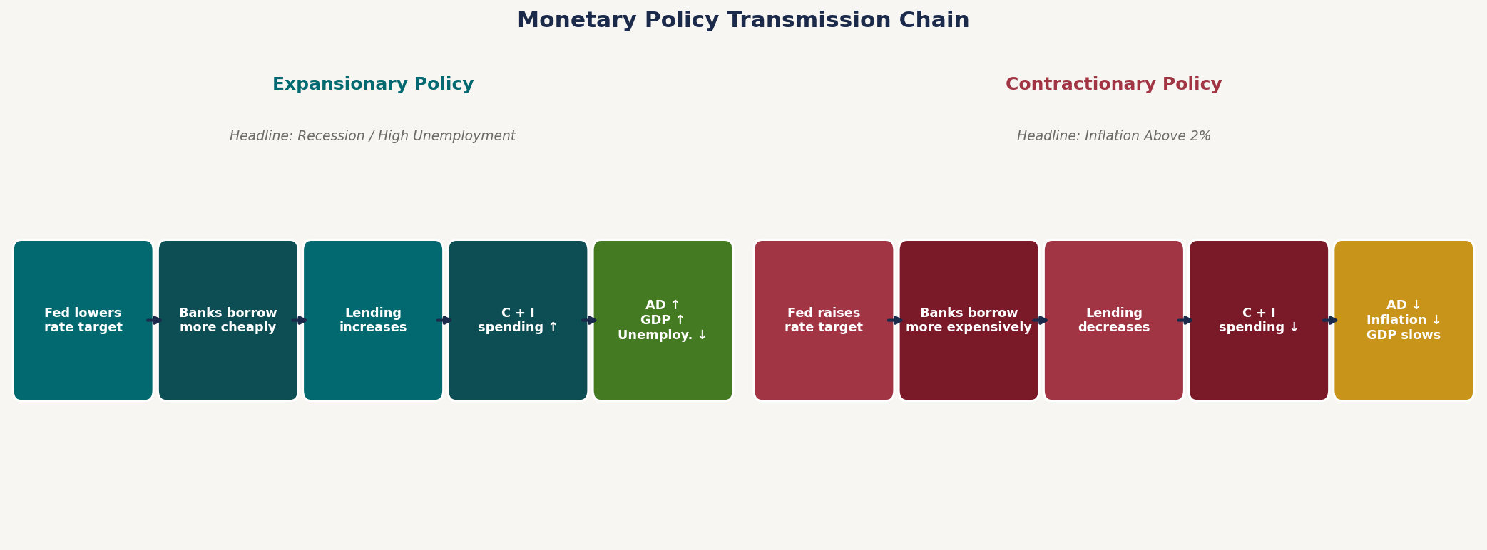
Post-2008 Policy: The Full Transmission Chain
FOMC Action
Administered Rates
Market Rates
Economic Effect
Recession
↓ FFR Target
↓ IORB, ↓ ON RRP
↓ All lending rates
↑ GDP, ↓ Unemployment
Inflation
↑ FFR Target
↑ IORB, ↑ ON RRP
↑ All lending rates
↓ Inflation, ↓ AD
Same macro destination as pre-2008: lower rates stimulate, higher rates cool. What changed is the plumbing — administered rates replace quantity control.
Notes:
This slide ties the whole chapter together. Post-2008 transmission is functionally identical to pre-2008 at the macro level. What changed is the implementation — not the economics. Exam strategy: For any monetary policy question: 1. What is the headline condition? (recession or inflation) 2. What type of policy? (expansionary or contractionary) 3. What tool actions follow? The rest of the chain — rates → spending → AD → GDP/inflation — is always the same.

