Slide 1
CANDLE Overview
ECP Annual Meeting, Houston, TX February 2020
John Gounley Computational Sciences and Engineering Division
Oak Ridge National Laboratory
gounleyjp@ornl.gov
www.ExascaleProject.org

Slide 2
Talk Outline
Background
Project Goals
CANDLE Environment
Repository

Slide 3
CANDLE Background
DOE-NCI Partnership
Joint Design of Advanced Computing Solutions for Cancer (JDACS4C)
Cancer Moonshot & National Strategic Computing Initiative
ANL, LLNL, LANL, ORNL, and Fredrick National Lab for Cancer Research
Accelerate precision oncology capabilities
3 application-focused Pilots
2 cross-cutting initiatives
Uncertainty quantification
Scalable deep learning (CANDLE)
NCI
National Cancer Institute
Computing driving cancer advances
DOE
Department
of Energy
Cancer driving computing advances

Slide 4
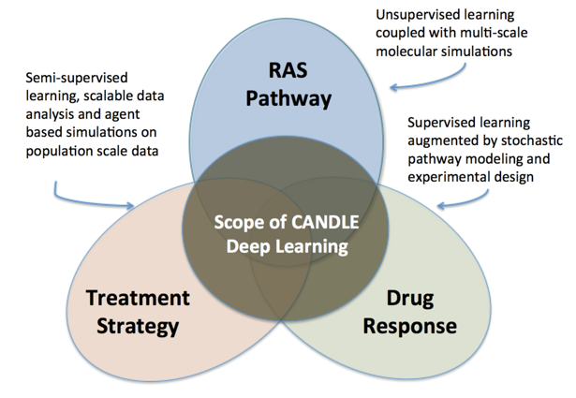
JDACS4C Pilots
Pilot 1: Pre-clinical models
Predictive patient drug response models
PI: Rick Stevens (ANL)
Pilot 2: Biological models
Multi-scale computational biological models
PI: Fred Streitz (LLNL)
Pilot 3: Cancer Surveillance
Insight into factors impacting clinical response
PI: Gina Tourassi (ORNL)

Slide 5
Team
Argonne
Tom Brettin
Nick Collier
Rajeev Jain
Jonathan Ozik
Arvind Ramanathan
Rick Stevens
Richard Turgeon
Justin Wozniak
Fangfang Xia
Harry Yoo
…
Fredrick
Andrew Weisman
George Zaki
…
Livermore
Brian van Essen
Sam Ade Jacobs
Adam Moody
…
Los Alamos
Christina Garcia-Cardona
Jamal Mohd Yusof
…
Oak Ridge
Shang Gao
John Gounley
Hong-Jun Yoon
Todd Young
…

Slide 6
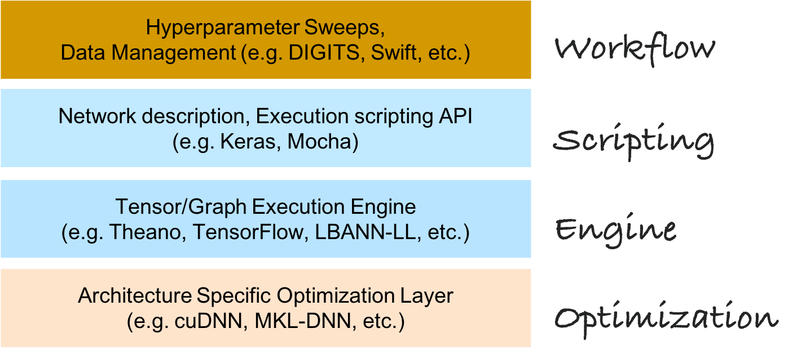
The CANDLE Environment

Slide 7
Project Goals
Provide API for deep learning on DOE supercomputers
CANDLE Library
Facilitate dependencies, IO, UQ, visualization, profiling
Support general set of deep learning workflows
CANDLE Supervisor
Portable across DOE computing platforms
Produce example proxy application models for vendors and users
CANDLE Benchmarks
Pilot-based deep learning models

Slide 8
Repository
Links
Codebase: https://github.com/ECP-CANDLE
Documentation: https://ecp-candle.github.io/Candle
Repos
Benchmarks (includes CANDLE library)
Supervisor
Tutorials

Slide 9
Acknowledgments
This research was supported by the Exascale Computing Project (ECP), Project Number: 17-SC-20-SC, a collaborative effort of two DOE organizations - the Office of Science and the National Nuclear Security Administration, responsible for the planning and preparation of a capable exascale ecosystem, including software, applications, hardware, advanced system engineering and early testbed platforms, to support the nation's exascale computing imperative.
www.ExascaleProject.org

