Slide 1
CANDLE Tutorial: Agenda
John Gounley (ORNL)
Jamal Mohd-Yusof (LANL)
Justin M. Wozniak (ANL)
Hong-Jun Yoon (ORNL)
2:30 High-level introductions
2:30 CANDLE Overview - Gounley
2:40 Software installation - Wozniak 2:45 CANDLE Library - Mohd-Yusof
3:00 CANDLE Workflows – Wozniak
3:15 Use of Summit features – Yoon
3:30 Break - installations in progress
4:00 Advanced workflows
4:00 NAS & PBT - Gounley
4:20 Data analysis workflow - Wozniak
4:40 The CANDLE DB & Restarts - Wozniak
5:00 Hands-on session
Wozniak - Noise workflow
Gounley/Yoon - NAS and bagging/ensembling
Mohd-Yusof - Libraries
5:45 Concluding questions & discussion - Wozniak
6:00 Dismissal
www.ExascaleProject.org

Slide 2
Talk Outline
Introduction
Benefits
Library Overview
Example Benchmark Workflow
Simple Parameter Sweeps

Slide 3
Introduction
Purpose
To streamline the writing of CANDLE-compliant codes
Allow rapid prototyping and exploration of hyperparameters
Integrate with the Supervisor framework
Historical perspective
Consolidation of frequently used functionality from the Benchmark codes
Evolving to incorporate new functionality as needed
Improved usability over time

Slide 4
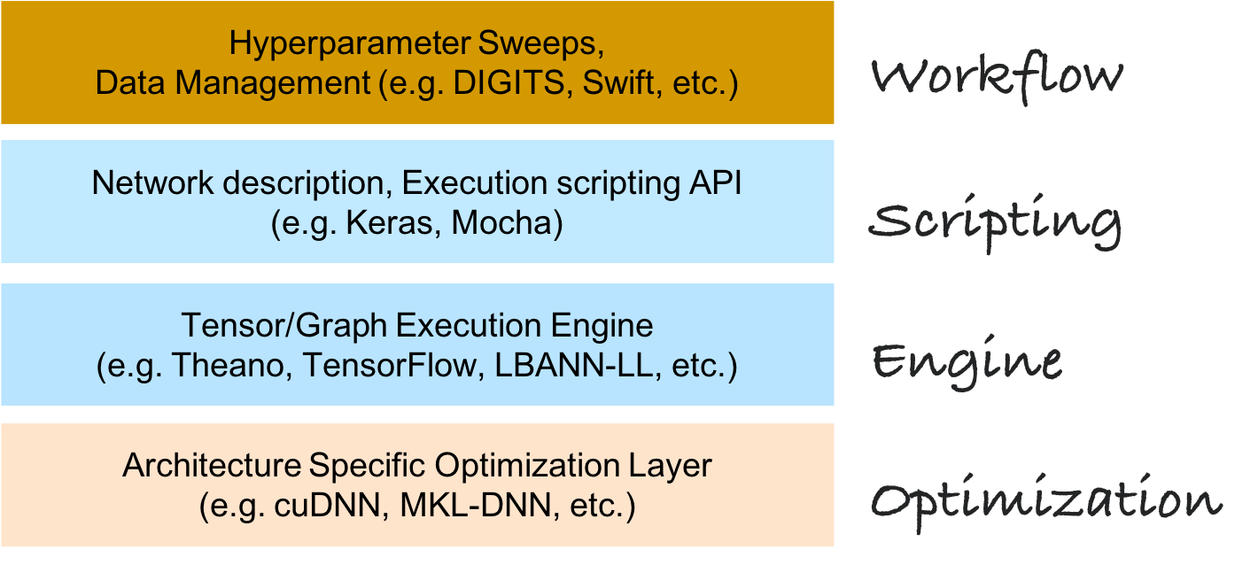
The CANDLE Environment

Slide 5
Benefits provided by CANDLE
Consistent
Standardized network specification with a “default_model_file”
Standardized command line intercept protocol
Standardized default values across frameworks
Ideal for testing the same problems with consistency on new DOE hardware
Convenient
Pass arguments via command line
Standard keywords parsed automatically, user can add new ones
Modify the default file
Provide a new default model specification ‘--config_file new_default_model.txt’

Slide 6
Benefits provided by CANDLE
Provides various utility packages that promote reuse and streamline code development
Actively developed, new functionality based on need
Provides the pathway for inferencing, data-parallelism, automated sweeps of hyperparameters
Availability of a robust framework for documentation and testing
Pre-existing for containers such as Singularity (Ex. machines such as Theta, Titan, Cori, summitdev)
Documentation: https://ecp-candle.github.io/Candle/html/index.html

Slide 7
Library Overview
Integrated into the scripting level of CANDLE stack
Keras-based (for now)
Allows multiple backends (Tensorflow, CNTK, etc)
Provides a single namespace for inclusion of useful functions into Benchmark codes
Allows developers to decide which functions are exposed to users
candle_keras directory with __init__.py file sets included functions
Allows reuse of non-Keras specific functions to create libraries for other languages

Slide 8
Library organization
Utilities are organized by functionality
Transparent to the user, mostly framework agnostic
default_utils: create, modify parameter dictionary
file_utils: fetch and unpack da†a files
data_utils: load and manipulate data, enable UQ (via uq_utils)
generic_utils: callback function, standardize screen output
keras_utils: translation from CANDLE keywords, enhance Keras functionality
solr_keras: database functionality
viz_utils: visualize networks and output (prototype)

Slide 9
Example Benchmark Workflow
initialize_parameters:
Read default values for the model from default_model.txt file
Automatically parse many standard ML hyperparameters
learning_rate, batch_size, etc
data_url, train_data, test_data…
Allows user to add other keywords via additional_definitions
Sets undefined hyperparameters to the corresponding Keras defaults to ensure consistency across backend frameworks
Early work revealed some performance differences were due to mismatched default settings

Slide 10
Example Benchmark Workflow
Data management
fetch_data
Check if local data copy exists; if not, fetch data from data_url
allows separate train_data and test_data files, check MD5 hash if provided, untar if needed
load_data
Load labeled (xy) or unlabeled (x) data, perform various manipulations
Shuffle, scale, split into {train, validation, test}
Takes UQ operations to provide repeatable cross-validation data splits

Slide 11
Example Benchmark Workflow
Model build
keras_utils translates CANDLE keywords into Keras methods
e.g. optimizer, initializer specification
Extends Keras functionality where useful
PermanentDropout
default_utils adds default EXP000 and RUN000 directory structure
solr_keras adds monitoring and logging
Timeout functionality to respect job limits

Slide 12
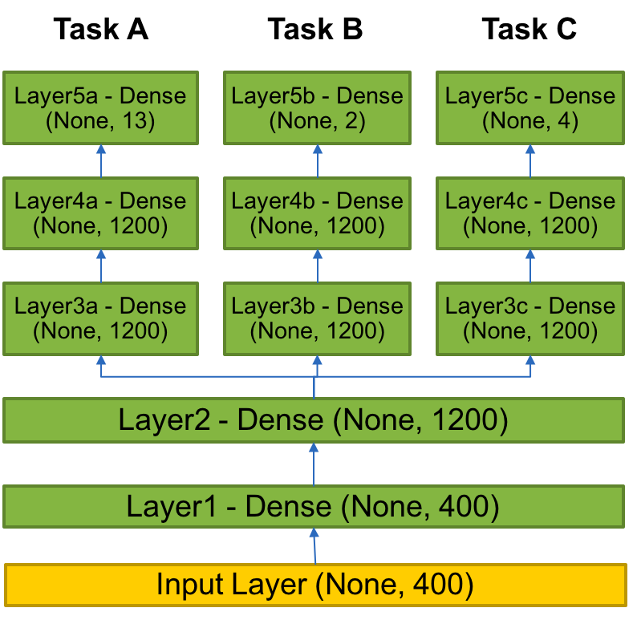
Example benchmark
P3B1: Multi-task Deep Neural Net (DNN) for data extraction from clinical reports
Overview: Given a corpus of patient-level clinical reports, build a deep learning network that can simultaneously identify:(i) b tumor sites, (ii) t tumor laterality, and (iii) g clinical grade of tumors.
Relationship to core problem: Instead of training individual deep learning networks for individual machine learning tasks, Build a multi-task DNN that can exploit task-relatedness to simultaneously learn multiple concepts.
Expected outcome: Multi-task DNN that trains on same corpus and can automatically classify across three related tasks.

Slide 13
Original code
shared_nnet_spec= [ 1200 ]
individual_nnet_spec0= [ 1200, 1200 ]
individual_nnet_spec1= [ 1200, 1200 ]
individual_nnet_spec2= [ 1200, 1200 ]
individual_nnet_spec = [ individual_nnet_spec0, individual_nnet_spec1, individual_nnet_spec2 ]
learning_rate = 0.01
batch_size = 10
n_epochs = 10
dropout = 0.0
## Read files
from data_utils import get_file
origin = 'http://ftp.mcs.anl.gov/pub/candle/public/benchmarks/P3B1/P3B1_data.tgz’
data_loc = get_file('P3B1_data.tgz', origin, untar=True, md5_hash=None, cache_subdir='P3B1')

Slide 14
CANDLE code
gParameters = initialize_parameters()
….
# input layer
layer = Input( shape = ( input_dim, ), name= 'input' )
shared_layers.append( layer )
# shared layers
for k in range( len( shared_nnet_spec ) ):
layer = Dense( shared_nnet_spec[ k ], activation=gParameters['activation'],
name= 'shared_layer_' + str( k ) )( shared_layers[ -1 ] )
if gParameters['drop'] > 0:
layer = Dropout( gParameters['drop'] )( shared_layers[ -1 ] )
shared_layers.append( layer )
# individual layers
……

Slide 15
CANDLE model file
data_url = 'ftp://ftp.mcs.anl.gov/pub/candle/public/benchmarks/P3B1/’
train_data = 'P3B1_data.tar.gz’
model_name = 'p3b1’
learning_rate = 0.01
batch_size = 10
epochs = 10
drop = 0.0
activation = 'relu’
out_activation = 'softmax’
loss = 'categorical_crossentropy’
optimizer = 'sgd’
metrics = 'accuracy’
n_fold = 1
shared_nnet_spec = '1200’
ind_nnet_spec = '1200, 1200:1200, 1200:1200, 1200’
feature_names = 'Primary site:Tumor laterality:Histological grade’
timeout =1800
scaling = 'none’
output_dir = '.’
initialization='glorot_uniform’

Slide 16
Simple parameter exploration
Provide a new default model specification
‘--config_file new_default_model.txt’
Overwrite individual parameters in the default model
‘--learning_rate 0.1 –drop 0.1’
Provides an easy way to perform individual experiments to probe the hyperparameter space
python myDNN.py –learning_rate 0.01 –run_id “run1”
python myDNN.py –learning_rate 0.02 –run_id “run2”
Provides the pathway for automated sweeps of hyperparameters
→ Supervisor workflows

Slide 17
Acknowledgments
This research was supported by the Exascale Computing Project (ECP), Project Number: 17-SC-20-SC, a collaborative effort of two DOE organizations - the Office of Science and the National Nuclear Security Administration, responsible for the planning and preparation of a capable exascale ecosystem, including software, applications, hardware, advanced system engineering and early testbed platforms, to support the nation's exascale computing imperative.
www.ExascaleProject.org

