Slide 1
CANDLE Overview
ECP Annual Meeting, Houston, TX February 2020
John Gounley Computational Sciences and Engineering Division
Oak Ridge National Laboratory
gounleyjp@ornl.gov
www.ExascaleProject.org

Slide 2
Talk Outline
Background
Project Goals
CANDLE Environment
Repository

Slide 3
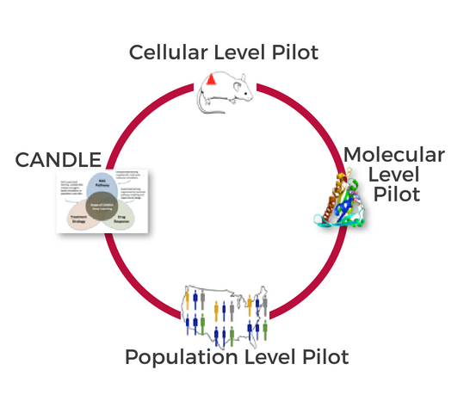
Background
DOE-NCI Partnership
Joint Design of Advanced Computing Solutions for Cancer (JDACS4C)
ANL, LLNL, LANL, ORNL, and Fredrick National Lab for Cancer Research
3 multi-disciplinary cancer-focused pilot projects
Molecular level
Cellular level
Population level
Uncertainty quantification
CANcer Distributed Learning Environment (CANDLE)

Slide 4
Project Goals
Provide API for deep learning on DOE supercomputers
CANDLE Library
Facilitate dependencies, IO, UQ, visualization, profiling
Support general set of deep learning workflows
CANDLE Supervisor
Portable across DOE computing platforms
Produce optimized models for CORAL2 systems
CANDLE Benchmarks
Pilot-based deep learning models

Slide 5
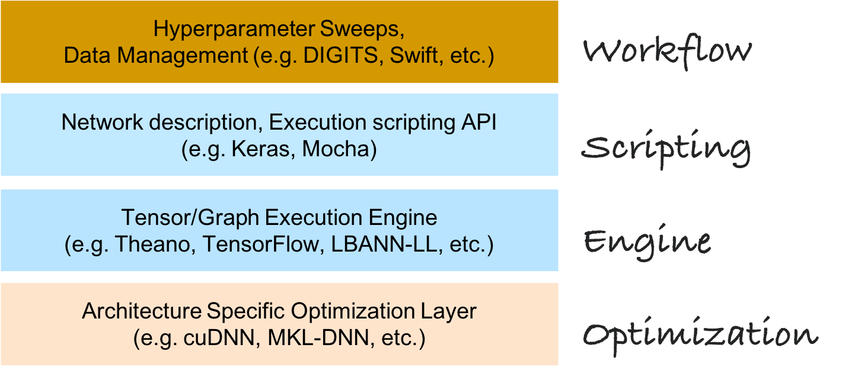
The CANDLE Environment

Slide 6
Repository
Links
Codebase: https://github.com/ECP-CANDLE
Documentation: https://ecp-candle.github.io/Candle
Repos
Benchmarks (includes CANDLE library)
Supervisor
Tutorials

Slide 7
Acknowledgments
This research was supported by the Exascale Computing Project (ECP), Project Number: 17-SC-20-SC, a collaborative effort of two DOE organizations - the Office of Science and the National Nuclear Security Administration, responsible for the planning and preparation of a capable exascale ecosystem, including software, applications, hardware, advanced system engineering and early testbed platforms, to support the nation's exascale computing imperative.
www.ExascaleProject.org

