Slide 1
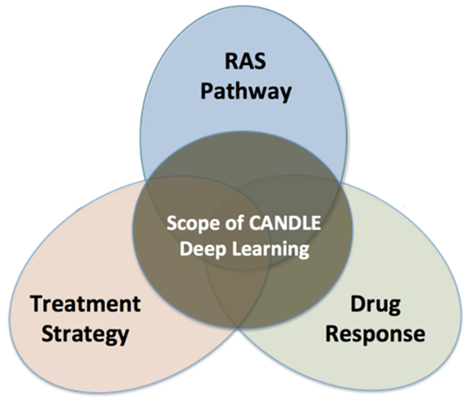
An Introduction to Scalable Deep Learning with CANDLE
OPTIMAL DEEP LEARNING On Large-scale computers
erhtjhtyhy
Justin M Wozniak
JAMAL MOHD-YUSOF
Computer Scientist
Mathematics & Computer Science
Argonne National Laboratory
Los Alamos National Laboratory
Exascale Computing Project 2nd Annual Meeting
February 6, 2018

Slide 2
OUTLINE
Overview of CANDLE project
Deep learning benchmarks
Introduction to neural networks and Keras
Tutorial: CANDLE Benchmark structure
Overview of hyperparameter optimization
Introduction to hyperparameter optimization
Workflow-based solution: EMEWS
Machine learning applications in cancer research: CANDLE/Supervisor
Tutorial: Hyperparameter pptimization of a CANDLE Benchmark

Slide 3
CANDLE TUTORIALS
May be found here: https://github.com/ECP-CANDLE/Tutorials
See the top-level README to get started with the installation

Slide 4
CaNcer Deep Learning Environment (CANDLE)

Slide 5
CANDLE
CANDLE (PI: Rick Stevens) is an Argonne led multi-DOE lab collaboration developing a suite of software to support scalable deep learning for cancer applications on DOE supercomputing resources
Funded by the DOE Exascale Computing Project
Developing implementations of deep neural networks on targeted problems related to the three core DOE-NCI Joint Design of Advanced Computing Solutions for Cancer (JDACS4C) pilot projects
CANDLE/Supervisor: https://github.com/ECP-CANDLE/Supervisor

Slide 6
CANDLE Software Stack
Hyperparameter Sweeps,
Data Management (e.g. DIGITS, Swift, etc.)
Workflow
Network description, Execution scripting API
(e.g. Keras, Mocha)
Scripting
Tensor/Graph Execution Engine
(e.g. Theano, TensorFlow, LBANN-LL, etc.)
Engine
Architecture Specific Optimization Layer
(e.g. cuDNN, MKL-DNN, etc.)
Optimization

Slide 7
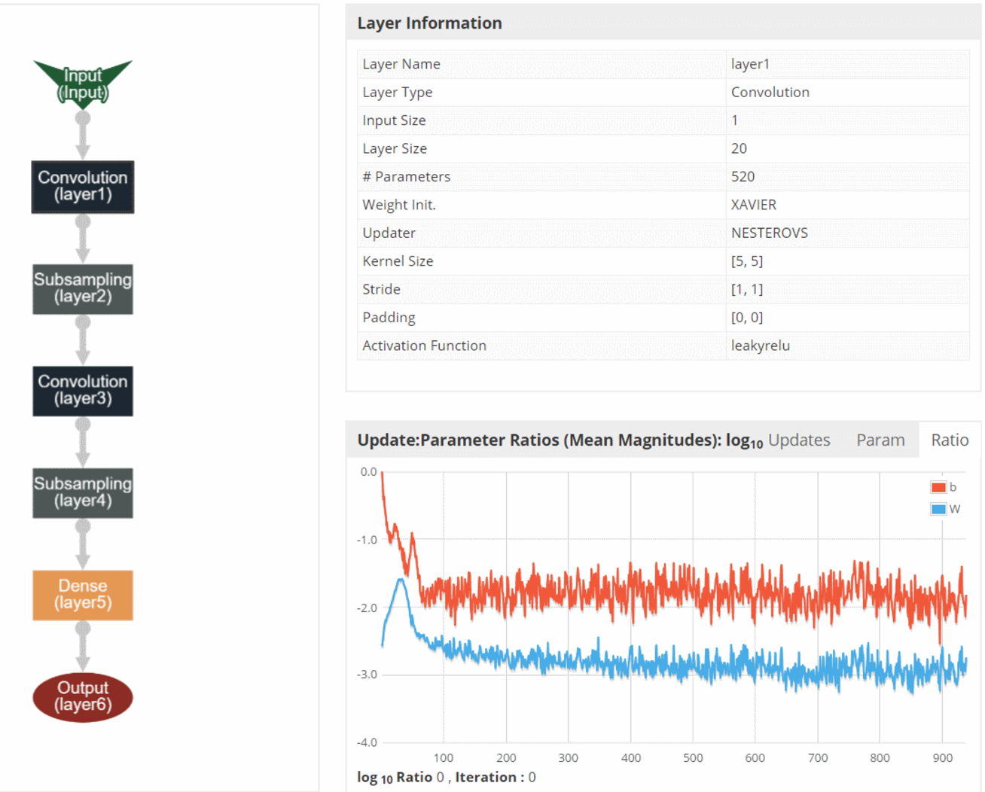
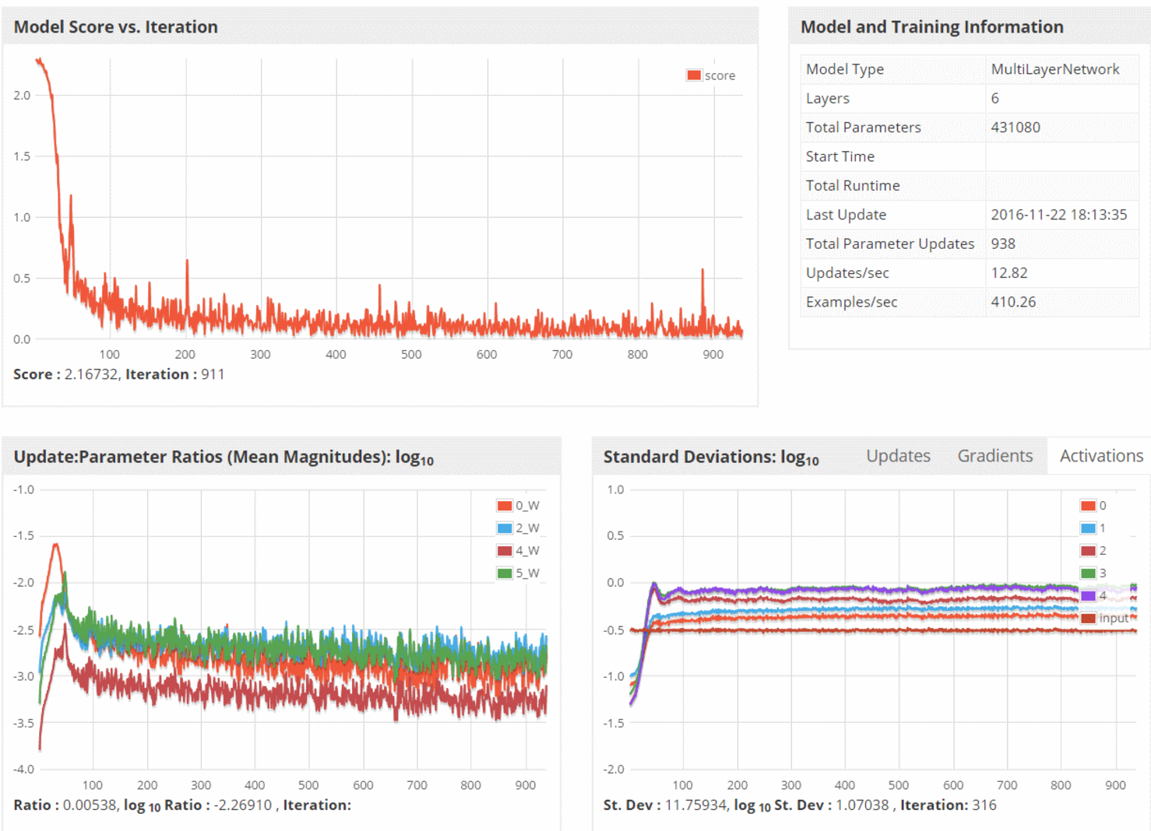
CANDLE System Overview
ML/DL Benchmarks
Pilot 1
Pilot 2
Pilot 3
CANDLE Database
CANDLE Specifications
Metadata Store
Model Store
Integrator Website
Benchmark Spec
Hyperparameter Spec
Hardware Spec
Benchmarks
Datasets
Models
Experiments
Runs
Model Descriptions
CANDLE Supervisor
Model Weights
Hyperparameter Optimization Frameworks
Hyperopt, mlrMBO, Spearmint
Workflow Manager
(Swift-T EMEWS)
Data API
ALCF
Theta, Cooley
NERSC
Cori
OLCF
Titan, SummitDev
Hardware Resources

Slide 8
Parallelism strategies
10,000 x 10-1000 x 10-100 = 1M – 1000M processing elements
Hyperparameter Search: up to ~10,000x
Depends on search strategy
Data Parallel: 10x-1000x
Data Parallel
10x-1000x
Model
Parallel
10x-100x
Model
Parallel
10x-100x
Model
Parallel
10x-100x
Model
Parallel
10x-100x
Model
Parallel
10x-100x
...
...
...

Slide 9
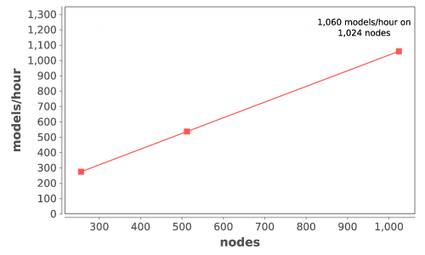
CANDLE Performance
Delivers 1+ petaflop!

Slide 10
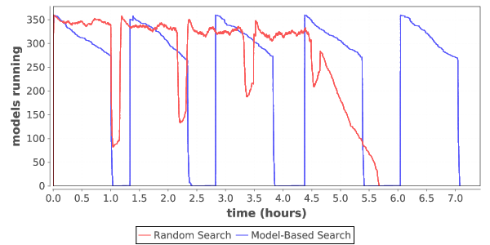
Load over time for search
Typical load plot for NT3 workflow on Cori

Slide 11
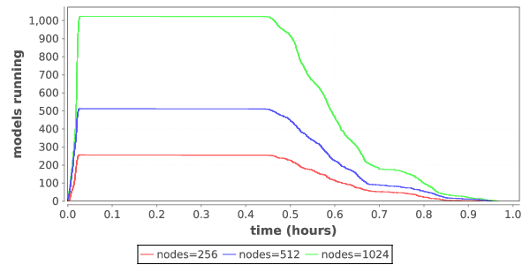
Ramp up / ramp down
Zoom in on single iteration on Titan

Slide 12
Driving integration of Simulation, Data Analytics and Machine Learning
Traditional
HPC
Systems
Scalable
Data Analytics
Large-Scale
Numerical
Simulation
CORAL Supercomputers
and Exascale Systems
Deep
Learning

Slide 13
HYPERPARAMETER OPTIMIZATION

Slide 14
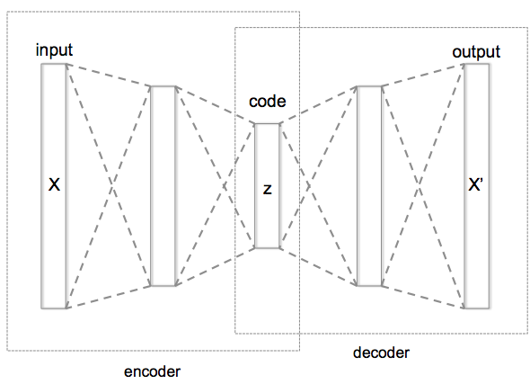
WHAT IS HYPERPARAMETER OPTIMIZATION
Hyperparameter optimization = HPO
Neural networks have a large number of possible configuration parameters, called hyperparameters
Avoids collision with NN weights, which are sometimes called parameters
Applying optimization can automate part of the design of the neural network
In the cancer Pilot 1 autoencoder shown, the system can determine
How many neurons to put in each layer
What activation function to use
What batch size to use
Etc.

Slide 15
Mathematical expression for hpo
For a given problem:
A loss function F is determined on a given NN (usually accuracy)
The hyperparameter optimization problem is to minimize F(p),
for all hyperparameter sets p in the valid parameter space P,
however, P is large and F is expensive.
P is the cross product of all valid network settings,
some of which may be categorical, some integer, some continuous.
Evaluating F involves training the network on a training data set and applying it to the validation set
We can use a generic, previously developed method to optimize F !
These methods require and can use large compute resources

Slide 16
BASIC STRATEGIES
Grid search
Random search
Generic optimization
Stochastic gradient descent
Evolutionary algorithms
Model-based optimization
NN hyperparameter-specific optimization
Hyperopt, NEAT, Optunity, …

Slide 17
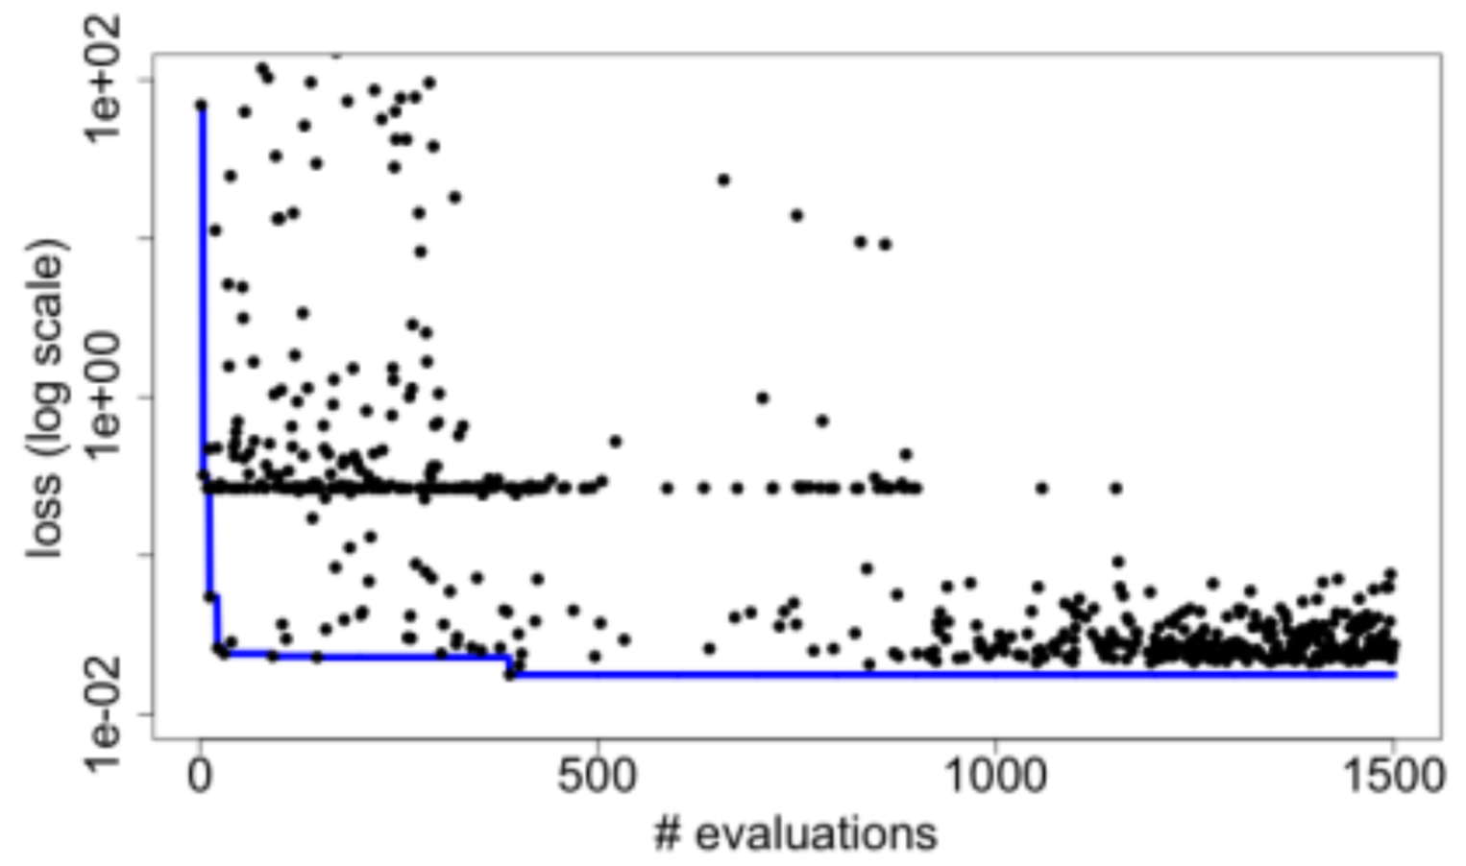
Candle Hyperparameter learning
Search trajectory of mlrMBO (R model-based optimization) algorithm
Each iteration does 300 evaluations (batch size)
Minimum and average performance on validation data set decreases as the ME algorithm learns
Predicting Tumor Cell Line Response to Drug Pairs with Deep Learning, F. Xia, M. Shukla, T. Brettin, C. Garcia-Cardona, J. Cohn, J. Allen, S. Maslov, Y. Evrard, S. Holbeck, J. Doroshow, E. Stahlberg, and R. Stevens (Computational Approaches for Cancer Workshop @ SC 2017)

Slide 18
SYSTEMS CHALLENGES

Slide 19
WORKFLOW support for ML frameworks
Concurrency:
Very fast task distributor
Intranode concurrency, accelerators left up to the framework
Multinode ML tasks are future work (already basically supported)
Data management:
Input staging methods have been developed
Intermediate caches via DataSpaces
Software integration:
Usually launch frameworks in separate process
Launching within process is a configuration challenge
Search methods launched within process

Slide 20

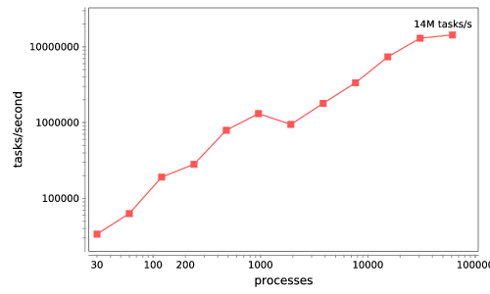


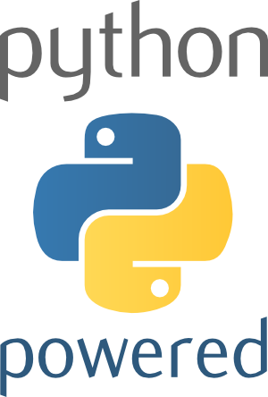



Swift/T: Enabling high-performance Scripted workflows
Supports tasks written in many languages
Write site-independent scripts
Automatic parallelization and data movement
Run native code, script fragments as applications
Rapidly subdivide large partitions for MPI jobs
Move work to data locations
Swift/T worker
Swift/T control process
Swift worker process
C
C++
Fortran
C
C++
Fortran
C
C++
Fortran
MPI
64K cores of Blue Waters
2 billion Python tasks 14 million Pythons/s
Interlanguage parallel scripting for distributed-memory scientific computing. Proc. WORKS @ SC 2015

Slide 21
Extreme-scale model exploration with Swift (EMEWS)

Slide 22
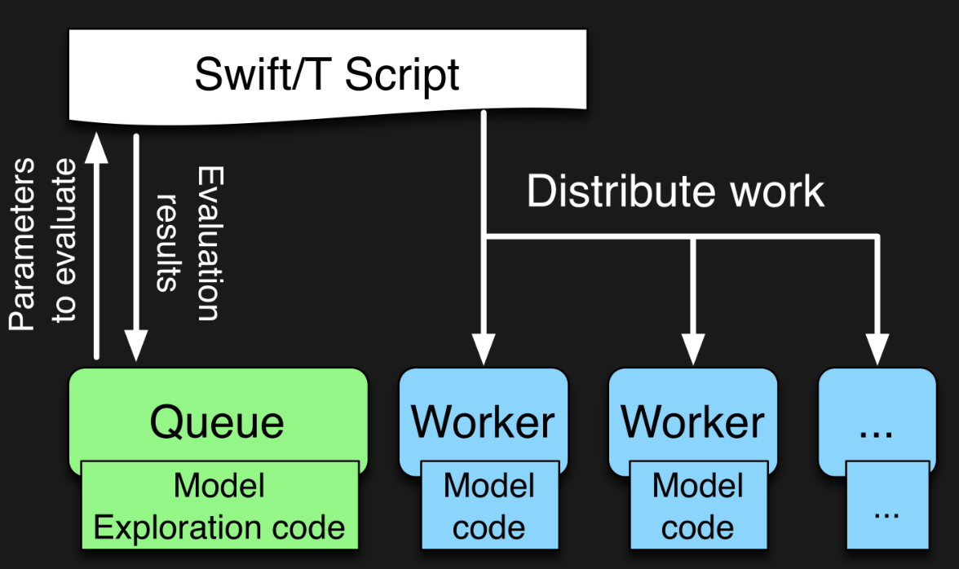

EMEWS workflow structure
The core novel contributions of EMEWS are shown in green, these allow the Swift script to access a running Model Exploration (ME) algorithm, and create an inversion of control (IoC) workflow
Both green and blue boxes accept existing multi-language code

Slide 23
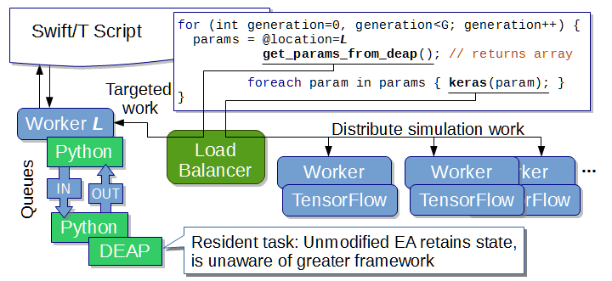
EMEWS: Extreme-scale model exploration workflows in Swift/T
To query the state of the EA, we designate one worker on location L for exclusive use by DEAP.
http://www.mcs.anl.gov/~emews/tutorial

Slide 24
Previous work on HPC workflows
Other uses of workflows to control model exploration (ME) typically take one of two approaches
They provide rich support for arithmetic operations so that ME algorithms can be constructed (ported)
requires that algorithm be coded from scratch
impossible to reuse code in other languages
The ME algorithm is provided as a built-in feature of the system
does not allow the end users much control over the algorithm used
may require access to workflow system source code in order to incorporate external ME algorithms or to modify built-in algorithms
In both cases, the many libraries being actively developed and implemented as free and open source software in programming languages such as R and Python cannot be directly/easily utilized.

Slide 25
Summary of key system points
What is different about Swift/T?
A workflow system that is actually a hierarchical programming language
Runs entirely on the compute nodes
Uses standard APIs for HPC (MPI), allows for minimal OS environment
Very high performance
Supports MPI tasks, embedded Python, R interpreters
What is different about EMEWS?
Allows user to focus on two sequential codes
The optimizer
Their objective function code
Everything else is managed by the system

Slide 26
FUTURE WORK

Slide 27
Directions for future work
General training workflows have been addressed by CANDLE
Tighter integration between workflow system and ML systems
What to run
Where to run
Priority
How to run
Integration with experimental and sensor-driven workflows
Integration with coupled simulation-analysis-learning workflows

Slide 28
Idealized ML Supercomputer
Embracing heterogeneity
Varying compute node accelerators: accessible in shared modes, capable of RDMA communication
Varying networks with placement groups (cheaper?)
Fast, direct external connections to external supercomputers and data streams
Workflow-optimized data movement, task assignment to resources
Scheduler features for bursty workloads, resource assignment
…
Experiments
Node 0:
GPU
Node 1:
“Normal” supercomputer
FPGA
Caches & staging
“Normal” PFS

Slide 29
Thanks
Thanks to the organizers
Code and guides:
CANDLE GitHub: https://github.com/ECP-CANDLE
Swift/T Home: http://swift-lang.org/Swift-T
EMEWS Tutorial: http://emews.org
This research was supported by the Exascale Computing Project (17-SC-20-SC), a joint project of the U.S. Department of Energy’s Office of Science and National Nuclear Security Administration, responsible for delivering a capable exascale ecosystem, including software, applications, and hardware technology, to support the nation’s exascale computing imperative.

