Slide 1
NVIDIA V100 GPU
In the GPU
80 Streaming Multiprocessors
16 GB HBM2, 900 GB/s
6MB L2 cache
8 512-bit memory controllers
In each SM
32 FP64 cores
64 FP32 cores
64 Int32 cores
96KB L1 cache
TensorCores

Slide 2
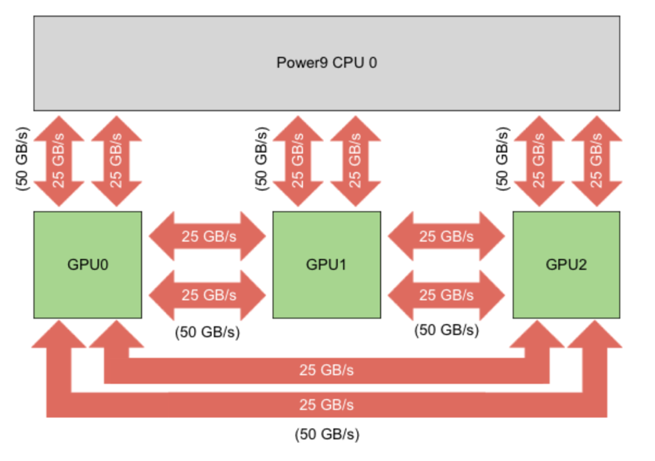
Summit compute node
NVIDIA NVLink
25 GB/s in each direction (peak rate)
2 links between processors
6 GPUs per Summit compute node
IBM Watson Machine Learning
Supports popular ML/DL packages and platforms
IBM TensorFlow Large Model Support
https://developer.ibm.com/linuxonpower/2019/06/11/tensorflow-large-model-support-resources/

Slide 3
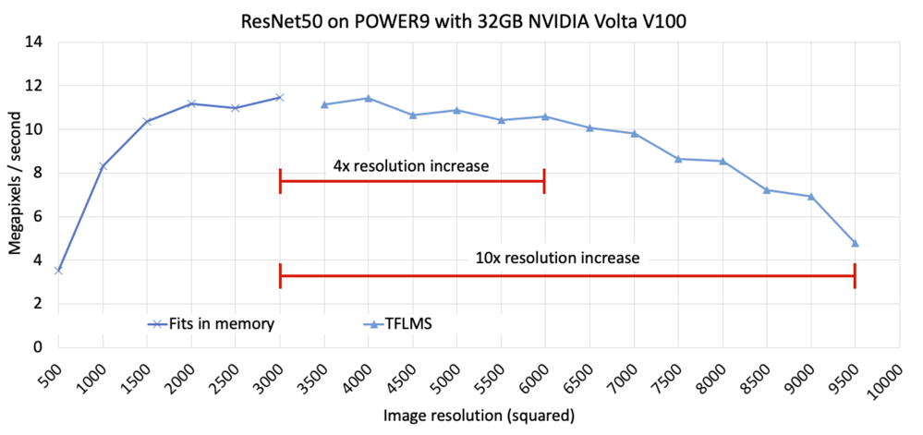
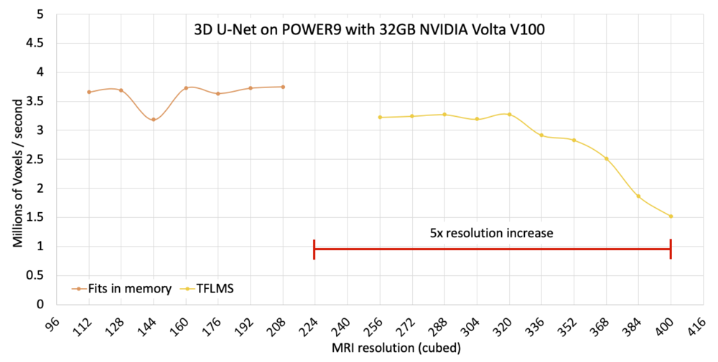

TFLMS
https://developer.ibm.com/linuxpower/2019/05/17/performance-results-with-tensorflow-large-model-support-v2/

