Slide 1
CANDLE Tutorial: Challenge Problem Workflow
ECP Annual Meeting, Houston, TX January 2019
Justin M Wozniak Data Science & Learning
Argonne National Laboratory
woz@anl.gov
www.ExascaleProject.org

Slide 2
Outline
Overview
Data splitting
Workflow structure

Slide 3
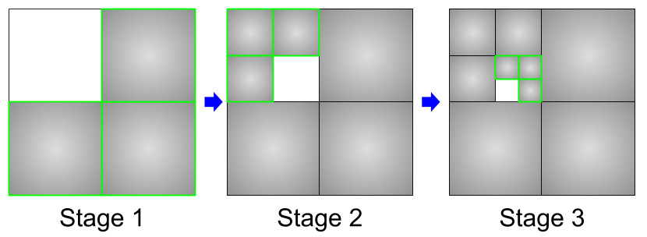
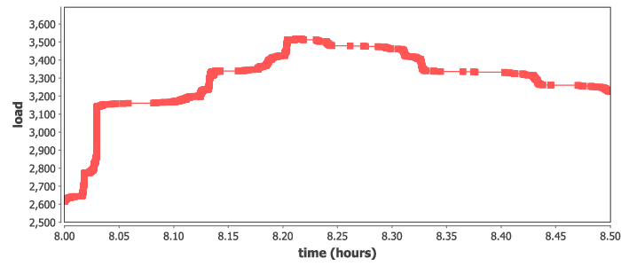
Incremental learning
Split up the training data into subsets, iteratively train on most remaining subsets.
Weight sharing from one subset to the next (incremental learning)
Allows for investigations into data quality and learning patterns
Could also boost performance by preventing overloading data ingest limits
Recursive calls define the datasets for train
Runs at large scale on Summit, ramp-up/down
run_stage(int N, int S, string this, int stage,
void block, string plan_id) {
void parent = run_single(this, stage, block, plan_id);
if (stage < S) {
foreach id_child in [1:N] {
run_stage(N, S, this+"."+id_child, stage+1, parent,
plan_id, db_file, runtype);
}}
}
run_single(string node, int stage, void block) {
json_fragment = make_json_fragment(node, stage);
json = "{\"node\": \"%s\", %s}" % (node, json_fragment);
block => obj(json, node);
}

Slide 4
Data splitting

Slide 5
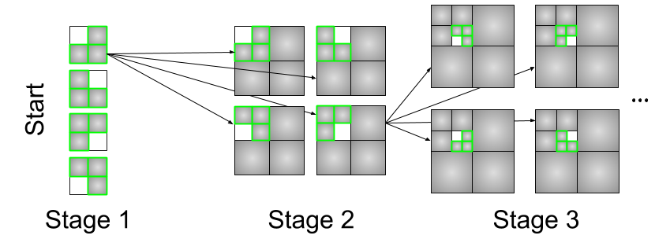
Workflow structure

Slide 6
Recursive workflow structure
/** RUN STAGE: A recursive function that manages the stage dependencies */
(void v)
run_stage(int N, int S, string node, int stage, void block)
{
// Run the model for this workflow node
void parent = run_single(node, stage, block);
if (stage < S) {
// Recurse to the child stages
foreach id_child in [1:N] { // parallel loop
run_stage(N, S, node+"."+id_child, stage+1, parent);
}
}
}
/** RUN SINGLE: Set up and run a single model via candle_obj() */
(void v) run_single(string node, int stage, void parent)
{
if (stage == 0) {
v = propagate();
}
else {
json_fragment = make_json_fragment(node, stage);
json = "{\"node\": \"%s\", %s}" % (node, json_fragment);
wait (parent) { // waits for parent data
// Run the model
obj_result = candle_obj(json, node);
}
}
}

Slide 7
Leave-out workflow: Epoch strategies
F-20 | Flat-20: Simply train for 20 epochs
F-10 | Flat-10: Simply train for 10 epochs
LINE | Linear: Train for a linearly decreasing number of epochs, starting from 20
SQRT | Square root: Train for a number of epochs equal to 20 / sqrt(stage)
EXP2 | Exponential: Train for a number of epochs equal to 20 / 2^(stage-1)

Slide 8
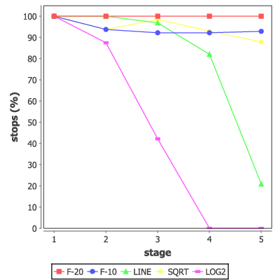
Leave-out workflow:

Slide 9
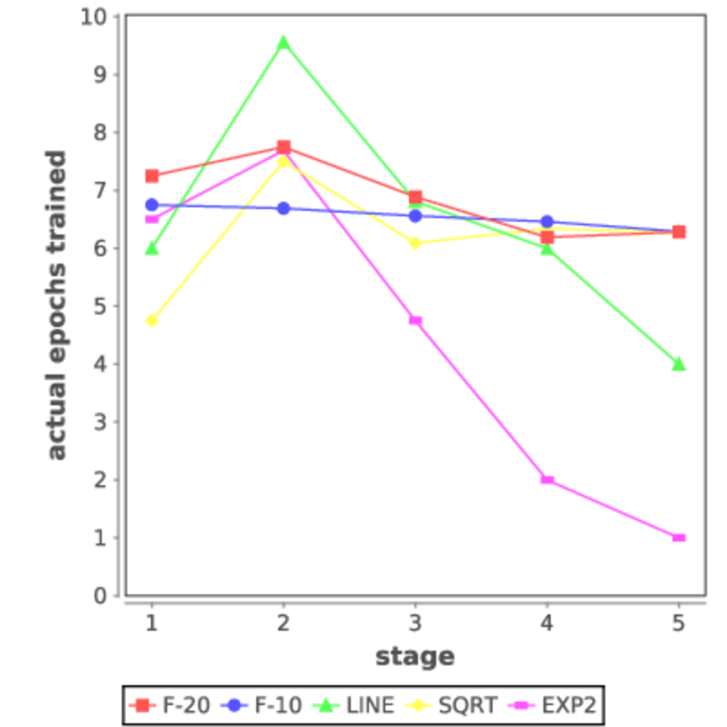
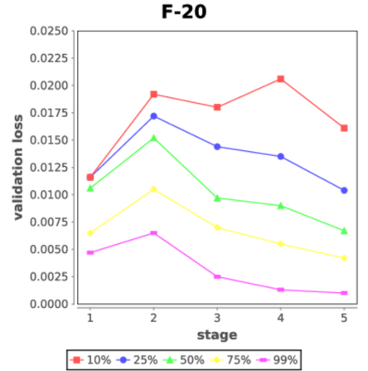
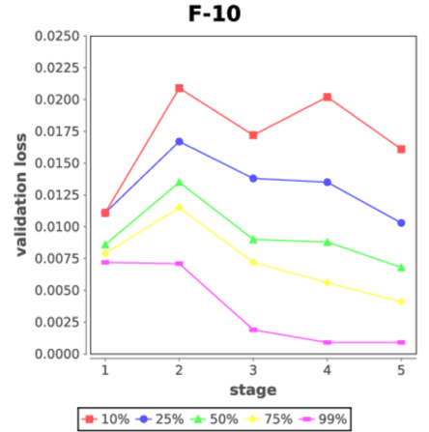
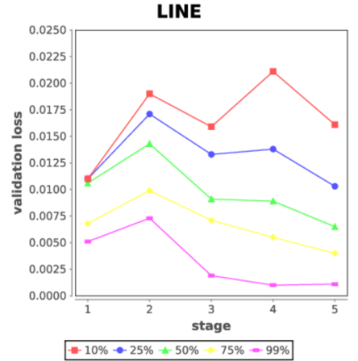
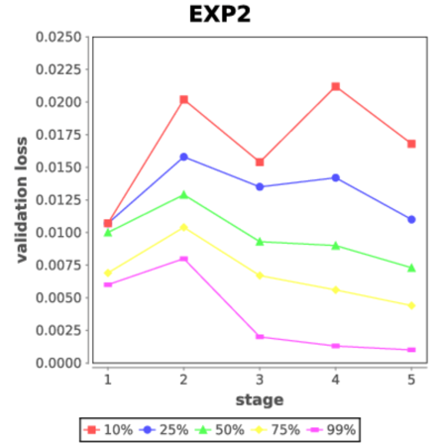
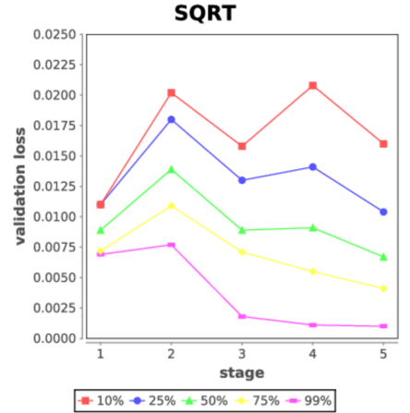
Leave-out workflow:

Slide 10
Summary and future work

Slide 11
Acknowledgments
This research was supported by the Exascale Computing Project (ECP), Project Number: 17-SC-20-SC, a collaborative effort of two DOE organizations - the Office of Science and the National Nuclear Security Administration, responsible for the planning and preparation of a capable exascale ecosystem, including software, applications, hardware, advanced system engineering and early testbed platforms, to support the nation's exascale computing imperative.
www.ExascaleProject.org

