Slide 1
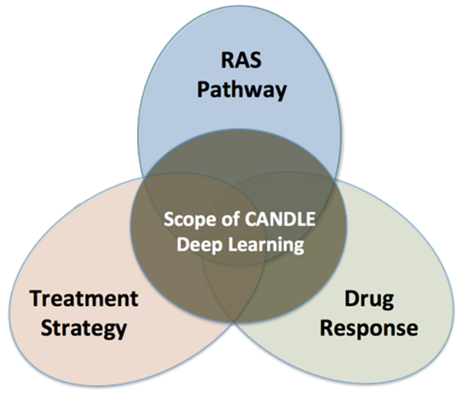
Data parallel training with CANDLE
OPTIMAL DEEP LEARNING On EXASCALE computers
erhtjhtyhy
Justin M Wozniak
Computer Scientist
Data Science & Learning
Argonne National Laboratory
CANDLE Tutorial @ Exascale Computing Project Annual Meeting
January 14, 2019

Slide 2
Collaborators
CANDLE Infrastructure: Tom Brettin, Jon Ozik, Nick Collier, Rajeev Jain (ANL), Harry Yoo (ANL) Jamal Mohd-Yusof, Cristina Garcia Cardona (LANL) George Zaki (NIH)
Pilot benchmarks Fangfang Xia (ANL), Brian Van Essen (LLNL), Arvind Ramanathan (ORNL)
PI Rick Stevens (ANL)

Slide 3
OUTLINE
Introduction to parallel tasks in workflows
Data parallel training in CANDLE
Horovod
Performance analysis
Big data management
Interaction with ECP CODAR

Slide 4
Parallel task support in workflows

Slide 5
Parallelism strategies
10,000 x 10-1000 x 10-100 = 1M – 1000M processing elements
Hyperparameter Search: up to ~10,000x
Depends on search strategy
Data Parallel: 10x-1000x
Data Parallel
10x-1000x
Model
Parallel
10x-100x
Model
Parallel
10x-100x
Model
Parallel
10x-100x
Model
Parallel
10x-100x
Model
Parallel
10x-100x
...
...
...

Slide 6
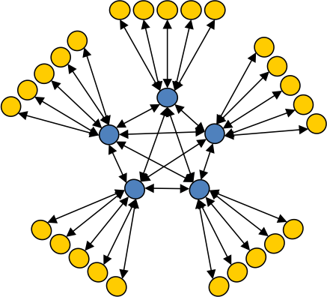
Asynchronous Dynamic Load Balancer
workers
ADLB for short
An MPI library for master-worker workloads in C
Uses a variable-size, scalable network of servers
Servers implement work-stealing
The work unit is a byte array
Optional work priorities, targets, types
For Swift/T, we added:
Server-stored data
Data-dependent execution
Parallel tasks
masters
Lusk et al. More scalability, less pain: A simple programming model and its implementation for extreme computing. SciDAC Review 17, 2010

Slide 7
Parallel tasks in CANDLE workflows
Complex concurrency structures
Training the same network across nodes
Library approach:
Use Swift/T @par syntax
Uses MPI 3 to dynamically create communicator from group
User task library accepts communicator via function input
Approach developed for other scientific computing cases, LAMMPS, NAMD, DIY, etc.
MPI_Launch approach
Use Swift/T launch() function
Creates MPI 3 group
Launches mpiexec on those resources, creating a new MPI_COMM_WORLD and separate processes (fault tolerance)
Works on clusters
Has initial vendor support

Slide 8
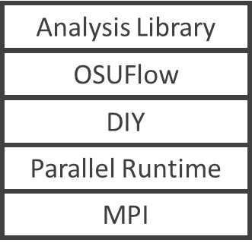
Dataflow+data-parallel analysis/visualization
Data source
Analysis Library
OSUFlow
Data source
DIY
Parallel Runtime
MPI
Dataflow-structured analysis framework
based on OSUFlow/DIY
Dataflow coordination of data-parallel tasks via MPI 3.0 Proc. EuroMPI, 2013

Slide 9
Parameter optimization for Data-parallel analysis
Process configurations

Slide 10
OSUFlow application
Complete code!
// Define call to OSUFlow feature MpiDraw
@par (float t) mpidraw(int bf) "mpidraw";
foreach b in [0:7] {
// Block factor: 1-128
bf = round(2**b);
foreach n in [4:9] {
// Number of processes/task: 16-512
np = round(2**n);
t = @par=np mpidraw(bf);
printf("RESULT: bf=%i np=%i -> time=%0.3f",
bf, np, t);
} }

Slide 11
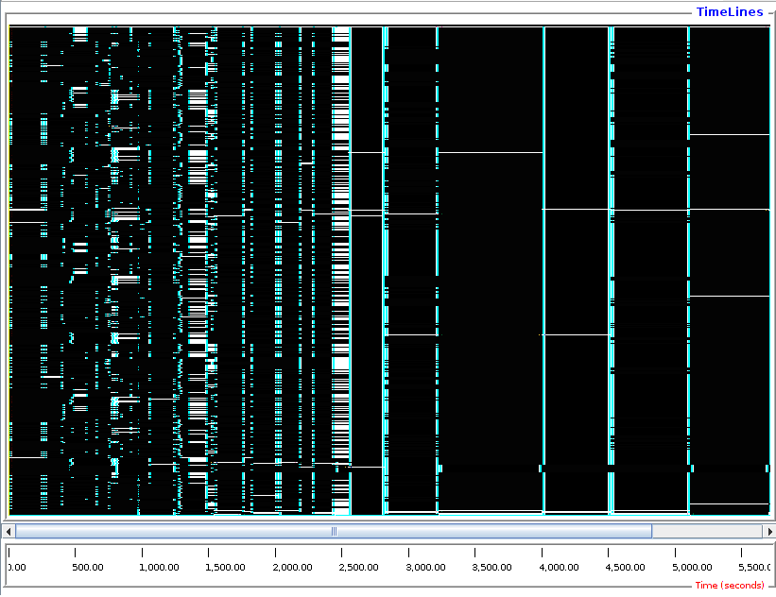
Times from 222s (blue) to 948 (red)
Best results (fastest times) at np=256, high block parameter
11

Slide 12
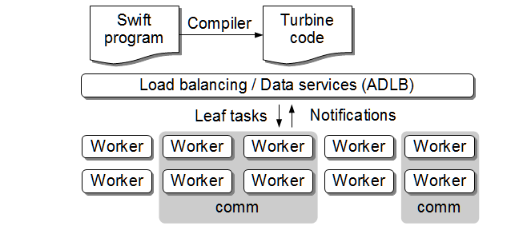
Multiple process allocation
Swift/T runs an MPI-based load balancer
When necessary, multiple idle workers may be pooled together
Swift/T runs MPI_Comm_create_group() on the workers to create a subcommunicator
Swift/T then invokes the user code on that communicator

Slide 13
LAMMPS parallel tasks
LAMMPS provides a convenient C++ API
foreach i in [0:20] {
t = 300+i;
sed_command = sprintf("s/_TEMPERATURE_/%i/g", t);
lammps_file_name = sprintf("input-%i.inp", t);
lammps_args = "-i " + lammps_file_name;
file lammps_input<lammps_file_name> =
sed(filter, sed_command) =>
@par=8 lammps(lammps_args);
}
This example can be found on GitHub:
https://github.com/b240/Workflows/tree/master/demo/LAMMPS-1
See the README.md file for more information.

Slide 14
MPI_Comm_create_group
This approach fundamentally uses MPI_Comm_create_group()
Child code runs in same address space as parent code
Works well on existing systems (even Blue Gene)
Fault tolerance: if child crashes, all of Swift/T crashes
Code coupling: may be difficult to integrate different codes into the same workflow if there are compiler or link-time conflicts
In situ communication: may be difficult to couple libraries with external communication techniques

Slide 15
Context: Parallel launch in mpi
Want to control scientific ensembles from MPI:
Parameter sweeps, searches, optimizations
Tests under varying parameters and process counts
Workflows and code coupling cases where jobs can exit or fail
State of the art:
MPI_Comm_spawn() has limited availability
in part due to complexity of implementing?
MPI_Comm_spawn() does not support job exit detection and failures
Users write complex shell scripts against vendor-specific job launchers
Proposing an alternate function: MPI_Comm_launch()
Implemented on clusters (via MPICH/mpiexec hack) and by a vendor (internal)

Slide 16
MPI_COMM_LAUNCH(): details
int MPIX_Comm_launch(const char *cmd, char **argv,
MPI_Info info, MPI_Comm comm,
int* exit_code);
Runs “in-place” on given communicator- no interaction with scheduler, etc.
Parent is blocked
No communication between parent and child
Parent gets exit code- easy recovery from child failures
Presented at MPI Forum December 2018- assigned to WG for discussion

Slide 17
MPI_COMM_LAUNCH(): Benefits
Allows user to use familiar communicator management to setup subjob
We have done things with MPI_Comm_split() and MPI_Comm_create_group()
Easy to work with unmodified child codes
Allows for the development of MPI-based workload management systems
Write simple test harnesses or parameter sweeps in C or Fortran + MPI
Or use an MPI-based system like ADLB, Swift/T, or MPI-Bash (all implemented!)
Possibly work with other parallel programming systems?

Slide 18
Swift/T example
When file A is created, launch N sub jobs of varying size
file B[]; // Define an array of file variables
A => {
foreach i in [0:N-1] {
file B_i<"B-%i.txt"%i>;
string args_B[] = [ int2string(i),
filename(A), filename(B_i) ];
@par=i launch("./child.x", args_B) => B_i = touch();
B[i] = B_i;
}}
Child tasks are load-balanced, MPI_Comm_create_group() is done automatically!

Slide 19
MPI-BAsh
Author: Scott Pakin (LANL)
Forked and extended for MPI_Comm_launch() by Wozniak
#! /usr/bin/env mpibash
enable -f mpibash.so
mpi_init mpi_init
mpi_comm_rank rank
mpi_barrier
if [ $rank -eq 0 ] ; then
iter=0
while [ $iter -lt $niters ] ; do
mpi_send 1 X
mpi_recv 1 msginfo
let iter++
done
. . .
# Run with:
$ mpirun -np 16 ./my-script.sh
#! /usr/bin/env mpibash
enable -f mpibash.so
mpi_init mpi_init
mpi_comm_rank rank
mpi_comm_split $rank $rank newcomm
echo newcomm: $newcomm
mpi_comm_set $newcomm
mpi_comm_rank rank
mpi_comm_launch hostname
echo exit_code $?
. . .

Slide 20
Integrating horovod with candle

Slide 21

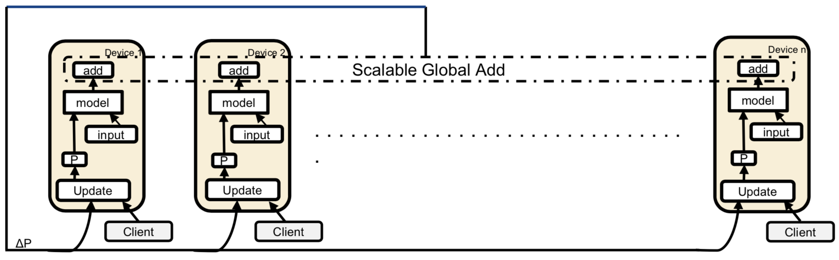
Horovod
Horovod developed by Uber Engineering in September 2017
An open source component of Uber internal ML-as-a-service platform Michelangelo’s deep learning toolkit
A distributed deep learning framework to speed up TensorFlow
Replaces native optimizer class with a new class DistributedOptimizer
Adds an allreduce operation between gradient computation and model update to average the gradients, then applies those averaged gradients
Allreduce
Source: Peter Mendygral, Scaling Deep Learning, ALCF SDL Workshop 2018

Slide 22
Horovod as a library
Horovod is a Python-wrapped C++ library that is injected into TensorFlow
Normally invoked as a stand-alone MPI application
$ mpiexec –n 4 python train.py
Need to load the library and pass it a communicator to run on from C/C++
Ultimately callable from any C/C++ program, notably Swift/T

Slide 23
Calling horovod from swift/t
Example Swift/T script to carry out a scaling sweep: code = read(input("test.py")); foreach p in [1:10] { @par=p horovod(code);
}
Invokes a C function:
int controller(MPI_Comm comm, char* code);
The C function can be called from any MPI program!

Slide 24
CANDLE Benchmarks
Pilot 1 Benchmarks: P1B1, P1B2, P1B3, NT3 (TensorFlow)
At the cellular level to predict drug response based on molecular features of tumor cells and drug descriptors
Architecture of NT3 Benchmark
Source: CANDLE Benchmarks, https://github.com/ECP-CANDLE/Benchmarks
Notes:
CANDLE benchmarks implement deep learning architectures that are relevant to the three cancer problems in Python and Keras. All of these benchmarks are sequential codes. Pilot 1 benchmarks are formed out of problems and data at the cellular level; Pilot 2 benchmarks focus on the molecular level; Pilot3 benchmarks focus on the population level. NT3 is 1D convolutional network for classifying RNA-seq gene expression profiles into normal or tumor tissue categories This network follows classic architecture of convolutional models with multiple 1D convolutional layers interleaved with pooling layers followed by final dense layers The output is binary classification - normal vs tumor. The softmax output gives the probability of the gene expression profile being in a class

Slide 25
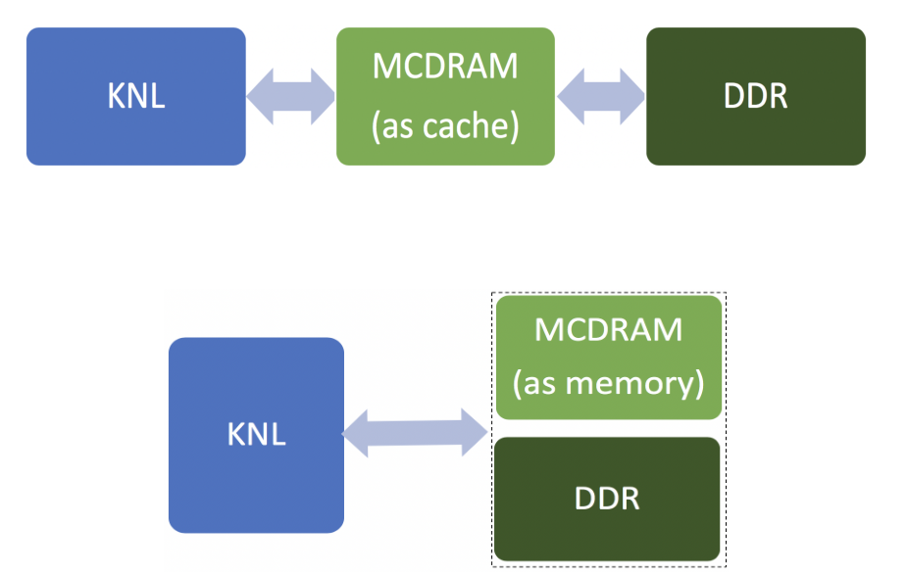
Performance analysis
Our collaborators built a Horovod-based version of the CANDLE app NT3
Studied how the app behaves on Theta in its two memory modes using
Overhead in NT3 increases significantly with the number of nodes although Horovod has the ability to scale up.
Cache mode
Flat mode

Slide 26
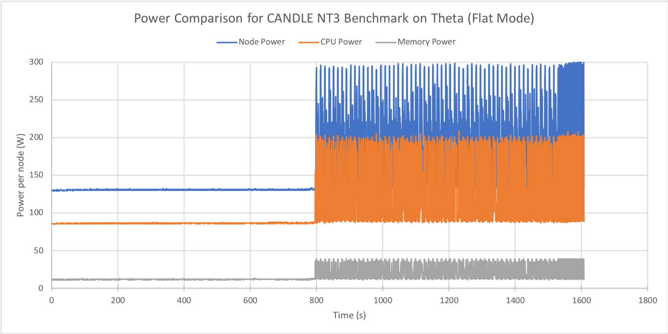
Interaction with MCS
With Xingfu Wu and Valerie Taylor
CANDLE benchmarks perform differently under different hyperparameters, parallelization
Goal: Analyze the performance and power usage of CANDLE Benchmarks
Use PoLiMeR to measure power and performance of CANDLE Benchmark
Could be used to determine
Shows difference between single-node parallelism and Horovod usage
Performance, Power, and Scalability Analysis of the Horovod Implementation of the CANDLE NT3 Benchmark on the Cray XC40. Xingfu Wu, Valerie Taylor, Justin M. Wozniak, Rick Stevens, Thomas Brettin, and Fangfang Xia. Proc. PyHPC @ SC 2018.

Slide 27
Summary
We analyzed the performance, power, and scalability of the Horovod NT3 with weak scaling and strong scaling
Power profiling is useful for showing how the Horovod NT3 benchmark behaves on the underlying system.
The Horovod overhead increased significantly with the number of nodes although Horovod has the ability to scale up.
The benchmark under the cache mode resulted in smaller runtime and lower power consumption for the node and CPU as compared with the flat mode.
Increasing the batch size led to a runtime decrease and slightly impacted the power
and the model training in NT3 requires the proper number of epochs to achieve the high accuracy.

Slide 28
Containerization of parallel task workflows

Slide 29
Candle containers: motivation
Portability and reproducibility are major requirements in life science applications
Containers technologies help life scientist to focus on their domain problem
This is a prototype implementation running on Biowulf, we are testing it on Summit
Future work includes adding data parallelism capabilities to the container in addition to HPO

Slide 30
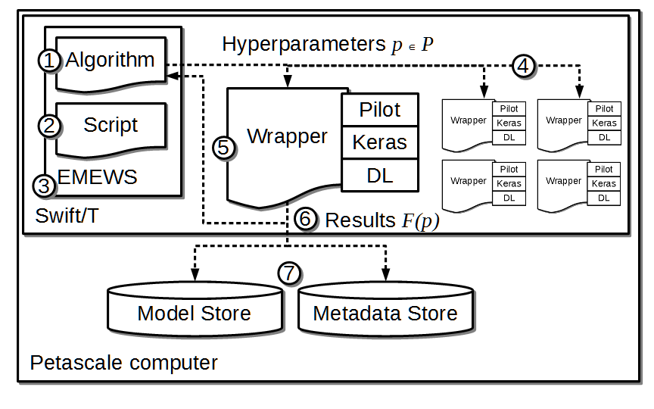
Basic candle architecture

Slide 31
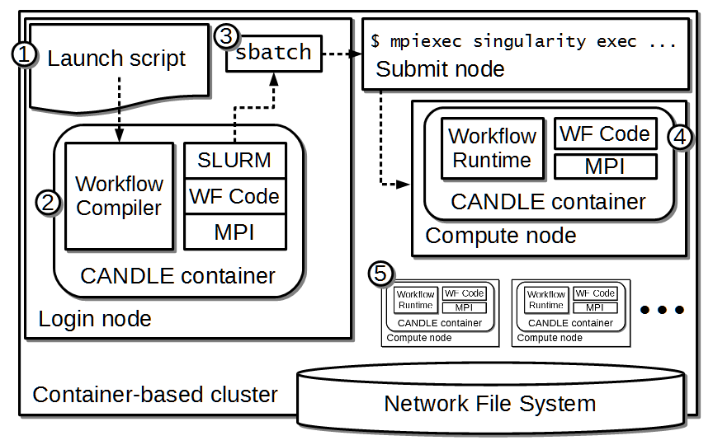
candle architecture with containers

Slide 32
CANDLE CONTAINER Performance study
HPO: Grid search
Model:
Time: 3 minutes
Workers: 2 MPI tasks
Native run: 891 evaluations
Container run: 869 evaluations
In our tests on the NIH HPC cluster, the container overhead is negligible.
Portable and reusable deep learning infrastructure with containers to accelerate cancer studies. Zaki, Wozniak, et al. Proc. PyHPC @ SC 2018.

Slide 33
Features for big data management

Slide 34
Features for Big Data analysis
Location-aware scheduling User and runtime coordinate data/task locations
Collective I/O User and runtime coordinate data/task locations
Application Dataflow, annotations
Application I/O hook
Runtime MPI-IO transfers
Runtime Hard/soft locations
Distributed data
Distributed data
Parallel FS
F. Duro et al. Flexible data-aware scheduling for workflows over an in-memory object store. Proc. CCGrid, 2016.

Slide 35
Task locations
User-written annotation on function call
Swift/T provides a hostmap library that maps host names to MPI ranks
User annotation sends function to rank:
Useful for data-intensive applications or leaf functions with state
Soft locations: allow queued tasks to be stolen and execute anywhere
foreach i in 0:N-1 {
location L = hostmap_lookup(“file”+i);
@location=L f(i);
}
foreach i in 0:N-1 {
location L = hostmap_lookup(“file”+i);
@location=(L, SOFT) f(i); }

Slide 36
Data rates for model generation
Model generation rates are manageable now but could become an unnecessary drain of system resources
M: Memory of a node (assumed full of NN weights)
N: Number of nodes T: Time to train a model
Data is generated at a rate of M x N / T bytes/second.
On Cori: M = 64 GB; N = 9,688; T = 3,600 for a sustained rate of 43 GB/s.
On Summit: M = 512 GB; N = 4,608; T = 3,600 for a sustained rate of 655 GB/s.
As computers increate in speed and scale, these rates will increase rapidly
Most of these models will be simply thrown out!

Slide 37
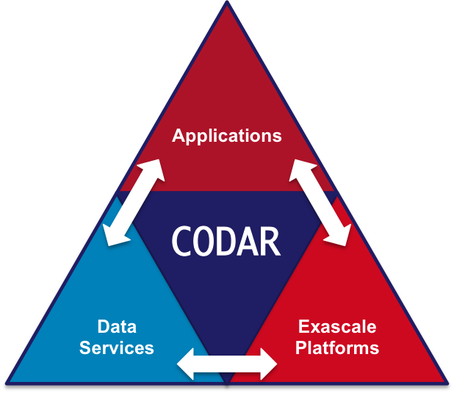
Using workflow-integrated storage
Swift/T training workflow
CANDLE workflows produce a great number of medium-sized ML models
Goal: Cache these on compute node storage for possible later use
Need to flush to global FS before end of run, but many models will be discarded
Accomplishment: Integrated Swift/T workflow system used in CANDLE with DataSpaces client
Accelerate CANDLE workflow performance, enable novel training strategies (parameter sharing)
Demonstrate the utility of node-local storage for complex workflows
CANDLE benchmark
CANDLE
…
TensorFlow
TensorFlow
Good NN model
DataSpaces Services
Parallel FS
Scaling Deep Learning for Cancer with Advanced Workflow Storage Integration. Justin M. Wozniak, Philip E. Davis, Tong Shu, Jonathan Ozik, Nicholson Collier, Manish Parashar, Ian Foster, Thomas Brettin, and Rick Stevens. Proc. MLHPC @ SC 2018.

Slide 38
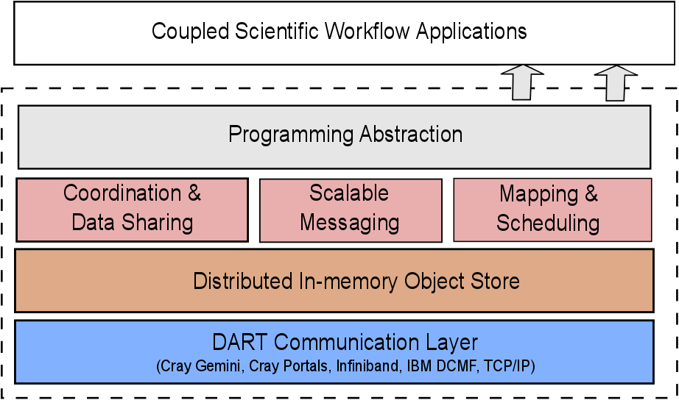
DataSpaces Code Coupling Library
Client library and storage servers
Storage servers run on separate nodes
Provides shared storage space using DRAM from server nodes
Uses RDMA for low-latency transfer
Enables communication between tasks, decoupled in space and time
Optimizations for HPC workflows
Assumes a shared space abstraction
Provides spatially-significant put/get primitives (variable X bounding box X version)
Indexing optimized for spatial locality of access with a SFC, allowing a high degree of scalability using a DHT.

Slide 39
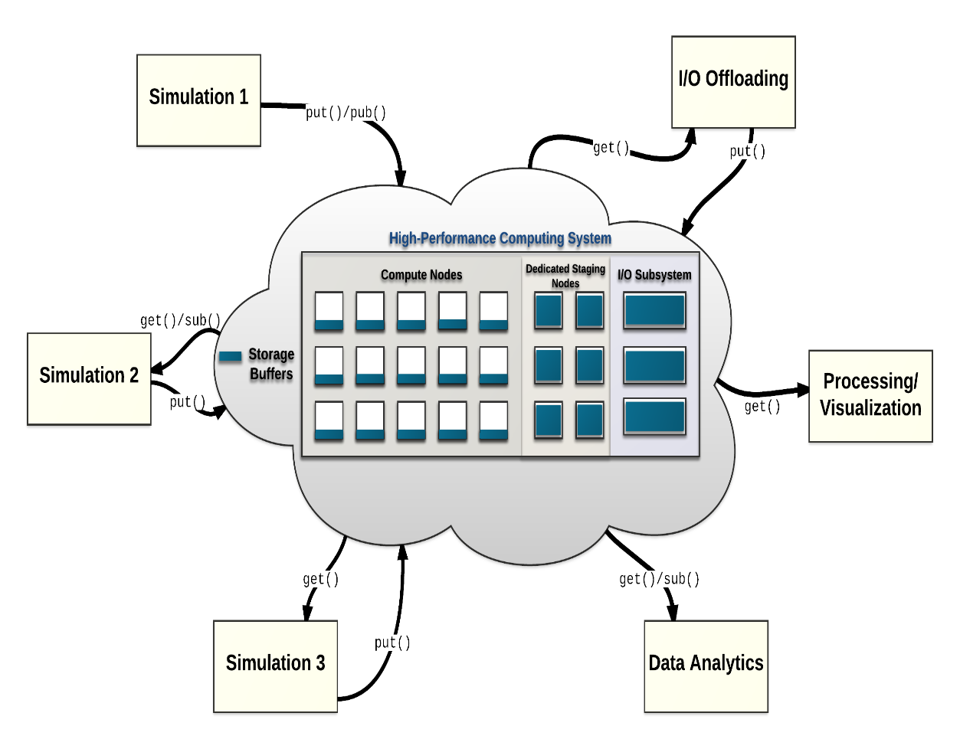
DataSpaces Interface and typical use
The DataSpaces Abstraction
Data is manipulated with a put/get interface
dspaces_put() – provide variable name, size, version, and bounding box along with input data buffer
dspaces_get() – arguments symmetric to dspaces_put(), put data into provided output buffer
Also provide simple synchronization primitives to check if a dspaces_put() operation has completed, and to stall a reader if a put operation has not completed.

Slide 40
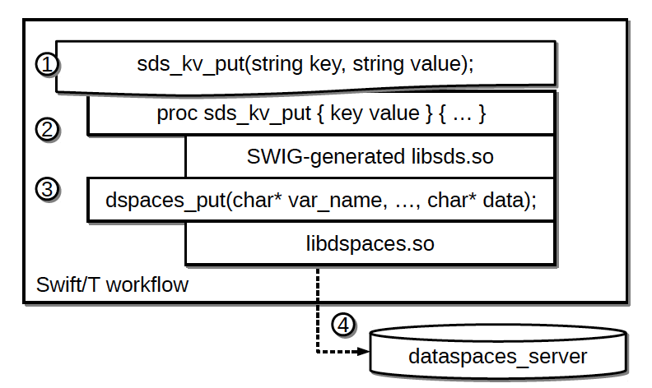
Swift/T-DataSpaces (SDS) Integration
Extend Swift/T with DataSpaces support
Implement a key/value store, where the value can be an array or file
Create small C wrapper around DataSpaces put/get primitives
Use SWIG to generate a shared object which a Swift module can load and use
Place key/value pairs into globally-accessible space
Decouple data access from data generation
Fast RDMA access vs shared FS access
SDS also provides APIs to load node-local files into DataSpaces
DataSpaces & Swift/T Callstack

Slide 41
Performance results
Ran workflows in Swift/T using DataSpaces and also the basic parallel file system (PFS) as a control
Systems:
Blues (ANL/LCRC)
306 nodes with 16-core Intel Xeon E5-2670 @ 2.6GHz, 64 GB RAM
Cori (LBNL/NERSC)
9,688 nodes with Intel Xeon Phi, 16 GB MCDRAM, 96 GB RAM
foreach i in [0:N-1] {
file f<"key"+i> = write("value");
string s = read(f);
}
foreach i in [0:N-1] {
sds_kv_put("key"+i, "value1") =>
sds_kv_get("key"+i, 100);
}
PFS
DataSpaces

Slide 42
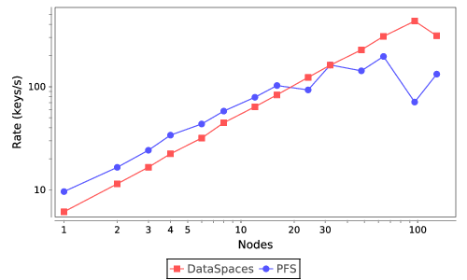
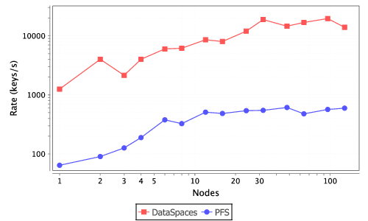
Performance results: small i/o
Small write/read operations from Swift/T on Blues and Cori
Blues
Cori

Slide 43
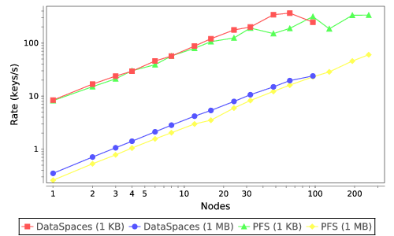
Two-step I/O
File is written to /tmp , then copied into DataSpaces
1 KB and 1 MB files
foreach j in [0:M-1] {
foreach r in [0:N-1] {
// in /tmp
name = make_file(j,r);
file f<name> = make_data(SIZE) => sds_kvf_put(name, name);
}
}
SDS

Slide 44
Conclusions
Presented an overview of the data parallel workflows in the CANDLE project
Described use of Horovod in CANDLE and the use of containers
Described the output data challenge in model generation
Presented performance results from a tight coupling of Swift/T and DataSpaces

Slide 45
Thanks
Thanks to the organizers
Code and guides:
CANDLE GitHub Organization: https://github.com/ECP-CANDLE
Swift/T Home: http://swift-lang.org/Swift-T
EMEWS Tutorial: http://emews.org
This research was supported by the Exascale Computing Project (17-SC-20-SC), a joint project of the U.S. Department of Energy’s Office of Science and National Nuclear Security Administration, responsible for delivering a capable exascale ecosystem, including software, applications, and hardware technology, to support the nation’s exascale computing imperative.

Slide 46
TUTORIAL: SUPERVISOR

Slide 47
Hands-on TUTORIALS
May be found here:
git@github.com:brettin/candle_tutorials.git
Subdirectory Topics/2_hyperparameter_optimization
See the top-level README to get started with the installation

