Slide 1
Neural Architecture Search
ECP Annual Meeting, Houston, TX February 2020
Hong-Jun Yoon and John Gounley Computational Sciences and Engineering Division
Oak Ridge National Laboratory
gounleyjp@ornl.gov
www.ExascaleProject.org

Slide 2
Talk Outline
Background
DARTS algorithm
CANDLE implementation

Slide 3
Background
How does one pick a deep learning architecture?
What kinds of layers?
How is the graph structured?
Options:
Off-the-shelf: start from known architecture for, e.g., image data
Manually: Design from scratch via trial-and-error
Machine learning: neural architecture search (NAS)
Search model descriptions of neural network specifications with given search space
Learn model architecture by training large number of models

Slide 4
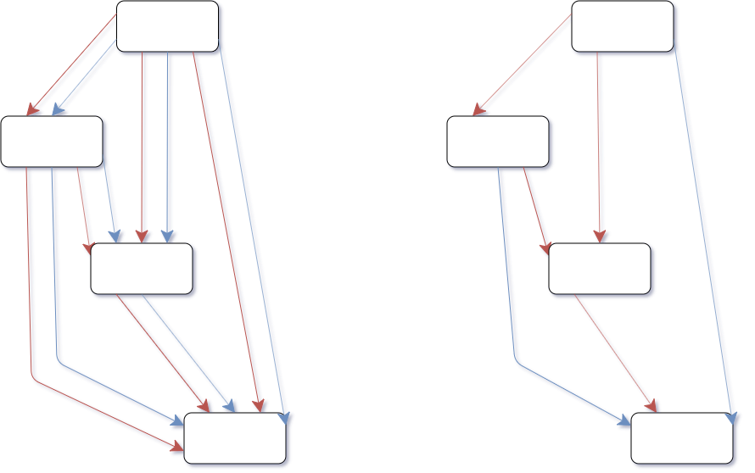
DARTS algorithm
Computational challenge: NAS is expensive
Standard techniques may require 10⁵ GPU hours
Alternative ’one-shot’ techniques: multiple architectures as subgraphs
DARTS (https://arxiv.org/abs/1806.09055)
Differentiable architecture search
Continuous search space
Bilevel optimization: architecture and weights

Slide 5
DARTS algorithm

Slide 6
CANDLE implementation
DARTS implemented as importable library in CANDLE
Natural language processing (NLP) example in Benchmark P3B5
Steps for implementing DARTS for a new model
Define search space
Implement architecture components: convolution filters, pooling operations, etc.
Address application-specific details: e.g., loss function for multi-task learning
Upcoming milestone: reinforcement-learning-based NAS
https://dl.acm.org/doi/pdf/10.1145/3295500.3356202

Slide 7
Acknowledgments
This research was supported by the Exascale Computing Project (ECP), Project Number: 17-SC-20-SC, a collaborative effort of two DOE organizations - the Office of Science and the National Nuclear Security Administration, responsible for the planning and preparation of a capable exascale ecosystem, including software, applications, hardware, advanced system engineering and early testbed platforms, to support the nation's exascale computing imperative.
www.ExascaleProject.org

