Slide 1
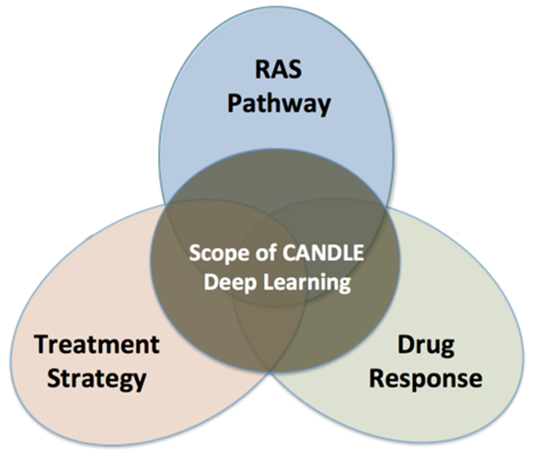
CANDLE TUTORIAL
CANCER deep learning environment
erhtjhtyhy
Justin M Wozniak
Arvind Ramanathan, HARRY YOO, Jamal MOHD-YUSOF
Computer Scientist
Data Science & Learning
Argonne National Laboratory
CANDLE Tutorial @ Exascale Computing Project Annual Meeting
January 14, 2019

Slide 2
CANDLE: Briefest overview
CANDLE: CANcer Deep Learning Environment
Running (mini) cancer application cases from partner “Pilot” projects
Collaborate with National Cancer Institute, Frederick National Lab, etc.
Focus on deep learning approach: TensorFlow, LBANN, et al.
Focus on cases that require exascale: parallel training, ensembles
Focus on scalable workflows: using the Swift/T workflow framework
Today’s tutorial will give you an overview of the concepts and tools

Slide 3
Schedule
9:00 a.m. Justin Wozniak Set-up and Orientation, Overview of day (30 min)
9:30 a.m. Arvind Ramanathan Motivating examples (30 min)
10:30 a.m. Jamal Mohd-Yusof CANDLE libs (30 min)
11:00 a.m. Harry Yoo Migrating to CANDLE (45 min)
11:45 a.m. Lunch break (1hr 45 min)
1:30 p.m. Justin Wozniak Hyperparameter Optimization (60 min)
2:30 p.m. Harry Yoo Model Ensembles for UQ: Overview and examples (60 min)
3:30 p.m. Justin Wozniak Data Parallelism: Overview and examples (60 min)
4:30 p.m. Study hall, viz, requirements, feedbacks (60 min)
5:30 p.m. Scheduled end

Slide 4
Hands-on TUTORIALS
May be found here:
https://github.com/ECP-CANDLE
Clone the Tutorials repo: git@github.com:ECP-CANDLE/Tutorials.git
$ cd 2019/ECP
See the top-level README to get started with the installation

