Slide 1
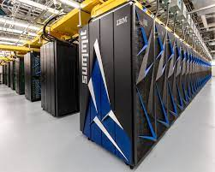
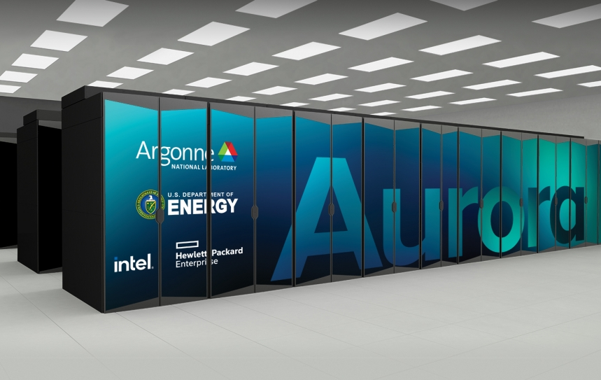

Exploiting and Supporting Exascale Infrastructure for Deep Learning Applications
MINISYMPOSIUM: CS and Math: Life Sciences
drhgfdjhngngfmhgmghmghjmghfmf
Chair: Justin m Wozniak
Presenters:
Thomas Brettin John Gounley Jamaludin Mohd-Yusof
PASC July 7, 2021

Slide 2
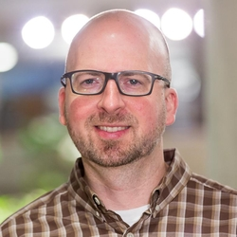
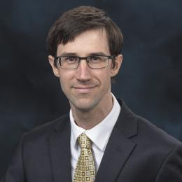
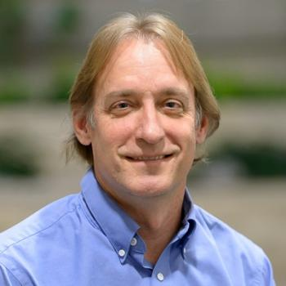
introductions
Justin Wozniak
Computer Scientist
Data Science & Learning Division
Argonne National Laboratory
Thomas Brettin
Strategic Program Manager
Computing, Environment, and Life Sciences
Argonne National Laboratory
John Gounley
Computational scientist
Computational Sciences and Engineering Division
Oak Ridge National Laboratory
Jamaludin Mohd-Yusof
Research Scientist
Los Alamos National Laboratory

Slide 3
Minisymposium Overview
Driving topics of this session
Deep learning (DL) has the capability to transform many scientific problems, including COVID-19 research, cancer studies, and a wide range of energy sciences. Ever more complex couplings of data sources, analysis, and learning methods demand additional resources in computing capability, data movement, and storage.
Exascale challenges for DL include scaling models, scaling workflows, integrating methods, integrating software, and down-scaling results for return to users with varying levels of available computing power.
This symposium will illustrate these challenges and present an infrastructure in which to address them, followed by three related application case studies, including two from the life sciences.

Slide 4
Schedule
All times CEST
14:00 Wozniak: Intros (these slides)
14:10 Wozniak: Programmable Infrastructure for Diverse, Scalable Learning at Exascale
14:35 Brettin: Targeting Billion-Scale Compound Libraries with Deep Learning: A SARS-Cov-2 Example
15:00 Gounley: Health Data Science at Scale
15:25 Mohd-Yusof: Reinforcement Learning at Exascale
15:50 Wozniak: Final discussion, questions
16:00 Adjournment

Slide 5
Questions?

