Slide 1
Hyperparameter Optimization & Neural Architecture Search
ECP Annual Meeting, Houston, TX February 2020
John Gounley Computational Sciences and Engineering Division
Oak Ridge National Laboratory
gounleyjp@ornl.gov
www.ExascaleProject.org

Slide 2
Talk Outline
Background
Hyperparameter optimization (HPO)
Background
Population-based training
CANDLE implementation
Neural architecture search (NAS)
Background
DARTS algorithm
CANDLE implementation

Slide 3
HPO background
How to chose optimal parameters for deep learning algorithm?
CANDLE workflows for HPO
User-defined parameter sets
Grid and random searches
Model-based optimization (mlrMBO)
Population-based training (PBT)

Slide 4
Population-based training
Asynchronous distributed optimization algorithm
Train multiple models independently with different hyperparameters
Periodically replace parameters and weights for poorly performing models
Trainer
Model
Model
Model
Trainer
Model
Model
Model
Trainer
Model
Model
Model
Datastore

Slide 5
Population-based training
Asynchronous distributed optimization algorithm
Train multiple models independently with different hyperparameters
Periodically replace parameters and weights for poorly performing models
Trainer
Model
Model
Model
Trainer
Model
Model
Model
Trainer
Model
Model
Model
Datastore

Slide 6
CANDLE implementation
Model-agnostic framework code for implementing a PBT workflow
Parallelized with mpi4Py
PBTMetaDataStore class: in-memory datastore for performance and hyperparameter data
PBTClient class: allow individual model to communicate with the datastore
PBTCallback class: pass performance data and weights to the data store, via Keras callback
PBTWorker interface: provide API for replacing model parameters and weights
Steps for implementing PBT for a new model
Modify workflow script which implements this framework (very close to boilerplate)
PBT parameter configuration (JSON) file

Slide 7
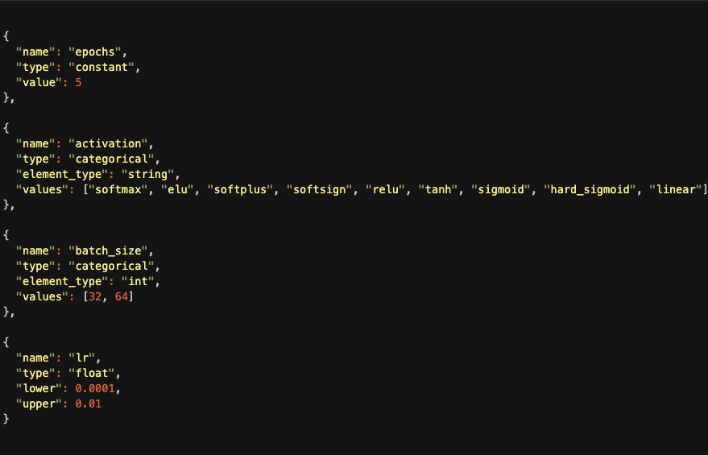
Hyperparameter search space config file

Slide 8
NAS background
How does one pick a deep learning architecture?
What kinds of layers?
How is the network structured?
Options:
Off-the-shelf: start from known architecture for, e.g., image data
Manually: Design from scratch via trial-and-error
Machine learning: neural architecture search (NAS)
Search model descriptions of neural network specifications with given search space
Learn model architecture by training large number of models

Slide 9
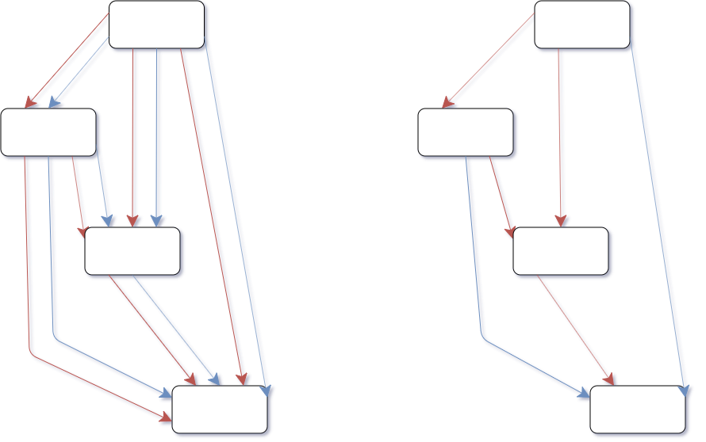
DARTS algorithm
Computational challenge: NAS is expensive
Standard techniques may require 10⁵ GPU hours
Alternative ’one-shot’ techniques: multiple architectures as subgraphs
DARTS (https://arxiv.org/abs/1806.09055)
Differentiable architecture search
Continuous search space
Bilevel optimization: architecture and weights
Caveat: results dependent on initial weights

Slide 10
DARTS algorithm

Slide 11
CANDLE implementation
DARTS implemented as importable library in CANDLE
Natural language processing example in Benchmark P3B5 (‘develop’ branch)
Steps for implementing DARTS for a new model
Define search space
Implement architecture components: convolution filters, pooling operations, etc.
Address application-specific details: e.g., loss function for multi-task learning
Upcoming milestone: reinforcement-learning-based NAS
https://dl.acm.org/doi/pdf/10.1145/3295500.3356202

Slide 12
Acknowledgments
This research was supported by the Exascale Computing Project (ECP), Project Number: 17-SC-20-SC, a collaborative effort of two DOE organizations - the Office of Science and the National Nuclear Security Administration, responsible for the planning and preparation of a capable exascale ecosystem, including software, applications, hardware, advanced system engineering and early testbed platforms, to support the nation's exascale computing imperative.
www.ExascaleProject.org

