Slide 1
CANDLE benchmark spec
Overall goal:
To enable the hyperparameter search and UQ (and more?) workflows in a consistent, convenient way
Standardized network specification format
default_model_file
Standardized command line intercept protocol
Overwrite the default model as needed
Standardized initialize and run protocol
Use same defaults across frameworks
run(gParameters)

Slide 2
CANDLE benchmark spec
Overview
Coded in Keras
Applicable to a variety of ML problems
Can target multiple execution frameworks including Tensorflow, Theano, CNTK, mxNet
Each framework may have different default parameters
Leverage existing packages: numpy, pandas, etc.
Provides various utility packages
Default_utils.py
File_utils.py
Data_utils.py
Keras_utils.py

Slide 3
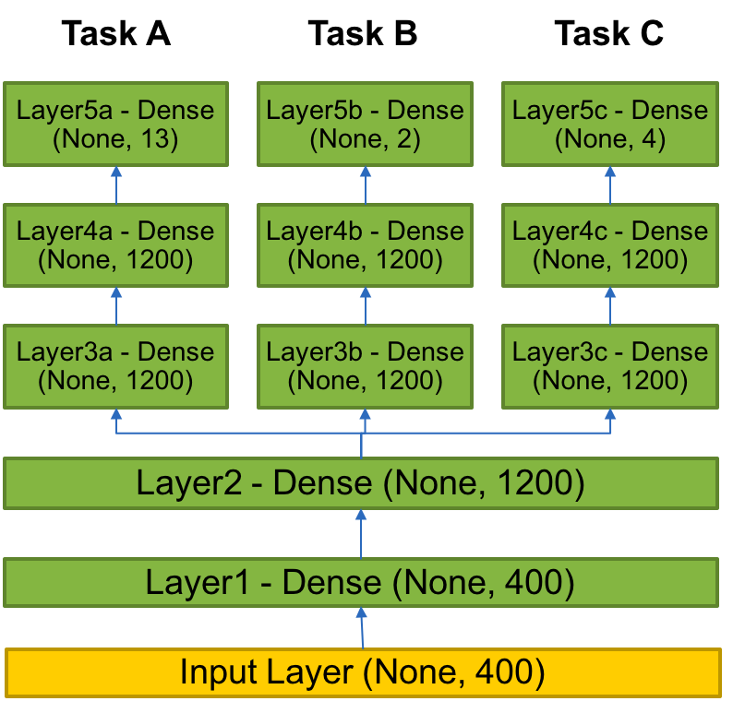
Example benchmark
P3B1
P3B1: Multi-task Deep Neural Net (DNN) for data extraction from clinical reports
Overview: Given a corpus of patient-level clinical reports, build a deep learning network that can simultaneously identify:(i) b tumor sites, (ii) t tumor laterality, and (iii) g clinical grade of tumors.
Relationship to core problem: Instead of training individual deep learning networks for individual machine learning tasks, Build a multi-task DNN that can exploit task-relatedness to simultaneously learn multiple concepts.
Expected outcome: Multi-task DNN that trains on same corpus and can automatically classify across three related tasks.

Slide 4
Original code
Hard coded hyperparameters
shared_nnet_spec= [ 1200 ]
individual_nnet_spec0= [ 1200, 1200 ]
individual_nnet_spec1= [ 1200, 1200 ]
individual_nnet_spec2= [ 1200, 1200 ]
individual_nnet_spec = [ individual_nnet_spec0, individual_nnet_spec1, individual_nnet_spec2 ]
a
learning_rate = 0.01
batch_size = 10
n_epochs = 10
dropout = 0.0
## Read files
from data_utils import get_file
origin = 'http://ftp.mcs.anl.gov/pub/candle/public/benchmarks/P3B1/P3B1_data.tgz’
data_loc = get_file('P3B1_data.tgz', origin, untar=True, md5_hash=None, cache_subdir='P3B1')

Slide 5
Default model file
P3B1
data_url = 'ftp://ftp.mcs.anl.gov/pub/candle/public/benchmarks/P3B1/’
train_data = 'P3B1_data.tar.gz’
model_name = 'p3b1’
learning_rate = 0.01
batch_size = 10
epochs = 10
drop = 0.0
activation = 'relu’
out_activation = 'softmax’
loss = 'categorical_crossentropy’
optimizer = 'sgd’
metrics = 'accuracy’
n_fold = 1
shared_nnet_spec = '1200’
ind_nnet_spec = '1200, 1200:1200, 1200:1200, 1200’
feature_names = 'Primary site:Tumor laterality:Histological grade’
timeout =1800
scaling = 'none’
output_dir = '.’
initialization='glorot_uniform’

Slide 6
Network specification
Shared layers
# input layer
layer = Input( shape = ( input_dim, ), name= 'input' )
shared_layers.append( layer )
# shared layers
for k in range( len( shared_nnet_spec ) ):
layer = dense( shared_nnet_spec[ k ], activation=gParameters['activation'],
name= 'shared_layer_' + str( k ) )( shared_layers[ -1 ] )
shared_layers.append( layer )
if gParameters['drop'] > 0:
layer = Dropout( gParameters['drop'] )( shared_layers[ -1 ] )
shared_layers.append( layer )
# individual layers
indiv_layers_arr = []
models = []

Slide 7
Network specification
Individual layers
for l in range( len( individual_nnet_spec ) ):
indiv_layers = [ shared_layers[-1] ]
for k in range( len( individual_nnet_spec[l] ) + 1 ):
if k < len( individual_nnet_spec[l] ):
layer = Dense( individual_nnet_spec[l][k], activation=gParameters['activation’],
name= 'indiv_layer_' + str( l ) + '_' + str( k ) )( indiv_layers[-1] )
indiv_layers.append( layer )
if gParameters['drop'] > 0:
layer = Dropout( gParameters['drop'] )( indiv_layers[-1] )
indiv_layers.append( layer )
else:
layer = Dense( n_out_nodes[l], activation=gParameters['out_activation’],
name= 'out_' + str( l ) )( indiv_layers[-1] )
indiv_layers.append( layer )
indiv_layers_arr.append( indiv_layers )
model = Model( inputs=[shared_layers[0]], outputs=[indiv_layers[-1]] )
models.append( model )

Slide 8
Parsing command line input
Overwrite the default model values with any command line options
(including specifying a new default model file)
# Parse common parameters
bmk.parse_from_common()
# Parse parameters that are applicable just to benchmark bmk.parse_from_benchmark()
# Get command-line parameters
args = bmk.parser.parse_args()
#print('Args:', args)
# Get parameters from configuration file
fileParameters = bmk.read_config_file(args.config_file)
#print ('Params:', fileParameters)
# Consolidate parameter set. Command-line parameters overwrite file configuration gParameters = args_overwrite_config(args, fileParameters)
print ('Params:', gParameters)
return gParameters

Slide 9
Modifying the model
Various ways to overwrite the default model file values
Provide a new default model specification
‘--config_file new_default_model.tx’
Overwrite individual parameters in the default model
‘--learning_rate 0.1 –drop 0.1’
Provides an easy way to perform individual experiments to probe the hyperparameter space
Provides the pathway for automated sweeps of hyperparameters
→ Supervisor workflows

Slide 10
Keras MNIST example
Keras sequential model specification
model = Sequential()
model.add(Dense(512, activation='relu', input_shape=(784,)))
model.add(Dropout(0.2))
model.add(Dense(512, activation='relu’))
model.add(Dropout(0.2))
model.add(Dense(num_classes, activation='softmax’))
model.summary()
Or in a default model file;
Dense=‘512, 512’
Drop = 0.2
Activation = ‘relu’
Out_activation = ‘softmax’

