Slide 1
CANDLE Tutorial: Challenge Problem Workflow
ECP Annual Meeting, Houston, TX February 4, 2020
Justin M Wozniak Data Science & Learning
Argonne National Laboratory
woz@anl.gov
www.ExascaleProject.org

Slide 2
Outline
Overview
Data splitting
Workflow structure
Implementation
Results from epoch strategy experiments

Slide 3
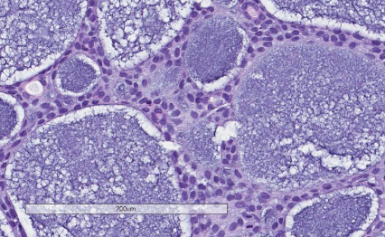
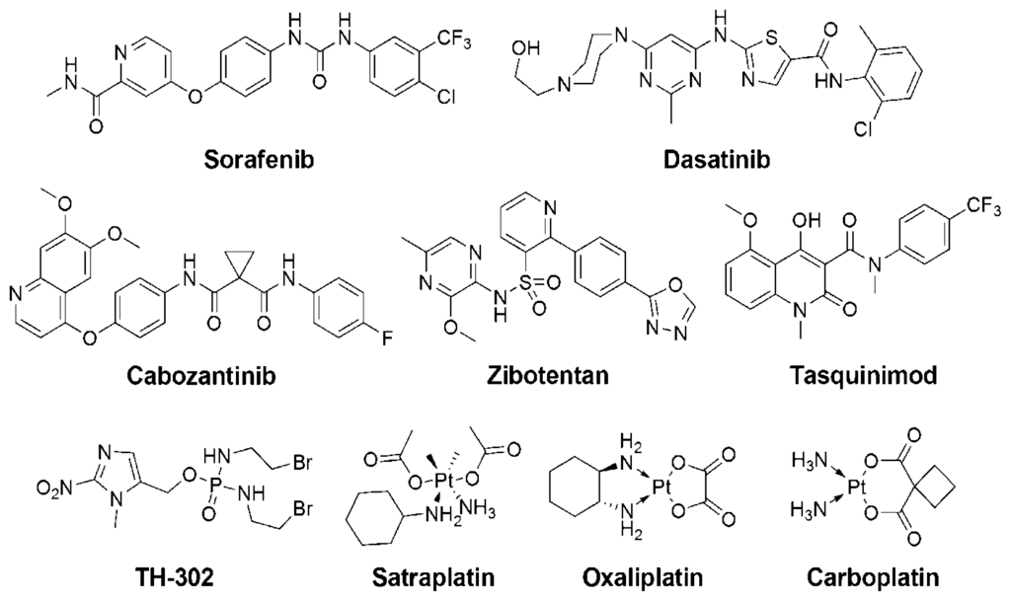
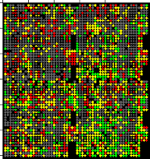
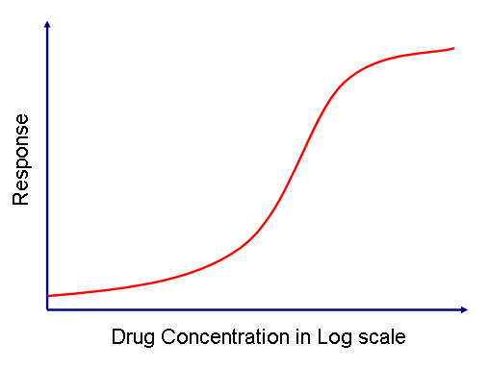
Uno Model for Cancer Drug Response
Drug (s)
descriptors
fingerprints
structures
SMILES
dose
→
𝓡 = 𝑓(𝓣, 𝓓)
𝓡 = 𝑓(𝓣, 𝓓₁ , 𝓓₂)
→
→
IC50
AUC
GI50
% growth
Z-score
gene expression levels
SNPs
protein abundance
microRNA
methylation
Response
Tumor

Slide 4
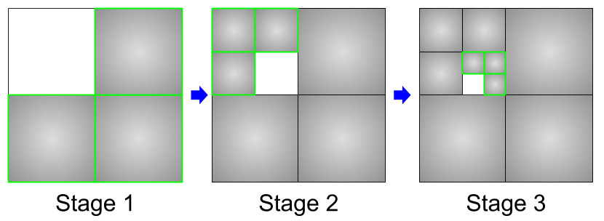
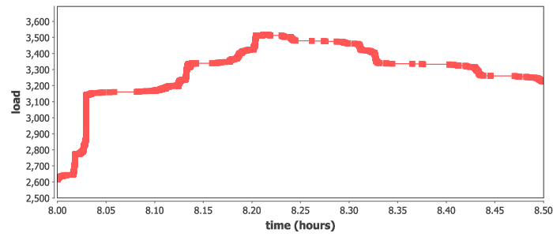
Data analysis workflow
Split up the training data into subsets, iteratively train on most remaining subsets.
Weight sharing from one subset to the next (incremental learning)
Allows for investigations into data quality and learning patterns
Could also boost performance by preventing overloading data ingest limits
Recursive calls define the datasets for train
Runs at large scale on Summit, ramp-up/down
run_stage(int N, int S, string this, int stage,
void block, string plan_id) {
void parent = run_single(this, stage, block, plan_id);
if (stage < S) {
foreach id_child in [1:N] {
run_stage(N, S, this+"."+id_child, stage+1, parent,
plan_id, db_file, runtype);
}}
}
run_single(string node, int stage, void block) {
json_fragment = make_json_fragment(node, stage);
json = "{\"node\": \"%s\", %s}" % (node, json_fragment);
block => obj(json, node);
}

Slide 5
Data splitting
Big picture- train on successively larger data sets

Slide 6
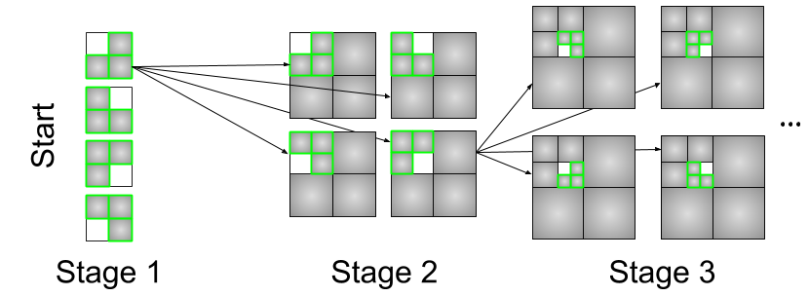
Workflow structure
Earlier stages have fewer models to train and typically train longer
Want to start child runs as soon as parent is complete (not whole stage)
Use dataflow control

Slide 7
Recursive workflow structure
Implemented as a recursively defined dataflow structure
Swift/T exploits all available concurrency among calls to candle_obj() (a CANDLE utility that ultimately runs TensorFlow)
/** RUN STAGE: A recursive function that manages the stage dependencies */
(void v)
run_stage(int N, int S, string node, int stage, void block)
{
// Run the model for this workflow node
void parent = run_single(node, stage, block);
if (stage < S) {
// Recurse to the child stages
foreach id_child in [1:N] { // parallel loop
run_stage(N, S, node+"."+id_child, stage+1, parent);
}
}
}
/** RUN SINGLE: Set up and run a single model via candle_obj() */
(void v) run_single(string node, int stage, void parent)
{
if (stage == 0) {
v = propagate();
}
else {
json_fragment = make_json_fragment(node, stage);
json = "{\"node\": \"%s\", %s}" % (node, json_fragment);
wait (parent) { // waits for parent data
// Run the model
obj_result = candle_obj(json, node);
}
}
}

Slide 8
Data analysis workflow: Epoch strategies
Ideally, training becomes cheaper in later stages
Ran varying strategies to reduce epochs by stage
Training stops early if no progress (Keras EarlyStopping=3)
F-20 | Flat-20: Simply train for 20 epochs
F-10 | Flat-10: Simply train for 10 epochs
LINE | Linear: Train for a linearly decreasing number of epochs, starting from 20
SQRT | Square root: Train for a number of epochs equal to 20 / sqrt(stage)
EXP2 | Exponential: Train for a number of epochs equal to 20 / 2^(stage-1)

Slide 9
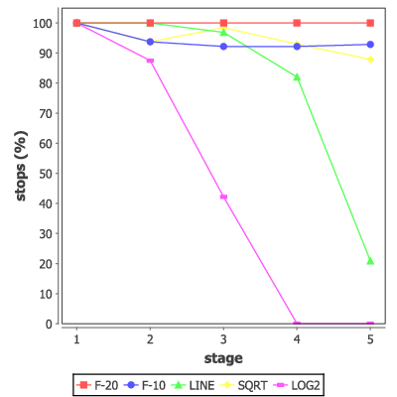
Data analysis workflow: Early stopping percentage
First: how many early stops occur by strategy and stage
F-20: 100% early stopping rate
F-10: 90+% early stopping rate
LINE: Decreasing early stopping rate
LINE is probably what one would want

Slide 10
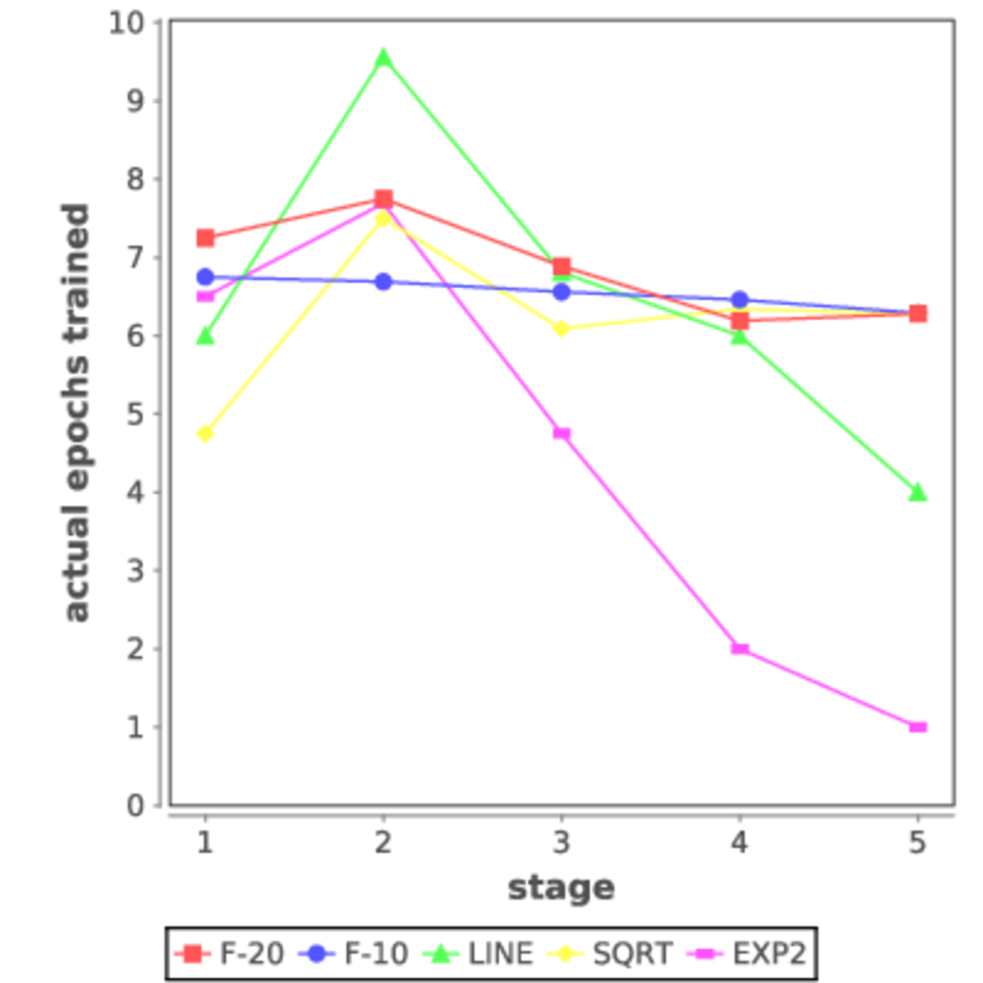
Data analysis workflow: Actual epochs trained
How many epochs are used on average by strategy and stage?
Given the opportunity, typical models exit after 6-8 epochs
If they are forced to exit early in later stages, does that affect error?

Slide 11
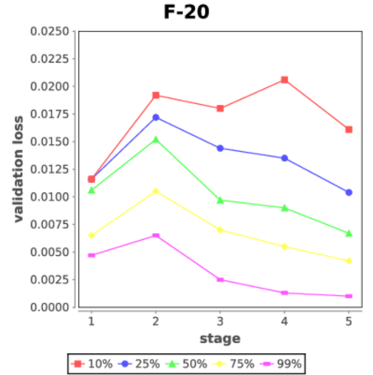
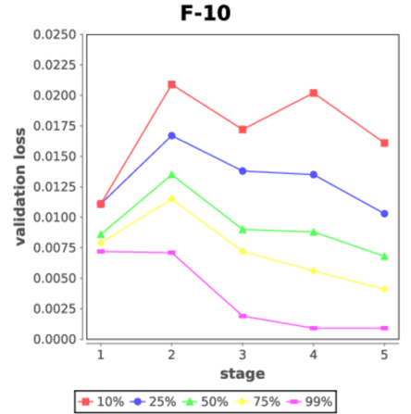
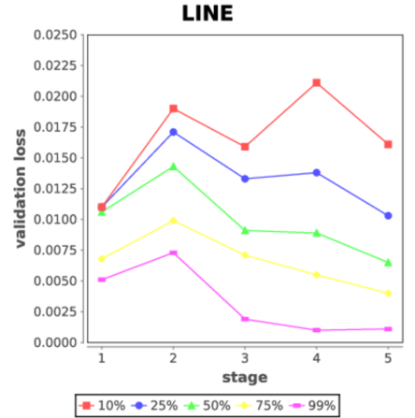
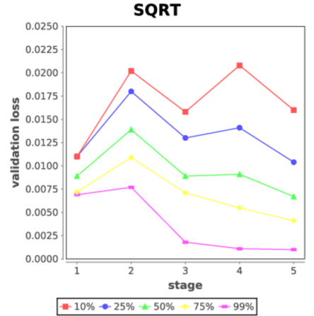
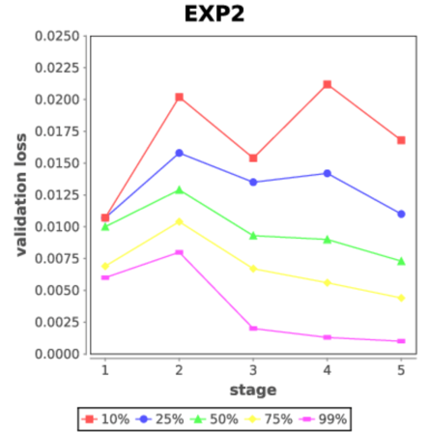
Data analysis workflow : Validation loss by strategy
Typical validation loss is not affected by aggressive early stopping strategies

Slide 12
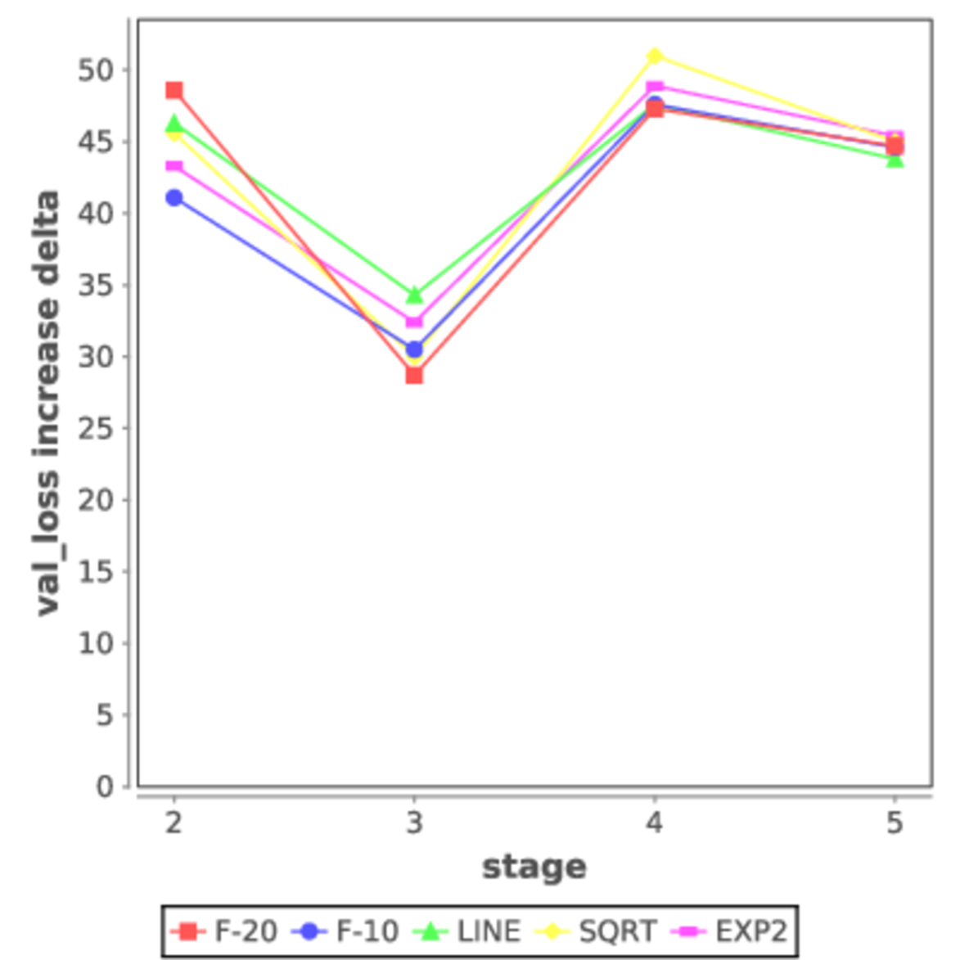
Data analysis workflow: Finding unexpected data
Given that val_loss can increase from one stage to the next, how often does this happen?
Answer: almost 50% of the time
Need to prioritize data subsets that produce the largest val_loss impacts

Slide 13
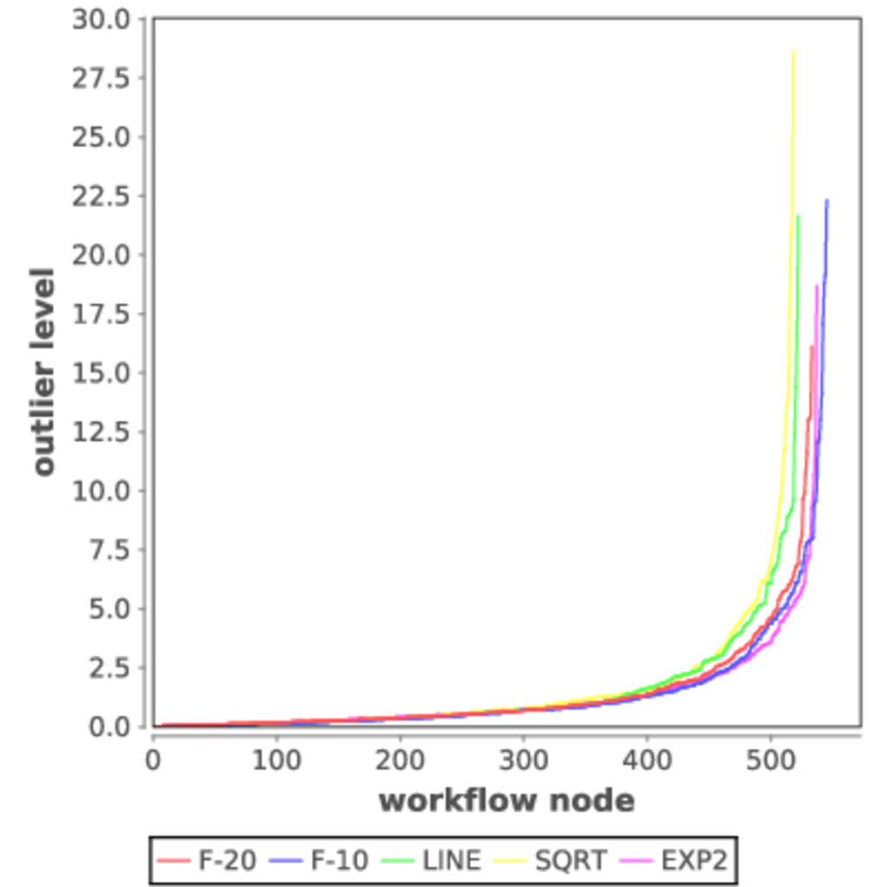
Data analysis workflow: Outlier level
Want to find largest relative val_loss increases in child stages by strategy
Defined outlier level as
val_loss[stage] / val_loss[stage-1]
Very few workflow nodes have a high outlier level
Greatly reduces the work needed to find unexpected data
Under review: Wozniak, Yoo, Mohd-Yusof, et al. High-bypass Learning: Automated Detection of Tumor Cells that Significantly Impact Drug Response Treatment. Royal Society Interfaces Focus, 2020.

Slide 14
CANDLE Restart Database
All trial runs in the data analysis workflow record progress in a SQLite database
Access is concurrent to the tasks, serialized by the Swift/T workflow
Accessed using Python SQLite API
Logs task start/stop status
Enables progress statistics and restarts

Slide 15
Job ramp-up – efficient use of the machine
Typical runs start with 4 trained models, then 16, 64, …
Total run over 1000 models
User can easily specify a prior run to use as a restart location
Output files and logs are archived for later reference
We also prototyped functionality to automatically restart on job completion with a larger allocation

Slide 16
Summary and future work
CANDLE/Supervisor enables deep learning studies to be quickly developed and deployed on large-scale systems like Summit
Investigated the Uno dataset to find data subsets that most significantly impact training accuracy
Found that a very small number of records have a big impact
Described the workflow implementation and database infrastructure
Future work: Apply these techniques to other deep learning apps

Slide 17
Acknowledgments
This research was supported by the Exascale Computing Project (ECP), Project Number: 17-SC-20-SC, a collaborative effort of two DOE organizations - the Office of Science and the National Nuclear Security Administration, responsible for the planning and preparation of a capable exascale ecosystem, including software, applications, hardware, advanced system engineering and early testbed platforms, to support the nation's exascale computing imperative.
www.ExascaleProject.org

