Slide 1
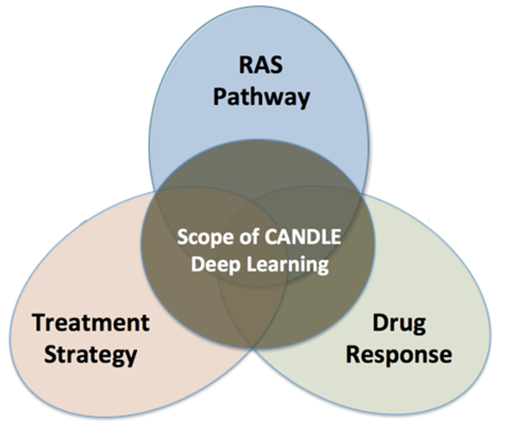
Hyperparameter optimization WORKflows with CANDLE
OPTIMAL DEEP LEARNING On EXASCALE computers
erhtjhtyhy
Justin M Wozniak
Computer Scientist
Data Science & Learning
Argonne National Laboratory
CANDLE Tutorial @ Exascale Computing Project Annual Meeting
January 14, 2019

Slide 2
Collaborators
CANDLE Infrastructure: Tom Brettin, Jon Ozik, Nick Collier, Rajeev Jain (ANL), Harry Yoo (ANL) Jamal Mohd-Yusof, Cristina Garcia Cardona (LANL), George Zaki (NIH)
Pilot benchmarks Fangfang Xia (ANL), Brian Van Essen (LLNL), Arvind Ramanathan (ORNL)
PI Rick Stevens (ANL)

Slide 3
OUTLINE
Overview of CANDLE project
Overview of hyperparameter optimization
Introduction to hyperparameter optimization
Workflow-based solution: EMEWS
Demo of Swift/T and CANDLE/Supervisor

Slide 4
CANDLE OVERVIEW

Slide 5
Driving integration of Simulation, Data Analytics and Machine Learning
Traditional
HPC
Systems
Scalable
Data Analytics
Large-Scale
Numerical
Simulation
CORAL Supercomputers
and Exascale Systems
Deep
Learning

Slide 6
CANDLE workflows: Goals
Develop an exascale deep learning environment for cancer
Building on open source deep learning frameworks and middleware
Optimization for CORAL and exascale platforms
Support all three pilot project needs for deep learning – common abstractions
Collaborate with DOE computing centers, HPC vendors and ECP co-design and software technology projects
Mission statement: Enable the most challenging deep learning problems in cancer research to run on the most capable supercomputers in the DOE

Slide 7
CANDLE Software Stack
Hyperparameter Sweeps,
Data Management (e.g. DIGITS, Swift, etc.)
Workflow
Network description, Execution scripting API
(e.g. Keras, Mocha)
Scripting
Tensor/Graph Execution Engine
(e.g. Theano, TensorFlow, LBANN-LL, etc.)
Engine
Architecture Specific Optimization Layer
(e.g. cuDNN, MKL-DNN, etc.)
Optimization

Slide 8
HYPERPARAMETER OPTIMIZATION

Slide 9
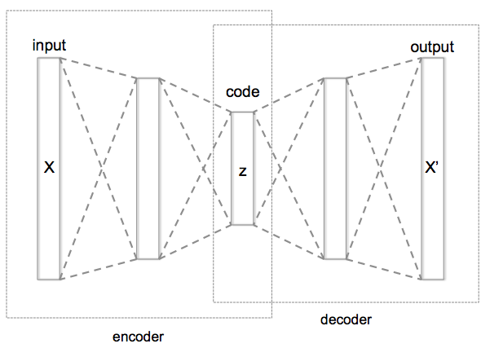
WHAT IS HYPERPARAMETER OPTIMIZATION
Hyperparameter optimization = HPO
Neural networks have a large number of possible configuration parameters, called hyperparameters
Avoids collision with NN weights, which are sometimes called parameters
Applying optimization can automate part of the design of the neural network
In the cancer Pilot 1 autoencoder shown, the system can determine
How many neurons to put in each layer
What activation function to use
What batch size to use
Etc.

Slide 10
Mathematical expression for hpo
For a given problem:
A loss function F is determined on a given NN (usually accuracy)
The hyperparameter optimization problem is to minimize F(p),
for all hyperparameter sets p in the valid parameter space P,
however, P is large and F is expensive.
P is the cross product of all valid network settings,
some of which may be categorical, some integer, some continuous.
Evaluating F involves training the network on a training data set and applying it to the validation set
We can use a generic, previously developed method to optimize F !
These methods require and can use large compute resources

Slide 11
BASIC STRATEGIES
Grid search
Random search
Generic optimization
Stochastic gradient descent
Evolutionary algorithms
Model-based optimization (mlrMBO in R)
NN hyperparameter-specific optimization
Hyperopt, NEAT, Optunity, …

Slide 12
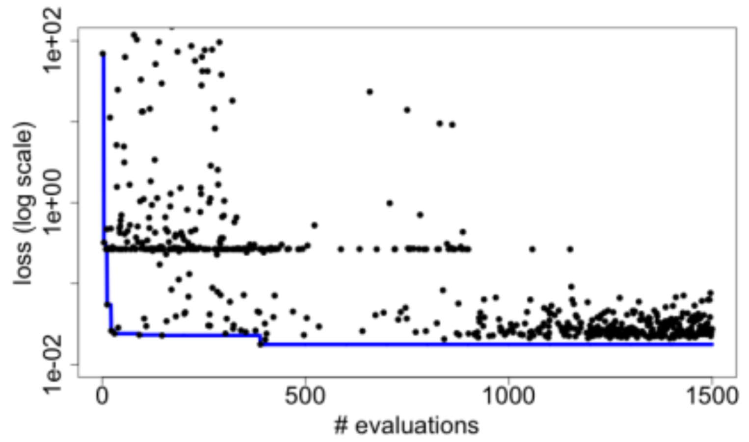
Candle Hyperparameter learning
Search trajectory of mlrMBO (R model-based optimization) algorithm
Each iteration does 300 evaluations (batch size)
Minimum and average performance on validation data set decreases as the ME algorithm learns
Predicting Tumor Cell Line Response to Drug Pairs with Deep Learning, F. Xia, M. Shukla, T. Brettin, C. Garcia-Cardona, J. Cohn, J. Allen, S. Maslov, Y. Evrard, S. Holbeck, J. Doroshow, E. Stahlberg, and R. Stevens (Computational Approaches for Cancer Workshop @ SC 2017)

Slide 13
CANDLE: WORKFLOWS

Slide 14
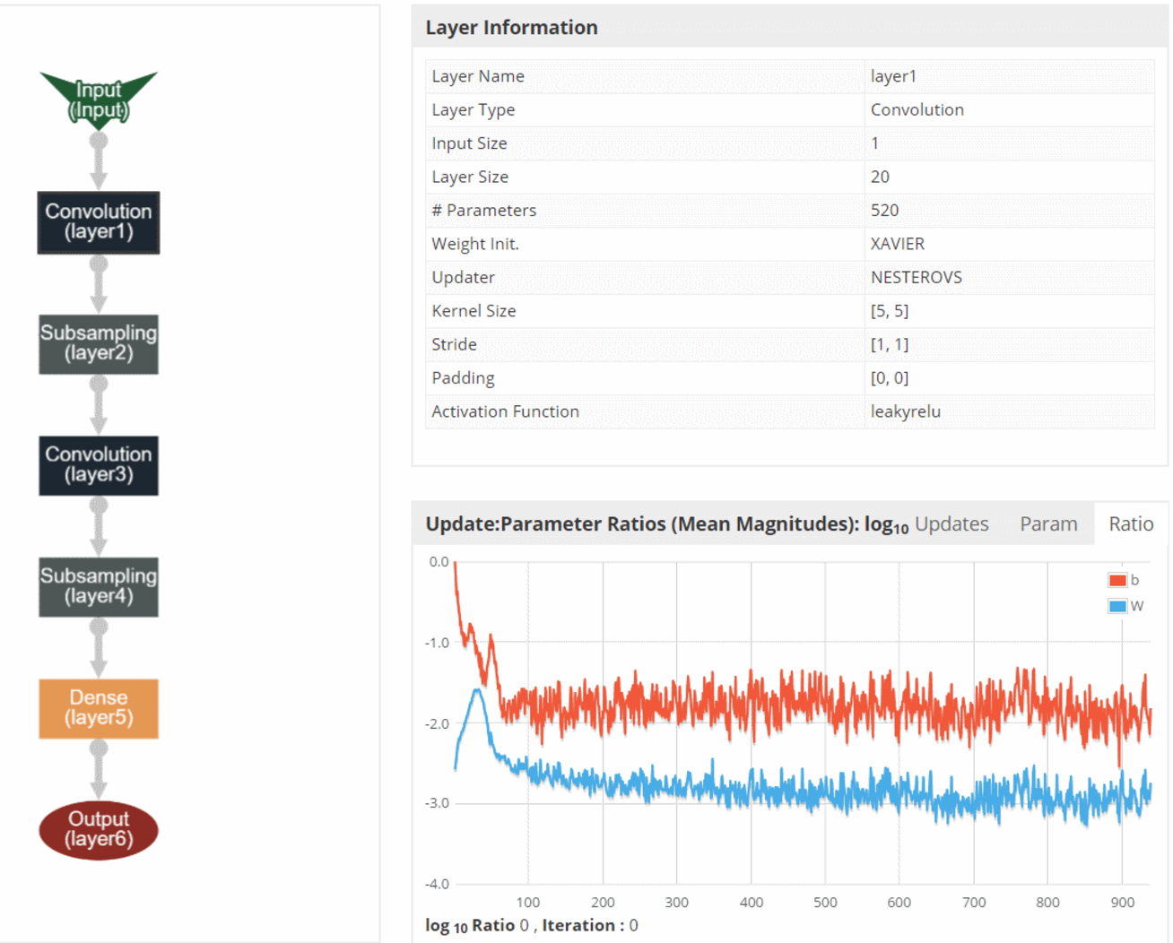
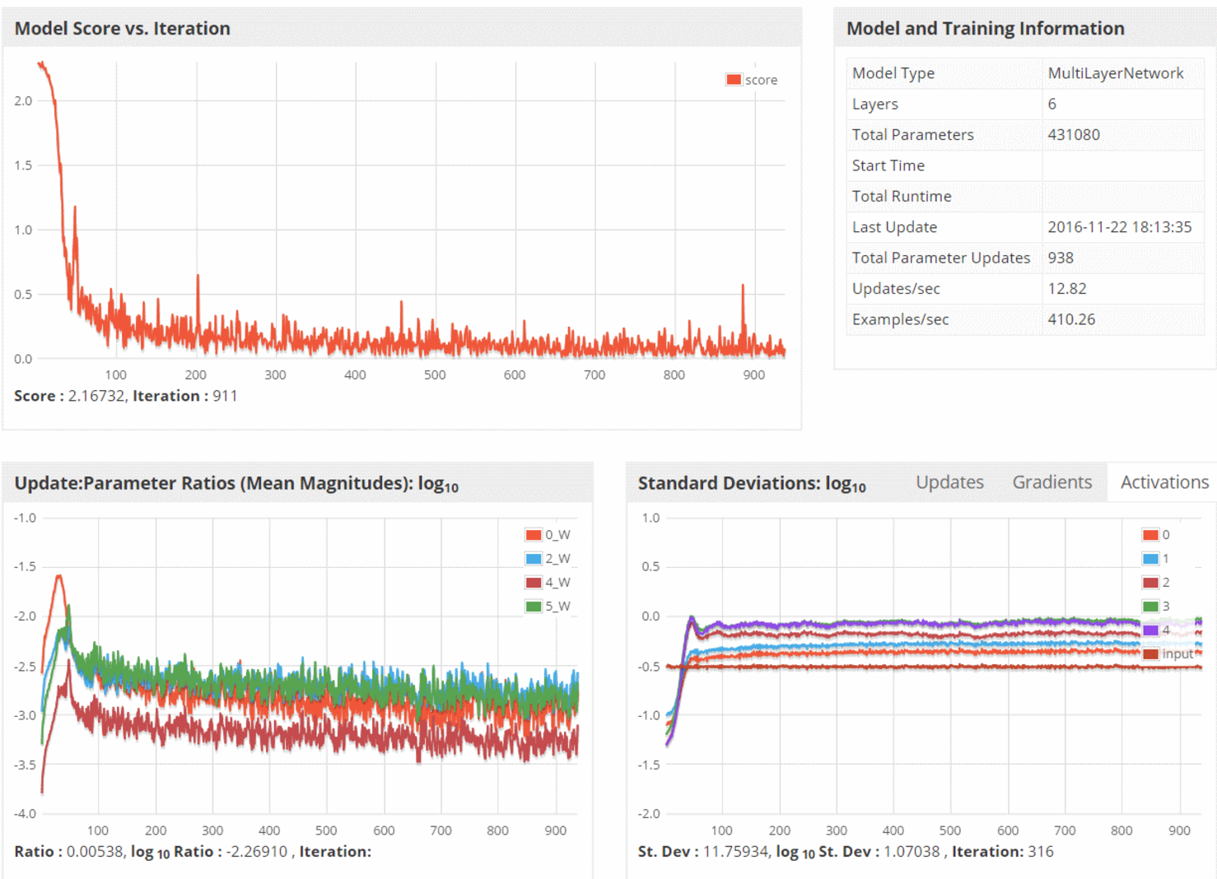
CANDLE System Overview
ML/DL Benchmarks
Pilot 1
Pilot 2
Pilot 3
CANDLE Database
CANDLE Specifications
Metadata Store
Model Store
Integrator Website
Benchmark Spec
Hyperparameter Spec
Hardware Spec
Benchmarks
Datasets
Models
Experiments
Runs
Model Descriptions
CANDLE Supervisor
Model Weights
Hyperparameter Optimization Frameworks
Hyperopt, mlrMBO, Spearmint
Workflow Manager
(Swift-T EMEWS)
Data API
ALCF
Theta, Cooley
NERSC
Cori
OLCF
Titan, SummitDev
Hardware Resources

Slide 15
Parallelism strategies
10,000 x 10-1000 x 10-100 = 1M – 1000M processing elements
Hyperparameter Search: up to ~10,000x
Depends on search strategy
Data Parallel: 10x-1000x
Data Parallel
10x-1000x
Model
Parallel
10x-100x
Model
Parallel
10x-100x
Model
Parallel
10x-100x
Model
Parallel
10x-100x
Model
Parallel
10x-100x
...
...
...

Slide 16
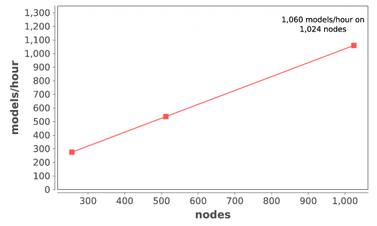
CANDLE Performance
Delivers 1+ petaflop!

Slide 17
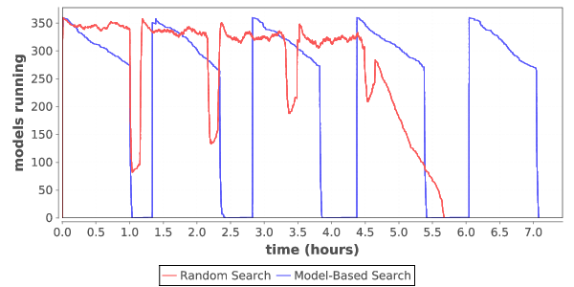
Load over time for search
Typical load plot for NT3 workflow on Cori

Slide 18
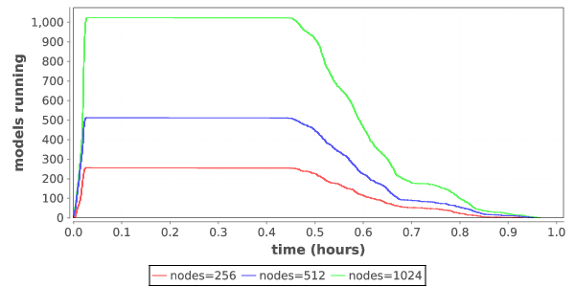
Ramp up / ramp down
Zoom in on single iteration on Titan

Slide 19
SYSTEMS CHALLENGES

Slide 20
WORKFLOW support for ML frameworks
Concurrency:
Scalable task distributor
Intranode concurrency, accelerators left up to the framework
Multinode ML tasks are future work (already basically supported)
Data management:
Input staging methods have been developed
Intermediate caches via DataSpaces
Software integration:
Usually launch frameworks in separate process
Launching within process is a configuration challenge
Search methods launched within process

Slide 21
Workflow goals
Hierarchical, naturally parallel, script-like programming
Make it easy to run large batteries of external program or library executions
Provide rich programming language at the top level – fully generic
Support implicit concurrency and conventional programming constructs
Enable complex tasks based in other scripting languages (e.g., Python) or parallel MPI tasks

Slide 22
The Swift programming model
All progress driven by concurrent dataflow
(int r) myproc (int i, int j)
{
int x = F(i);
int y = G(j);
r = x + y;
}
F() and G() implemented in native code or external programs
F() and G()run in concurrently in different processes
r is computed when they are both done
This parallelism is automatic
Works recursively throughout the program’s call graph

Slide 23
Swift syntax
Data types
int i = 4;
string s = "hello world";
file image<"snapshot.jpg">;
Shell access
app (file o) myapp(file f, int i)
{ mysim "-s" i @f @o; }
Structured data
typedef image file;
image A[];
type protein_run {
file pdb_in; file sim_out;
}
bag<blob>[] B;
Conventional expressions
if (x == 3) {
y = x+2;
s = strcat("y: ", y);
}
Parallel loops
foreach f,i in A {
B[i] = convert(A[i]);
}
Data flow
merge(analyze(B[0], B[1]),
analyze(B[2], B[3]));
Swift: A language for distributed parallel scripting. J. Parallel Computing 2011
Compiler techniques for massively scalable implicit task parallelism. Proc. SC 2014

Slide 24
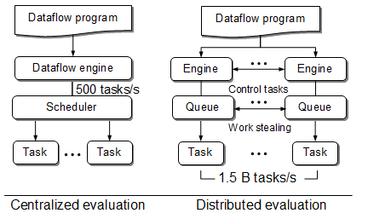
Centralized evaluation is a bottleneck at extreme scales
Had this (Swift/K):
Now have this (Swift/T):
Turbine: A distributed-memory dataflow engine for high performance many-task applications. Fundamenta Informaticae 28(3), 2013

Slide 25
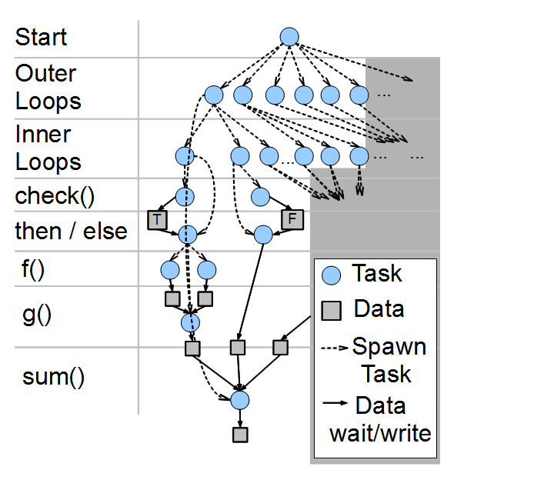
Swift/T: Fully parallel evaluation of complex scripts
int X = 100, Y = 100;
int A[][];
int B[];
foreach x in [0:X-1] {
foreach y in [0:Y-1] {
if (check(x, y)) {
A[x][y] = g(f(x), f(y));
} else {
A[x][y] = 0;
}
}
B[x] = sum(A[x]);
}
Swift/T: Scalable data flow programming for distributed-memory task-parallel applications . Proc. CCGrid, 2013.

Slide 26


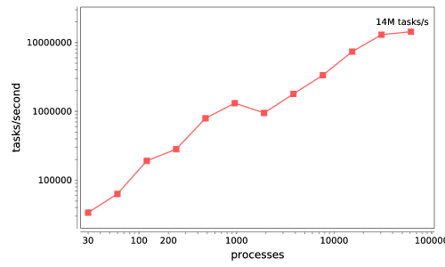


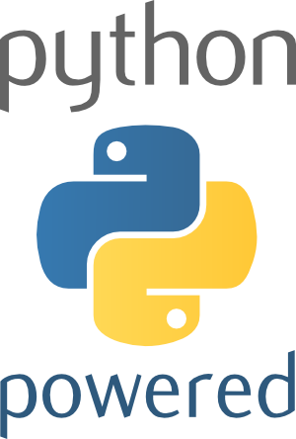



Swift/T: Enabling high-performance Scripted workflows
Supports tasks written in many languages
Write site-independent scripts, translates to MPI
Automatic task parallelization and data movement
Invoke native code, script fragments
Rapidly subdivide large partitions for MPI jobs in multiple ways
Swift/T control process
Swift/T worker
C
C++
Fortran
C
C++
Fortran
MPI
C
C++
Fortran
64K cores of Blue Waters
2 billion Python tasks 14 million Pythons/s
Compiler techniques for massively scalable implicit task parallelism. Proc. SC 2014.
$ conda install -c lightsource2-tag swift-t

Slide 27
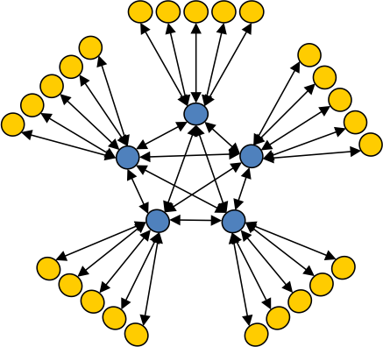
Asynchronous Dynamic Load Balancer
workers
ADLB for short
An MPI library for master-worker workloads in C
Uses a variable-size, scalable network of servers
Servers implement work-stealing
The work unit is a byte array
Optional work priorities, targets, types
For Swift/T, we added:
Server-stored data
Data-dependent execution
Parallel tasks
masters
Lusk et al. More scalability, less pain: A simple programming model and its implementation for extreme computing. SciDAC Review 17, 2010

Slide 28
Extreme-scale model exploration with Swift (EMEWS)

Slide 29
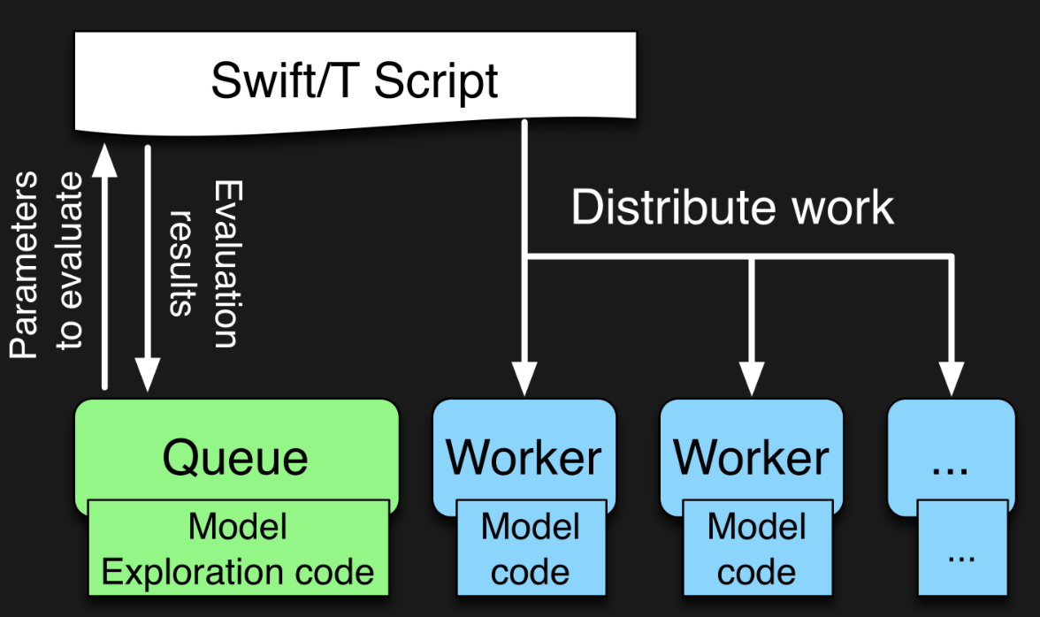

EMEWS workflow structure
emews.org
The core novel contributions of EMEWS are shown in green, these allow the Swift script to access a running Model Exploration (ME) algorithm, and create an inversion of control (IoC) workflow
Both green and blue boxes accept existing multi-language code

Slide 30
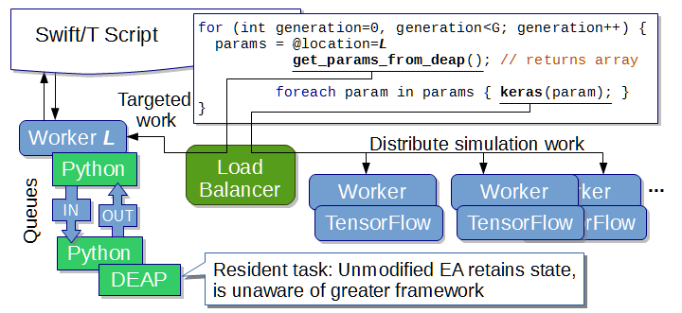
EMEWS: Extreme-scale model exploration workflows in Swift/T
To query the state of the EA, we designate one worker on location L for exclusive use by DEAP. Other optimizers can easily be used (e.g., mlrMBO in CANDLE)
http://www.mcs.anl.gov/~emews/tutorial

Slide 31
Previous work on HPC workflows
Other uses of workflows to control model exploration (ME) typically take one of two approaches
They provide rich support for arithmetic operations so that ME algorithms can be constructed (ported)
requires that algorithm be coded from scratch
impossible to reuse code in other languages
The ME algorithm is provided as a built-in feature of the system
does not allow the end users much control over the algorithm used
may require access to workflow system source code in order to incorporate external ME algorithms or to modify built-in algorithms
In both cases, the many libraries being actively developed and implemented as free and open source software in programming languages such as R and Python cannot be directly/easily utilized.

Slide 32
Summary of key system points
What about Swift/T enables CANDLE?
A workflow system that is actually a hierarchical programming language
Runs entirely on the compute nodes
Uses standard APIs for HPC (MPI), allows for minimal OS environment
Very scalable
Supports MPI tasks, embedded Python, R interpreters
What about EMEWS enables CANDLE?
Allows user to focus on two sequential codes
The optimizer
Their objective function code
Everything else is managed by the system

Slide 33
Thanks
Thanks to the organizers
Code and guides:
CANDLE GitHub Organization: https://github.com/ECP-CANDLE
Swift/T Home: http://swift-lang.org/Swift-T
EMEWS Tutorial: http://emews.org
This research was supported by the Exascale Computing Project (17-SC-20-SC), a joint project of the U.S. Department of Energy’s Office of Science and National Nuclear Security Administration, responsible for delivering a capable exascale ecosystem, including software, applications, and hardware technology, to support the nation’s exascale computing imperative.

Slide 34
TUTORIAL: SUPERVISOR

Slide 35
Hands-on TUTORIALS
May be found here:
git@github.com:brettin/candle_tutorials.git
Subdirectory Topics/2_hyperparameter_optimization
See the top-level README to get started with the installation

