Slide 1
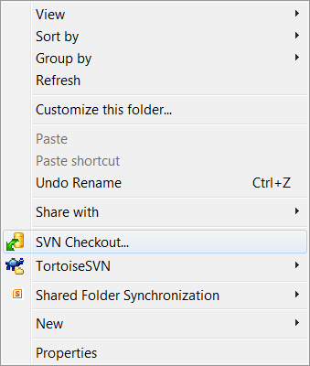
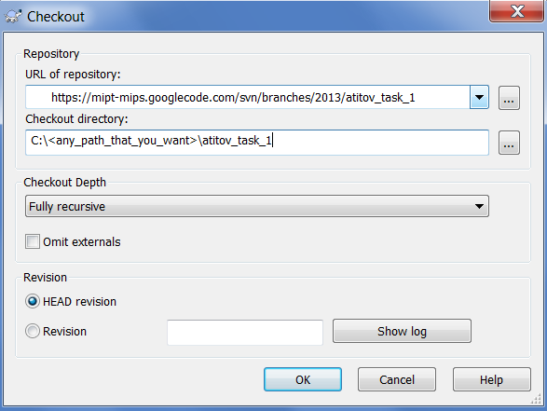
2
Enter the URL of your branch
1
Click here
3
Enter the path and the name of the folder to checkout the files (“atitov_task_1” here)

