Slide 1
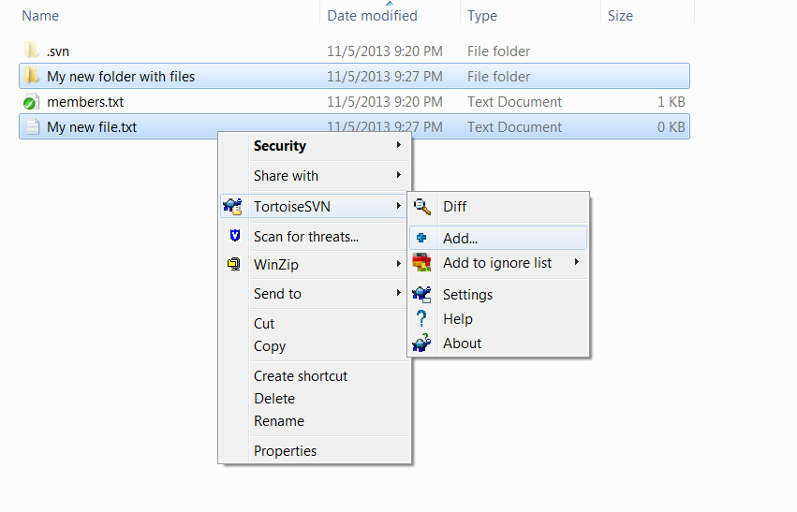
Select and right click on the files or/and folders that you want to update
1
2
Click here

