Slide 1
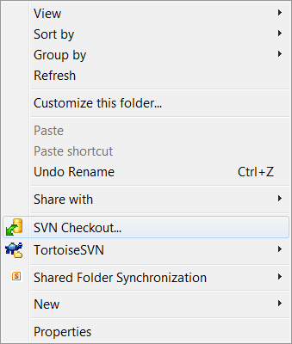
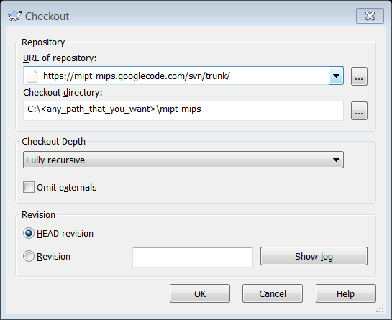
2
Enter the link to our trunk
1
Click here
3
Enter the path and the name for the folder (“mipt-mips” here)

