Slide 1
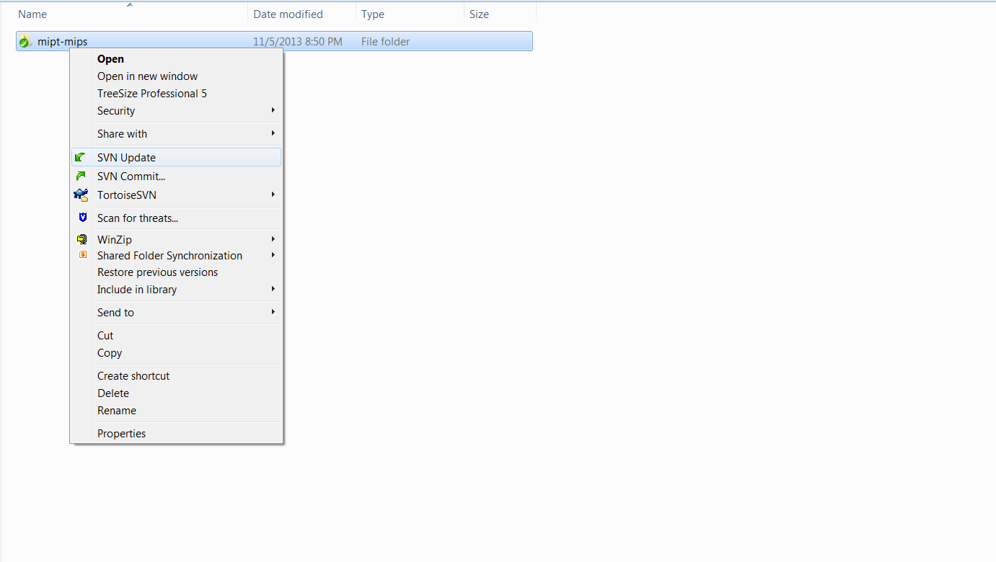
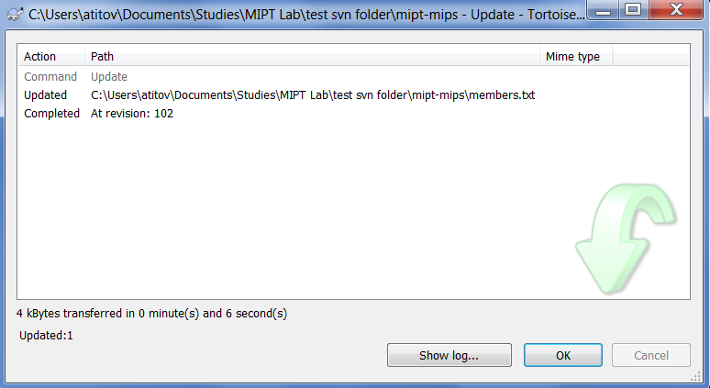
1
Right click on the folder that you want to update
Updated files
The number of the current revision of your local copy
2
Click here

